Slide 1
Key Stage 1 Maths
Term 3 Week 2
Addition and Subtraction

Slide 2
Key Teaching points to help you!
Addition can be done in any order.
With subtraction you must start with the biggest number.
Addition + count forwards
Subtraction – count backwards
Common misconceptions!! Children often include the starting number when they count.
E.g. for 5 – 3
They might go 5, 4, 3 – therefore giving the wrong answer. It is vital to model how to count backwards by ‘ putting the start number in our head and counting backwards.’

Slide 3
The use of zero is important so children know that when nothing is taken away, the start number remains the same or when the whole group is taken away, there will be nothing left.
One of the most difficult concepts for children is finding the difference where they subtract to calculate how many more.

Slide 4
MONDAY

Slide 5
11.01.2021 LI: To subtract two numbers.
Steps to Success
I can subtract single numbers up to 10.
I solve number problems involving the subtraction of single digit numbers. (Level 1)
I subtract 1 and 2 digit numbers to 20, including 0. (Level 2)
I can solve problems with subtraction, applying increasing knowledge of written methods and mental methods. (Level 3)

Slide 6
Warm up
Practise counting forwards and backwards from different numbers on the number square. (On next slide).
Pick random numbers. What comes before? What comes after?

Slide 7
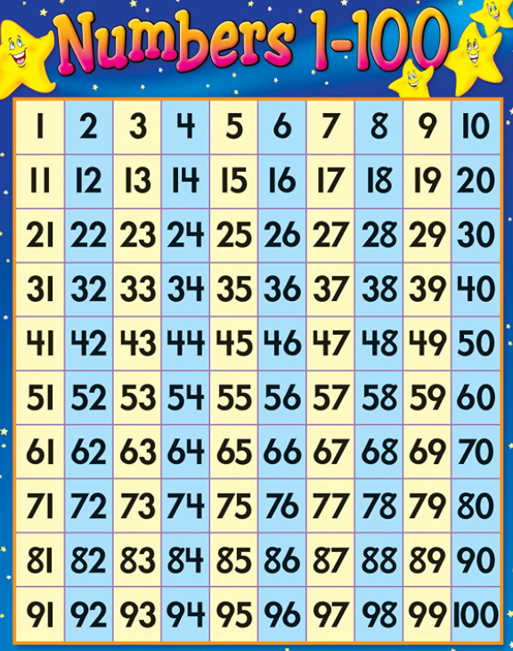
Number Square

Slide 8
What do you know about subtraction?
What words do we use?
What symbol do we use?
What way do we jump on a number line if we are using a number line or a number square?
How is subtraction different to addition?

Slide 9
Choose the level sheet appropriate for your child. Level 1 mainly uses numbers up to 10. Level 2 uses numbers up to 20, and greater explanation is needed. Level 3 uses more mental arithmetic, application and wider written methods. They should be secure with their number bonds to 10 and 20.
Activity Time!
The activities are problem solving based so will require discussion.
Level 3: This introduces and reinforces the column method of subtraction. Note this week the children will explore numbers involving carrying.
Please allow the children to explore the relationship between the two representations before demonstrating the column method. Reinforce the link between the tens and ones in each representation.
Remind the children to ALWAYS add the ones column first, otherwise it will complicate adding with carrying.

