Slide 1
Lesson 3: Exploring the toolbar
Save a copy
Year 1 – Creating Media – Digital writing
Notes:
Last updated: 01-07-20
This resource is available online at ncce.io/cm1w-3-s. Resources are updated regularly – please check that you are using the latest version.
This resource is licensed under the Open Government Licence, version 3. For more information on this licence, see ncce.io/ogl.

Slide 2
Lesson 3: Exploring the toolbar
Objectives
Lesson objective: To identify that the look of text can be changed on a computer
I can type capital letters
I can explain what the keys that I have learnt about already do
I can identify the toolbar and use bold, italic, and underline

Slide 3
Key vocabulary
Lesson 3: Exploring the toolbar
Key vocabulary
Word processor
Keyboard
Keys
Capital letters
Toolbar
Bold
Italic
Underline
Google Docs
Microsoft Word

Slide 4
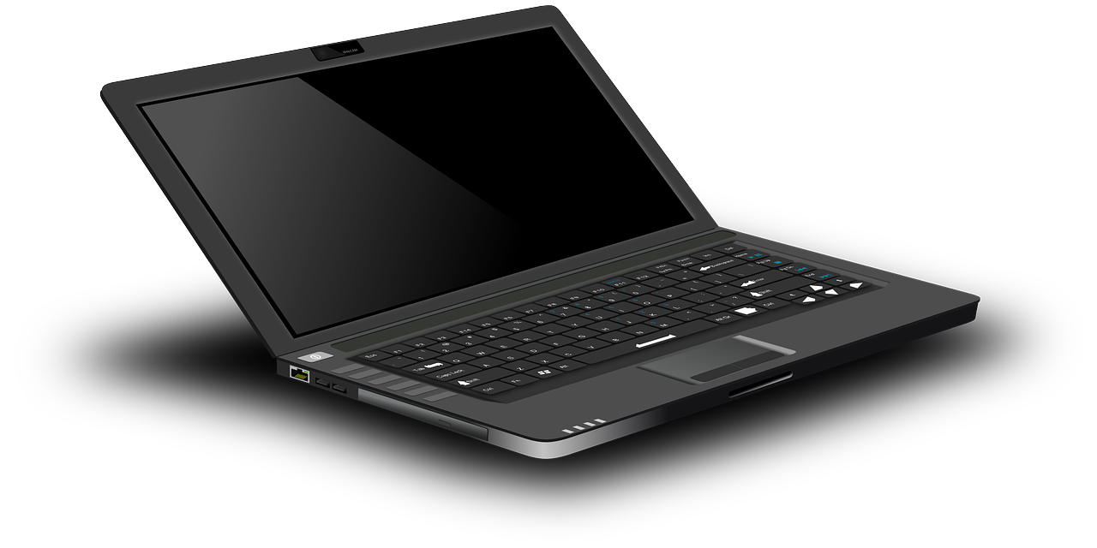
Log in to the computer and open your poster
Activity 1
Notes:
Note: This is likely to be highly scaffolded depending on the school’s setup. You may wish to add a page detailing the steps that your learners need to take to access their documents. This could be reused in future lessons.
Image sources:
https://pixabay.com/vectors/laptop-notebook-mobile-computer-154091/
https://pixabay.com/vectors/computer-desktop-workstation-office-158675/
https://commons.wikimedia.org/wiki/File:Microsoft_Word_2013_logo.svg
https://commons.wikimedia.org/wiki/File:Icon-doc.svg
https://commons.wikimedia.org/wiki/File:LibreOffice_6.1_Writer_Icon.svg
https://www.openoffice.org/ui/VisualDesign/OOo30MimeType.html

Slide 5
Think, pair, share
What do you need at the start of sentences?
What do you need for names of people, places, and days of the week?
Activity 2
Notes:
Click to animate the circles showing the capital letters.

Slide 6
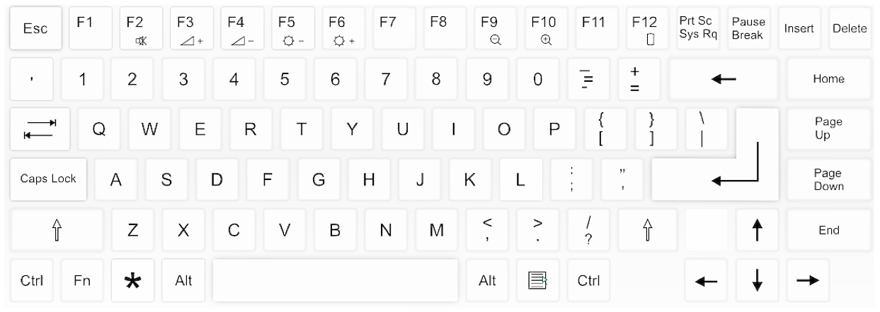
This is the Caps Lock key
Activity 2
Colour in the Caps Lock key on your keyboard template
Notes:
Click to animate the Caps Lock key.
Image source: https://pixabay.com/vectors/computer-keyboard-home-computer-158770/

Slide 7
Adding capital letters
Activity 2
Notes:
Click to open the model lost toy poster.
Image source: https://pixabay.com/photos/teddy-soft-toy-funny-teddy-bear-2977694/

Slide 8
Adding capital letters
Activity 2
Think, pair share
Was anything tricky about this activity?
Notes:
Give the learners time to discuss what they found difficult about the activity. Commonly, the learners will find placing the cursor in the correct place challenging.
Image source: https://pixabay.com/photos/teddy-soft-toy-funny-teddy-bear-2977694/

Slide 9
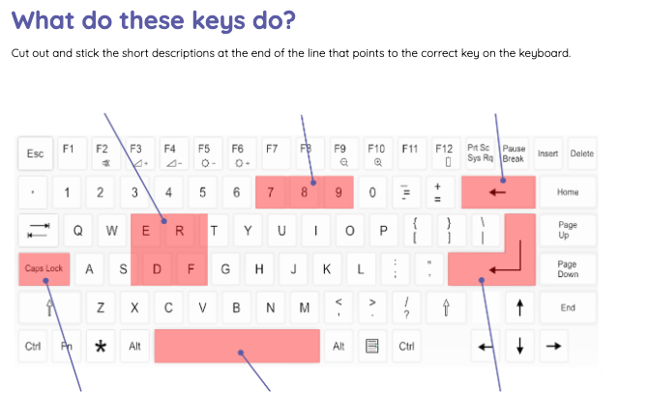
Activity 3
Cut out and stick the short descriptions at the end of the line that points to the correct key on the keyboard
Notes:
Provide the learners with the printout and ask them to cut out the description boxes on page 2 and stick them at the end of the line pointing to the correct key on the keyboard. You may wish to through the descriptions as a whole class prior to the activity, to support early readers.
This activity could also be completed as a whole class activity on an interactive whiteboard.
Image source: https://pixabay.com/vectors/computer-keyboard-home-computer-158770/

Slide 10
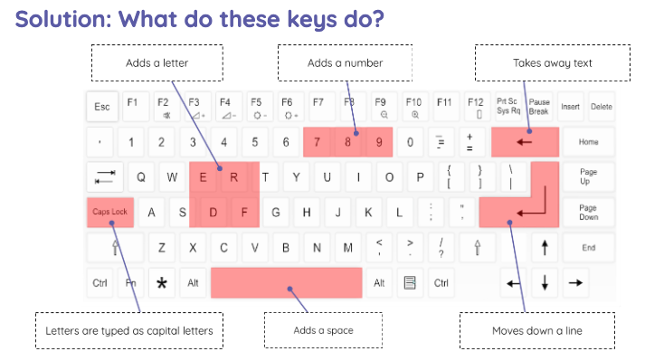
Activity 3
Notes:
Share the solution (ncce.io/cm1w-3-a3-s) with the learners.
Image source: https://pixabay.com/vectors/computer-keyboard-home-computer-158770/

Slide 11
What is this?
Activity 4
This is called the toolbar. It is one of the ways that you can change the way the text looks on the page.
Notes:
Click to animate the red box, then ask the learners. Make links to other units of work in which the children may have used this (e.g. Year 1 Digital Painting, etc.).
Click to animate the bottom text box.

Slide 12
What do you think these tools do?
Activity 4
Move your text cursor to the bottom of the page. Press B and write Ted.
What has happened?
Notes:
Ask the learners to use the Enter key to add space to the bottom of their document. This will allow them to experiment away from their writing, which will ensure that the learners are not making changes to their main description of the lost toy.

Slide 13
Your writing should look like this...
Activity 4
Did you remember to add a capital letter for Ted’s name?
Notes:
Explain what each of the toolbar buttons does to the writing.
Bold: makes the letters thicker
Italic: makes the letters slanted or lean
Underline: underlines the letters

Slide 14
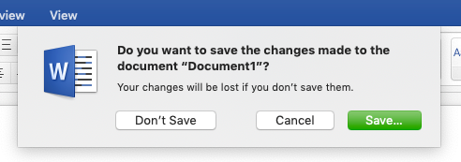
Time to finish!
Activity 4
Click “Save…”
Log off your computer
Notes:
Ask the learners to save. As this is something that they have already done, they should only need to press the Save button.
Note: If the school uses a cloud-based system that allows collaboration on documents (e.g. Google Docs), the learners may not need to save their documents. This is something that should be explained to learners.

Slide 15
Teach your partner…
Plenary
What did each of the buttons do to the writing?

Slide 16
How confident are you? (1–3)
Assessment
I can type capital letters
I can explain what the keys that I have learnt about already do
I can identify the toolbar and use bold, italic, and underline
3 - Very confident
2 - Unsure
1 - Not confident
Notes:
Image source: https://pixabay.com/vectors/thumb-up-hand-like-confirm-go-top-307176/

Slide 17
Next lesson
Summary
In this lesson, you…
Added capital letters to text and looked back at some of the keys on the keyboard. You also looked at the toolbar and found out what some of the buttons do.
Next lesson, you will…
Select writing to make it easier for you to change things more quickly, and look at different buttons on the toolbar to explore what they do to the writing.

