Slide 1
Term 3 Week 3
Art

Slide 2
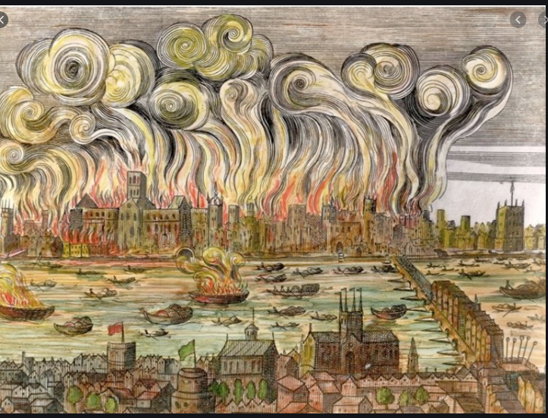

Slide 3
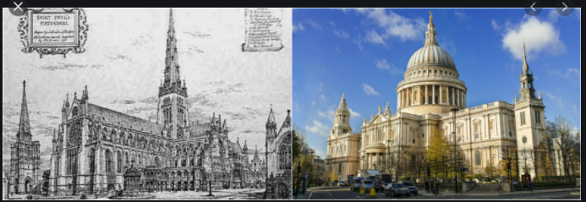
L.I: To create a 3D picture of a London landmark that was destroyed in the Great Fire.
Old and New St. Pauls Cathedral

Slide 4
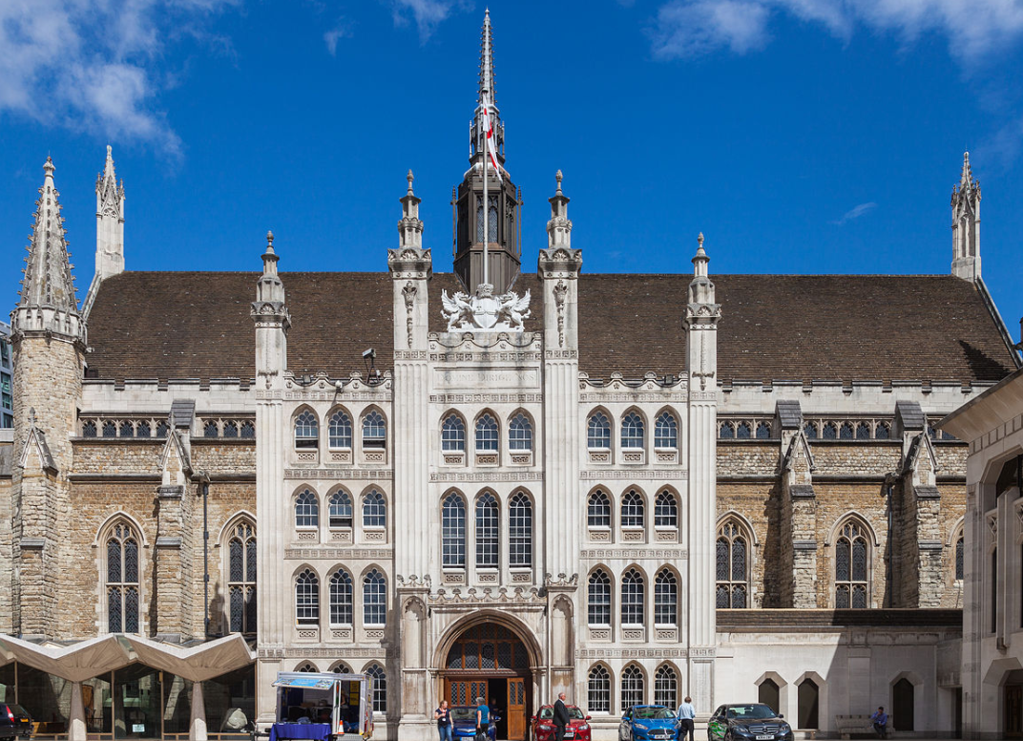
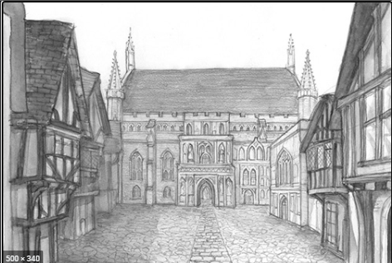
Old and New Guildhall

Slide 5
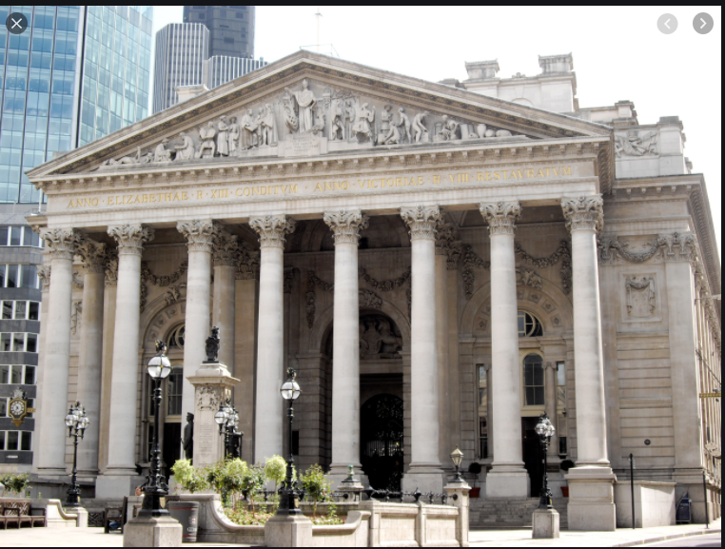
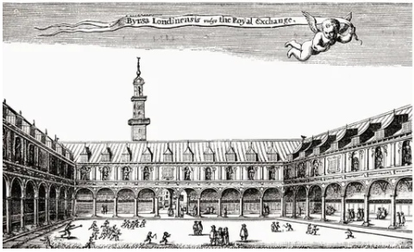
Old and New Royal Exchange

Slide 6
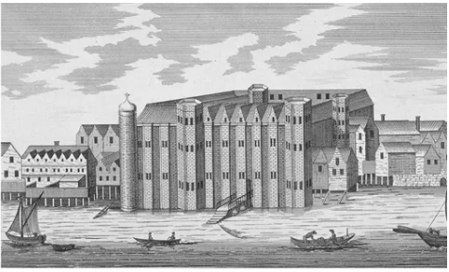
Castle Baynard

Slide 7
Task
To create 3-D pictures of a London landmark that was destroyed in The Great Fire.
You can use a variety of materials and techniques to make the buildings before adding 3-D flames to them.

