Slide 1
Year 2 Maths
Term 3 Week 3 Monday
Multiplication and Division
Make equal groups

Slide 2
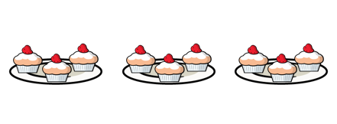
Year 2 | T3Wk3| Tues

Slide 3
18.01.2021
LI: To make equal groups
Steps to Success:
I count in groups of 2s, 5s and 10.
I recognise when groups are equal.
I recognise when groups are not equal.

Slide 4
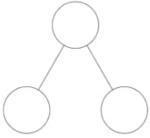
18.01.2021
LI: To make equal groups
Note: You will see part-part-whole models at the beginning of the video.
[Sometimes they are just called part-whole models.]
7
l0
7
3
l0
7
3
3
l0
Two parts (highlighted yellow) are equal to the whole number (highlighted blue).
Care needs to be taken when the part-part-whole model has been turned around.

Slide 5

Click here to open this video link.

Slide 6
18.01.2021
LI: To make equal groups
Steps to Success:
I count in tens to solve problems
e.g. count the number of items by counting groups of ten. (Band1)
Activity Time!

Slide 7
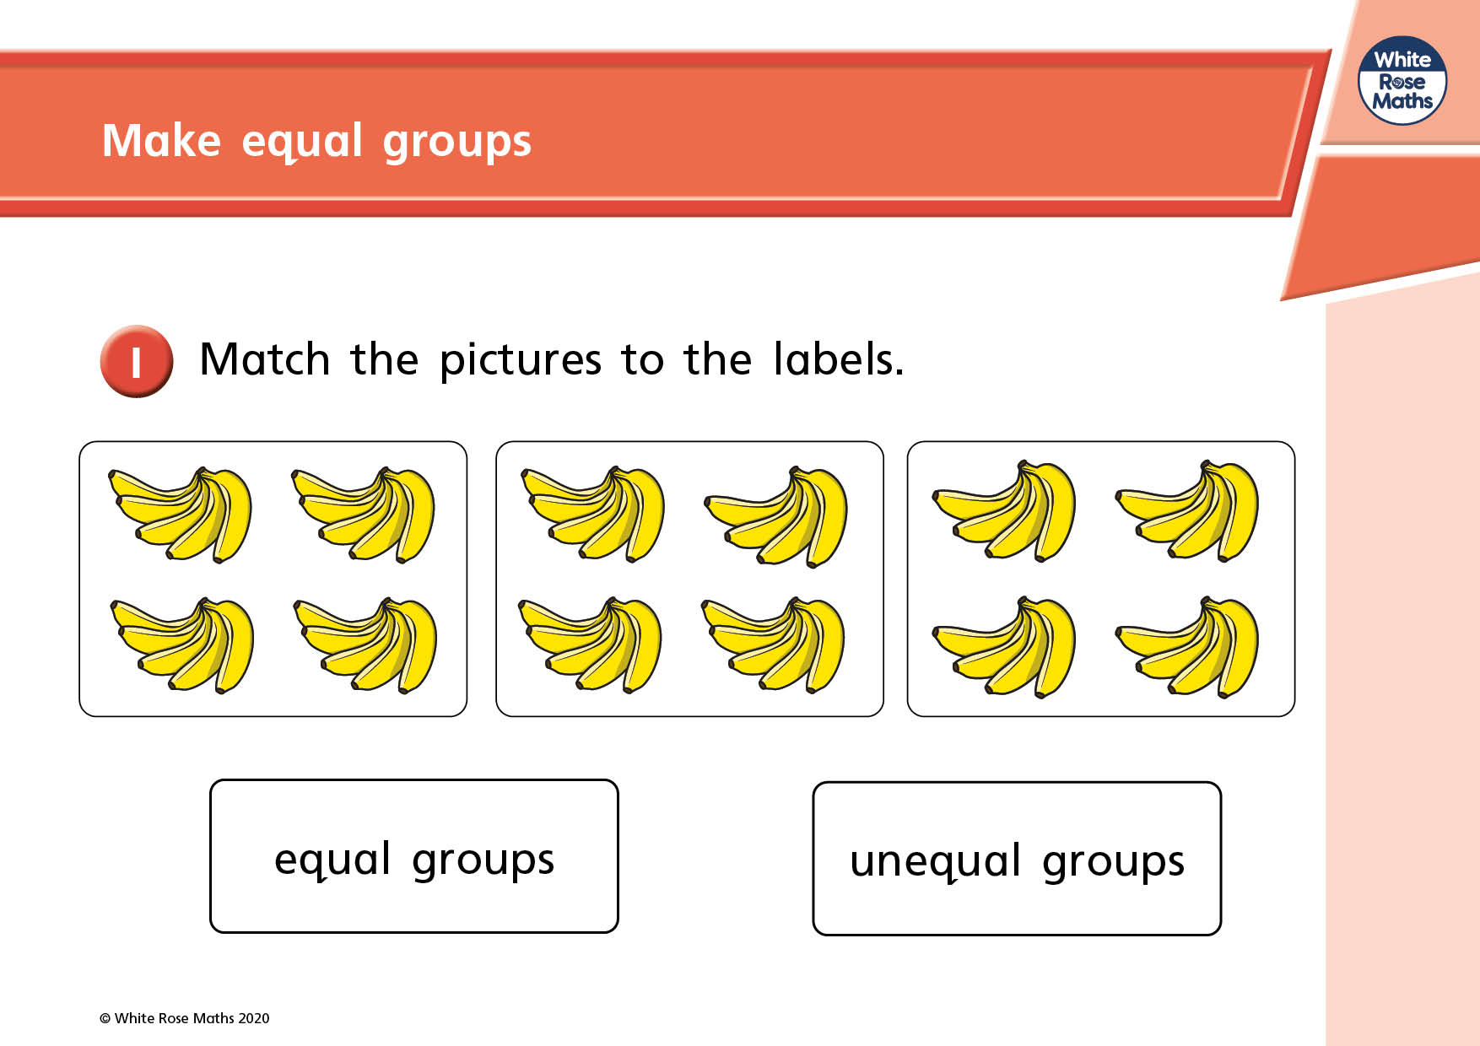

Slide 8
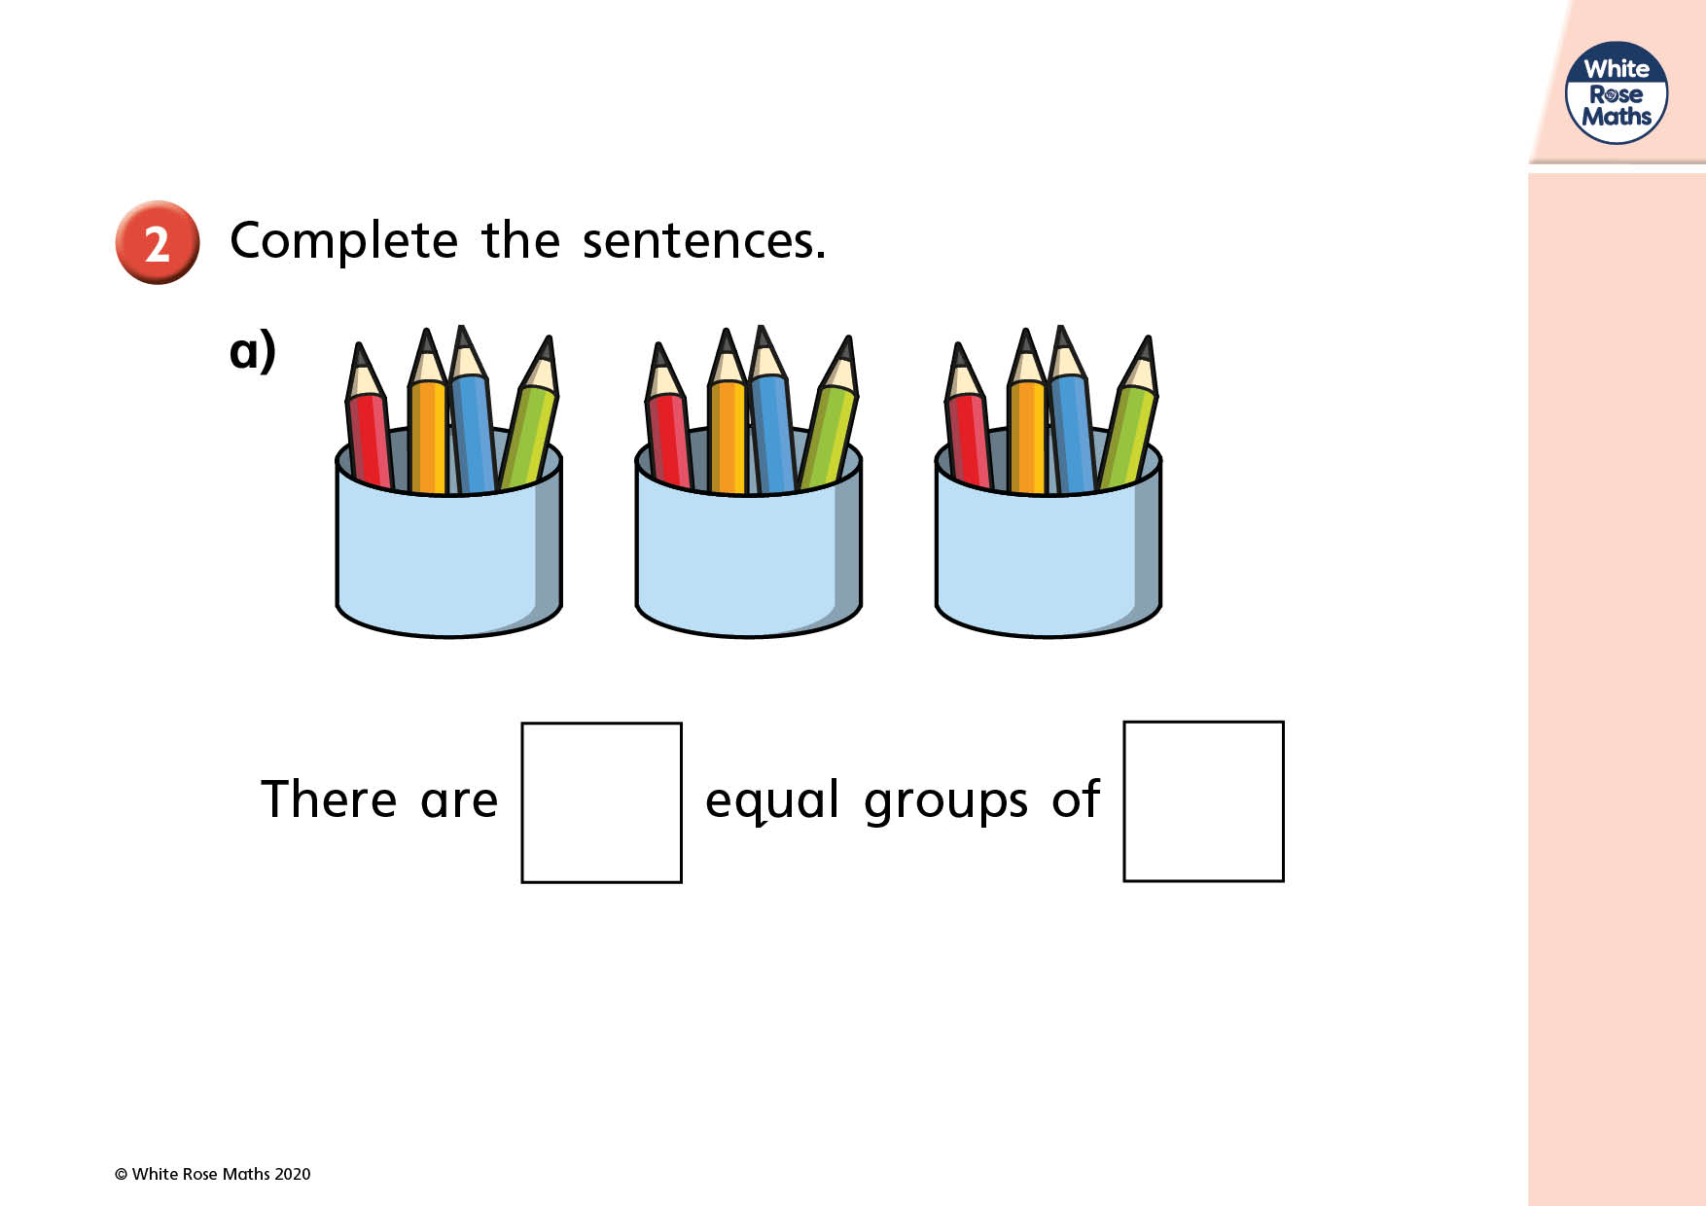

Slide 9
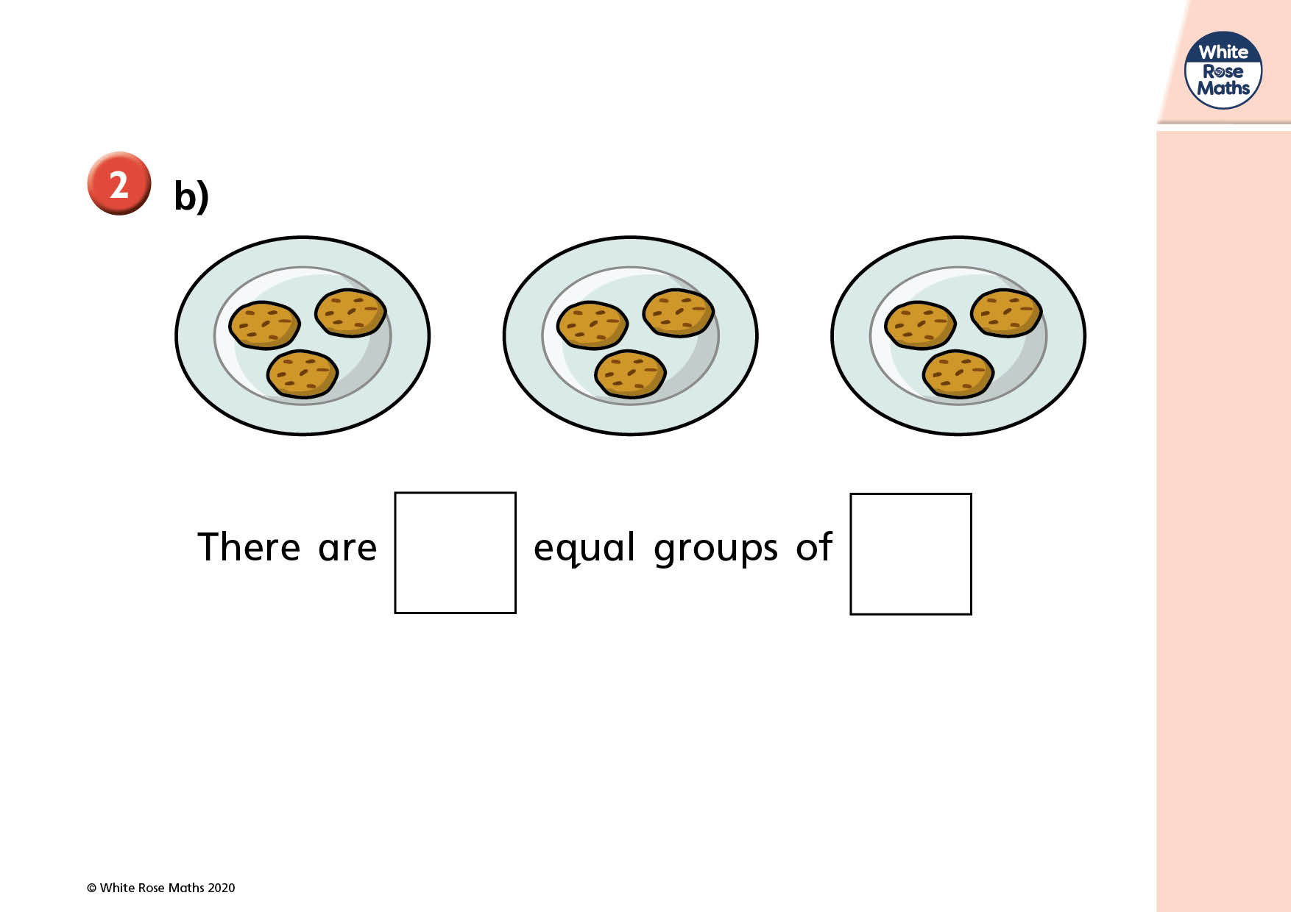

Slide 10
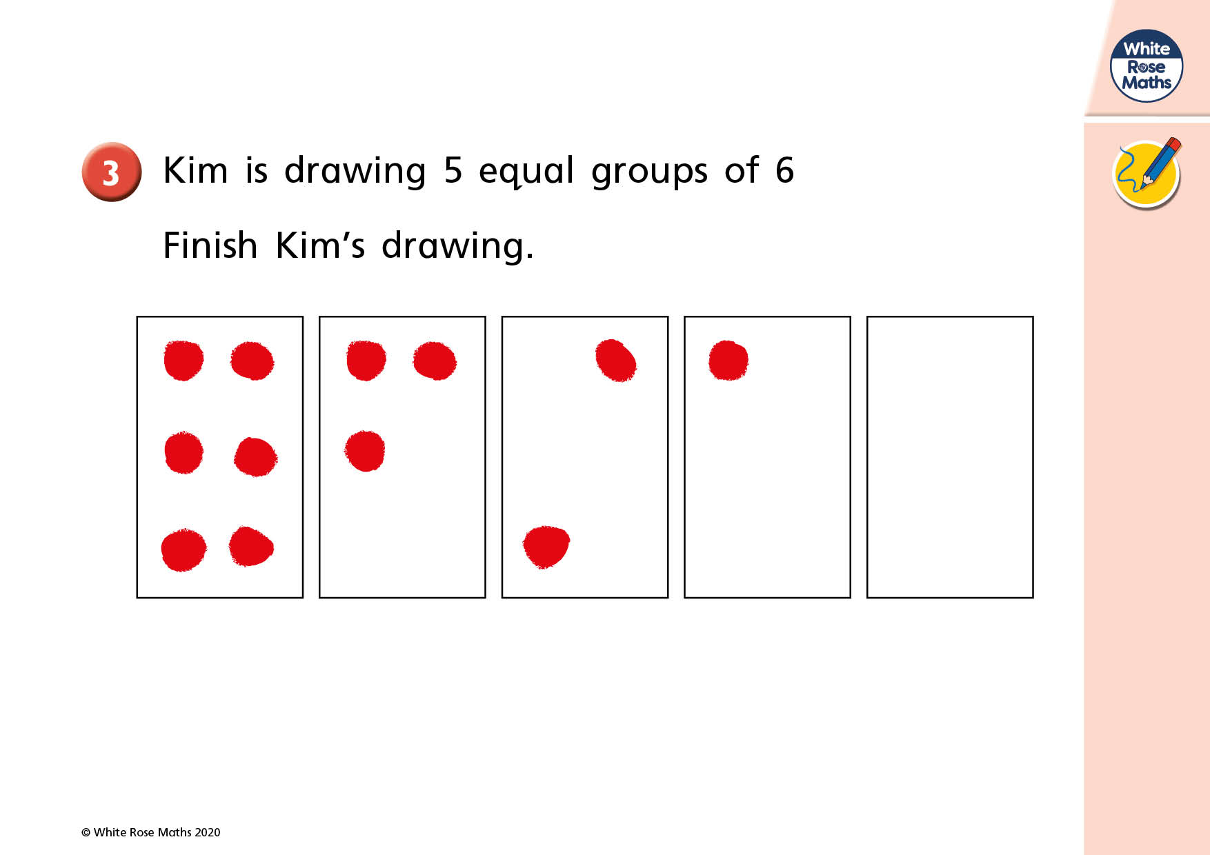

Slide 11
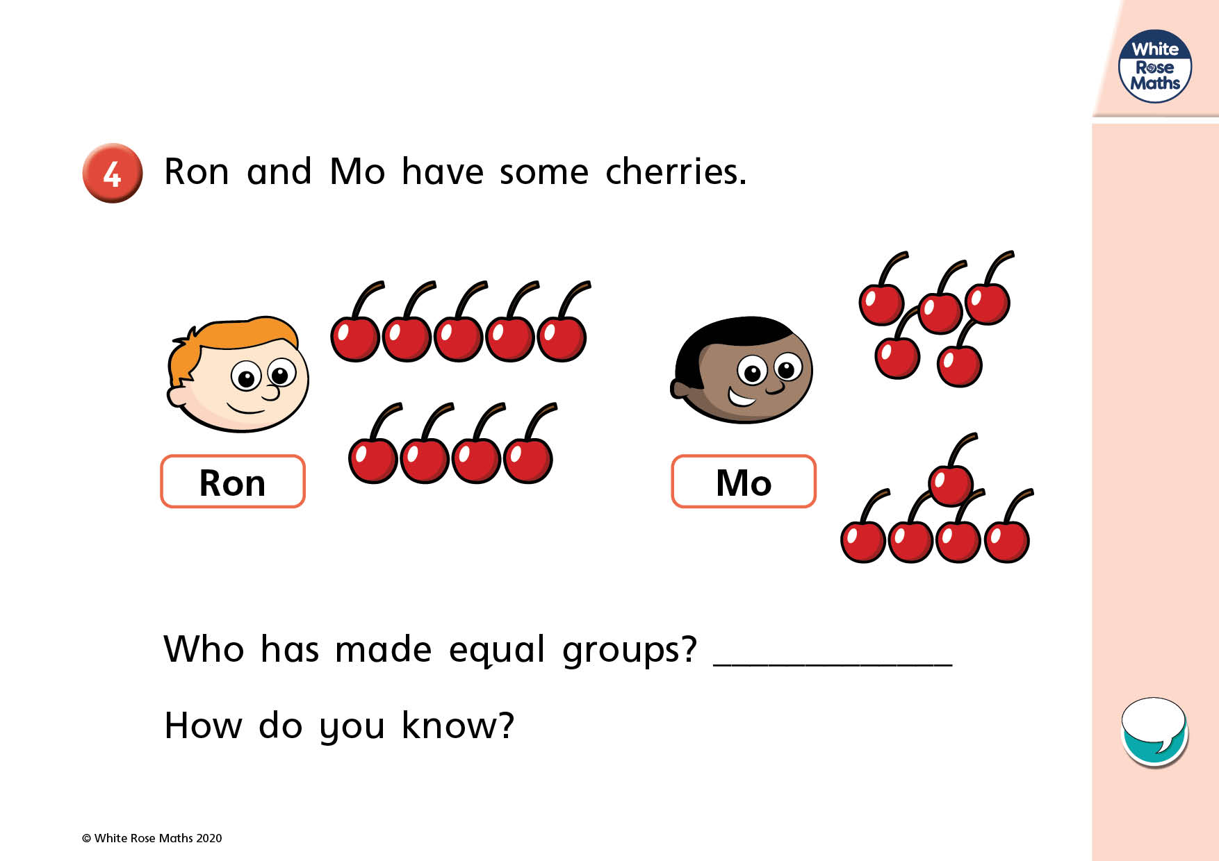

Slide 12
