Slide 1
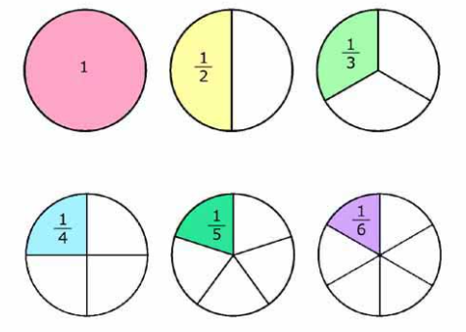
Tuesday Term 5 Week 1
Fractions

Slide 2
L.I. to understand and use fractions
PKS – Begin to recognise a half as one of two equal parts.
Band 1 – Recognise, find and name a half as one of two equal parts of an object, shape or quantity.
Band 2 – Recognise, find, name and write fractions 1/2, 1/3, 1/4, 2/4 and 3/4 of a length, shape, set of objects or quantity and demonstrate understanding that all parts must be equal parts of the whole.

Slide 3
What do you think a fraction is?
A fraction represents a part of a whole or, more generally, any number of equal parts. They are useful whenever we need to split things up.
A fraction has three parts. They are:
The numerator – the number above the bar.
The denominator – the number below the bar.
The vinculum – the bar separating the two numbers.

Slide 4
Mario uses fractions to split up his pizzas
How many parts will he cut it into if he is sharing with his brother Antonio?

Slide 5
Mario splits the pizza into two equal parts.
Each part is a fraction.
We call these parts halves.
It is important that they are equal.

Slide 6
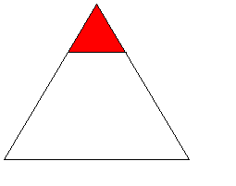
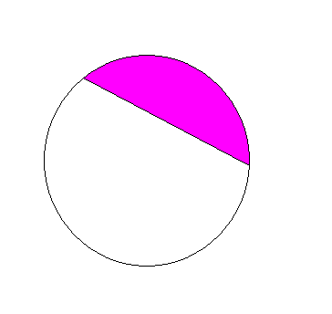
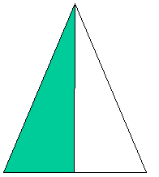
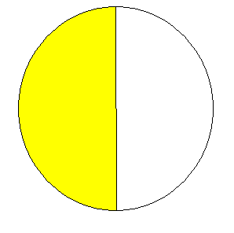
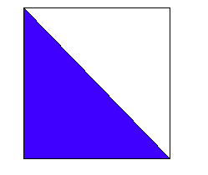
Which of these shapes are split into halves?

Slide 7
One half can be written like this
As you can see fractions are made up of 2 different parts.
One part on the top and one part on the bottom.

Slide 8
The top and bottom parts of the fraction have different meanings.
The top number is the number of parts
The bottom number is the total number of parts

Slide 9
Another name for these parts is
The numerator
The denominator

Slide 10
The numerator is the top part. It shows how many parts of the whole we are talking about.
The denominator is the bottom part. It shows how many parts the whole has been split into.

Slide 11
Activity
Cutting and folding shapes in half.
Find half of a shape worksheet
Extension – Finding half of an amount challenge.
Choose a number card. Count out the amount using counters or multilink. Can you share the amount in half? TWO EQUAL GROUPS.
What did you find out?

Slide 12
Plenary
Why is it so important that each part is equal?

