Slide 1
Bank Holiday Monday

Slide 2
Tuesday 4th May 2021 LI: To use a verb.

Slide 3
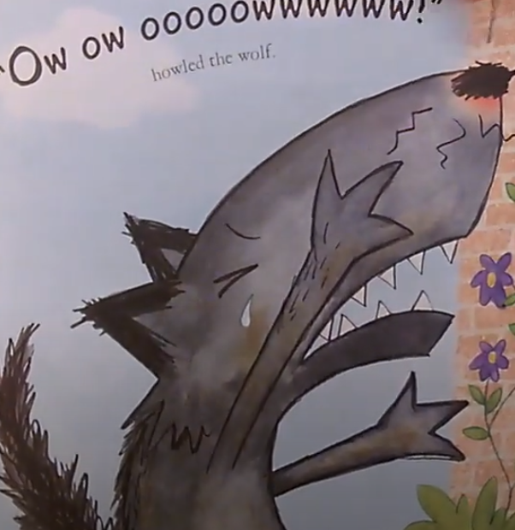
https://www.youtube.com/watch?v=bFCv02IGtn4 big cats
https://www.youtube.com/watch?v=b9xhOQ26QYI wolves

Slide 4
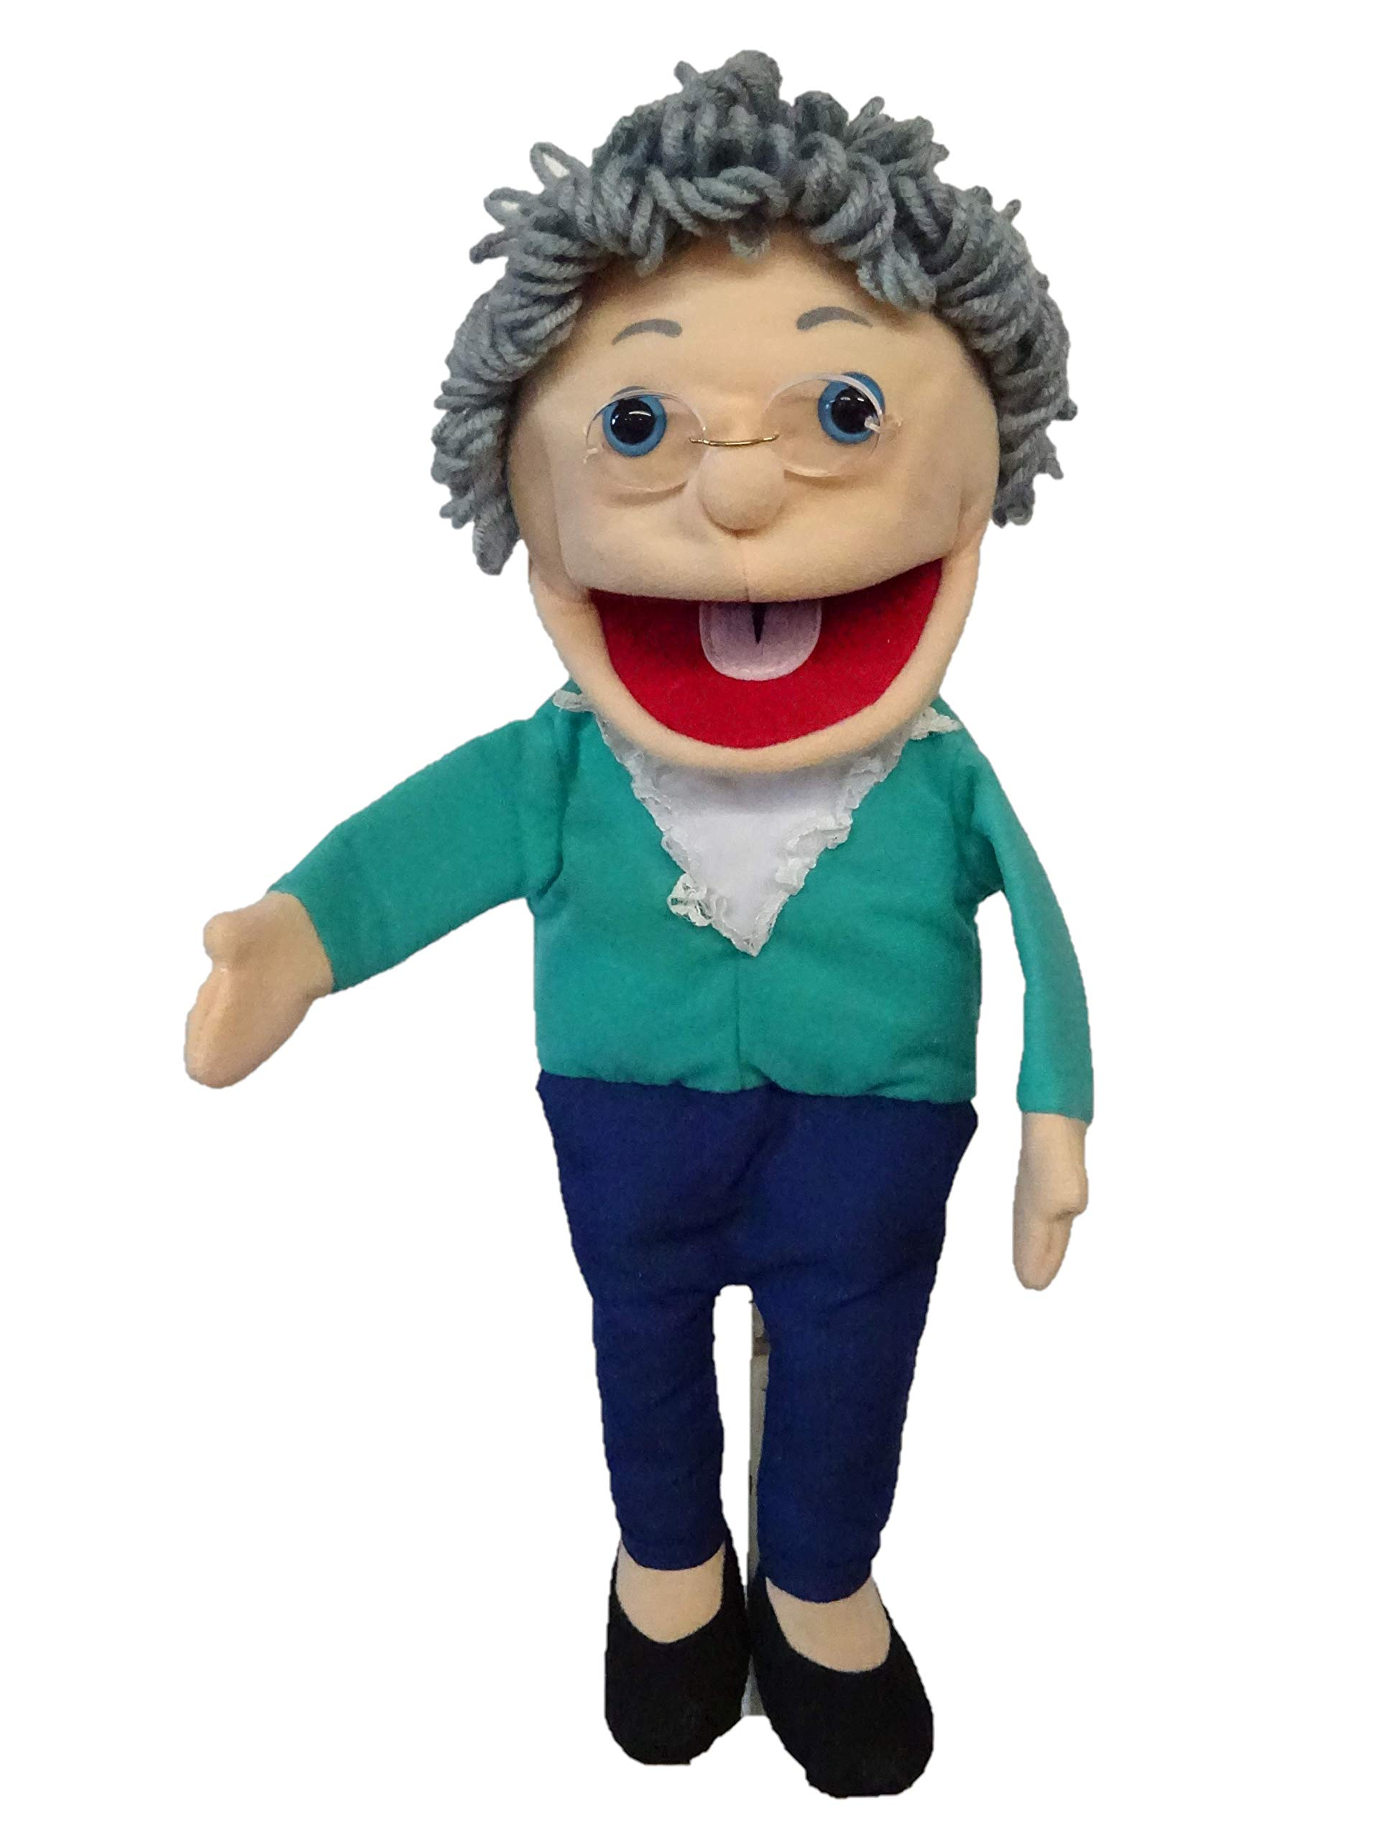
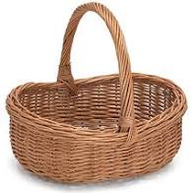
Grandma Fantastic what is in your basket?
roared
yelped
bawled
scratchy
bellowed
snarled

Slide 5
cried
barked
roared
howled
growled

Slide 6
“Ow ow oooowwwwww!” howled the wolf.

Slide 7
“Ow ow oooowwwwww!” howled the wolf.

Slide 8
Tuesday 4th May 2021 LI: To use a verb.
“Ow ow oooowwwwww!” howled the wolf.

Slide 9
Tuesday 4th May 2021 LI: To use a verb.
“Ow ow oooowwwwww!” howled the wolf.

Slide 10
Wednesday 5th May 2021 LI: To use an adverb.

Slide 11
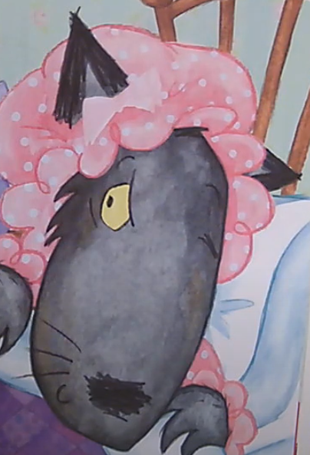
Watch Charlie and Loa – First day of school

Slide 12
Grandma Fantastic what is in your basket?
nervously
cautiously
gingerly
feebly
guarded

Slide 13
quietly
softly
faintly
lowly

Slide 14
“Why Granny! she said slowly. “What BIG EARS you have!”

Slide 15
“Why Granny! she said slowly. “What BIG EARS you have!”

Slide 16
“Why Granny! she said slowly. “What BIG EARS you have!”

Slide 17
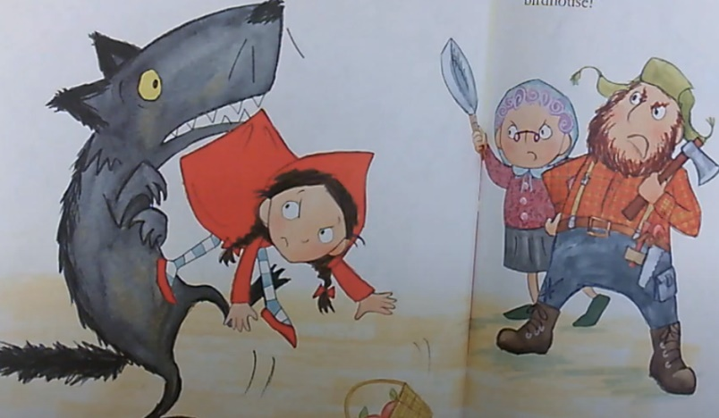
Thursday 6th May 2021 LI: To use a noun.

Slide 18
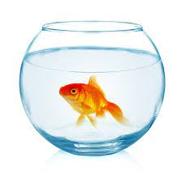
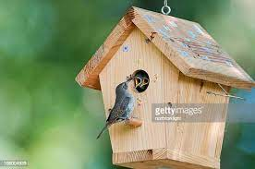
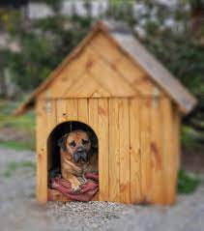
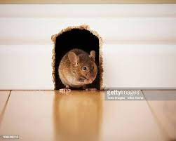

Slide 19
Grandma Fantastic what is in your basket?
bird-cage
aviary
birdbath
birdfeeder

Slide 20
treehouse
mousehole
fishbowl
doghouse

Slide 21
“Or we’ll chop you up and turn you into a birdhouse!”

Slide 22
“Or we’ll chop you up and turn you into a birdhouse!”

Slide 23
“Or we’ll chop you up and turn you into a birdhouse!”

Slide 24
Friday 7th May 2021 LI: To use an adjective.

Slide 25
https://www.youtube.com/watch?v=tWrOeNKvtHI
Michael Rosen – Chocolate cake

Slide 26
Grandma Fantastic what is in your basket?
mouth-watering
delicious
flavoursome
delectable
appetizing
scrumptious

Slide 27
tasty
nice
lovely
yummy

Slide 28
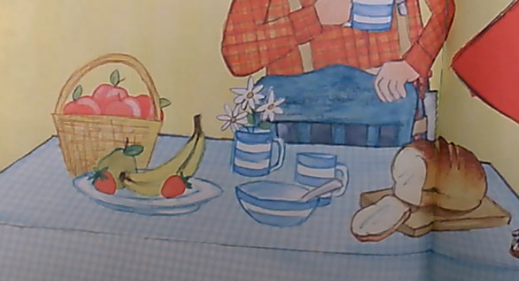
“Now let’s all have a lovely breakfast!”

Slide 29
“Now let’s all have a lovely breakfast!”

Slide 30
“Now let’s all have a lovely breakfast!”

