Slide 1
Term 3 Week 2 Poetry

Slide 2
Monday 11th January L.I. To explore language for poetry
By the end of this week, you will have written a poem of your own and you will know one poem (or maybe more) off by heart!

Slide 3
Steps to Success:
I recite poems by heart. (Band 1 reading)
I join in with predictable phrases when being read to. (Band 1 reading)
I am beginning to build up a repertoire of poems learnt by heart. (Band 2 reading)
I recite poems with understanding and use of intonation. (Band 2 reading)
I am beginning to develop stamina by planning and writing poetry. (Band 2 writing)

Slide 4
Re-cap - What is a poem?
A poem can be about anything!
It uses just a few words to quickly share something...
They can rhyme... but they don't have to.
They can be funny... or serious.
Best of all... they don't have to be whole sentences. Often they are written in short lines, not long lines like a story.
Only the best words are chosen for sharing.
Someone who writes a poem is called a poet.

Slide 5
Last week you wrote your poems in a Kennings style.
This week we are going to think about list poems.
A list poem does exactly as described and collects content in a list form. A list poem can be a list of objects, actions, ideas, or even words or people.

Slide 6
Here are some examples of List Poems
What a poem's not by John Hegley
A poem is not an Ant but it can be quite short. A poem is not a Banana but there may be something under its skin. A poem is not a Coat but it may have some warmth in it. A poem is not a Dog but it might be quite a friend. A poem is not an Endless pair of trousers but it can be quite long. A poem is not a Football shaped like a cucumber. A poem is not a Great number of things. A poem is not a Hedgehog but it might be hard to get hold of. A poem is not an Igloo but it can feel like home. A poem is not a Jumble sale, but it might contain some rubbish. A poem is not a Kite but it might enjoy the wind. A poem is not a Lightbulb but you can change it if you want to.

Slide 7
A poem is not a Monkey but can be quite human. A poem is not a Nut but you can give it to a monkey. A poem is not an Opera score or an open score but it can be revealing. A poem is not a Prison and it shouldn't feel like one either. A poem is not a Question... actually it is sometimes. A poem is not a Radio but you may have to tune into it. A poem is not a Slot machine but you may have to put something into it. A poem is not a Toothbrush So don't clean your teeth with it. A poem is not an Umbrella but it can give you protection. A poem is not a Verruca and I'm glad. A poem is not a Wig but maybe it will change you. A poem is not an X-ray: make no bones about it. A poem is not a Year-old bag of vegetables but it can smell quite strongly. A poem is not a Zylophone and it can spell words wrongly

Slide 8
What is happening in the poem?
Can we guess how the poet is feeling?
Do you notice any patterns? What else do you notice? E.g. Is there rhyme, repetition, alliteration?
Do you like the poem? Why/why not?

Slide 9
Flame by Rachel Rooney
Fire under footfall. Fire over skies.
Fire on a matchstick. Fire in my eyes.
Fire holding hunger. Fire seeking wood.
Fire hiding danger. Fire feeling good.
Fire as the enemy. Fire acting friend.
Fire I must stamp on. Fire I must tend.
Fire in the embers. Fire at the heart.
Fires to remember. Fires yet to start.

Slide 10
What is happening in the poem?
Can we guess how the poet is feeling?
Do you notice any patterns? What else do you notice? E.g. Is there rhyme, repetition, alliteration?
Do you like the poem? Why/why not?

Slide 11
I like to stay up by Grace Nichols
I like to stay up and listen when big people talking jumbie stories
I does feel so tingly and excited inside me
But when my mother say “Girl, time for bed”
Then is when I does feel a dread
Then is when I does jump into me bed
Then is when I does cover up from me feet to me head
Then is when I does wish I didn't listen to no stupid jumbie story
Then is when I does wish I read me book instead
(“Jumbie” is a Guyanese word for “ghost”.)

Slide 12
What is happening in the poem?
Can we guess how the poet is feeling?
Do you notice any patterns? What else do you notice? E.g. Is there rhyme, repetition, alliteration?
Do you like the poem? Why/why not?

Slide 13
Today’s Task - Click on the link to watch Roger McGough reading his poem‘The Sound Collector.’
BBC Two - Let's Write Poetry: The Big Slam, Imaginary Words, 'The Sound Collector' by Roger McGough (poem only)

Slide 14
Responding to the Poem
What do you like the sound of? How would you feel if it was suddenly taken away?
You are going to write your own sound collector poem. Can you think of any wow words (adjectives) that you could use? Make a word bank that you can look back on.
You can watch the video as many times as you need to, so you have some brilliant language to use.

Slide 15
Performance Time!
How much of the poem can you remember?
Can you remember your favourite words, or even the whole poem?
Can you perform the poem, with actions, to someone in your family?

Slide 16
Tuesday 12th January L.I. To explore language for poetry Steps to Success:
I say out loud what I am going to write about. (Band 1)
I compose a sentence (poetry phrase) before writing it. (Band 1)
I think about what I am going to write before I write it. (Band 2)
I write down ideas/keywords, including new vocabulary. (Band 2)

Slide 17
Let’s look at another list poem

Slide 18
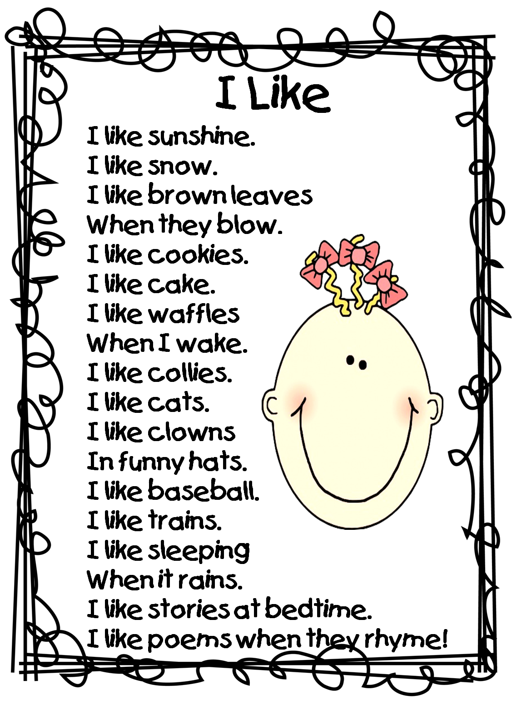

Slide 19
Can you guess the name of the poem?
What is happening in the poem?
Can we guess how the poet is feeling?
Do you notice any patterns? What else do you notice? E.g. Is there rhyme, repetition, alliteration?
Do you like the poem? Why/why not?

Slide 20
Can you remember yesterday's poem The Sound Collector by Roger McGough?
BBC Two - Let's Write Poetry: The Big Slam, Imaginary Words, 'The Sound Collector' by Roger McGough (poem only)
Why not have another go at performing it?

Slide 21
Today you are going to write your own sound collector poem!
Look back at the word bank that you made yesterday.
Think carefully about the things you like the sound of.
You might not want to use all of your ideas or you might have thought of some new ones that you would like to use.
Your first verse and last verse should use the opening line ‘A stranger called this morning’
Your poem should be no longer than 7 verses. It is fine if it is shorter.

Slide 22
Wednesday 13th January L.I. To explore language for poetry Steps to Success:
I say out loud what I am going to write about. (Band 1)
I compose a sentence (poetry phrase) before writing it. (Band 1)
I think about what I am going to write before I write it. (Band 2)
I write down ideas/keywords, including new vocabulary. (Band 2)

Slide 23
Let’s look at another list poem

Slide 25
What is happening in the poem?
Can we guess how the poet is feeling?
Do you notice any patterns? What else do you notice? E.g. Is there rhyme, repetition, alliteration?
Do you like the poem? Why/why not?

Slide 26
Let’s look back at your sound collector poem!
Look back at the poem that you wrote yesterday.
What parts do you like the most? Why?
Look carefully! Are there any parts that could be made better? Why?
Choose one or two sections of your poem that you would like to edit and use a hi-lighter to go over them.
Think about how they could be made better. Could you use more wow words or better description? Could you add alliteration, onomatopoeia or repetition?
Make your edits above your original lines/on the back of your sheet/on a separate piece of paper. Whatever is easiest for you.

Slide 27
When you have finished editing
It is time to write up in best!
Is each phrase on its own line?
Does each line begin with a capital letter?
Have you organised your poem into verses?
Does each verse use four lines?
Exclamation mark - your poem could end with an exclamation!
You can add some illustrations.

Slide 28
And now to perform!
Remember:
A clear, loud voice using expression.
Face the audience.
Keep any paper away from your face.
Can you add some actions?

