Slide 2
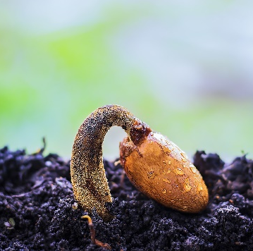
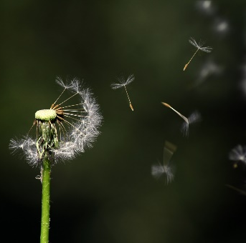
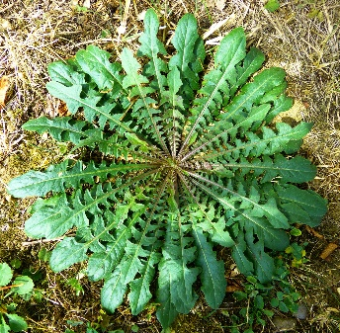
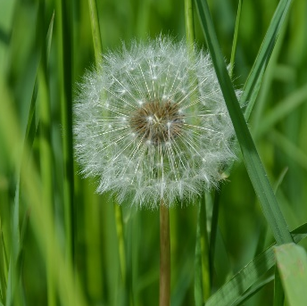
Dandelions go through many changes throughout their life. This is called the life cycle of a dandelion.
germination
Seed dispersal by wind
Life cycle of a dandelion
plant
Seed head
flower

Slide 3
Life Cycle of a Dandelion
Each dandelion will begin its life as a seed. Dandelion seeds are spread by the wind. When the conditions are right, the seed will begin to sprout. The roots will push down into the soil and start to grow.
Stage 1 Germination

Slide 4
Life Cycle of a Dandelion
The young dandelion plant will then push up through the ground as it searches for sunlight. The plant will grow stronger as it gets nutrients from the soil. Buds and leaves will begin to grow.
Stage 2 Dandelion Plant

Slide 5
Life Cycle of a Dandelion
In the next stage of the life cycle, the bright flowers of the dandelion plant will begin to bloom.
They can be yellow or orange in colour.
The flower heads open during the day and close during the night.
Stage 3 Dandelion Flowers

Slide 6
Life Cycle of a Dandelion
The flower will gradually change into a seed head. This can take up to 15 days to happen.
The seed head is shaped like a puffy, white ball.
One seed head can contain up to 100 seeds.
Stage 4 Seed Head

Slide 7
Life Cycle of a Dandelion
The last stage in the dandelion’s life cycle happens when the seeds are blown off and spread by the wind. The new seeds will become dandelion plants if they can find suitable soil to grow in.
Stage 5 Seed Dispersal

