Slide 1
What do you remember about our book yesterday?
Tuesday 3rd November 2020
Can I draft and write by building a varied and rich vocabulary?​

Slide 2
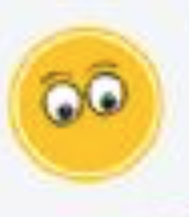
We are going to watch the following video, pausing at certain points and looking around.
https://www.youtube.com/watch?v=09jAjZLK1LM
We're going to use the Feelings, Imagining and Noticing lenses from the FANTASTICs to build our vocabulary as we are watching the video.
How do you think the person is feeling?
What are they imagining?
What do you notice?

