Slide 1
Year 3: Can I add and subtract 3-digit and 1-digit numbers? Year 4: Can I add 4-digit numbers?

Slide 2
Thursday 8.10.20

Slide 3
All – Do and talk
Use counters on a place value grid to show 223
Add 6
Subtract 5
Which column do I need to focus on?
To get it right, you have to start on the right!

Slide 4
All – Do and talk
What number is represented?
What will happen if I subtract 3?
Which column changes?
How can I write this sum in my book?
To get it right, you have to start on the right!

Slide 5
Year 3 – independent work
Write down the number sentences
Build the numbers with the counters
Draw them in your book and explain what happens.

Slide 6
Year 4 - Pictorial
What calculation is shown here?
How would you set out your numbers if this was a written calculation?

Slide 7
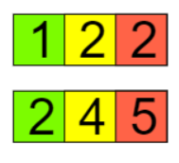
Year 4 - Abstract
Write the calculation 122 + 245 on your whiteboard.
How are the place value columns lined up?
Where would you start if you were adding up the digits?
To get it right, you have to start on the right!

Slide 8
Year 4: Can I add two 4-digit numbers?
We do
Let’s practise on the whiteboards
Year 4
3,466 + 2,321 =
5,017 + 3,470 =
1,709 + 7,281 =

Slide 9
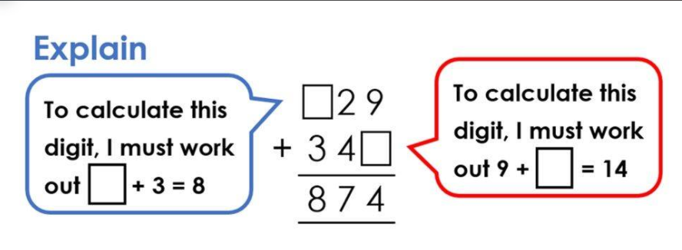
Year 4: Can I add two 4-digit numbers?
We do
Reasoning
Work out the missing numbers

Slide 10
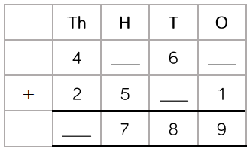
Year 4: Can I add two 4-digit numbers?
We do
Reasoning
Work out the missing numbers

Slide 11
Lightbulb challenge
Year 3: Year 4: (on sheet)

