Slide 1
Biographies
Thursday 22nd October 2020

Slide 2
William the Conqueror
(1028 - 1087)
King of England

Slide 3
Independent writing
Today, you are going to write the biography using the planning grid and your notes.

Slide 4
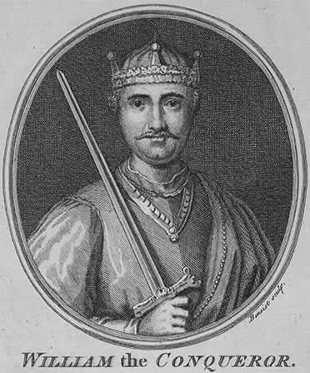
William the Conqueror
King of England
Domesday book
Castles
Feudal system
French
Soldier King
Was promised the throne of England
Write three interesting facts about William, using good adjectives, nouns, adverbs and verbs
Parents were not married
Became a Duke age 7

