Slide 1
Lesson 1: Can a picture move?
Save a copy
Year 3 – Creating Media – Animation
Notes:
Last updated: 01-07-20
This resource is available online at ncce.io/cm3a-1-s. Resources are updated regularly — please check that you are using the latest version.
This resource is licensed under the Open Government Licence, version 3. For more information on this licence, see ncce.io/ogl.

Slide 2
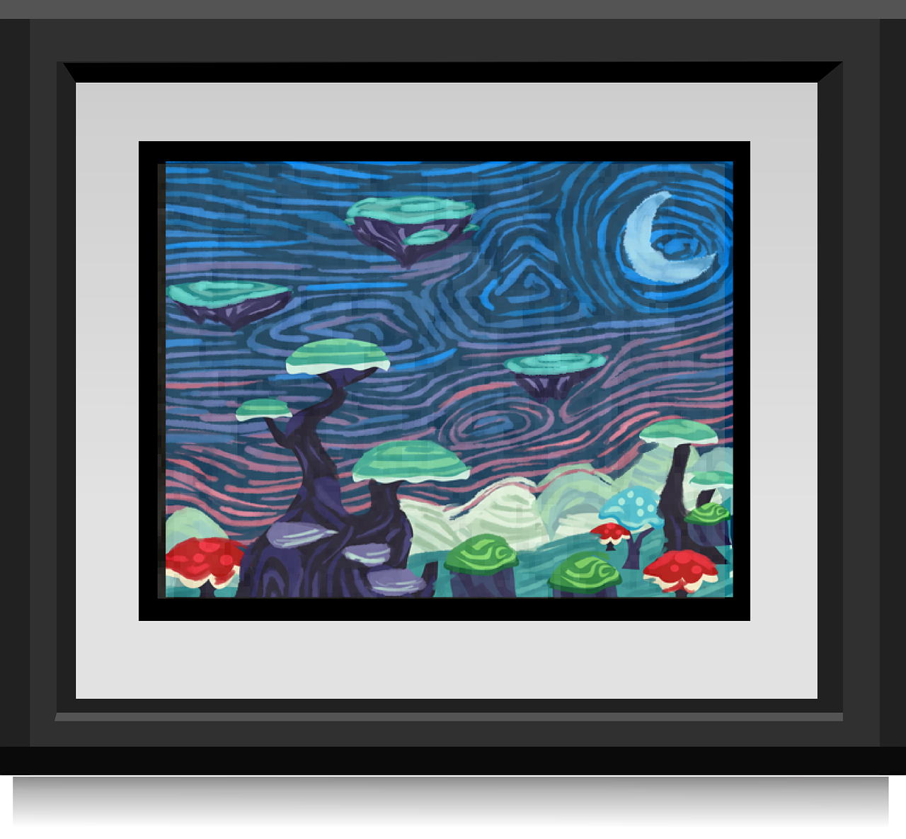
Can a picture move?
Introduction
Question: Can a picture move?
Think, pair, share
Notes:
Framed picture: https://cdn.pixabay.com/photo/2014/12/21/23/46/paintings-576027_1280.png

Slide 3
Lesson 1: Can a picture move?
Objectives
Lesson objective: To explain that animation is a sequence of drawings or photographs
I can draw a sequence of pictures
I can create an effective flip book–style animation
I can explain how an animation/flip book works

Slide 4
Animation
Activity 1
Question: What is an animation?
Think, write, pair, share
Notes:
Animation: https://pixabay.com/videos/board-light-bulb-chalk-success-18400/ (Also saved in Google Drive)

Slide 5
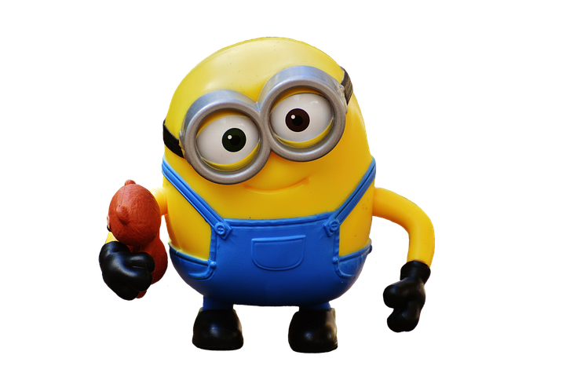
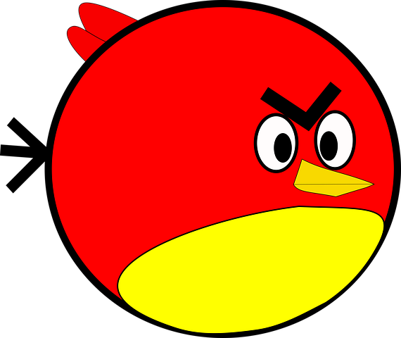
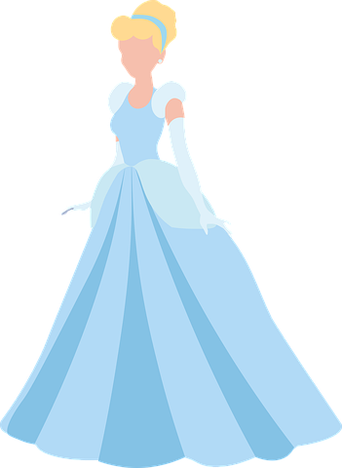
Animations
Activity 2
What is an animation?
Animations have been created throughout history — even before computers were invented!
An animation is where a number of pictures are drawn or taken of an object or picture, and the pictures are shown quickly, which gives the illusion that the object or picture is moving.
Have you seen any animations?
Today you are going to make some simple animations by creating flip books.
Notes:
Minion image: https://cdn.pixabay.com/photo/2017/07/31/23/45/minion-2562071__480.png
Disney princess image: https://cdn.pixabay.com/photo/2019/07/18/08/01/cinderella-4345775__480.png
Angry Bird image: https://cdn.pixabay.com/photo/2019/07/25/11/57/angry-4362418__480.png
Lego minifigure: https://cdn.pixabay.com/photo/2012/04/18/02/17/lego-36566__480.png
Lamp: https://cdn.pixabay.com/photo/2012/04/01/19/49/magic-24293__480.png

Slide 6
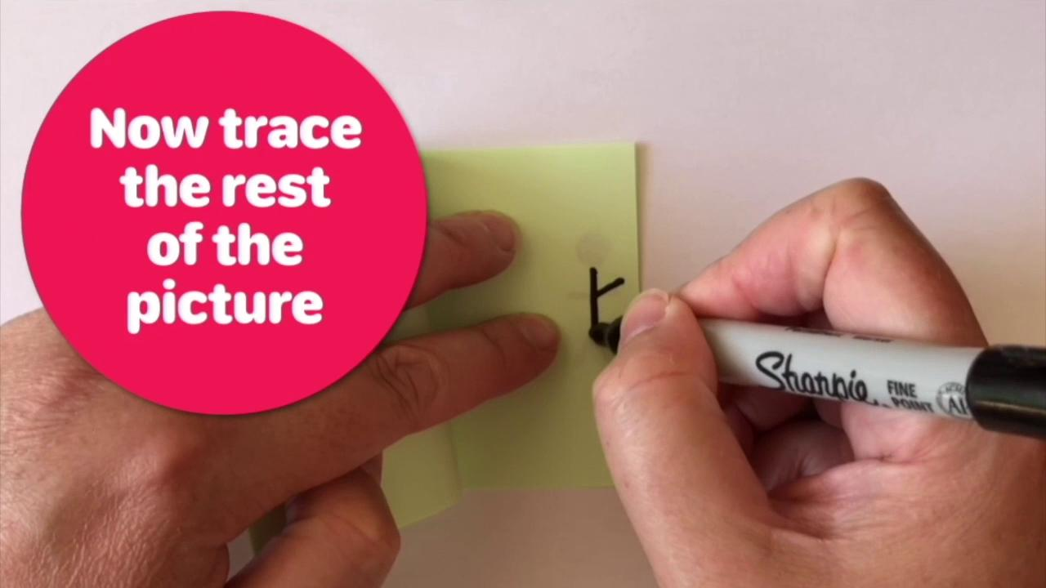
Flip book animation
Activity 2

Slide 7
Flip books
Activity 2
Instructions
Start on the bottom sheet
Create your drawing (make it simple)
Turn over the next page
Make a change to the part of the drawing that you want to move
Copy the rest of the drawing
Repeat until all pages have a drawing on
Flip through the pages to see your animation
Notes:
Sticky note image: https://cdn.pixabay.com/photo/2018/02/21/09/41/green-3169887__480.png
Pen image: https://pixabay.com/vectors/felt-tip-felt-pen-marker-black-154473/

Slide 8
What will work best?
a)
b)
Activity 2
Where would you draw the stick person?
Close to the opening edge of the sticky note
Close to the closed edge of the sticky note
Why?
Notes:
Sticky note image: https://cdn.pixabay.com/photo/2018/02/21/09/41/green-3169887__480.png

Slide 9
What will work best?
a)
b)
Activity 2
Where would you start drawing?
The top sheet of the sticky notes
The bottom sheet of the sticky notes
Why?
Notes:
Sticky note image: https://cdn.pixabay.com/photo/2018/02/21/09/41/green-3169887__480.png

Slide 10
What will work best?
a)
b)
Activity 2
Which part of the stick person would you draw first?
The part that needs to move
The parts that do not need to move
Why?
Notes:
Sticky note image: https://cdn.pixabay.com/photo/2018/02/21/09/41/green-3169887__480.png

Slide 11
Now create your own flip book
Can you make a stick person wave?
Activity 3
Notes:
Sticky note image: https://cdn.pixabay.com/photo/2019/04/29/13/20/post-it-4166054_1280.png
Pen image: https://pixabay.com/vectors/felt-tip-felt-pen-marker-black-154473/

Slide 12
Lesson 1: Can a picture move?
Plenary
Do you think that pictures can move?
Verbal exit ticket:
Can you give me an example of an animation that you have seen at school or outside school?
Notes:
Question mark image: https://cdn.pixabay.com/photo/2017/03/07/13/02/question-mark-2123967__480.jpg
Film strip image: https://cdn.pixabay.com/photo/2016/06/15/08/23/tape-1458416_1280.png

Slide 13
How confident are you? (1–3)
Assessment
I can draw a sequence of pictures
I can create an effective flip book–style animation
I can explain how an animation/flip book works
3 - Very confident
2 - Unsure
1 - Not confident
Notes:
Image source: https://pixabay.com/vectors/thumb-up-hand-like-confirm-go-top-307176/

Slide 14
Next lesson
Summary
In this lesson, you…
Created simple animations by making your own flip books
Next lesson, you will…
Relate animated movement with a sequence of images
Notes:
Walking, hiking stickman image: https://cdn.pixabay.com/photo/2013/07/12/17/14/walking-151828__480.png
Striding stickman image: https://cdn.pixabay.com/photo/2013/07/12/17/13/striding-151823__480.png
Stickman jump, fly, fall image: https://cdn.pixabay.com/photo/2014/04/03/10/28/stickman-310587__480.png
Sticky note image: https://cdn.pixabay.com/photo/2018/02/21/09/41/green-3169887__480.png

