Slide 1
Geography
Can I explain what climate is?
- I can identify different types of climates around the world
- I can explain why there are different climates

Slide 2
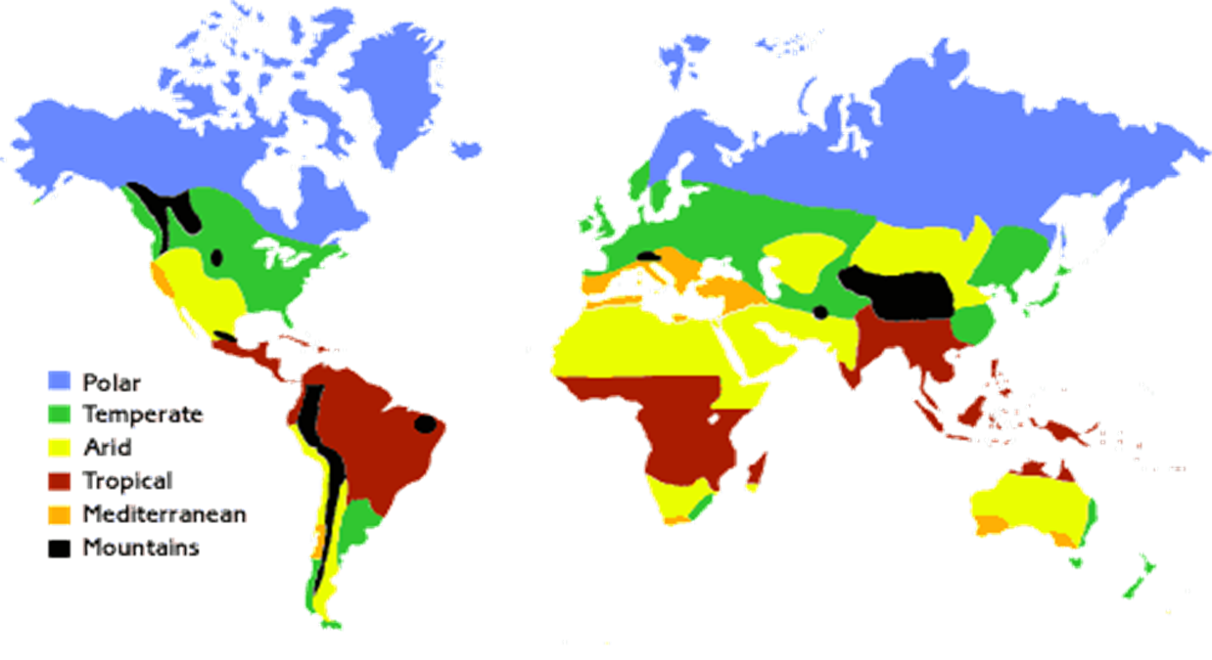
There are six main climate zones.
https://www.youtube.com/watch?v=1MN_L5CuIrI

Slide 3
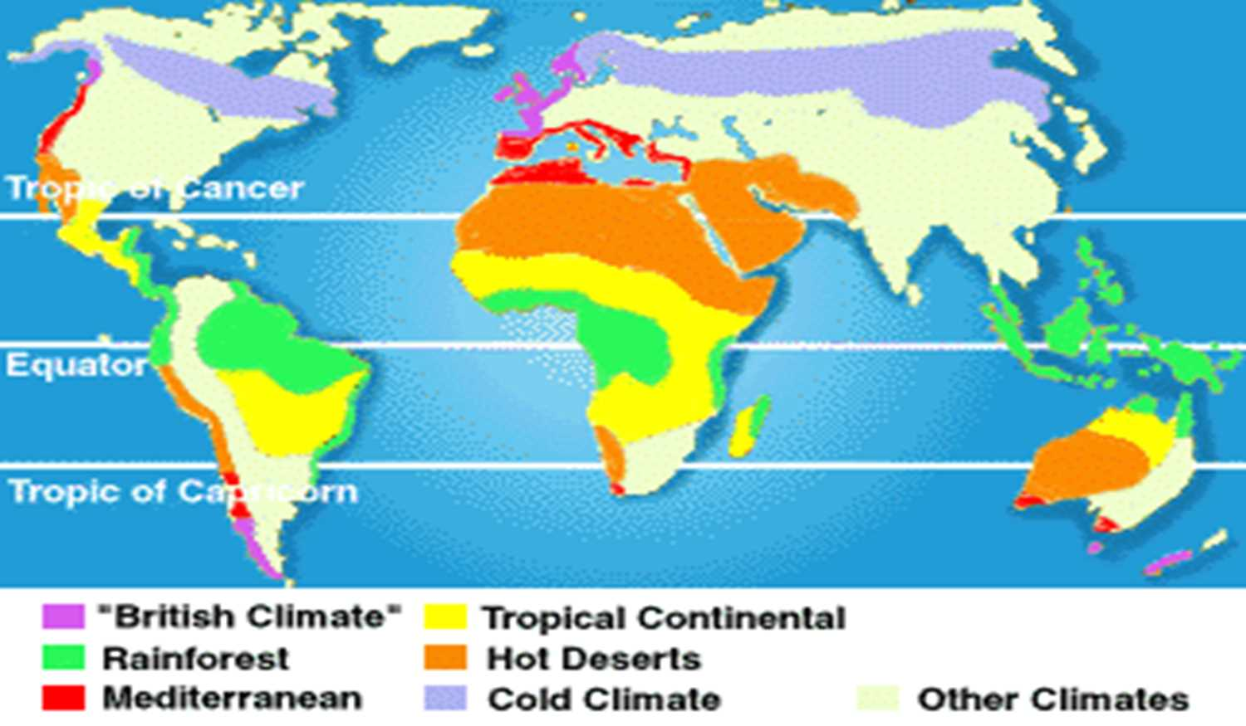
Which countries have a climate similar to Britain’s ?
What type of climate you will find in the rainforests?
Difference in Climate is found by observing which three things?
Temperature, rainfall and plant life.

Slide 4
Task
On your maps,
colour and label the different climatic zones.
In your books explain:
What the different climatic zones are.
What are the similarities and differences between them?
What 3 things are used to identify the different climate zones?

