Slide 1
Y3 LI: Can I make equal groups when sharing? Y4 LI: Can I multiply numbers by 10?

Slide 2
Focus task
Year 3
Gather 10 cubes and share them equally between 2 groups
Year 4
Draw an array for:
1 x 10
and
2 x 10

Slide 3
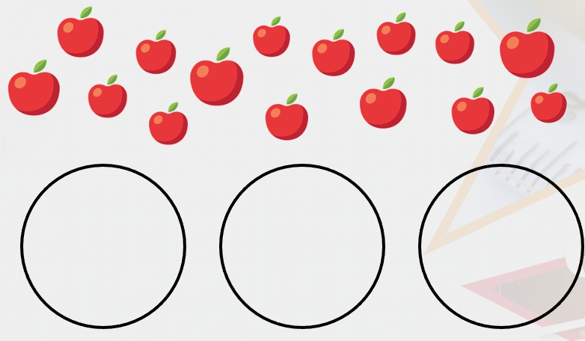
Year 3 on a whiteboard
Year 4 on a whiteboard
Share the apples into equal groups. Complete the stem sentence.
_____ is shared into _____ groups of _____.
Complete the calculation represented by the image below.
_____ x _____ = ______
Challenge: Can you write it in another way?
What do you notice when multiplying by 10? Does it always work?
= 10
Challenge: How many do you have to begin with?
How many equal groups are you sharing between?
How many are in each group?
How do you know that you have shared the objects equally?

Slide 4
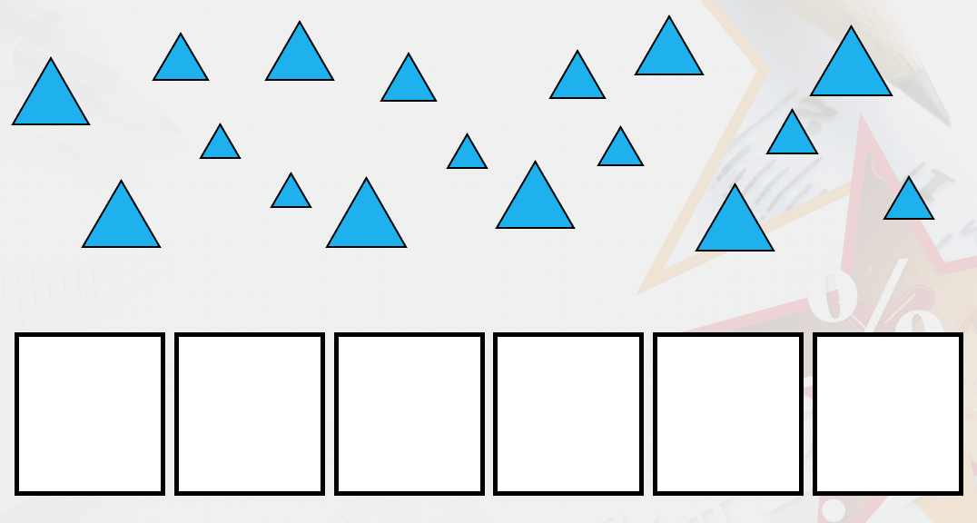
Year 3 on a whiteboard
Year 4 on a whiteboard
True or false?
17 can be shared equally between 6 groups.
Can you draw this?
True or false?
10 lots of 76 crayons gives a total of 760 crayons.
Challenge: How could you draw this simply?

Slide 5
Year 3 on a whiteboard
Year 4 on a whiteboard
Use the pictures to complete the number sentence.
12 divided by _____ = _____
Can you write this a different way?
Eggs are sold in boxes of 10.
Mark buys 27 boxes of eggs.
How many eggs does he buy altogether?
Can you draw this?

Slide 6
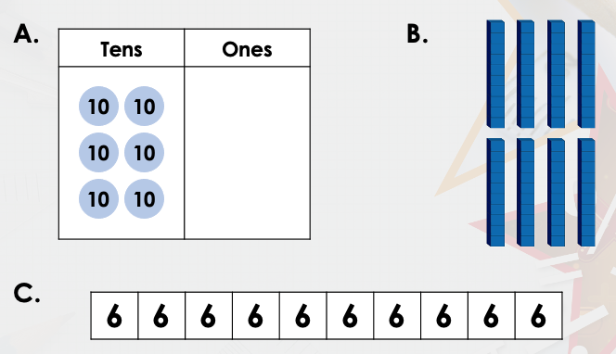
Year 3 on a whiteboard
Year 4 on a whiteboard
Solve the calculation below.
27 divided by 3 equals _____.
Can you write this in a different way?
Which representation is the odd one out?

Slide 7
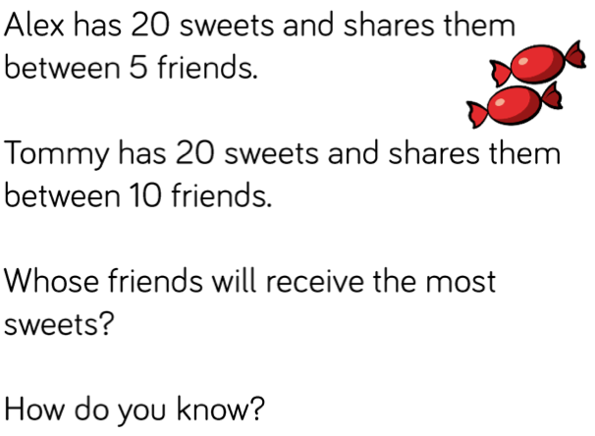
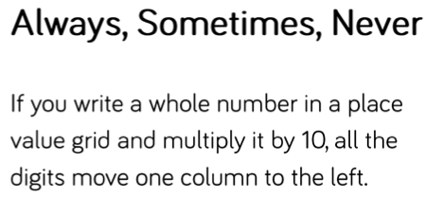
Lightbulb challenge
Year 3
Year 4

