Slide 1
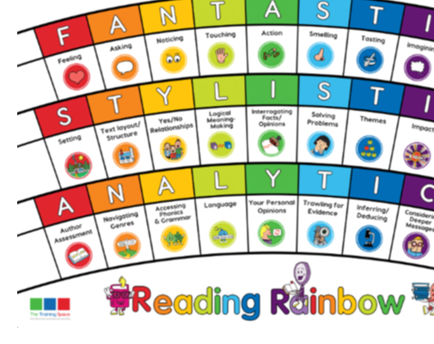
Monday 23rd November
Lesson 1:
BOOK TALK

Slide 2
Book Talk
We are going to read Demon Dentist chapter 15 together and focus on 2 lenses (p.173).
Noticing
Language

Slide 3
How does the author help you to visualise the chase?

Slide 4
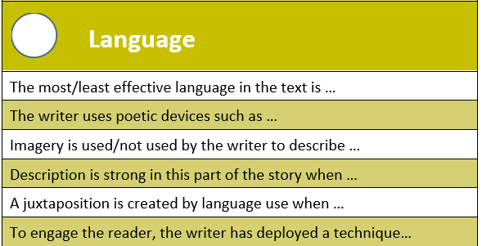
Find examples of how the author has used ‘repetition’ to engage the reader.

Slide 5
Thursday 26th November
Lesson 2:
MODEL

Slide 6
Model
Read Page 1 from The Lost Happy Endings’.
We are going to create some sentences together today using the same 2 lenses:
Noticing
Language
We will write the answers together, but you can add in extra information if you would like to.

Slide 7
Noticing lens
What do you notice about the time and place Jub is emptying out the sack of Happy Endings?
In the text is says each … and Jub goes to the ….
OR
The author describes the place as …. and the time as …..
2) Language
Each evening dusk was removing the outline of things, like a rubber.
This simile is effective / not effective because ….
OR
The description is strong in this part of the story when …

Slide 8
Friday 27th November
Lesson 3:
ENABLE

Slide 9
Lesson 3 - Enable
Today is your turn to answer questions on your own.
Please use the sentence starters from this week to help you.
Noticing
Language

Slide 10
Session 3 – Enable (Independent comprehension)
Year 3
1)
2)
Bonus question
3)
Year 4
1)
2)
Bonus question
3)

