Slide 1
Explanation text
Friday 27th November 2020

Slide 2
Can I plan my writing by discussing writing that is similar?
Today we will use:
Alliteration
Adjectives and technical vocabulary
Cause and effect language

Slide 3
Benefits
Let’s brainstorm alliterative phrases for a dog.
Chotting
Clever canine, wonderful wager, …

Slide 4
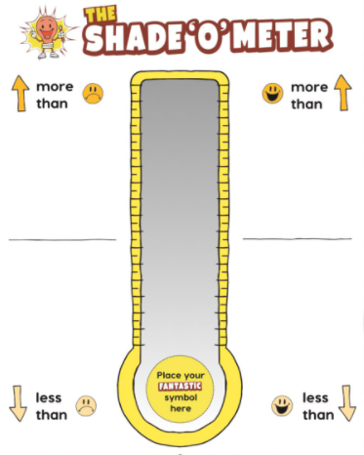
Benefits
Now, let’s use the shad-o-meter to think of words which mean the same as quickly.
Chotting
Remember: is the word more or less than quickly?

Slide 5
Benefits
Model
Once linked to the iRobot dog app, you can quickly call on your canine companion wherever you are. Surely, this would make you feel ..
Deepen the moment
Use the feelings lens to describe how it will make the owner feel.

Slide 6
Adjectives
Secret lives of dogs https://www.youtube.com/watch?v=XPluctLY8Y4
While watching this clip, think of good adjectives to describe the dog’s sense of smell.
Gather vocabulary
Acute, …

Slide 7
Technical vocabulary
How could we describe a robot dog’s nose? Let’s invent some technical words.
Chotting
Nasal turbine, supercharged sniffer, …

Slide 8
Technical vocabulary
Model:
As you know, dogs have a heightened sense of smell. When you are near your dog a proximity meter will alert the nasal turbine.
Deepen the moment
Write how the dog will respond.

Slide 9
Cause and effect
Look at the cause and effect words. Do you understand what they mean?
Chotting
Make up technical language for the voice box.

Slide 10
Cause and effect
Model
If the smell sensor gauge reaches 14 odour grams, it will result in activation of the nasal chamber.
You can adjust the volume settings for a personalised bark.
Do your own for the voice box.

