Slide 1
To know how to divide by 8
Success Criteria I can explain how to divide by 8 I know that grouping and sharing both mean division I can check my answers using the inverse operation

Slide 2
Starter:
Explain the difference between groups of 4 and 4 equal groups.
If I split the balls into groups of 4, I would have 5 groups of 4.
If I made 4 equal groups, I would have 4 groups with 5 balls in each group.
Answers
Notes:
This starter encourages pupils to discuss the difference between groups of and equal groups. Pupils can use the balls to help them explain their answers. It will be important that pupils understand the difference between these two terms.
Concrete resources – Counters/ resources to represent the balls
Key Questions – How are the terms similar? How are the terms different? What do you notice about the way you would arrange the balls for each question?
Extension – How many different ways can you arrange the balls? (recapping arrays)

Slide 3
If I know that 4 x 8 = 32, what division questions do I also know?
Explain your answer.
32 ÷ 8 = 4
32 ÷ 4 = 8
4 = 32 ÷ 8
8 = 32 ÷ 4
Answers
Notes:
This slide encourages pupils to consider inverse operations. Some pupils may need reminding that division is not commutative.
Concrete resources – Counters, blocks
Key Questions – What do you know about the relationship between multiplication and division? Which division questions could you write? Is division commutative? What does commutative mean?
Misconceptions/ Common Errors – Pupils may believe division is commutative.
Further Practice – Which multiplication questions could you write that match?
Extension – Make a mistake on purpose. Explain your mistake.

Slide 4
Guided Practice:
Apples are sold in bags of 8.
There are 48 apples in the shop.
How many bags of apples are there?
48 ÷ 8 = 6
Answers
Notes:
Concrete resources – Counters etc to represent apples
Key Questions – How many apples are there in total? How many apples are in each bag? Can you write a number sentence for this word problem? How would you solve this calculation? How can you check your answer?
Extension – Explain your process.

Slide 5
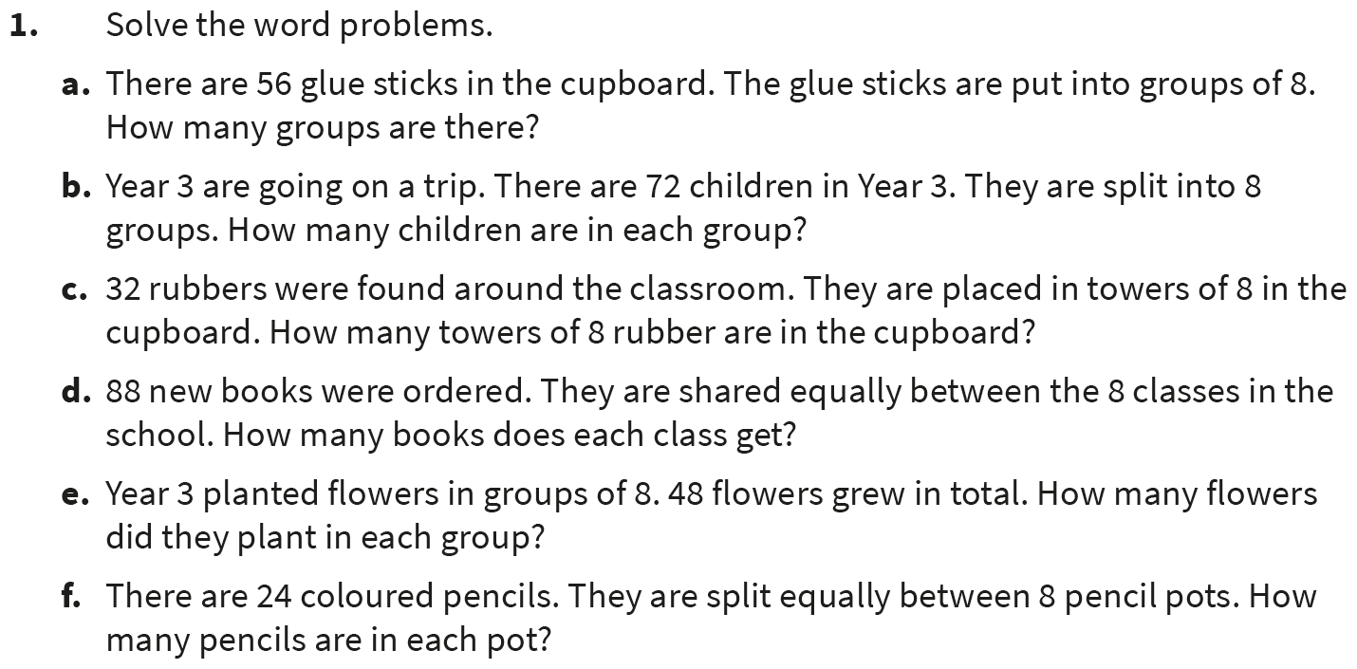
Independent Practice:
Notes:
56 ÷ 8 = 7
72 ÷ 8 = 9
32 ÷ 8 = 4
88 ÷ 8 = 11
48 ÷ 8 = 6
24 ÷ 8 = 3

Slide 6
Guided Practice:
Match the questions to their answers.
11
48 ÷ 8
12
96 ÷ 8
5
40 ÷ 8
6
Answers
Notes:
Concrete resources – Counters etc to represent calculations.
Key Questions – Which questions match? How do you know? Can you check you answers? How?
Misconceptions/ Common Errors – Pupils may find it difficult as there are 4 answers and 3 questions.
Further Practice – Write a division question for the answer that is left.
Extension – Show one of the calculations pictorially.

Slide 7
Independent Practice:
Notes:
9
10
1
6
7
4
5
12
Pupils should have drawn one of the calculations pictorially (this could be an array, groups of 8, 8 groups etc).

Slide 8
Guided Practice:
The mathstronaut says, “I have made 4 equal groups of 8.”
Do you agree?
The mathstronaut is wrong. They have made 2 equal groups of 7 and 2 equal groups of 8.
Answers
Notes:
Concrete resources – Blocks
Key Questions – What do you know about equal groups? Does this show equal groups? Why/ why not? How could you make this into equal groups? How can you check your answer?
Misconceptions/ Common Errors – Pupils may think that as there are two sets of equal groups, the mathstronaut is correct.
Further Practice – Can you make this into equal groups of 8? Write a division number sentence for the corrected image.

Slide 9
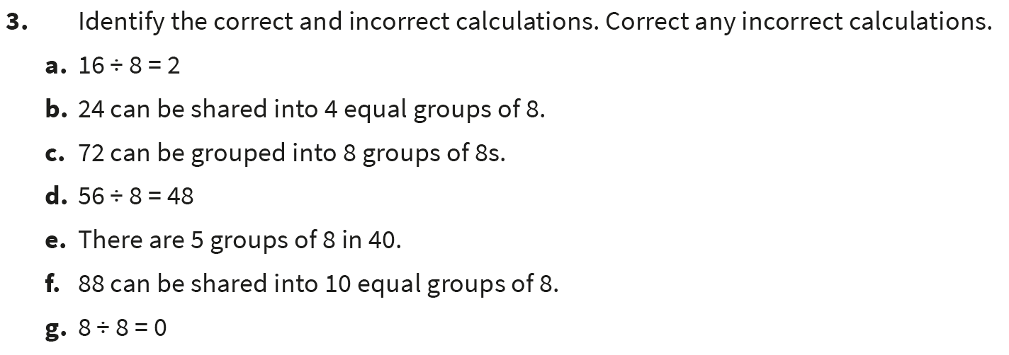
Independent Practice:
Notes:
Correct
Incorrect (24 ÷ 8 = 3)
Incorrect (72 ÷ 8 = 9)
Incorrect (56 ÷ 8 = 7)
Correct
Incorrect (88 ÷ 8 = 11)
Incorrect (8 ÷ 8 = 1)

Slide 10
Let’s Reflect:
Write a word problem to match this bar model.
8 | 8 | 8 | 8 | 8 | 8 | 8 | 8
Notes:
Key Questions – Does this bar model show groups of 8 or 8 groups? How would you show this in a word problem? What do you notice?
Misconceptions/ Common Errors – Pupils may struggle to write an appropriate word problem for the bar model.

Slide 11
The following slides are based on lesson 6 of this Year 3 block – Divide by 4

Slide 12
Put the cherries in groups of 4.
How many groups are there?
Now split the buttons into 4 equal groups.
What is the same?
What is different?
There would be 6 groups.
There would be 6 in each group.
Answers
Notes:
How and when to use these slides – Before moving on to dividing by 8, pupil may need to recap previous learning on dividing by 4. This slide recaps the difference between groups of 4 and 4 equal groups.
Concrete resources – Counters/ items to represent the cherries
Key Questions – If I split them into groups of 4, how many would be in each group? If I split them into 4 equal groups, how many would be in each group? What is the difference between the two? What is the same?
Misconceptions/ Common Errors – Pupils may not understand the difference between groups of 4 and 4 equal groups.
Further Practice – Repeat the process with a different number of cherries.

Slide 13
Find your way through the maze by following the path of correct answers.
40 ÷ 4 = 10 | 4 ÷ 4 = 4 | 20 ÷ 4 = 4 | 40 ÷ 4 = 9 | 48 ÷ 4 = 11
44 ÷ 4 = 11 | 12 ÷ 4 = 2 | 28 ÷ 4 = 24 | 16 ÷ 4 = 4 | 8 ÷ 4 = 4
16 ÷ 4 = 4 | 24 ÷ 4 = 6 | 48 ÷ 4 = 12 | 4 ÷ 4 = 2 | 36 ÷ 10
32 ÷ 4 = 16 | 44 ÷ 4 = 40 | 8 ÷ 4 = 2 | 36 ÷ 4 = 9 | 4 ÷ 4 = 1
20 ÷ 4 = 5 | 16 ÷ 4 = 12 | 32 ÷ 4 = 7 | 24 ÷ 4 = 7 | 28 ÷ 4 = 7
Start
End
Answers
Notes:
How and when to use these slides – Before moving on to dividing by 8, pupil may need to recap previous learning on dividing by 4. Pupils can use counters/ arrays etc to help them answer these questions.
Concrete resources – Counters, multiplication grid
Key Questions – Which calculations are correct? How can you check the answers are correct? What is the opposite of division? How can using the opposite help?
Misconceptions/ Common Errors – Pupils may struggle to identify the correct/ incorrect answers.
Further Practice – When pupils have found the way through, can they correct the incorrect answers?

