Slide 1
To be able to multiply and divide by 7
Success Criteria I can use my knowledge of times tables facts to multiply by 7. I can use my knowledge of times tables facts to divide by 7. I can explain patterns when multiplying and dividing by 7.

Slide 2
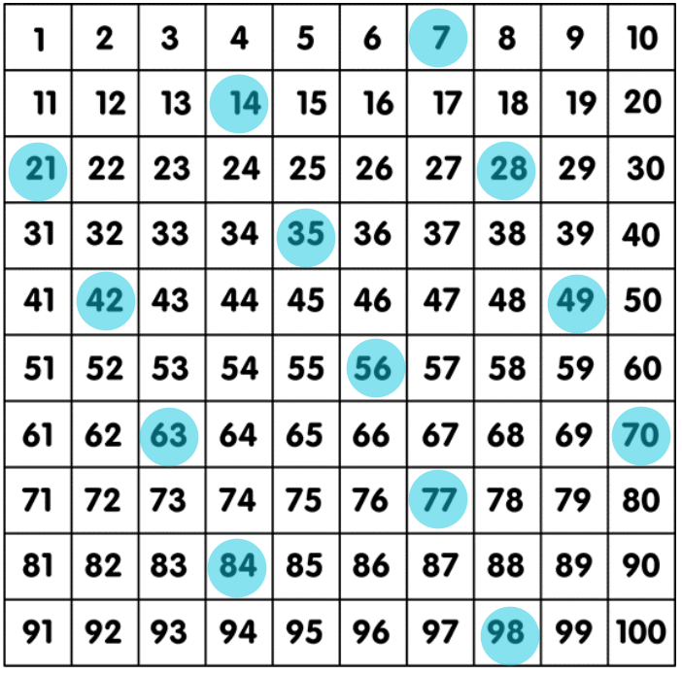
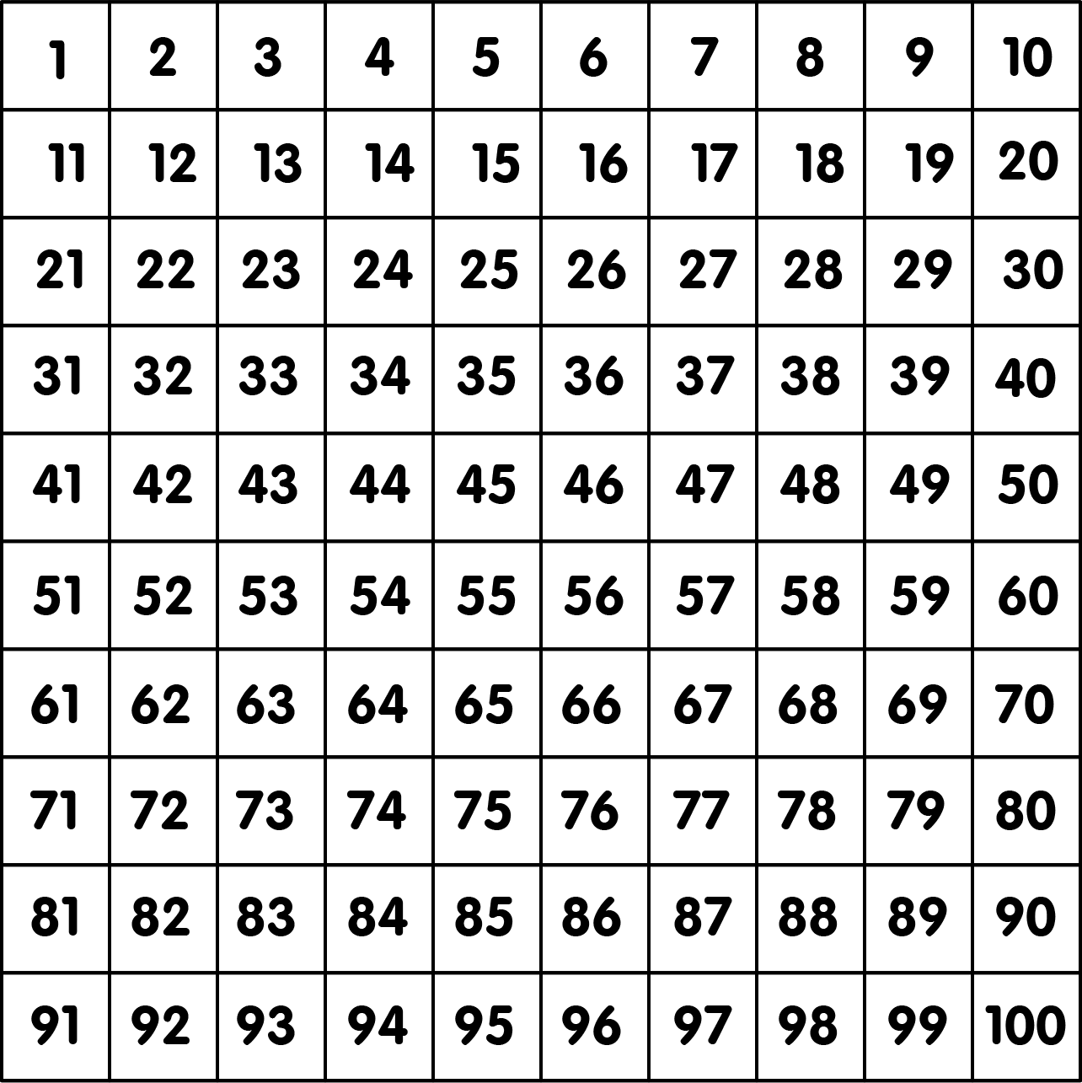
Starter:
Place a counter on all numbers within the 7 times table.
What patterns can you see?
The diagonals to the left – the tens jump in 20. The ones jump in 1s.
The tens have a pattern of 1, 2, 2, 3, 4, 4, 5, 6, 7,7
The ones have a pattern of 7, 4, 1, 8, 5, 2, 9, 6, 3, 0 . The first three add up to 11 (7 + 4 + 1 = 11). The second three add up to 12 (8 + 5 + 2 = 12) and so on.
Answers
Notes:
This starter links back to 6 times tables lesson (lesson 7).
Concrete resources – Hundred square, times table square, counters
Key Questions – What patterns can you see? Can you use any other times tables to help you? What do you notice about the ones/ tens?

Slide 3
Complete the sentences.
3
7
21
There are _____ lots of _____ apples.
There are _____ apples in total.
_____ x _____ = _____
First there were _____ apples.
Then they were shared into groups of _____.
There are _____ groups of _____.
_____ ÷ _____ = _____
21
7
3
7
21
3
7
21
7
3
Answers
Notes:
Concrete resources – Counting objects
Key Questions – How many groups are there? Can you circle the groups? How many are there altogether? Are all the calculations commutative? How do you know? How can we find out how many apples there are? Should add these up 1 by 1? Is there a more efficient method?
Misconceptions/ Common Errors – Pupils may think that division is commutative. Use part whole/bar models to support.

Slide 4
Guided Practice:
Complete the sentences.
4
7
28
There are _____ lots of _____ cupcakes.
There are _____ cupcakes in total.
_____ x _____ = _____
First there were _____ cupcakes.
Then they were shared into groups of _____.
There are _____ groups of _____.
_____ ÷ _____ = _____
28
7
4
7
28
4
7
28
7
4
Answers
Notes:
Concrete resources – Counting objects
Key Questions – How many groups are there? How many cupcakes are in each group? What information does this give you? How can you use this information to help you? Can you solve this calculation any other way? Do you need to count each cupcake?
Misconceptions/ Common Errors – Pupils may think that division is commutative. Use part whole/bar models to support.
Further Practice – Additional representations

Slide 5
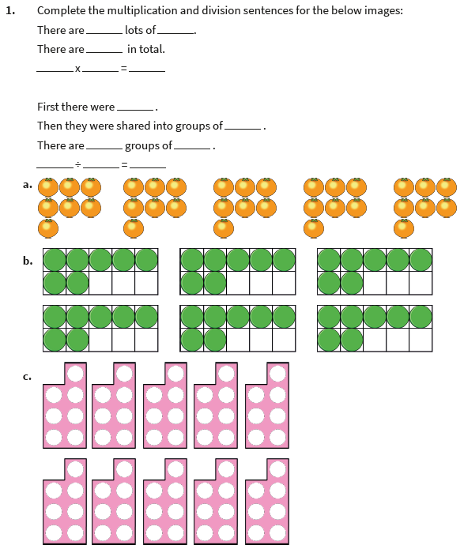
Independent Practice:
Notes:
5, 7, 35 5 x 7 = 35
35, 7, 5, 7 35 ÷ 5 = 7
6, 7, 42 6 x 7 = 42
42, 7, 6, 7 42 ÷ 6 = 7
10, 7, 70 10 x 7 = 70
70, 7, 10, 7 70 ÷ 10 = 7

Slide 6
Guided Practice:
Complete the fact family:
What is the same and what is different about these two representations?
_____ x _____ = _____
_____ ÷ _____ = _____
5 x 7 = 35
35 ÷ 5 = 7
35 = 5 x 7
7 = 35 ÷ 5
_____ x _____ = _____
_____ ÷ _____ = _____
7 x 5 = 35
35 ÷ 7 = 5
35 = 7 x 5
5 = 35 ÷ 7
Answers
Notes:
Concrete resources – Number shapes, place value counters, Base 10
Key Questions – What is a fact family? How many different ways can you write the calculations? Why are there two different representations for the same numbers? What do you notice about the representations?
Misconceptions/ Common Errors – Pupils may think that division is commutative. Use part whole/bar models to support. The use of repeated addition/subtraction could also support this.
Further Practice – Additional representations

Slide 7
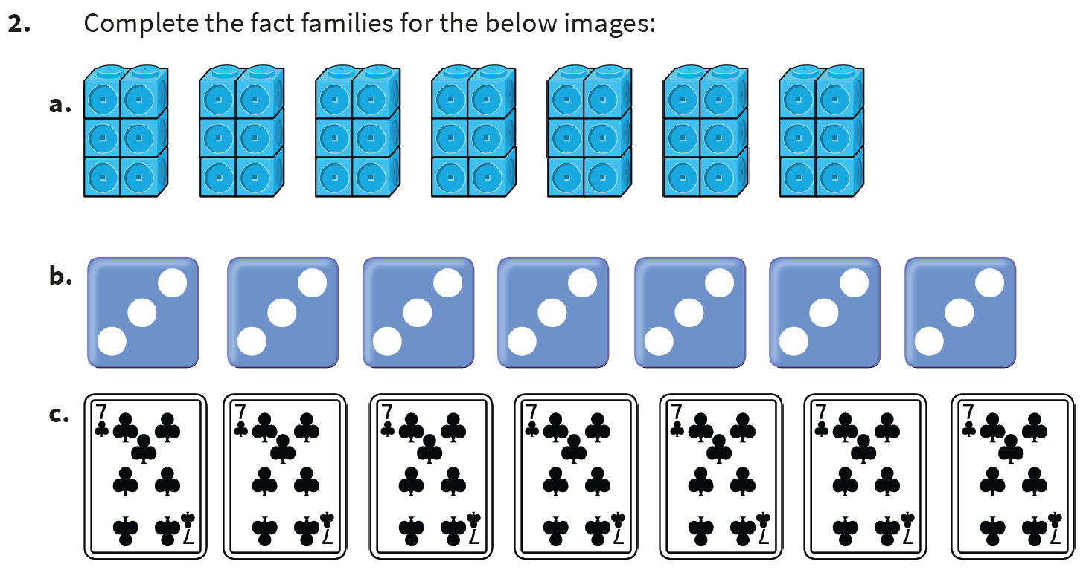
Independent Practice:
Notes:
7 x 6 = 42 42 ÷ 7 = 6 6 lots of 7 cubes 6 x 7 = 42 42 ÷ 6 = 7
7 x 3 = 21 21 ÷ 7 = 3 3 lots of 7 on a dice 3 x 7 = 21 21 ÷ 3 = 7
This is a square number so it only has two fact families. 7 x 7 = 49 49 ÷ 7 = 7

Slide 8
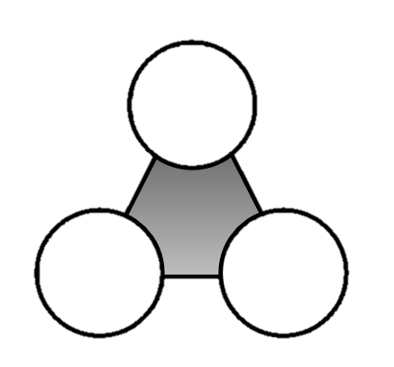
Guided Practice:
Use these numbers to find four multiplication and division facts.
_____ x _____ = _____
_____ x _____ = _____
_____ ÷ _____ = _____
_____ ÷ _____ = _____
7 x 8 = 56
8 x 7 = 56
56 ÷ 8 = 7
56 ÷ 7 = 8
Also:
56 = 7 x 8
56 = 8 x 7
7 = 56 ÷ 8
8 = 56 ÷ 7
56
8
7
Answers
Notes:
Concrete resources – Number shapes, place value counters, Base 10
Key Questions – Which numbers do you have? How can you arrange the numbers in the calculation? Can you check you answer is correct? How do you know? What do you know about multiplication that is different to division?
Misconceptions/ Common Errors – Pupils may think that division is commutative. Use part whole/bar models to support. The use of repeated addition/subtraction could also support this.
Further Practice – Additional representations

Slide 9
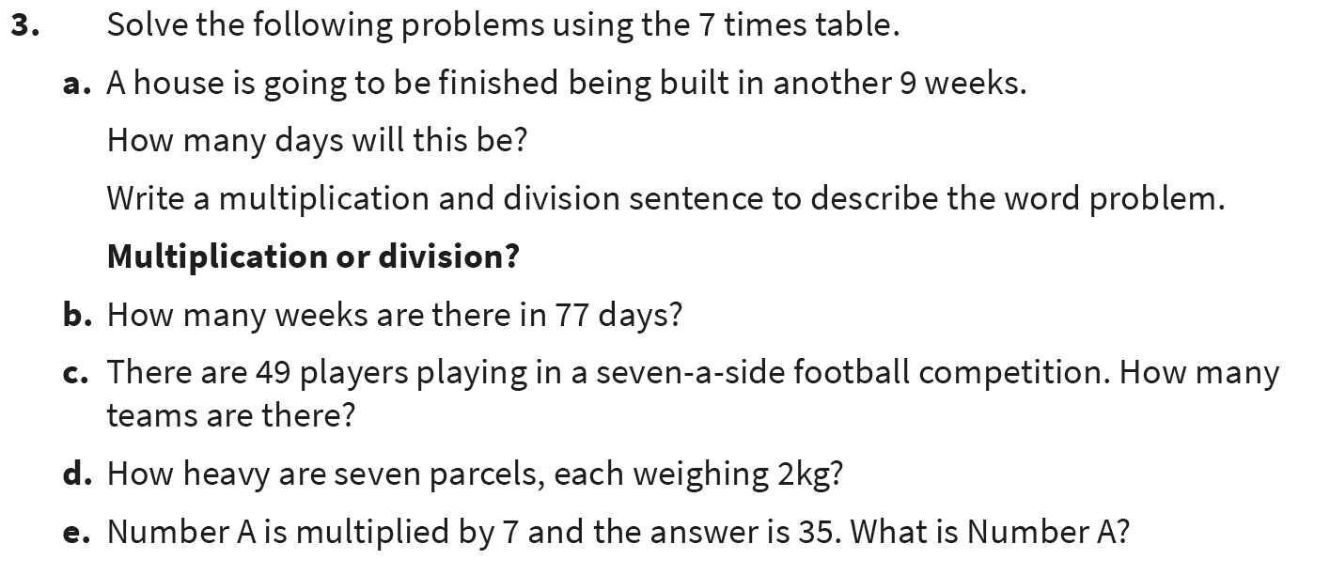
Independent Practice:
Notes:
9 x 7 = 63 63 ÷ 7 = 9 It will take 63 days.
Divide: 77 ÷ 7 = 11 weeks
Divide: 49 ÷ 7 = 7 teams
Multiply: 2 x 7 or 7 x 2 = 14 kg
Divide: 35 ÷ 7 = 5

Slide 10
Let’s Reflect:
Explain how we have used representations and concrete resources to help us multiply by the 7 times table.
What is 12 x 7?
How did you work it out?
Notes:
Concrete resources – Number shapes, place value counters, Base 10
Key Questions – Which representations have been used in the lesson? How could you represent 12 x 7? Can you use the answer to create a fact family? How many ways can you represent the fact family?
Misconceptions/ Common Errors – Pupils may think that division is commutative. Use part whole/bar models to support. The use of repeated addition/subtraction could also support this.

Slide 11
The following slides are based on recapping lesson 7 (multiplying and dividing by 6)

Slide 12
Using the digit cards, how many different calculations can you make?
0
1
2
5
6
x
6
=
Notes:
How and when to use these slides – Some pupils will need to recap and solidify their understanding of the 6 times table before moving on to the 7 times tables. They can use the 6 times tables to help them solve the 7 times tables, but must be secure with these before moving on.
Possible answers: 1 x 6 = 6 etc. Pupils could also try 10 x 6, 12 x 6, 120 x 6 etc. Encourage pupils to use known facts to help them solve calculations.
Concrete resources – Number cards, multiplication grid (if pupils are struggling).
Key Questions – Which digit cards could you use? How can you solve the calculation? Can you use two digit cards? What do you notice? Which known facts can you use to help you?

Slide 13
Ping Pong Game
For this game you will need a partner.
You need to imagine you are playing ping pong with the multiples of 6.
One person starts by saying the first multiple of 6 (6).
The next person replies with the next multiple of 6 (12).
Continue going up in the multiples of 6 until you get to 6 x 12.
If you get to this point without making a mistake, go backwards, starting with 72.
Notes:
How and when to use these slides – Some pupils will need to recap and solidify their understanding of the 6 times table before moving on to the 7 times tables. They can use the 6 times tables to help them solve the 7 times tables, but must be secure with these before moving on.
Key Questions – What are the multiples of 6? Which times tables can help you? What do you notice?
Misconceptions/ Common Errors – Pupils may still not be confident with the 6 times tables. They could write the multiples/ number sentences for the six times tables on a white board/ paper to aid them.
Further Practice – Continue with this game but add the extra rule of if you take too long or make a mistake, you must start again. Add a time limit.

