Slide 1
Let’s make it CLIC
Tuesday, 8th December 2020

Slide 2
CLIC - Counting
I can compare numbers
-2, 1
5, -3
0, -5
-6, 10
Smaller than
Greater than
small
BIG

Slide 3
CLIC - Learn Its
12 x 3 = 36
Year 3, your learn it this week is:
Year 4, your learn it this week is:
Can you spot a link between the learn its?
I’ll put the timer on. How many times in a minute can you write your learn it on your whiteboard?
6 x 6 = 36

Slide 4
CLIC – It’s nothing new
I can double 2-digit numbers.
If I can double 2, I can double 20
Double 2 is ____________, double 20 is ___________________.
If I can double 5, I can double 50
Double 5 is ____________, double 50 is ___________________.
If I can double 8, I can double 80
Double 8 is ____________, double 80 is ___________________.

Slide 5
CLIC – It’s nothing new
I can double 2-digit numbers.
If I can double 3, I can double 30
Double 2 is ____________, double 20 is ___________________.
If I can double 7, I can double 70
Double 5 is ____________, double 70 is ___________________.
If I can double 4, I can double 40
Double 8 is ____________, double 40 is ___________________.

Slide 6
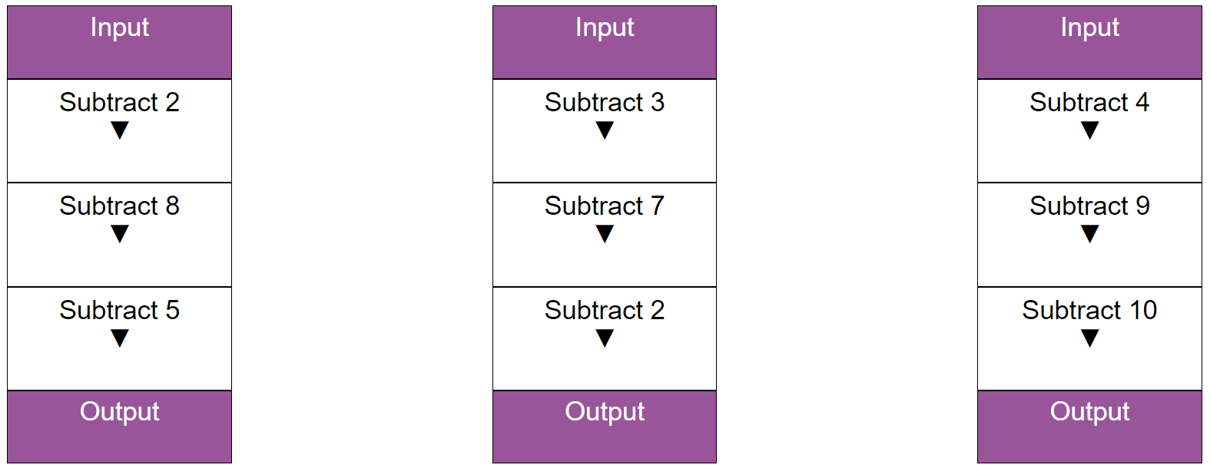
CLIC - Calculations
I can subtract 3 numbers
25
29
37

Slide 7
CLIC - Calculations
I can subtract 3 numbers
25
29
37
10
17
14

Slide 8
Let’s make it CLIC
Wednesday, 9th December 2020

Slide 9
CLIC - Counting
I can compare numbers
37, 73
503, 530
221, 212
81, 83
Smaller than
Greater than
small
BIG

Slide 10
CLIC - Learn Its
12 x 3 = 36
Year 3, your learn it this week is:
Year 4, your learn it this week is:
Hide and seek
Remember to repeat the learn it softly, when far away and louder when getting near.
6 x 6 = 36

Slide 11
CLIC – It’s nothing new
I can double 2-digit numbers.
Double 23
Step 1: partition
Step 2: double the tens
Step 3: double the ones
Step 4: add together
20
3
40
6
46

Slide 12
CLIC – It’s nothing new
I can double 2-digit numbers.
Double 23
Double
12
34
43
25
Step 1: partition
Step 2: double the tens
Step 3: double the ones
Step 4: add together
20
3
40
6
46

Slide 13
CLIC - Calculations
34 – 2 tens
76 – 5 tens
22 – 2 ones
87 – 3 tens and 4 ones
65 – 4 tens and 2 ones
234 – 2 hundreds
706 – 3 hundreds
122 – one hundred and 1 ten
910 – 4 hundreds and 1 ten
452 – 3 tens and 2 ones

Slide 14
Let’s make it CLIC
Thursday, 10th December 2020

Slide 15
CLIC - Counting
I can compare numbers
321, 231
765, 756
478, 482
618, 608
Smaller than
Greater than
small
BIG

Slide 16
CLIC - Learn Its
12 x 3 = 36
Year 3, your learn it this week is:
Year 4, your learn it this week is:
Fact families
Write the fact family for your learn it.
Draw an example to show me what it looks like.
6 x 6 = 36

Slide 17
CLIC – It’s nothing new
I can double 2-digit numbers.
Double 46
Double
37
26
48
65
Step 1: partition
Step 2: double the tens
Step 3: double the ones
Step 4: add together
40
6
80
12
92

Slide 18
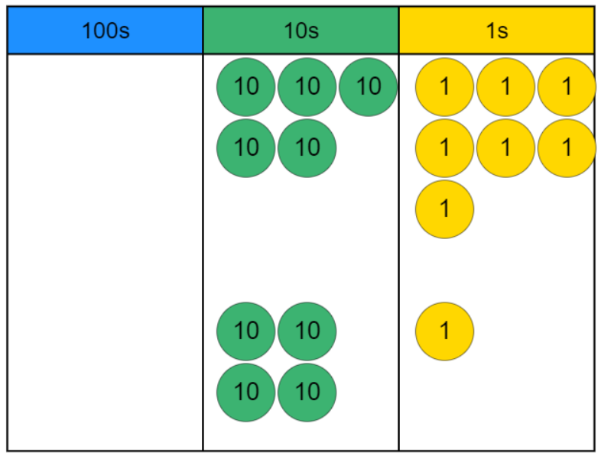
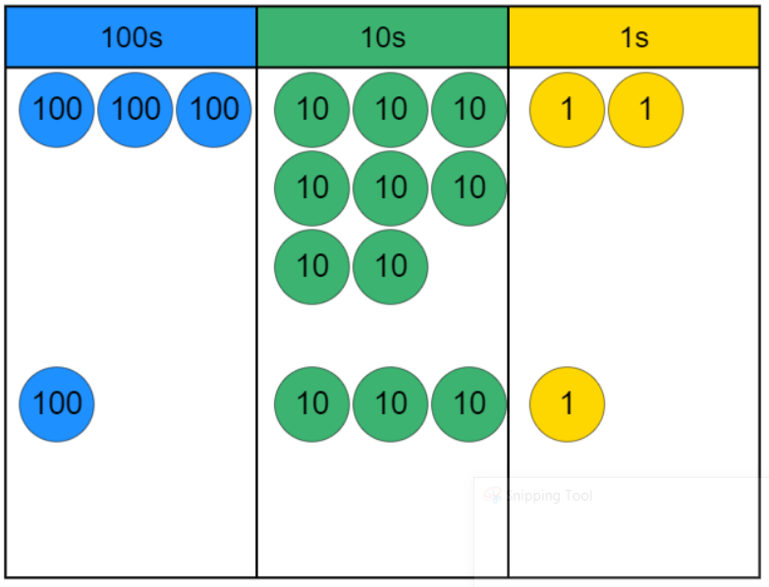
CLIC – Calculations
Year 3: I can subtract two 2-digit numbers
Year 4: I can subtract two 3-digit numbers
-
-

Slide 19
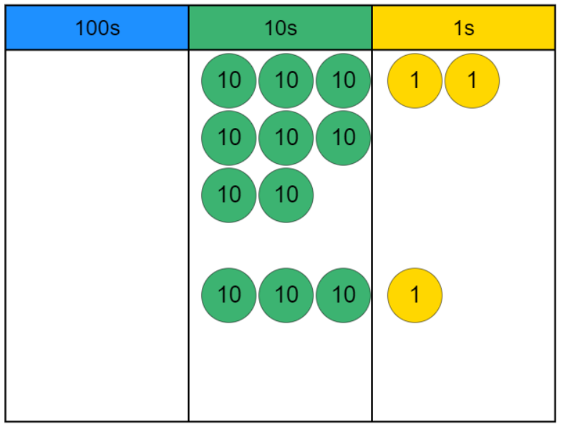
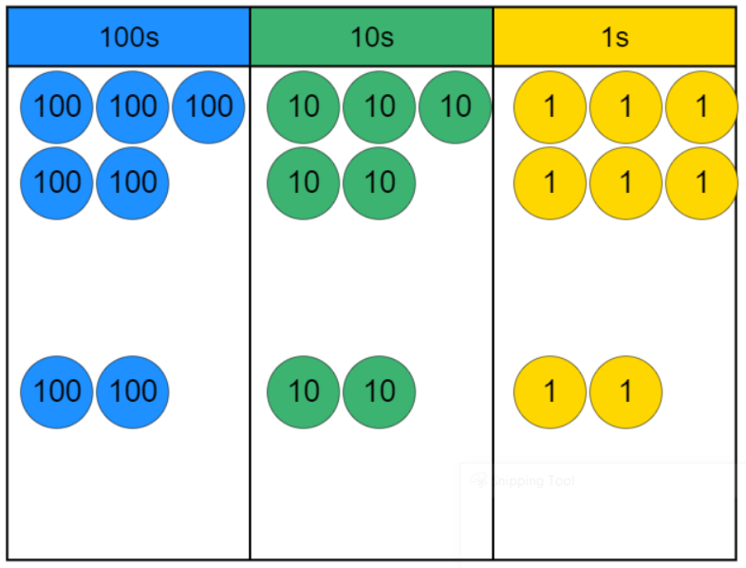
CLIC – Calculations
Year 3: I can subtract two 2-digit numbers
Year 4: I can subtract two 3-digit numbers
-
-

