Slide 1
Can I check answers using the inverse?
Key Vocabulary:
Checking
Reasonable
Inverse
Sentence Stems:
Addition is the inverse of subtraction.
Subtraction is the inverse of addition.

Slide 2
Can I check answers using the inverse?
In focus task
Which calculation would you use to check this calculation?
419 – 156 = 263
263 – 419
419 + 263
263 – 156
263 + 156
Notes:
Assessment point for the lesson – ask the pupils to vote for the answer they think is correct.
A – The pupil does not understand that subtraction is not commutative.
B – The pupil does not understand that this calculation is not a related calculation or the inverse.
C – The pupil does not understand that this calculation is not a related calculation or the inverse.
D – Correct answer
If answers A, B or C are given, pupils may require extra support through small group or 1:1 discussions. There are support slides covering lessons from the previous year group at the end of these slides.

Slide 3
Can I check answers using the inverse?
Steps to success I can explain what the inverse is I can explain how to check calculations I can create related questions

Slide 4
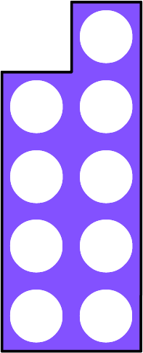
How can we use these resources to check the calculations are right?
9 + 3 = 12
12 – 9 = 3
Notes:
How and when to use these slides – Pupils learn to check calculations in Year 2, addition and subtraction. Some pupils will need to recap this learning before moving on to larger numbers and different methods.
Concrete resources – Encourage pupils to use concrete resources (such as those on the slide) to explore the different ways they can check/ prove the calculations are correct.
Key Questions – How can you use the concrete resources to help you? What do you notice? How else can you check the calculation? Why have I picked these two calculations? How are they related?

Slide 5
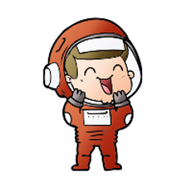
The mathstronaut has written a calculation.
8 + 11 = 19
Which calculation could he use to check his work? Explain your answer.
19 + 11
19 + 8
19 – 11
19 – 8
The mathstronaut could use either 19 – 11 or 19 – 8 to check the calculations as these are inverse calculations.
Answers
Notes:
How and when to use these slides – Pupils learn to check calculations in Year 2, addition and subtraction. Some pupils will need to recap this learning before moving on to larger numbers and different methods.
Concrete resources – Counter, tens frame, number shapes, cubes etc
Key Questions – What do you know about the calculation? How could you check it? Why would 19 + 11 or 8 not be useful for checking the calculation? What is the inverse?
Misconceptions/ Common Errors – Pupils may struggle to understand that there are two calculations they could use. Use concrete resources to help them identify the connection between these calculations.

Slide 6
Starter:
How many ways can you check the answer to this calculation is correct?
Year 3: 54 + 9 = 63
Year 4: 154 + 9 = 163
Notes:
This starter is a recap of Year 2 - check calculations (but with larger numbers).
Pupils could use inverse calculations to check the answer. They could use concrete resources or pictorial representations. They could use estimation from the previous lesson. Discuss the method pupils have use as a class.
Concrete resources – Counters, base 10, tens frame, place value grid etc.
Key Questions – How can you check this calculation? Do you need to use the same operation to check it? How many ways can you show me the answer is correct?

Slide 7
Which operation can we used to check this calculation?
234 + 34 = 268
We can use subtraction to check this calculation.
Subtraction is the inverse of addition.
The inverse means the opposite.
Answers
Notes:
Concrete resources – Base 10, counters, place value grid, blank bar model
Key Questions – What do you know about this calculation? How can you check it? Why is subtraction a good choice to check the answer?
Misconceptions/ Common Errors – Pupils may say you can use addition and complete 34 + 234. While you can complete this, it won’t necessarily check the answer, if someone has made a mistake when adding, they will likely make the same mistake again.
Extension – Write the subtraction calculation(s) that you could use to check.

Slide 8
Guided Practice:
From this bar model, I can make the calculation 451 + 142 = 593.
How can I use the bar model to check my answer?
How many more number sentences can you create using this bar model?
593
142 |  | 451
I can use the bar model to find the inverse.
593 – 451 = 142
593 – 142 = 451
Answers
Notes:
Concrete resources – Base 10, counters, place value grid, blank bar model etc
Key Questions – Why is a bar model useful when checking answers? Why can you use a bar model to make so many different calculations? How can you check your answer using the inverse? Why is it important to check your answer?
Further Practice – Provide pupils with a calculation and a blank bar model to complete. Discuss the benefits of a bar model but also stress the importance of checking, just because you have made a bar model, doesn’t mean it’s right.

Slide 9
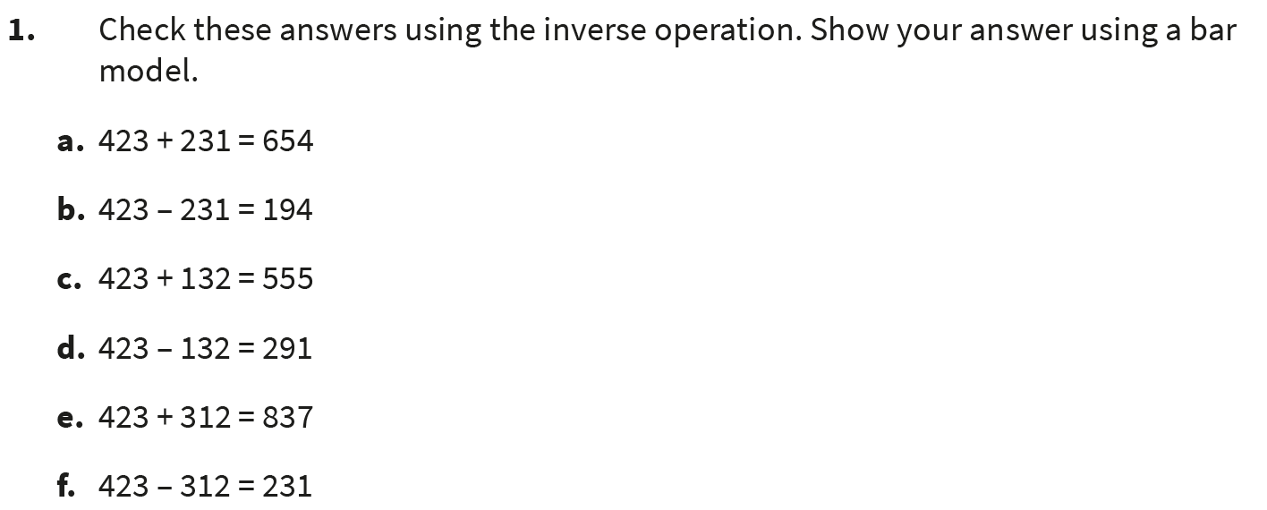
Independent Practice:
Notes:
Correct, subtraction should be used to check
Incorrect, addition should be to check. Correct answer = 423 – 231 = 192
Correct, subtraction should be used to check
Correct, addition should be used to check
Incorrect, subtraction should be to check. Correct answer = 423 + 312 = 735
Incorrect, addition should be to check. Correct answer = 423 – 312 = 111

Slide 10
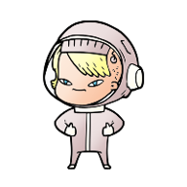
Guided Practice:
321 + 145 = 464
I know I’m right, I checked it using 145 + 321 = 464.
Is the mathstronaut correct?
Explain.
 | H | T | O
 | 3 | 2 | 1
+ | 1 | 4 | 5
 | 4 | 6 | 4
 | H | T | O
 | 1 | 4 | 5
+ | 3 | 2 | 1
 | 4 | 6 | 4
The mathstronaut is wrong. They have completed the calculation incorrectly then made the same mistake when checking their calculation.
Answers
Notes:
Concrete resources – Base 10, counters, place value grid, blank bar model etc
Key Questions – What should the mathstronaut have done? Why were they wrong? Why is it better to complete a different calculation to check you answers?
Misconceptions/ Common Errors – Pupil may not identify the error.
Extension – Prove the mathstronaut is right or wrong using a pictorial representation.

Slide 11
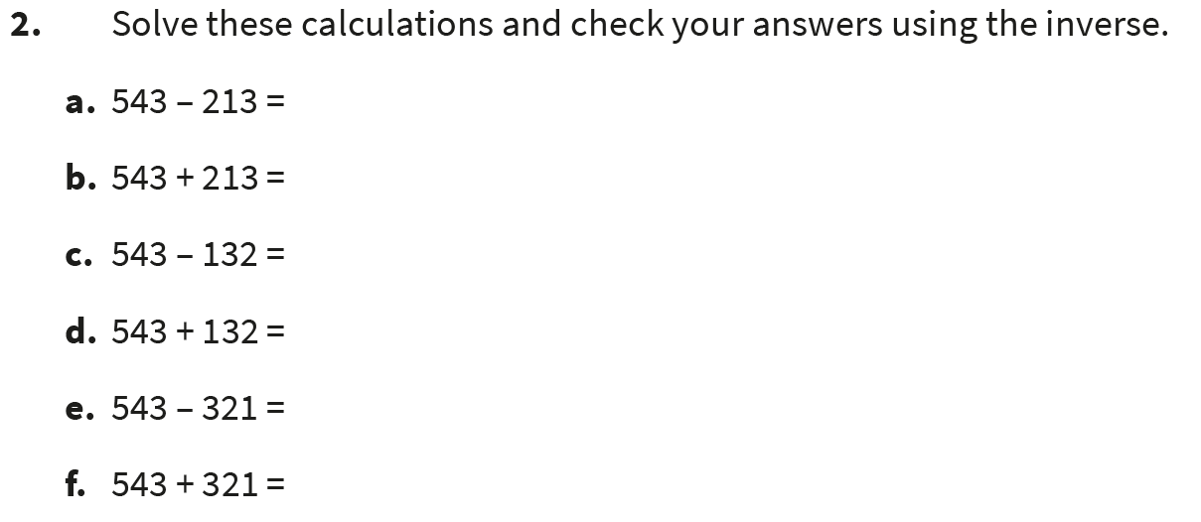
Independent Practice:
Notes:
330
756
411
675
222
864
Answers should be accompanied by appropriate inverse calculations.

Slide 12
Guided Practice:
The mathstronaut wants to use the cards to make as many calculations as possible.
Help them to write as many calculations as possible.
450
390
840
=
+
–
450 + 390 = 840
390 + 450 = 840
840 – 450 = 390
840 – 390 = 450
840 = 450 + 390
840 = 390 + 450
390 = 840 – 450
450 = 840 – 390
Answers
Notes:
Concrete resources – printed cards from this slide
Key Questions – What do you notice about the numbers? How can you place the cards to make calculations? What do you need to remember? What will be the same/ different?
Misconceptions/ Common Errors – Pupils may write (for example) 390 – 840, not realising or remembering that subtraction is not commutative. Pupils may also not identify that they can write calculations with = at the front.

Slide 13
Independent Practice:
Notes:
170 + 580 = 750, 580 + 170 = 750, 750 = 170 + 580, 750 = 580 + 170, 750 – 170 = 580, 750 – 580 = 170, 580 = 750 – 170, 170 = 750 – 580
271 + 356 = 627, 356 + 271 = 627, 627 = 271 + 356, 627 = 356 + 271, 627 – 271 = 356, 627 – 356 = 271, 356 = 627 – 271, 271 = 627 – 356
366 + 153 = 519, 153 + 366 = 519, 627 = 366 + 153, 519 = 153 + 366, 519 – 366 = 153, 519 – 153 = 366, 153 = 519 – 366, 366 = 519 – 153

Slide 14
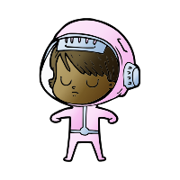
Let’s Reflect:
Is the mathstronaut correct?
Explain.
To check 436 + 191 = 627, I can swap the + for a –
The mathstronaut is incorrect.
436 + 191 is a different calculation to 436 – 191, not the inverse.
Answers
Notes:
Concrete resources – Base 10, counters, place value grid, blank bar model etc
Key Questions – Do you think this is the inverse calculation? Why/ why not? What do you notice about the calculation the mathstronaut is suggesting? How would you check the calculation?

