Slide 1
PSHE
Dealing with disappointments

Slide 2
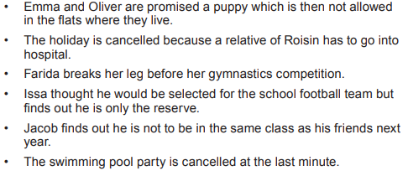
When hopes and dreams go wrong
Look at these scenarios of hopes and dream going wrong. How do you imagine these people feel? What would they do next?

Slide 3
Advise
Choose one of the scenarios from the previous slide. Write some advise.
How could these people overcome their disappointment?

Slide 4
Reflect
Think of a time when you felt disappointed or let down.
How did you cope with that situation?
Finish these sentences
A broken dream can feel …..
One thing I can do when I feel upset or hurt is …..

Slide 5
Final thought

