Slide 1
Can I subtract lengths?
Year 3 Thursday 4th February 2021

Slide 2
Watch the video
https://vimeo.com/427994372
Now complete the questions on the next slides

Slide 4
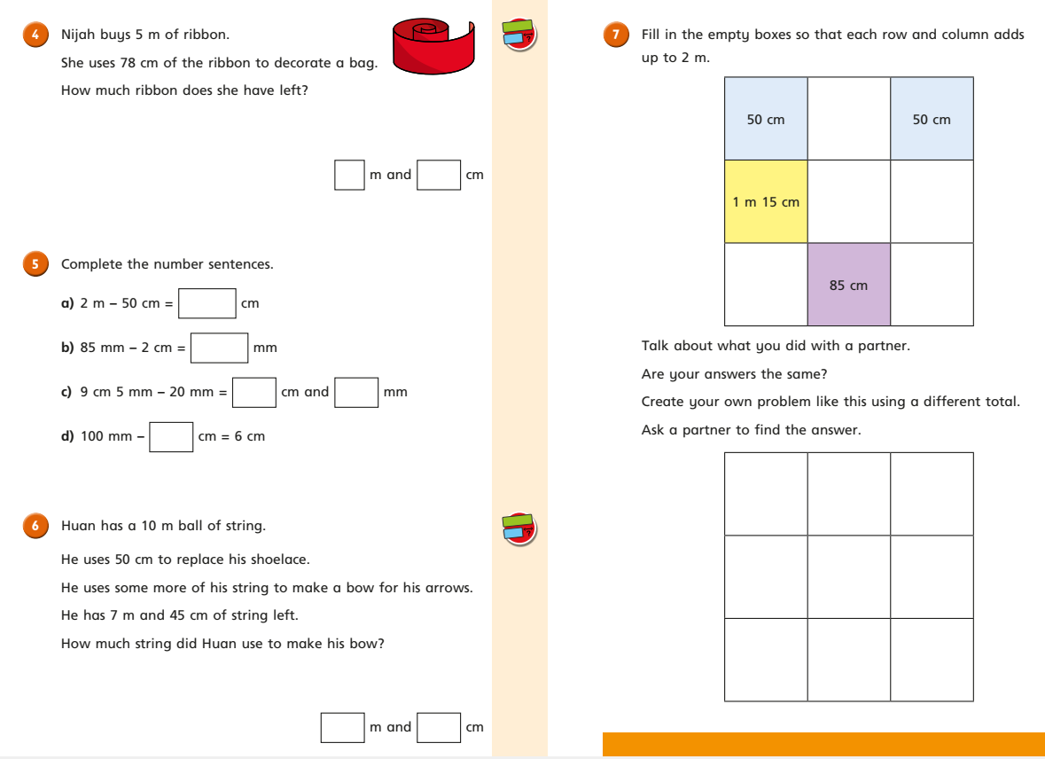

Slide 6
Answer sheets
Please check your answers using the answer sheets on the next slide.
If you have made a mistake, can you explain what you did wrong and what you should have done instead?

