Slide 1
Can I convert between 24 hour analogue and digital clocks?
Use this game to help you:
https://www.topmarks.co.uk/time/teaching-clock

Slide 2
Starter:
Investigate on a 12 hour digital clock: over 12 hours, how many
times does the digit 5 appear?

Slide 3
Starter:
Investigate on a 12 hour digital clock, over 12 hours, how many
times does the digit 5 appear?
144 times.
During the hour of 5am or 5pm there are 67 in total.
05:00, 05:01…….., 05:05………05:15…….
7 times in every other hour
00:05, 00:15, 00:25, 00:35, 00:45, 00:55

Slide 4
Talking time:
12 hour clock time
24 hour clock time
What do you notice?
What is the same and what is different about the 12 hour and the 24 hour clock times?

Slide 5
Talking time:
24 hour clock time
Use the 24 hour clock times in digital format. What would these times be?
1pm (one o’clock in the afternoon)
9 o’clock in the morning (9am)
Midnight (middle of the night)
Half past 7 in the evening (07:30pm)
11:15pm (quarter past 11 at night)

Slide 6
Talking time:
24 hour clock time
Use the 24 hour clock times in digital format. What would these times be?
1pm (one o’clock in the afternoon) 13:00
9 o’clock in the morning (9am) 09:00
Midnight (middle of the night) 24:00 or 00:00
Half past 7 in the evening (07:30pm) 19:30
11:15pm (quarter past 11 at night) 23:15

Slide 7
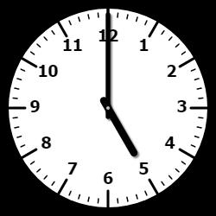
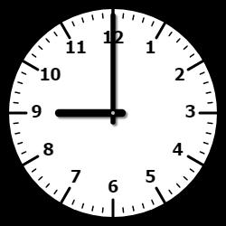
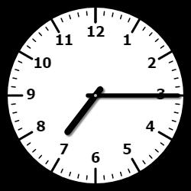
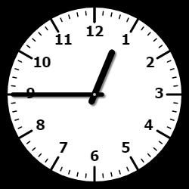
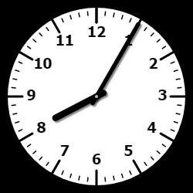
Activity 1:
Write the times shown in the 24 hour clock time (digital format)
a. b. c.
evening morning evening
d. e. f.
afternoon morning evening

Slide 8
Activity 1:
Write the times shown in the 24 hour clock time (digital format)
a. b. c.
17:00 09:00 19:15
d. e. f.
12:45 03:20 20:05

Slide 9
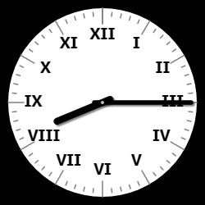
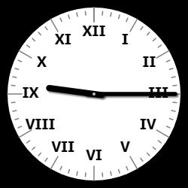
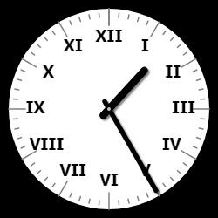
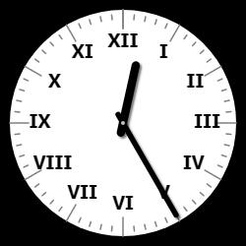
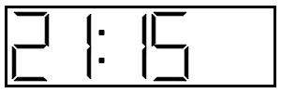
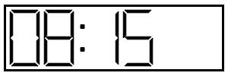
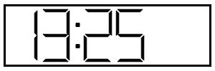
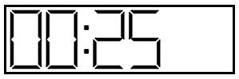
Activity 2:
Match the analogue and digital times.
am pm pm am

Slide 10
Activity 2:
Match the analogue and digital times.
am pm pm am

Slide 11
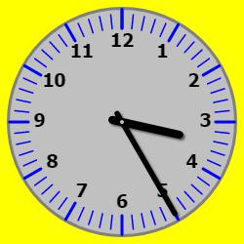
Talking time:
Helen leaves school at the time shown.
She arrives at the football ground 50
minutes later and has 1 hour of training.
She arrives home 35 minutes later.
Show what time Helen gets home in
24 hour digital format.

Slide 12
Talking time:
Helen leaves school at the time shown.
She arrives at the football ground 50
minutes later and has 1 hour of training.
She arrives home 35 minutes later.
Show what time Helen gets home in
24 hour digital format.
17:50
50 minutes later than 15:25 is 16:15.
I hour training takes us to 17:15.
35 minutes later than 17:15 is 17:50.

Slide 13
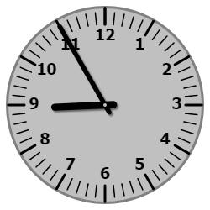
Activity 3:
Tommy arrives at school at the time shown.
He has registration for 25 minutes followed
by a maths lesson lasting 1 hour and 10
minutes. Assembly is next which lasts for
15minutes. After assembly is break time.
Show what time Tommy has break in 24
hour clock time.
If on Wednesday Tommy arrived 17 minutes later than usual, what time did he arrive at school and how long would he be in registration for?

Slide 14
Activity 3:
Tommy arrives at school at the time shown.
He has registration for 25 minutes followed
by a maths lesson lasting 1 hour and 10
minutes. Assembly is next which lasts for
15minutes. After assembly is break time.
Show what time Tommy has break in 24
hour clock time.
10:45
He arrives at 08:55, 25 minutes later is the end of registration at 09:20. Then maths lasts until 10:30 followed by another 15 minutes for assembly taking us to 10:45 the start of Break Time.
If on Wednesday Tommy arrived 17 minutes later than usual, what time did he arrive at school and how long would he be in registration for? 09:12 8 minutes of registration.

Slide 15
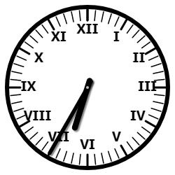
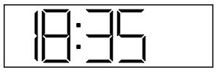
Talking time:
What is the quickest way to convert a digital 24 hour clock time to an analogue clock?

Slide 16
Talking time:
What is the quickest way to convert a digital 24 hour clock time to an analogue clock?
Subtract 12 hours from the 24 hour digital display.
18 – 12 = 6 so the hour hand on the analogue clock is in the 6pm section.

Slide 17
Activity 4:
Convert the times on these digital displays to times on analogue clocks.
18:00
19:45
02:15
06:20
21:12
23:56
00:04

Slide 18
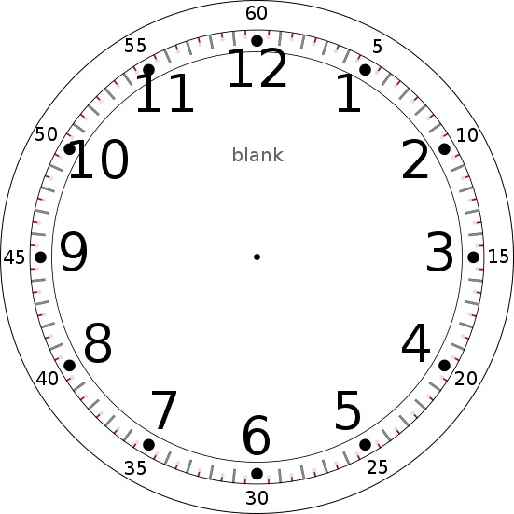
Activity 4:
Convert the times on these digital displays to times on analogue clocks.
18:00
19:45
02:15
06:20
21:12
23:56
00:04

Slide 19
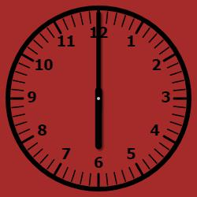
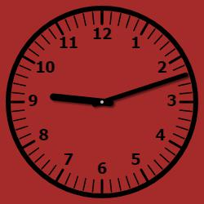
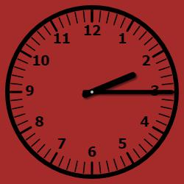
Activity 4:
Convert the times on these digital displays to times on analogue clocks.
18:00 06:20
19:45 21:12
02:15 23:56 00:04

Slide 20
Activity 5:
Harry says,
True or false? Explain your thinking.
To change afternoon and evening times from 12 hour clock to 24 hour clock in the digital format, you just add a ten and two ones to the 12 hour clock number.

Slide 21
Activity 5:
Harry says,
True or false? Explain your thinking.
True – Adding 12 comes from the fact that we are changing from 12 hour clock to 24 hour clock which is double 12 therefore we add 12 hours to the hour time
e.g. 3pm = 15:00 (3 + 12 = 15)
To change afternoon and evening times from 12 hour clock to 24 hour clock in the digital format, you just add a ten and two ones to the 12 hour clock number.

Slide 22
Evaluation:
Three children are meeting at their local leisure centre.
Hollie says,
Neil says,
Joshua says,
Will all the children meet at the same time?
Convince me.
We are meeting at 15:20.
We are meeting at 03:20pm.
We are meeting at twenty to three.

Slide 23
Evaluation:
Three children are meeting at their local leisure centre.
Hollie says,
Neil says,
Joshua says,
Will all the children meet at the same time? NO
Convince me. Hollie and Neil will be there at the same time as they both have the same time – Hollie’s is in 24 hour clock and Neil’s is in 12 hour clock. Joshua won’t be there as the time should be twenty past three not twenty to three.
We are meeting at 15:20.
We are meeting at 03:20pm.
We are meeting at twenty to three.

