Slide 1
Starter:
Success Criteria: I can calculate the perimeter of simple 2D shapes I know there are different ways of calculating the perimeter, depending on the shape
Which one is different?
The length of a fence that goes all the way around a park
The distance Georgia runs when she runs once around a running track.
The height of an apple tree.
The distance around a maths book.
The length of the white line that is painted around the outside of a football pitch.

Slide 2
Starter:
Success Criteria: I can calculate the perimeter of simple 2D shapes I know there are different ways of calculating the perimeter, depending on the shape
Which one is different?
The length of a fence that goes all the way around a park
The distance Georgia runs when she runs once around a running track.
The odd one out is the height of an apple tree.
All the other measurements are examples of perimeter – the distance around the outside of a shape.
The height of an apple tree.
The distance around a maths book.
The length of the white line that is painted around the outside of a football pitch.

Slide 3
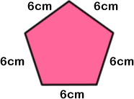
Talking time:
How would you calculate the perimeter of this shape?

Slide 4
Talking time:
How would you calculate the perimeter of this shape?
A pentagon has five sides and this one has sides that are all 6cm long.
To find the perimeter, we could add 6cm five times: 6 + 6 + 6 + 6 + 6
…or multiply 6cm by five: 6 x 5
The perimeter is 30cm.

Slide 5
Talking time:
How would you calculate the perimeter of this swimming pool?

Slide 6
Talking time:
How would you calculate the perimeter of this swimming pool?
Rectangles have two pairs of sides that are the same length, so we can add the side lengths in different ways:
Two lots of 60 + 10 Two lots of 60 + Two lots of 10
= Two lots of 70 = 120 + 20
= 2 x 70 = 140
= 140 The perimeter of the pool is 140 m.

Slide 7
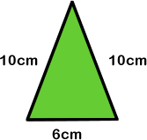
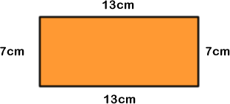
Activity 1:
Calculate the perimeters of each of these shapes.

Slide 8
Activity 1:
Calculate the perimeters of each of these shapes.
10 + 10 + 6
= 26cm
13 + 13 + 7 + 7
= 40cm
5 + 5 + 2 + 2 + 7 + 7 + 5
= 33cm

Slide 9
Talking time:
Describe two ways to calculate the perimeter of this square.

Slide 10
Talking time:
Describe two ways to calculate the perimeter of this square.
The sides of a square are all the same length, so we can calculate:
10 + 10 + 10 + 10 or 4 x 10
= 40 cm = 40 cm

Slide 11
Activity 2:
Use addition (or multiplication where you can) to find the
perimeter of these shapes.

Slide 12
Activity 2:
Use addition (or multiplication where you can) to find the
perimeter of these shapes.
15 cm x 2 = 30 cm
3cm x 2 = 6cm
30 cm + 6cm = 36cm
9cm x 4 = 36 cm
4cm x 6 = 24 cm

Slide 13
Talking time:
What is the length of the missing side?
How do you know?

Slide 14
Talking time:
What is the length of the missing side?
How do you know?
We know that the opposite side to
the 9cm side is also 9cm.
Both of these sides total 18cm.
This means that if we subtract 18cm from the perimeter we will be left with the total of the other two sides. 26 – 18 = 8cm, so both sides equal 8cm in total.
If we then divide 8 by 2, we get the length
of one of the unknown sides. 8 ÷ 2 = 4cm,
so the missing side is 4cm in length.

Slide 15
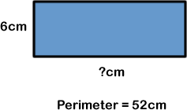
Activity 3:
What is the length of the missing side?

Slide 16
Activity 3:
What is the length of the missing side?
52 – (6 + 6)
= 52 – 12
= 40
40 ÷ 2
= 20
So the length of the missing side is 20cm

Slide 17
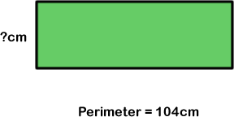
Activity 4:
What is the length of the missing side?

Slide 18
Activity 4:
What is the length of the missing side?
This is a bit of a trick question – but one with a helpful reason behind it.
To calculate the length of a missing side here, we need to know the perimeter (which is given) and one of the other side lengths. Unfortunately, we aren’t given any of the side lengths at all and so we can’t calculate the missing side length as we do not have enough information! By being given trick questions like this, it should help you to think through what you need to be able to calculate an answer rather than just thinking you can automatically find the answer, just because someone has asked you a question!

Slide 19
Activity 5:
Draw two shapes that you only need to know one side length of to be able to calculate their perimeter.
Draw two shapes that you only need to know two side lengths
of to be able to calculate their perimeter.

Slide 20
Activity 5:
Draw two shapes that you only need to know one side length of to be able to calculate their perimeter.
Any two regular shapes (shapes where all the sides are the same length). For example:
Draw two shapes that you only need to know two side lengths
of to be able to calculate their perimeter.
Any two shapes with only two different side lengths.
For example:
Extension
What other shapes can you think of to answer these questions? There are more to find if you can think of them.
[A CLUE: try making shapes made out of several squares and think about which two sides you need to know to find the perimeter]

Slide 21
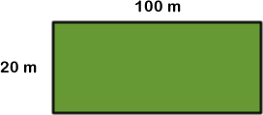
Evaluation:
Success Criteria: I can calculate the perimeter of simple 2D shapes I know there are different ways of calculating the perimeter, depending on the shape
True or False?
If a square has a side length of 2cm, it must have a
perimeter of 8cm.
A rectangle needs to have all four sides labelled for us
to find its perimeter.
The perimeter of this field is 120 m.
These three shapes all have the
same perimeter.

Slide 22
Evaluation:
Success Criteria: I can calculate the perimeter of simple 2D shapes I know there are different ways of calculating the perimeter, depending on the shape
True or False?
If a square has a side length of 2cm, it must have a
perimeter of 8cm. TRUE
A rectangle needs to have all four sides labelled for us
to find its perimeter. FALSE
The perimeter of this field is 120 m.
FALSE
These three shapes all have the
same perimeter. TRUE

