Slide 1
Cinquain poems

Slide 2
Can I discuss form and structure of a cinquain poem?
Steps to success:
I can explain what a cinquain poem is, using word classes and syllables
I can give my opinion about different poems
I can discuss the poet’s voice

Slide 3
Cinquain 1
Snowfall
White, very cold
Falling, settling, drifting
Sloping gently up by the fence
Blizzard

Slide 4
Cinquain 2
Flowers
Colourful, flagrant
Swaying, growing, blooming
I smile and am feeling happy
Blossom

Slide 5
Comparing the poems
Read both poems
What do you think a cinquain poem is?
Look at what both poems have in common. What is the same?
Look at the structure and the words.
Write a list of things that are the same.

Slide 6
A cinquain poem has this structure
2 syllables
4 syllables
6 syllables
8 syllables
2 syllables
Flowers
Colourful, flagrant
Swaying, growing, blooming
I smile and am feeling happy
Blossom

Slide 7
A cinquain poem has this form
Flowers
Colourful, flagrant
Swaying, growing, blooming
Make me feel happy
Blossom
2 syllables – subject (noun)
4 syllables – describing the subject with adjectives
6 syllables – action of subject (verbs)
8 syllables – feeling about a subject
2 syllables – another name for the subject (noun)

Slide 8
Is this a cinquain?
Castle Strong, beautiful Imposing, protecting, watching Symbolizes wealth and power Fortress

Slide 9
Is this a cinquain?
Castle
Strong, beautiful
Imposing, protecting, watching
Symbolizes wealth and power
Fortress
Even though it doesn’t follow the structure completely, it is still a cinquain.
noun, 2 syllables
adjectives, 4 syllables
Verbs, 8 syllables
Opinion, 9 syllables
Synonym, noun 2 syllables

Slide 10
Is this a cinquain?
Castle
Strong, beautiful
Imposing, protecting, watching
Symbolizes wealth and power
Fortress
noun, 1 word
adjectives, 2 words
verbs, 3 –ing verbs
feelings or thoughts
synonym, 1 word
Notes:
Differentiation: alternative provision do not have to count syllables, they can count words.

Slide 11
Is this a cinquain?
Computer Fun, new Forgot, can’t login I want to play a game Help me

Slide 12
Is this a cinquain?
Computer
Fun, new
Forgot, can’t login
I want to play a game
Help me
It follows the structure and form a little, but not enough. This is not a cinquain.
noun, 3 syllables
adjectives, 2 syllables
Verbs, 5 syllables
Feeling, 6 syllables
Not a synonym, 2 syllables

Slide 13
Your task
Read
Read the cinquain poems on the sheet.
Write
Write what the poet is thinking about the subject (this is called poet’s voice) for each poem.
Choose
Choose your favourite cinquain
Copy
Copy it in your book
Explain
Explain why you like it best.

Slide 14
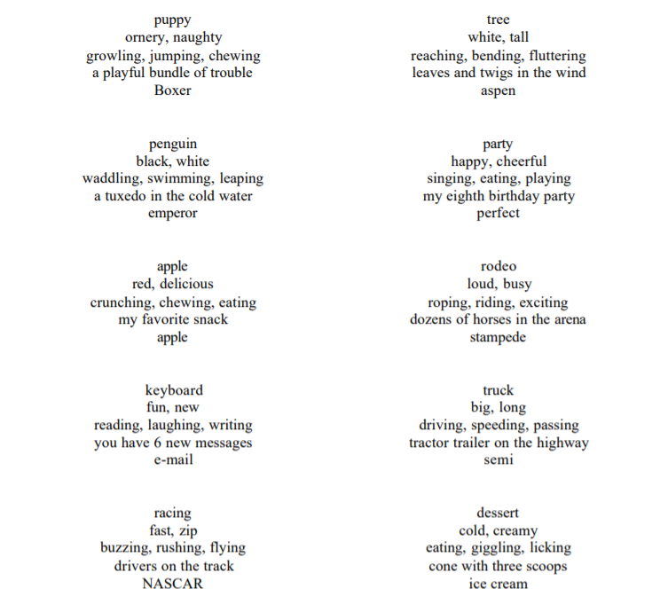

Slide 15
Brainstorm
Choose a noun
Describe it with adjectives
Describe it with verbs
How do you feel about the noun?
Find a synonym in the thesaurus

Slide 16
Can I write a cinquain?
Count the syllables
Do you need to add another adjective or verb?
Do you need to replace a word?
2 syllables
4 syllables
6 syllables
8 syllables
2 syllables
Flowers
Colourful, flagrant
Swaying, growing, blooming
Make me feel happy
Blossom

