Slide 1
Year 3
L.I – Can I use grams and kilograms to measure mass?
Steps to success
I can understand the mass can be measured in grams.
I can use g to represent grams and kg to represent kilos.
I can measure using a scale.
Challenge: Convince me
Year 4
L.I. – Can I compare decimal numbers?
Steps to success
I can use a place value grid.
I can represent each number on a place value grid.
I can understand the decimal point in a decimal number.
Challenge: True or false

Slide 2
In Focus Task
Year 3: Find three objects and get as close to 1kg as you can
Year 4: What is the value of the underlined digit?

Slide 3
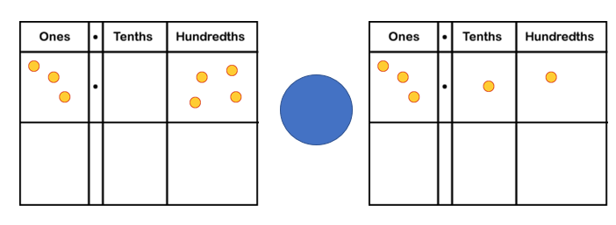
Talk Task
Year 3
Doug says, “There are 1000g in a kilo.” Is he correct?
Year 4
Compare the numbers using <, > or =

Slide 4
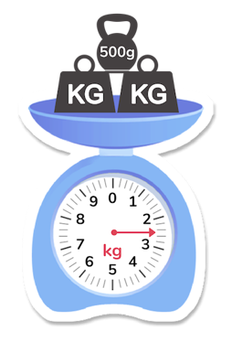
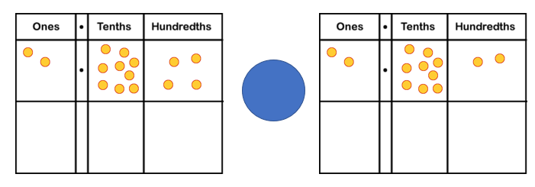
New Learning
Year 3
How much weight is on the scales?
How do you know?
Year 4
Compare the numbers using <, > or =

Slide 5
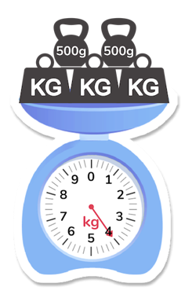
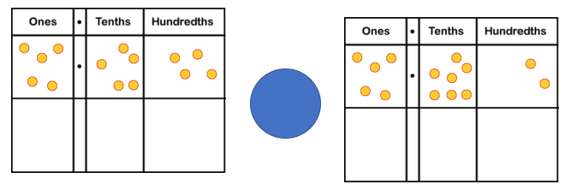
New Learning
Year 3
How much weight is on the scales?
How do you know?
Year 4
Compare the numbers using <, > or =

Slide 6
Develop Learning
Year 3
We are going to use balance scales to weigh some items. Let me show you how.
How can we make this statement true?
Year 4

Slide 7
Develop Learning
Year 3
Work in groups of two or three to weigh some items using the balance scales.
Year 4
Compare the numbers using <, > or =

Slide 8
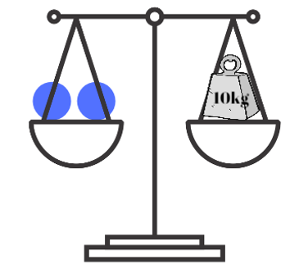
Develop Learning
Year 3
Calculate the weight of the circles on the balance scale.
Year 4
What could be the missing digit?

Slide 9
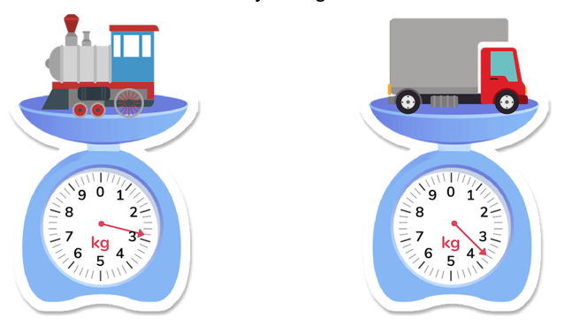
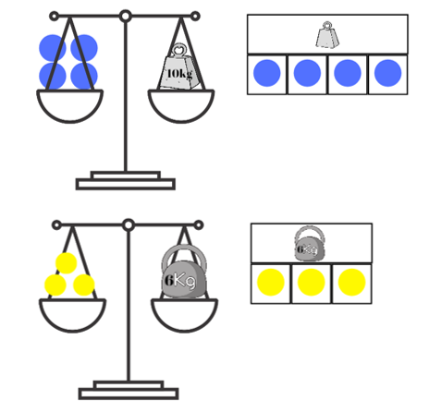
Independent Task
Year 3
How much do these toys weigh?
Calculate the weight of the circles on the balanced scales.

Slide 10
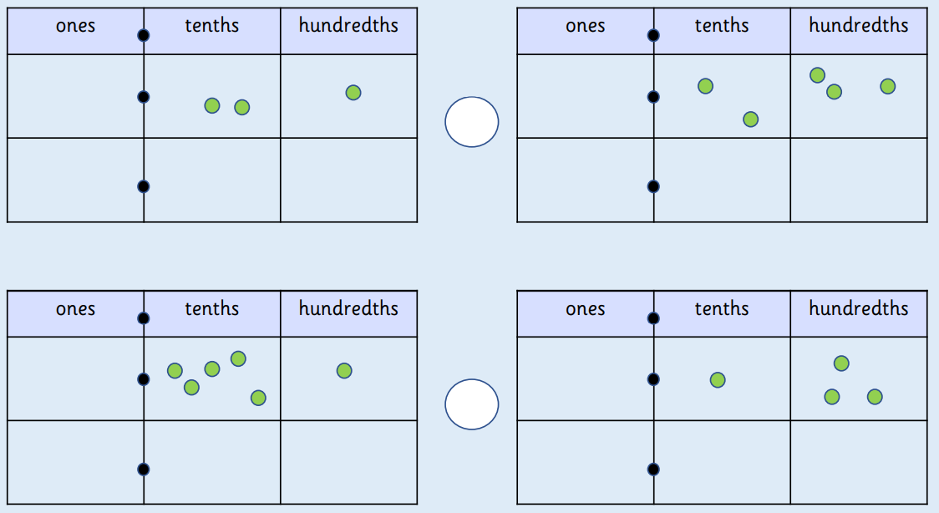
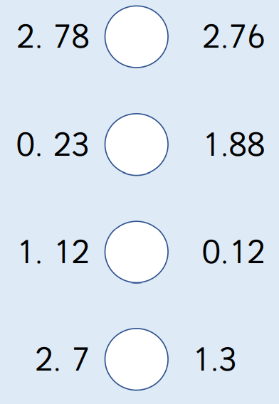
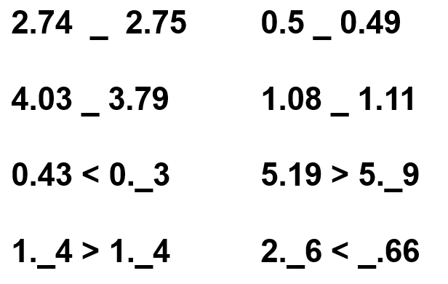
Independent Task
Year 4
Compare the numbers, using <, >, =.
Fill in the blanks. There could be more than one possibility.

Slide 11
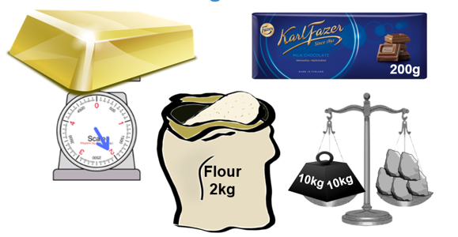
Plenary
Year 3
Year 4
Which is the odd one out?
True or false:
0.12 > 0.21

