Slide 1
The Water Cycle
Explanation Text
Friday 11 June 2021

Slide 2
LI: Can I draft and write an explanation text?
Explanation Text
Steps to success:
I can use scientific language
I can use interesting adjectives
I can use precise verbs

Slide 3
Precipitation
Step sentence.
Copy this sentence in your book to link the paragraph about precipitation with the previous paragraph about condensation.
Look, there’s some more water droplets from another group. Let’s join them and make a really big cloud.

Slide 4
Precipitation
What is precipitation again?
Watch this video and take notes.
Write your notes in the first box.
We will use them to write a scientific explanation using key science words.
1

Slide 5
Precipitation
Tell each other in your own words, using your notes, what precipitation is and why it happens.

Slide 6
Precipitation
Model sentence:
When too much water has condensed, the water droplets in the clouds become too heavy so we fall back to the ground as rain, snow, hail, pelt or sleet. This is called precipitation.
Your task:
Write your own explanation of precipitation starting with when to build a complex sentence.
Deepen the moment:

Slide 7
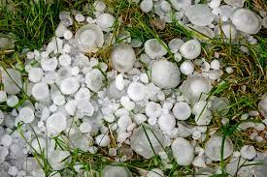
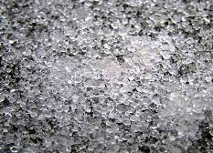
Precipitation
What do hail, snow, rain and sleet look like?
Use the noticing lens to find descriptive words.
Write them in the middle four boxes. You can label each box with a form of precipitation.
hail
sleet

Slide 8
Precipitation
Here are some of my ideas:
Sleet: minute ice pellets, globular, transparent
Hail: frozen ice balls or irregular lumps, solid
Snow: lightweight crystals, delicate
Rain: water droplets, liquid

Slide 9
Precipitation
Model sentence:
Choose what you want to be. Costumes are under your seats. Wow, you make a splashing smashing rain drop.
Your task:
Instruct the visitors to prepare to descend and to choose what they would like to be (rain? hail? etc.). End with a compliment to how one of your visitors are dressed.
Deepen the moment: use alliteration

Slide 10
Precipitation
How and where will precipitation fall to earth?
Write your ideas in the last box.
6.

Slide 11
Precipitation
Here are some of my ideas:
pool in puddles
pour into pools
drench the earth
saturating downpour
drizzle in droves
hail in hoards
tumble into tides
splash into seas
6.

Slide 12
Precipitation
Model sentence:
Okay, 1,2,3… spill into puddles or pools, hail a storm or snow like a Christmas card. Bombs away!
Your task:
Directly address the visitor and describe using specific verbs how to travel down to earth.
Deepen the moment: use alliteration or an informal colloquial expression to signal the start of the action.

Slide 13
Share and feedback
Share your work
What sentence are your proud of?
What does the class think of the work?
How could we make it even better?

