Slide 1
Year 3 & 4
L.I - Can I convert money in pounds and pence?
Steps to success
- I can identify the value of the notes and coins.
I can convert pounds and pence into pence
Challenge: True or false?
Alternative provision
L.I - Can I recognise the symbols of £ and pence and combine amounts to make a total?
Steps to success
- I can identify the value of the notes and coins.
- I can use the value of notes and coins to calculate totals.
-Challenge: True or false?

Slide 2
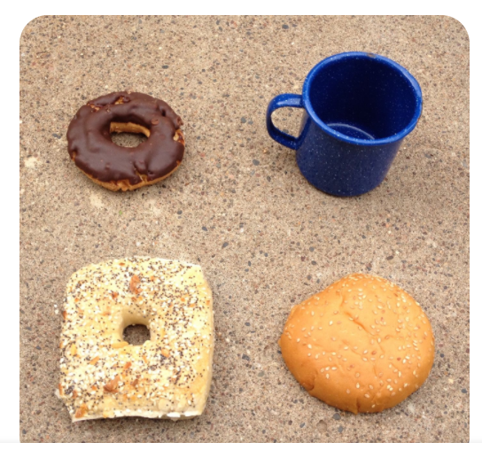
Which one doesn't belong?

Slide 4
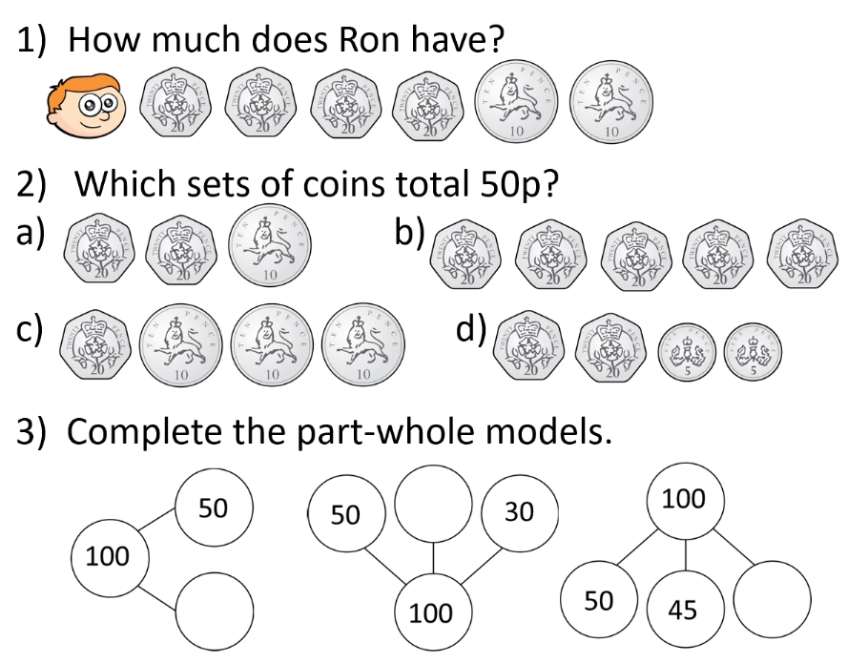
In Focus Task
Year 3 & 4
Can you draw part whole models to show 200 pence?

Slide 5
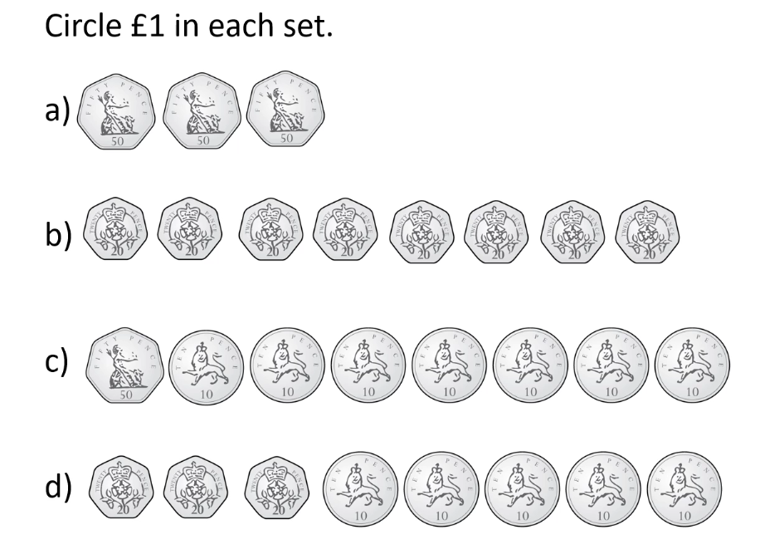
Talk Task

Slide 6
Develop Learning
What do we need to add to each set of coins to make 100p?

Slide 7
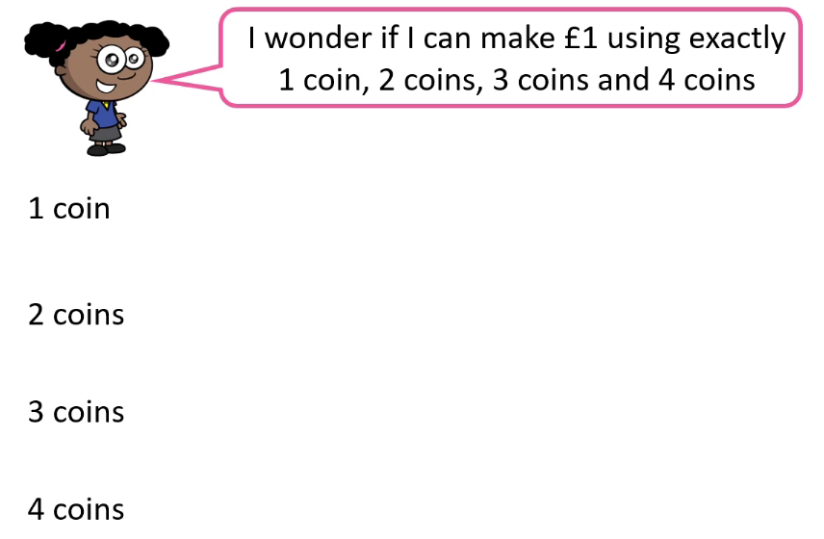
Develop Learning
Year 3 & 4
Can you make £1 with 5 coins or 6 coins?

Slide 8
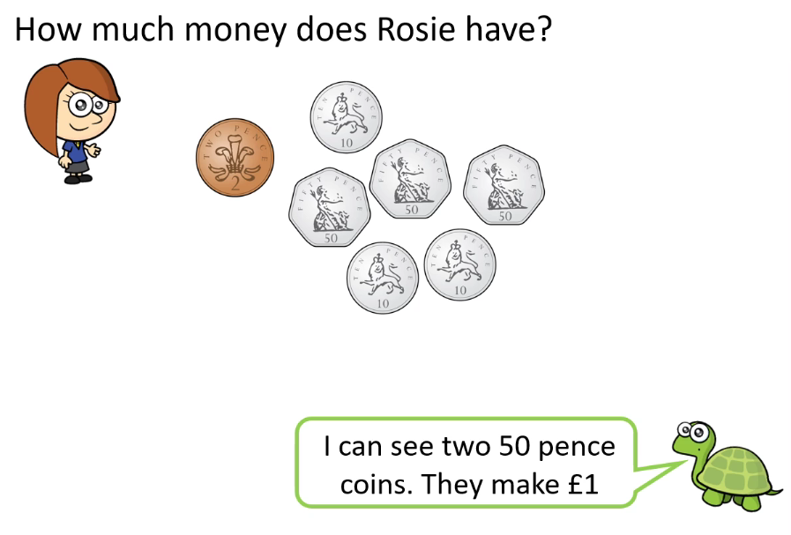
Develop Learning
Next rearrange the rest of the coins in an order that makes them easy to count.

Slide 9
Develop Learning
Now all try this one
Remember to sort the money into order starting with the largest amount first.

Slide 10
Develop Learning

Slide 11
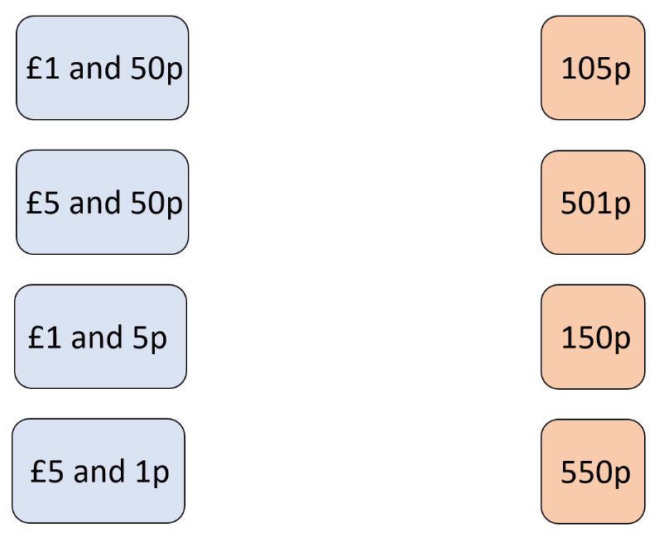
Develop Learning
Here we have some amounts of money in the blue boxes in pounds and pence. In the pink boxes there are some amounts in pence.
Can you match the amounts?

Slide 12
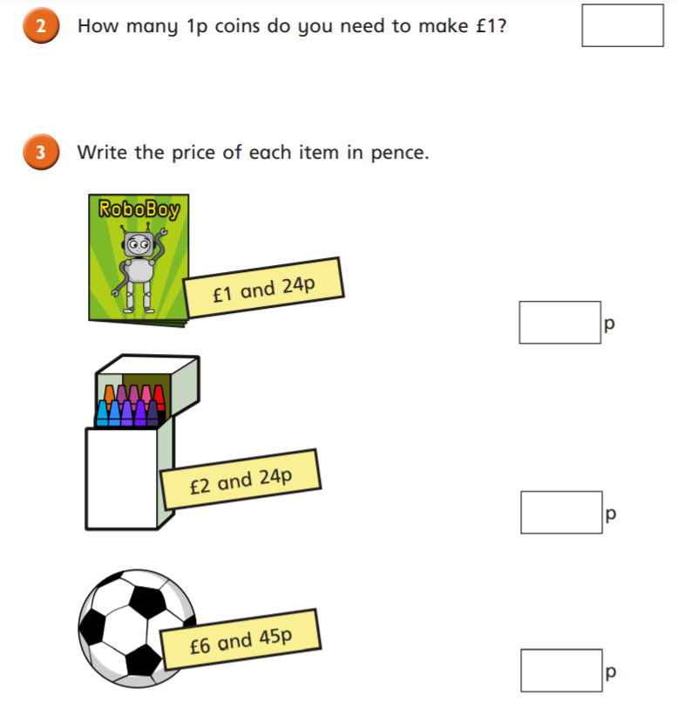
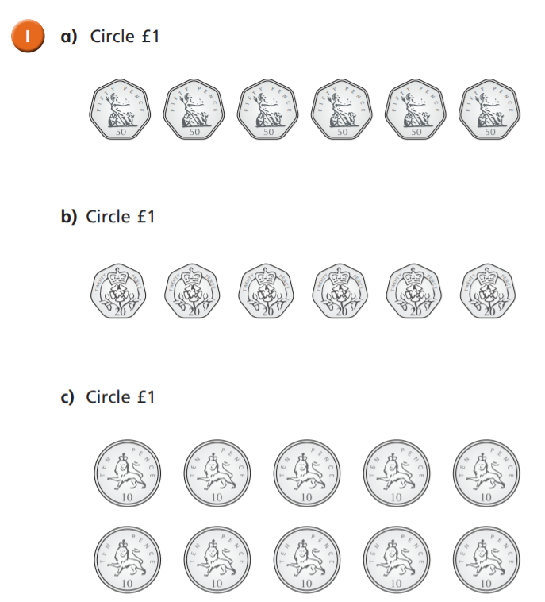
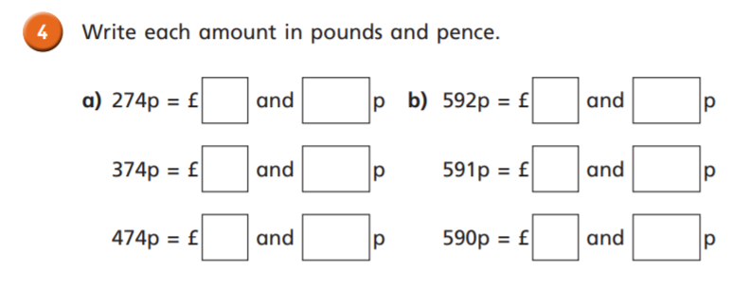
Independent Task
Year 3 & 4

Slide 13
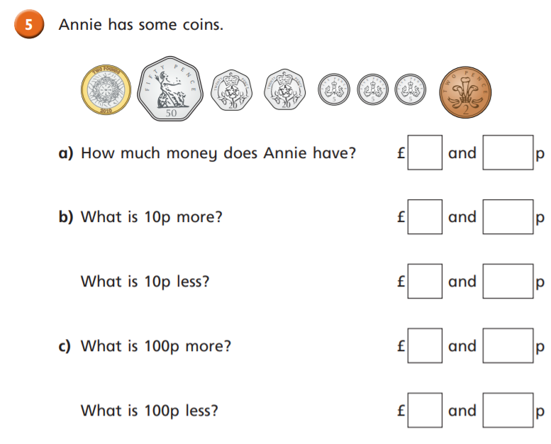
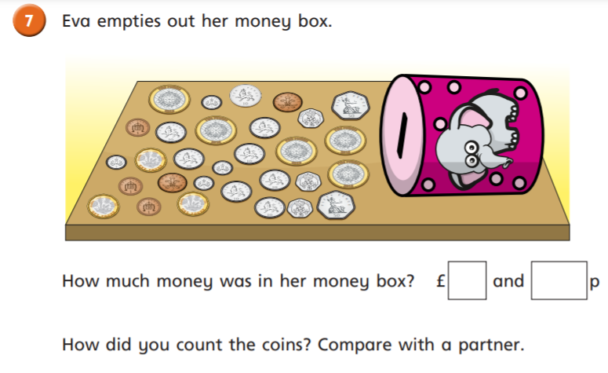
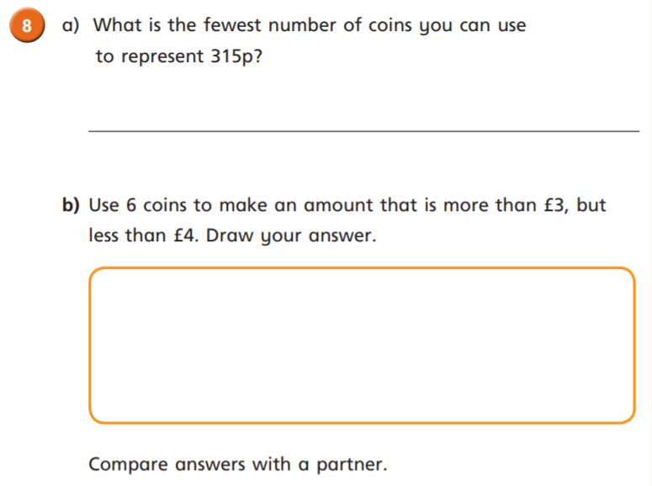
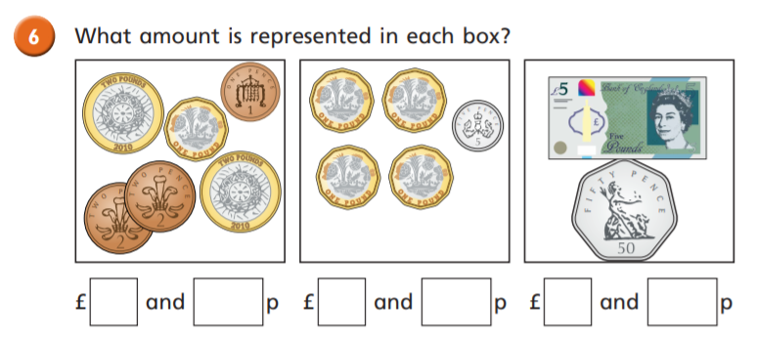
Independent Task
Year 3 & 4

Slide 14
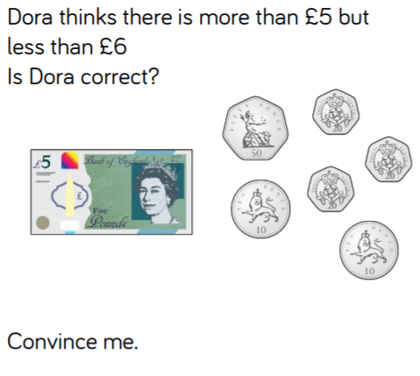
Plenary
Year 3 & 4

