Slide 1
Year 3 & 4
L.I - Can I add money?
Steps to success
- I can identify the value of the notes and coins.
- I can use the value of notes and coins to calculate totals.
Challenge: True or false?
Alternative provision
L.I - Can I recognise the symbols of £ and pence and combine amounts to make a total?
Steps to success
- I can identify the value of the notes and coins.
- I can use the value of notes and coins to calculate totals.
-Challenge: True or false?

Slide 2
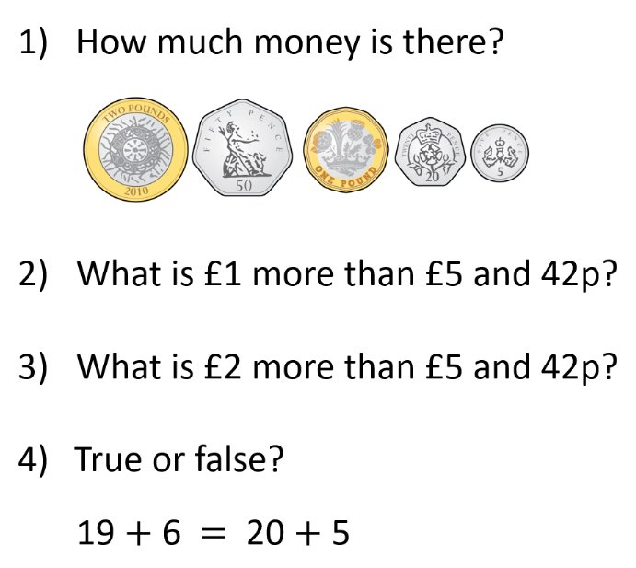
In Focus Task
Year 3 & 4

Slide 3
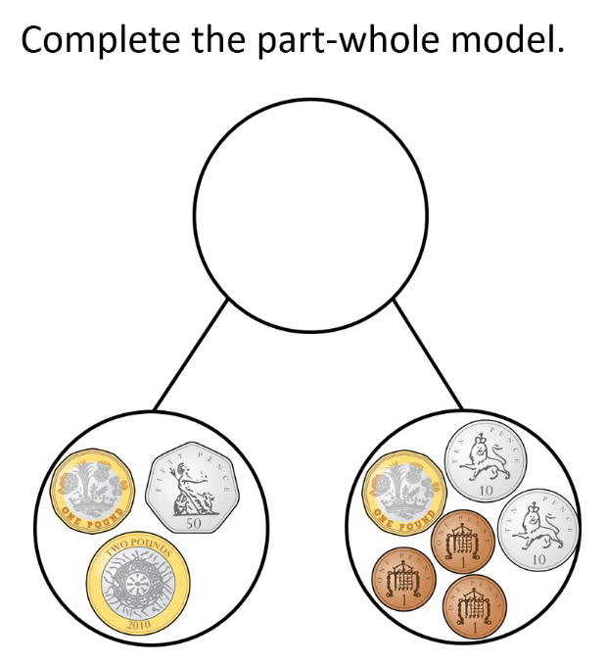
Talk Task
First start by adding the pounds in each part.
Next add the pence in each part.

Slide 4
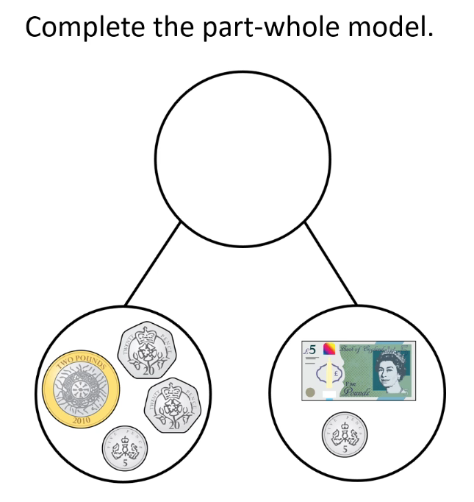
Develop Learning
Now here’s one for you to try.

Slide 5
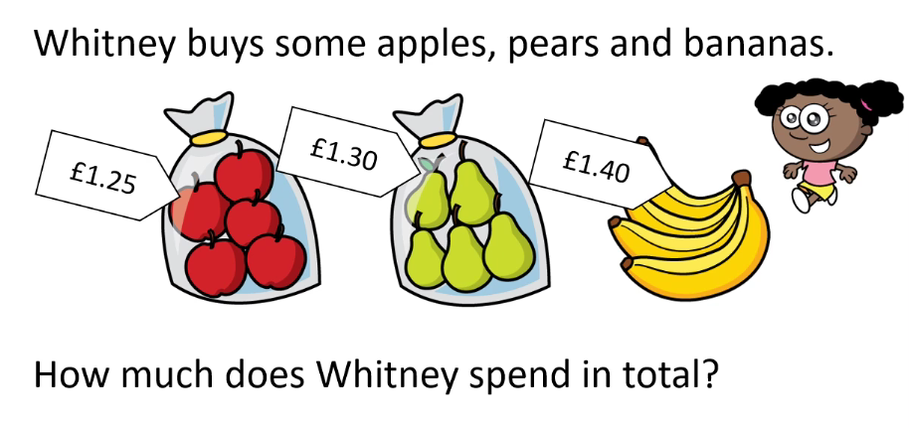
Develop Learning
Year 3 & 4
Remember to add the pounds first.

Slide 6
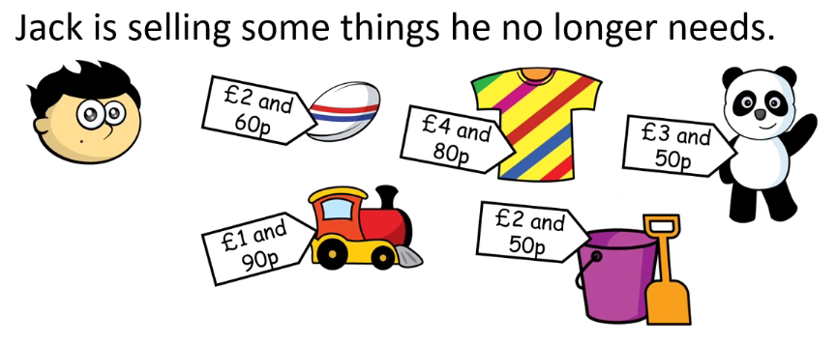
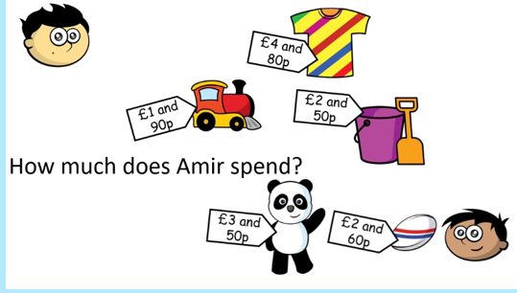
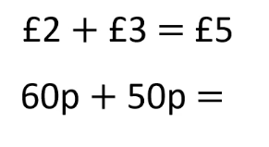
Develop Learning
Amir decides to buy two things.
Let’s start by adding the pounds together
Look at the coins to help you with the next part

Slide 7
Develop Learning
Now try this one

Slide 8
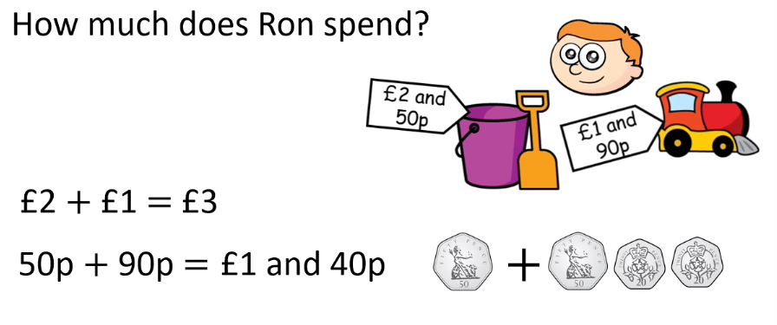
Develop Learning

Slide 9
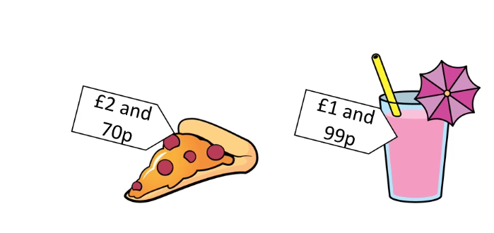
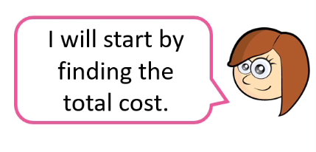
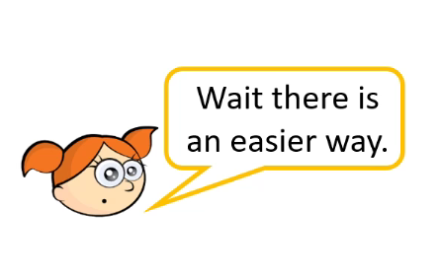
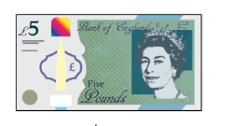
Develop Learning
Rosie has £5 and is wondering if she has enough money to buy a slice of pizza and a milkshake.
Alex says
What do you think?

Slide 10
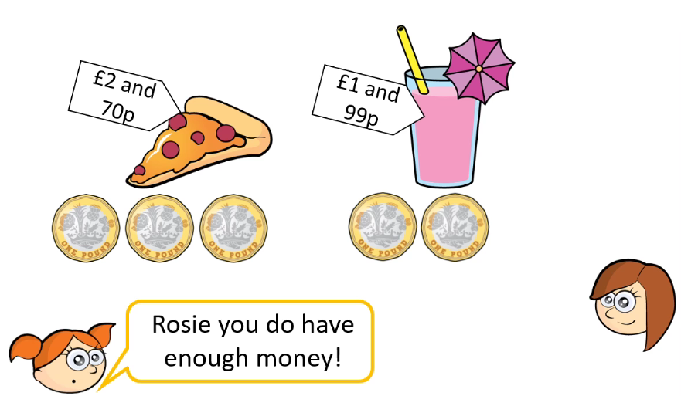
Develop Learning
Alex says that an easier way is to exchange the £5 note for five £1 coins that way we can use £3 to pay for the pizza
And £2 to pay for the milkshake. Did you get it right?

Slide 11
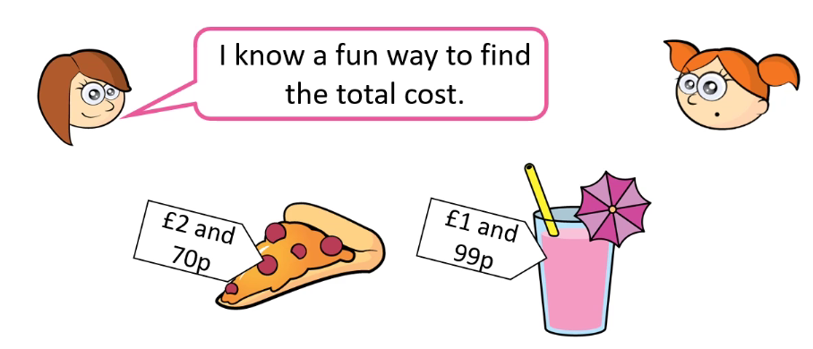
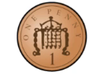
Develop Learning
Rosie says we need to add them together so
If I take 1 pence from the £2 pounds and 70p and add it to the £1 and 99p to make £2 then I can add

Slide 12
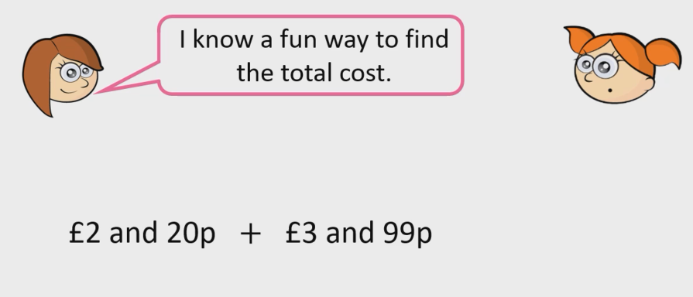
Develop Learning
Now it’s your turn
Remember to move the penny to make it easier

Slide 13
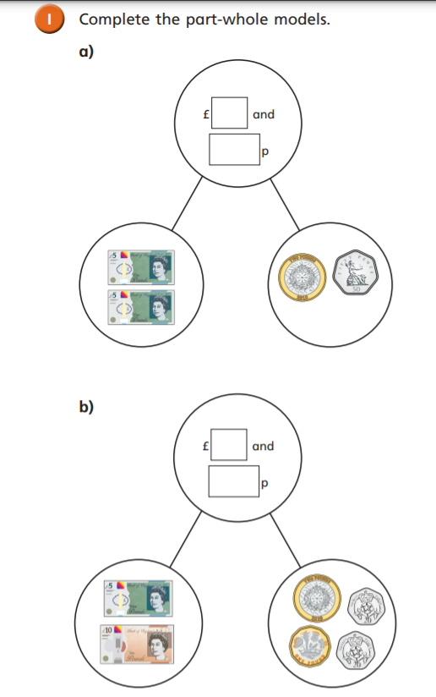
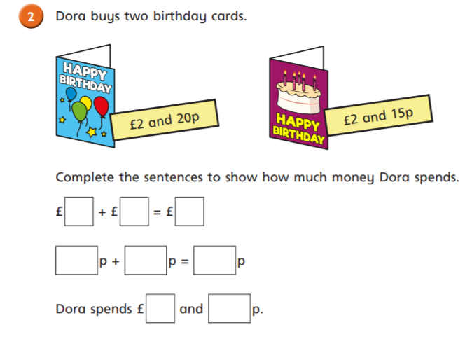
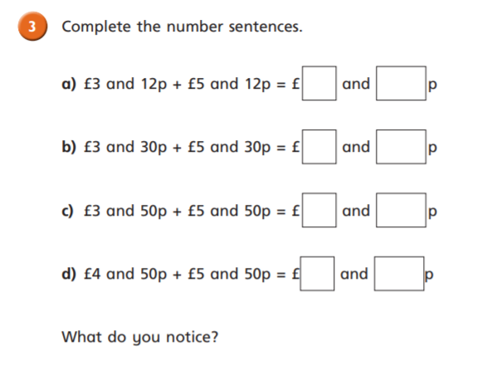
Independent Task
Year 3 & 4

Slide 14
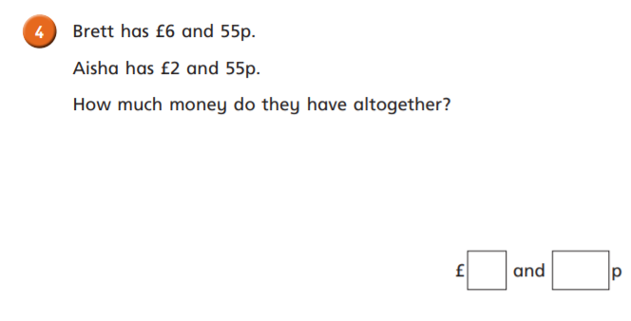
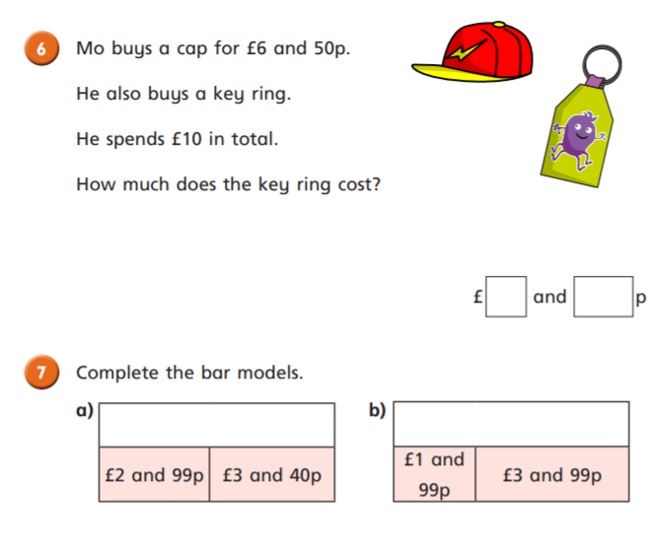
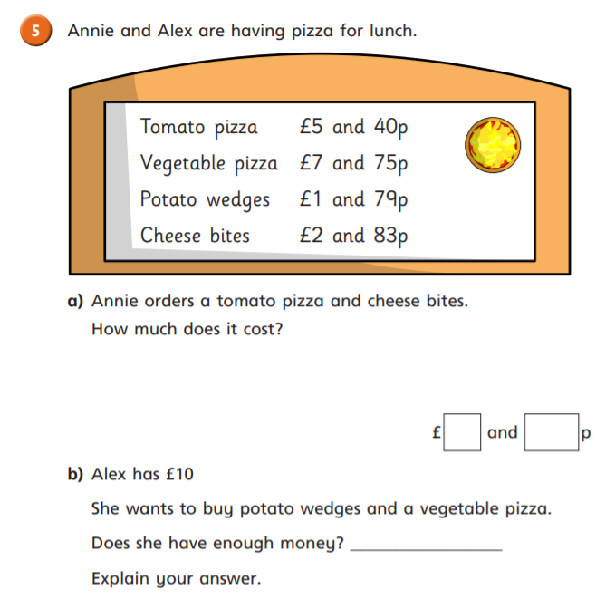
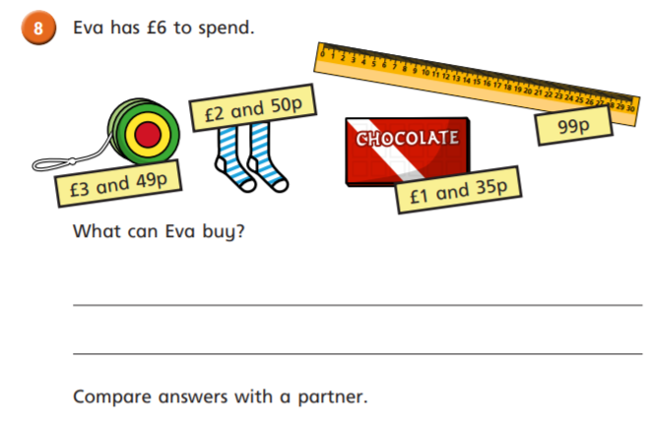
Independent Task
Year 3 & 4

Slide 15
Plenary
Year 3 & 4

