Slide 1
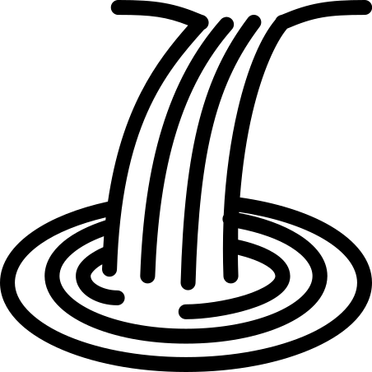
The river Severn from source to mouth
Plynlimmon hills: the source. Soggy moorland, water trickles and forms a stream in a v-shaped valley.
Waterfall ‘the Severn breaks its neck’: fast flowing water breaks weak rocks.
Shrewsbury: river flattens and meanders. It widens and forms loops.
Gloucester: estuary, the rivers nears the sea and has tides and becomes deep. It flows into the sea.

