Slide 1
The Water Cycle A river journey
Explanation Text
Thursday 17 June 2021

Slide 2
LI: Can I write an explanation text?
Explanation Text
Steps to success:
I can gather interesting facts
I can include descriptions of the landscape
I can use an informal tone to engage the reader

Slide 3
Independent write
You are going to write an explanation about the journey of the river Severn, the longest river in Britain.
You need to write it as if it is a factual tour and you are a guide taking water droplets on a tour.
Remember all the informal ways we have used to engage the reader in the explanation about the water cycle?
We do not want this explanation to be dull!

Slide 4
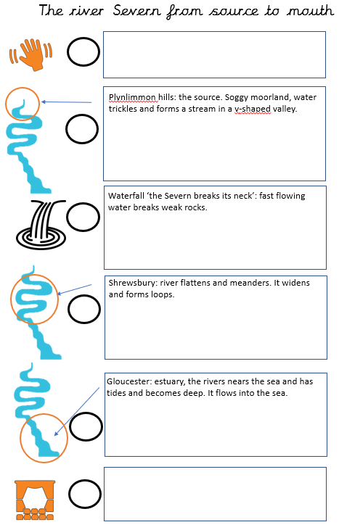
Independent write
Use your plan and fact file.
You can always use the wordmats to help you find excellent vocabulary.
You have 45 minutes to write your ‘factual tour’.

Slide 5
Share and feedback
Share your work
What sentence are your proud of?
What does the class think of the work?
How could we make it even better?

