Slide 1
Lesson 1: Answering questions
Year 4 – Data and information – Data logging
Notes:
Last updated 29-09-21
Resources are updated regularly — the latest version is available at: ncce.io/tcc.

Slide 2
Lesson 1: Answering questions
Objectives
To explain that data gathered over time can be used to answer questions
I can choose a data set to answer a given question
I can suggest questions that can be answered using a given data set
I can identify data that can be gathered over time

Slide 3
Data around us
Introduction
What is the data shown here?
How often is the data collected?
What can we tell from the data?
Register
Name | Reg | Mon 07/05 |  | Tue 08/05 |  | Wed 09/05 |  | Thu 10/05 |  | Fri 11/05
 |  | AM | PM | AM | PM | AM | PM | AM | PM | AM | PM
Addy, George | Y4D | / | \ | / | \ | / | \ | / | \ | / | \
Ahmed, Zahir | Y4D | / | \ | / | \ | / | \ | / | \ | / | \
Bocci, Sofia | Y4D | / | \ | / | \ | L | \ | / | \ | / | \
Brand, Mabel | Y4D | / | \ | / | \ | / | \ | / | A | / | \
Chang, Freya | Y4D | A | \ | / | \ | / | \ | / | \ | / | \
Droffer, Michael | Y4D | / | \ | / | \ | / | \ | / | \ | / | \
Fuller, Jane | Y4D | / | \ | / | \ | / | \ | / | \ | / | \
George, Freddie | Y4D | / | \ | / | \ | / | \ | O | O | O | O
Hussain, Soni | Y4D | / | \ | / | \ | / | \ | / | \ | / | \
Jones, Gemma | Y4D | / | \ | / | \ | / | \ | / | \ | / | \

Slide 4
Data collected over time
Introduction
The class register is data that is collected over time.
Data is added every morning and every afternoon that the school is open.
Register
Name | Reg | Mon 07/05 |  | Tue 08/05 |  | Wed 09/05 |  | Thu 10/05 |  | Fri 11/05
 |  | AM | PM | AM | PM | AM | PM | AM | PM | AM | PM
Addy, George | Y4D | / | \ | / | \ | / | \ | / | \ | / | \
Ahmed, Zahir | Y4D | / | \ | / | \ | / | \ | / | \ | / | \
Bocci, Sofia | Y4D | / | \ | / | \ | L | \ | / | \ | / | \
Brand, Mabel | Y4D | / | \ | / | \ | / | \ | / | A | / | \
Chang, Freya | Y4D | A | \ | / | \ | / | \ | / | \ | / | \
Droffer, Michael | Y4D | / | \ | / | \ | / | \ | / | \ | / | \
Fuller, Jane | Y4D | / | \ | / | \ | / | \ | / | \ | / | \
George, Freddie | Y4D | / | \ | / | \ | / | \ | O | O | O | O
Hussain, Soni | Y4D | / | \ | / | \ | / | \ | / | \ | / | \
Jones, Gemma | Y4D | / | \ | / | \ | / | \ | / | \ | / | \

Slide 5
Data tables
Activity 1
A
B
C
Weather
Day | Summary | Temperature (°C) | Rainfall (mm)
Sunday | Sunny | 21 | 0
Monday | Partly cloudy | 17 | 0
Tuesday | Overcast | 16 | 2
Wednesday | Overcast | 15 | 1
Thursday | Partly cloudy | 16 | 0
Friday | Sunny | 20 | 0
Saturday | Sunny | 22 | 0
Fitness tracker
Day | Steps
Sunday | 10307
Monday | 12139
Tuesday | 9844
Wednesday | 12015
Thursday | 7053
Friday | 11413
Saturday | 4341
Sports
Team | Played | Won | Lost | Drawn
Archers | 7 | 2 | 2 | 3
Badgers | 7 | 4 | 1 | 2
Coasters | 8 | 3 | 4 | 1
Flyers | 7 | 1 | 3 | 3
Ringers | 8 | 3 | 4 | 1
Zoomers | 7 | 5 | 0 | 2
Which table would you look at to find the warmest day?

Slide 6
Data tables
Activity 1
A
B
C
Weather
Day | Summary | Temperature (°C) | Rainfall (mm)
Sunday | Sunny | 21 | 0
Monday | Partly cloudy | 17 | 0
Tuesday | Overcast | 16 | 2
Wednesday | Overcast | 15 | 1
Thursday | Partly cloudy | 16 | 0
Friday | Sunny | 20 | 0
Saturday | Sunny | 22 | 0
Fitness tracker
Day | Steps
Sunday | 10307
Monday | 12139
Tuesday | 9844
Wednesday | 12015
Thursday | 7053
Friday | 11413
Saturday | 4341
Sports
Team | Played | Won | Lost | Drawn
Archers | 7 | 2 | 2 | 3
Badgers | 7 | 4 | 1 | 2
Coasters | 8 | 3 | 4 | 1
Flyers | 7 | 1 | 3 | 3
Ringers | 8 | 3 | 4 | 1
Zoomers | 7 | 5 | 0 | 2
Which table would you look at to find the warmest day?
Would we still know even if less information were visible?

Slide 7
Classroom data
Activity 2
Think of some questions that you could answer if this table of data were complete.
Hint: Questions will mainly start with ‘what’ or ‘when’.
Examples:
 | Temperature | Sound | Light
Time 1
Time 2
Time 3
...
What was the highest temperature?
When was the room quietest?

Slide 8
Classroom data
Activity 2
What was the highest temperature?
When was the room quietest?
Helpful words: ‘what’, ‘when’
 | Temperature | Sound | Light
Time 1
Time 2
Time 3
...
Hottest, coolest, coldest, warmest, loudest, quietest, brightest, dullest, highest, lowest
Think, pair, share.

Slide 9
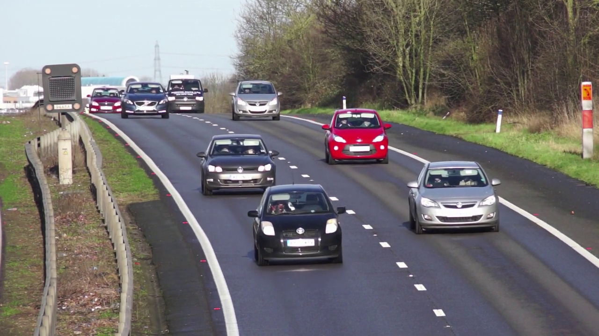
Collecting data
Activity 3
You will watch a one-minute video. Different groups will:
Count red cars
Count black cars
Count blue cars
Count silver cars
Count white cars
Count vehicles that aren’t cars
Notes:
Image source: https://pixabay.com/videos/cars-motorway-speed-motion-traffic-1900

Slide 10
Activity 3
Notes:
Image source: https://pixabay.com/videos/cars-motorway-speed-motion-traffic-1900

Slide 11
Collecting data
Activity 3
Which questions can be answered with the data collected?
How many red cars?
How many black cars?
How many buses?
How many blue cars?
How many lorries?
How many silver cars?
How many vehicles that aren’t cars?
How many cars with two people in?
✔️
✔️
❌
✔️
❌
✔️
Why can’t some questions be answered?
✔️
❌
Notes:
Some questions can’t be answered because suitable data wasn’t collected (the learners weren’t told to collect it). Highlight the importance of thinking carefully about the questions that we want answers to before we collect data.
Image source: https://pixabay.com/videos/cars-motorway-speed-motion-traffic-1900

Slide 12
Collecting data
Activity 3
 | Number
Red cars | 5
Black cars | 12
Blue cars | 3
Silver cars | 14
White cars | 3
Non-cars | 2
Why might the answers that you have be different to the answer above?
Notes:
Image source: https://pixabay.com/videos/cars-motorway-speed-motion-traffic-1900

Slide 13
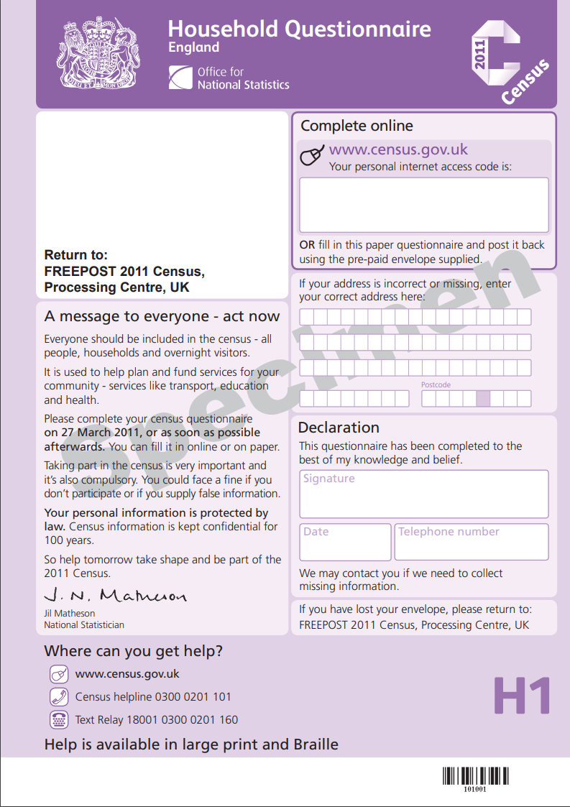
Data gathered over time: people
Activity 4
Census
Carried out by the government every ten years.
Includes:
Who lives with you?
What are their ages?
Are they employed?
What are their qualifications?
What is their religion?
Notes:
Image source: Office for National Statistics https://www.ons.gov.uk
Education relates to level of education/qualifications.
Census 2011 form: https://www.ons.gov.uk/file?uri=/census/censustransformationprogramme/consultations/the2021censusinitialviewoncontentforenglandandwales/2011censusquestionnaireenglandh1.pdf

Slide 14
Data gathered over time
Activity 4
Can you think of any other data that is gathered regularly?
Try to think of situations where data is gathered.
Think, pair, share.
Notes:
Image source: https://pixabay.com/illustrations/feedback-white-male-3d-model-1889006

Slide 15
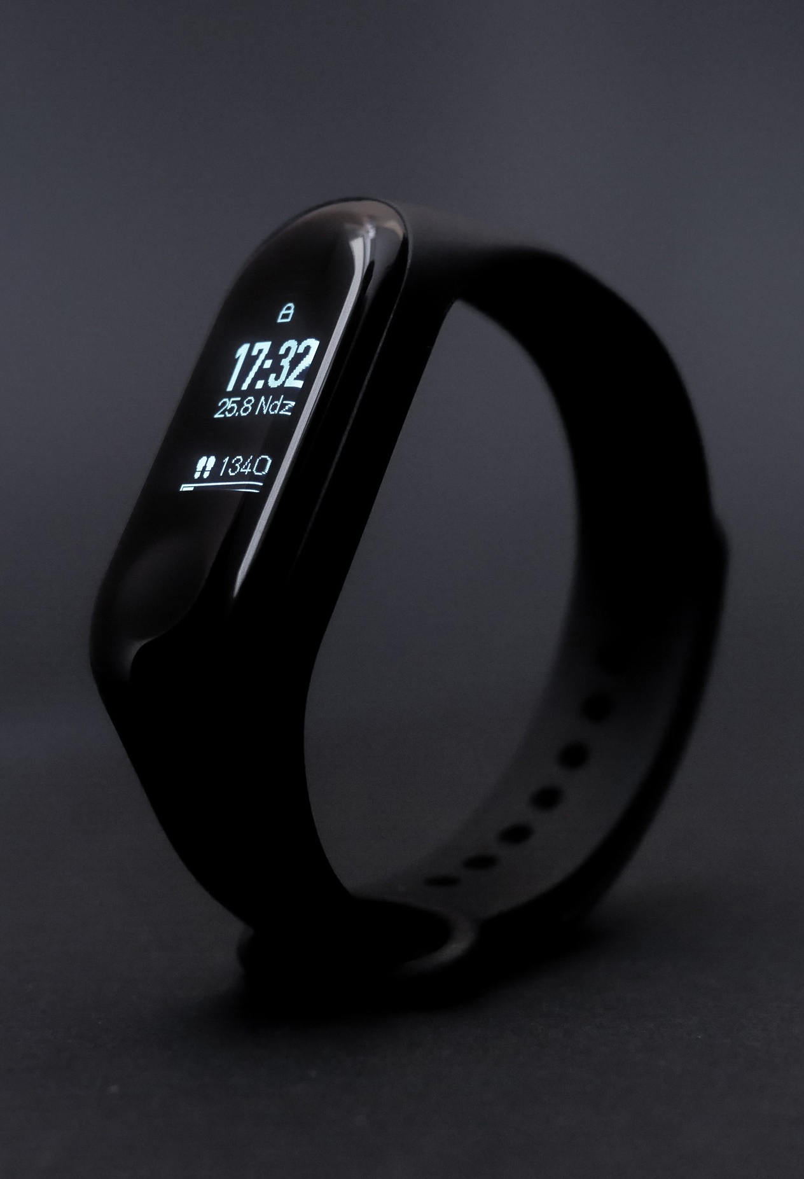
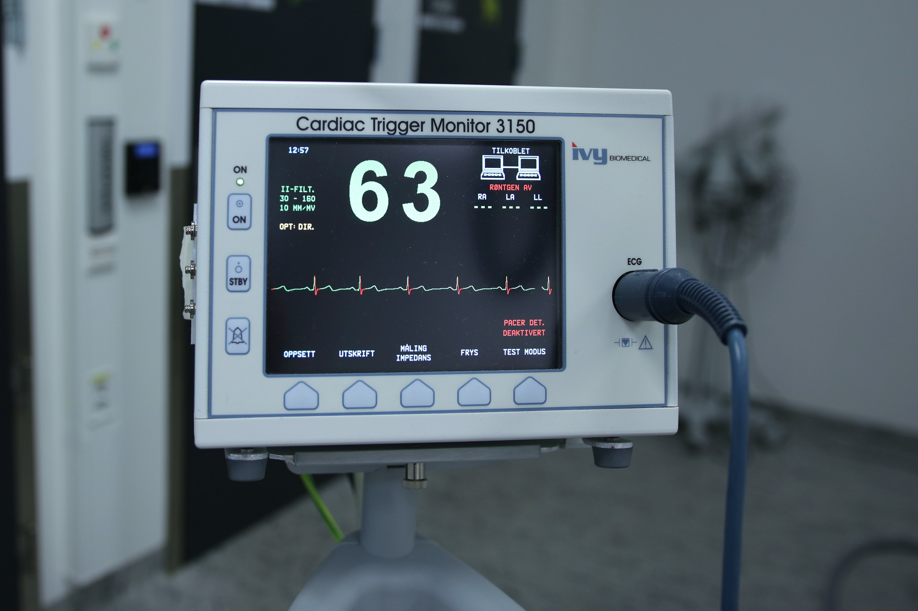
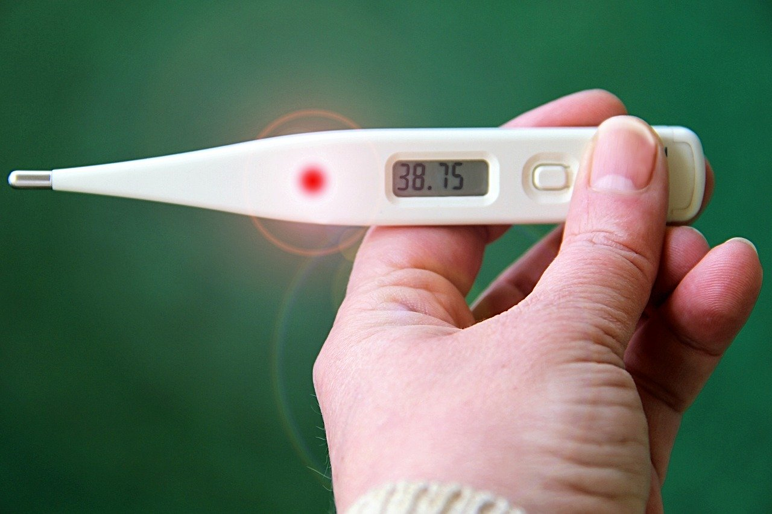
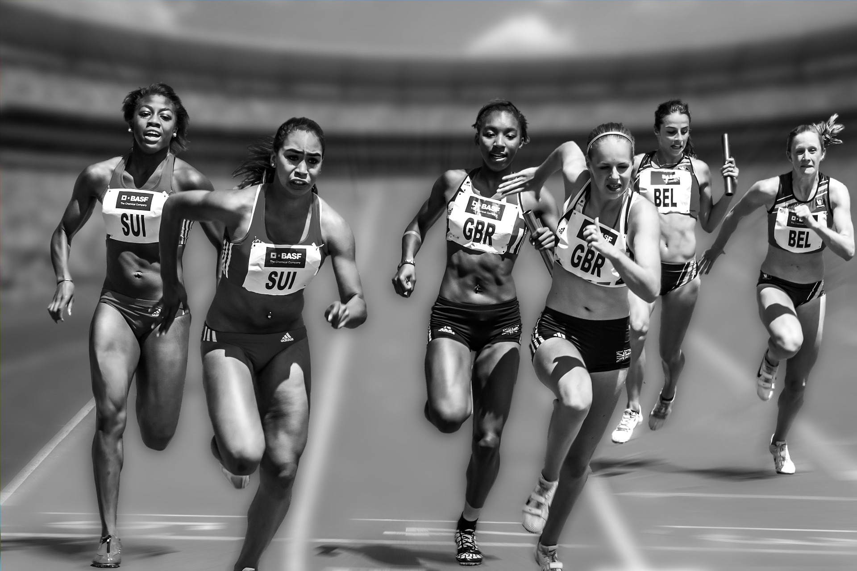
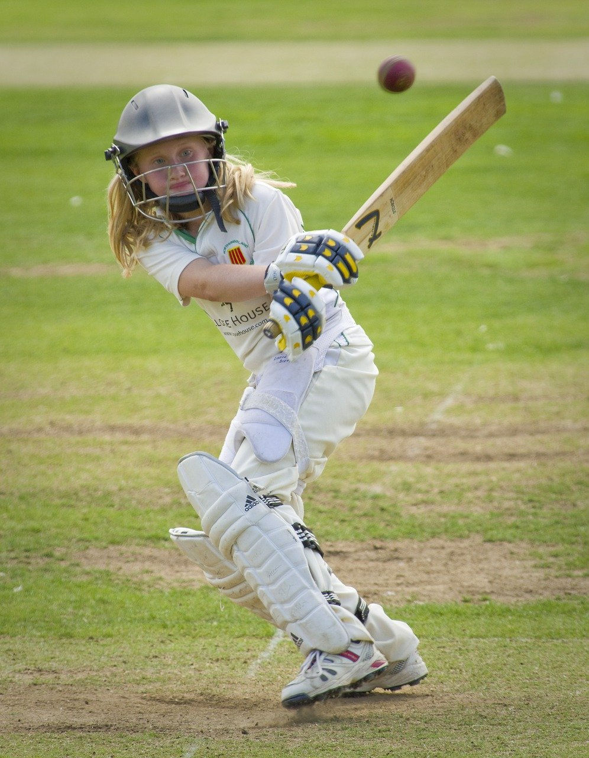
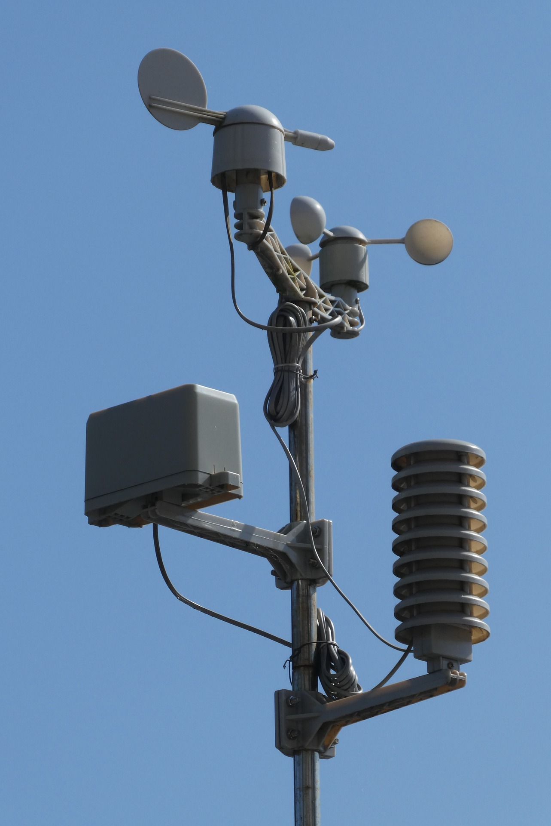
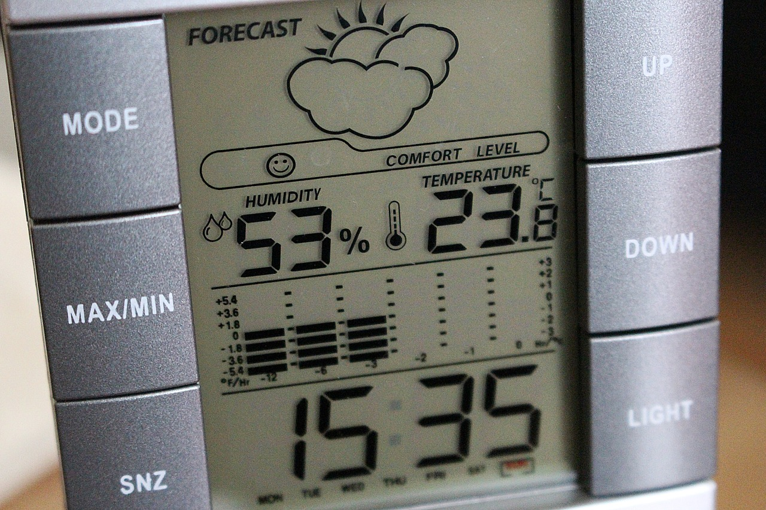
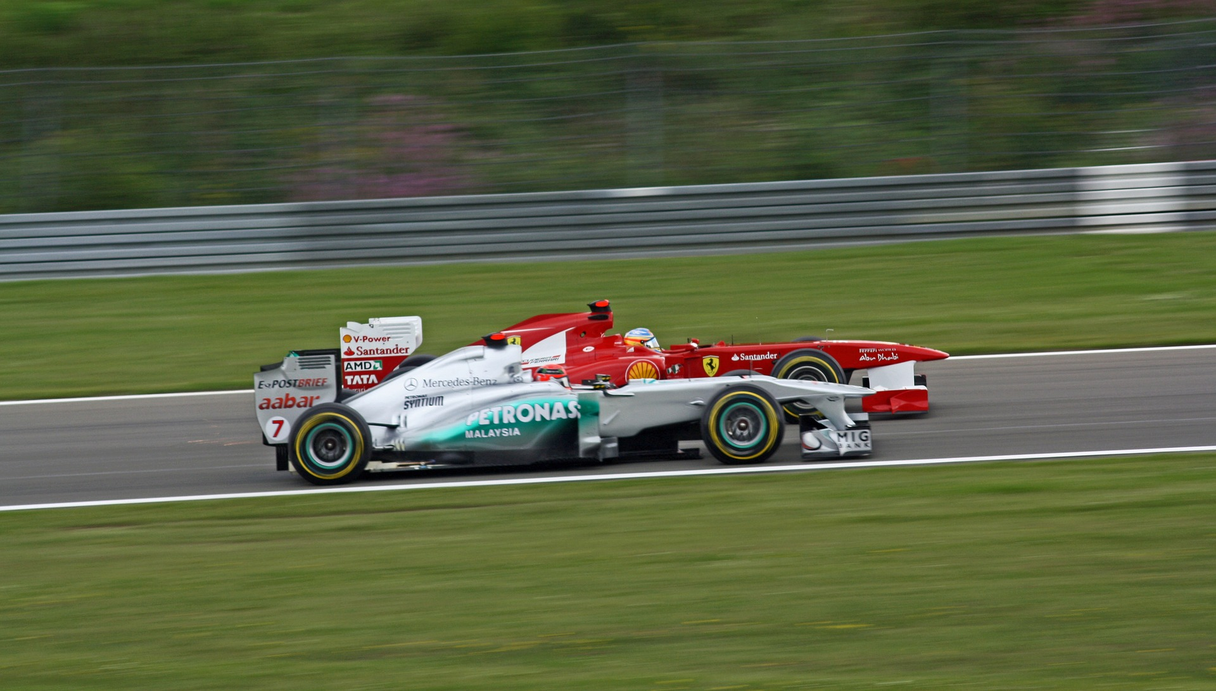
Data gathered over time
Activity 4
Health
Sport
Environment and weather
Notes:
Some examples: race times, lap times, rainfall, sunshine, temperature, steps
Image sources:
https://pixabay.com/photos/equipment-hospital-ecg-3089883
https://pixabay.com/photos/thermometer-fever-number-hand-3656065
https://pixabay.com/photos/headband-sport-sports-training-4432093
https://pixabay.com/photos/weather-station-weather-vane-set-5010904
https://pixabay.com/photos/weather-station-digital-display-572856
https://pixabay.com/photos/formula-1-car-racing-speed-2205262
https://pixabay.com/photos/relay-race-competition-stadium-655353
https://pixabay.com/photos/cricket-batting-batter-girl-junior-724621
https://pixabay.com/photos/gymnastics-gymnast-man-sports-89615

Slide 16
What can we find out?
Activity 4
How can gathering data over time be useful to us?
Think, pair, share.
Notes:
Data gathered over time can show whether we’re getting enough exercise, or which team is doing the best.
Image sources:
https://pixabay.com/photos/equipment-hospital-ecg-3089883
https://pixabay.com/photos/thermometer-fever-number-hand-3656065
https://pixabay.com/photos/headband-sport-sports-training-4432093
https://pixabay.com/photos/weather-station-weather-vane-set-5010904
https://pixabay.com/photos/weather-station-digital-display-572856
https://pixabay.com/photos/formula-1-car-racing-speed-2205262
https://pixabay.com/photos/relay-race-competition-stadium-655353
https://pixabay.com/photos/cricket-batting-batter-girl-junior-724621
https://pixabay.com/photos/gymnastics-gymnast-man-sports-89615

Slide 17
Answering questions
Plenary
It was sunny yesterday and again today. Does that mean we live in a sunny place?
Gerta was away for three days last week. Does that mean Gerta is always away?
Think, pair, share.
?
Notes:
Image source: https://pixabay.com/illustrations/fax-white-male-3d-model-isolated-1889017

Slide 18
Assessment
How confident are you? (1–3)
I can choose a data set to answer a given question
I can suggest questions that can be answered using a given data set
I can identify data that can be gathered over time
3 – Very confident
2 – Unsure
1 – Not confident
Notes:
Image source: https://pixabay.com/vectors/thumb-up-hand-like-confirm-go-top-307176

Slide 19
Next lesson
Summary
In this lesson, you…
Thought about different data that can be collected over time
Thought about the data that would be needed to answer different questions
Next lesson, you will…
Look at the input devices computers can use to capture data
Use a digital device called a data logger, which can collect data

