Slide 1
Theseus and the Minotaur

Slide 2
The lenses we are going to be focusing on this lesson are:
use a time/weather clause
use simile
use noticing

Slide 3
LI: I can write effective sentences for my myth

Slide 4
Success Criteria:
use a time/weather clause
use simile
use noticing

Slide 5
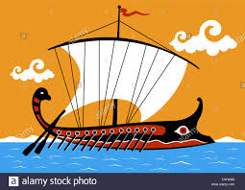
https://www.stwilliamofyork.co.uk/greeks-at-sea-the-trireme/
Chotting box 1
Collect 'time' and 'weather' fronted adverbials

Slide 6
Did you get any of these?
As days turned into nights; As the storms rolled on in the distance; As the clouds gathered in the sky; As the sun set under the horizon;

Slide 7
Write a few sentences describing the journey at sea. Start at least one of the sentences with a fronted adverbial describing the time/weather

Slide 8
Teacher model
As days turned into nights, Theseus sailed closer to home.

Slide 9
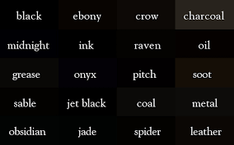
Chotting box 2
Gather different words for black using our colour thesaurus and add an object to go with them, e.g
Crow, spider, raven

Slide 10
Now, collect negative adjectives for each one:
A tragic crow,
a deadly spider,
a sinister raven

Slide 11
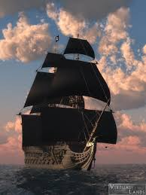
Build powerful sentences using similes for the black sails.

Slide 12
Teacher model:
However, he forgot to fly white sails to show his father he was safe.
The sails were black, like a tragic crow’s wing.

Slide 13
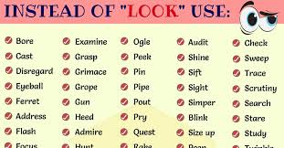
Chotting box 3
Use this thesaurus to collect synonyms for 'looked'
Arrange these according to degrees of meaning
Eg. From a quick peep (low intensity) to a stronger gaze/stare (high intensity)

Slide 14
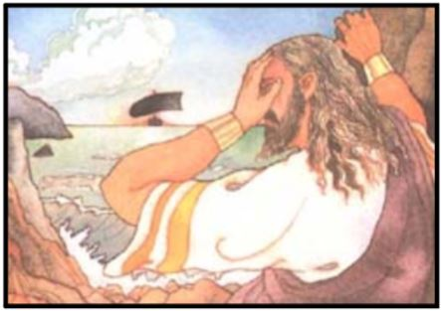
Use a synonym for 'looked' to make the moment more dramatic – describe in a few sentences how King Aegeus looked out to sea and what he thought and realised

Slide 15
Teacher model:
King Aegeus gazed out to sea and realised his son was dead.

