Slide 1
Theseus and the Minotaur

Slide 2
The lenses we are going to be focusing on this lesson are:
use feelings
use pathetic fallacy
use personification

Slide 3
LI: I can write effective sentences for my myth

Slide 4
Success Criteria:
use feelings
use pathetic fallacy
use personification

Slide 5
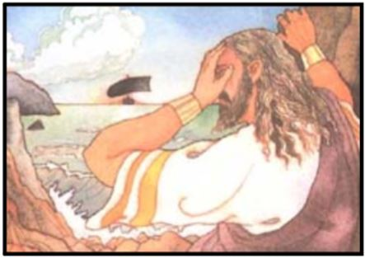
Chotting box 1
Gather feelings for how King Aegeus is feeling in this moment
Arrange these in degrees of meaning (from low to high intensity)

Slide 6
Did you get any of these?
Sad, heavy-hearted, crushed, devastated, heartbroken, wretched, distraught

Slide 7
Write 2-3 sentences describing how King Aegeus was feeling in this moment including 3 feelings in the final position

Slide 8
Teacher model
Believing his only son had been slain by the Minotaur, he was distraught, devastated, desperate.

Slide 9
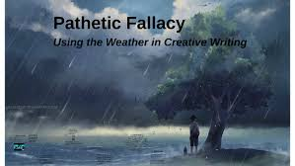
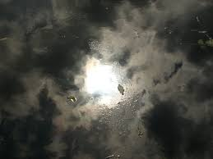
Gather synonyms for 'mirrored' (for the oppressive weather and King Aegeus' feelings)
Matched, reflected, corresponded with, were akin to
Explore and collect powerful weather phrases
The sky turned to bruises, thunder rumbled ominously, rivulets of darkness bled across the sky, torrents of rain fell from the heavens

Slide 10
Chotting box 2
Gather synonyms for 'mirrored' (for the oppressive weather and King Aegeus' feelings)
Matched, reflected, corresponded with, were akin to
Explore and collect powerful weather phrases
The sky turned to bruises, thunder rumbled ominously, rivulets of darkness bled across the sky, torrents of rain fell from the heavens

Slide 11
Did you get any of these?
Matched, reflected, corresponded with, were akin to
Explore and collect powerful weather phrases
The sky turned to bruises, thunder rumbled ominously, rivulets of darkness bled across the sky, torrents of rain fell from the heavens

Slide 12
Explore and collect powerful weather phrases
The sky turned to bruises, thunder rumbled ominously, rivulets of darkness bled across the sky, torrents of rain fell from the heavens

Slide 13
What powerful actions (showing high emotion) can you think of from a bereaved/distraught person
Tears tumbled down, wailed inconsolably, fell to his knees, legs buckled, crumpled to the floor

Slide 14
Write a pathetic fallacy set of sentences where the weather reflects the character's emotions/actions

Slide 15
Teacher model
The oppressive, dark thunderclouds mirrored the despair in his desolate, breaking heart.

Slide 16
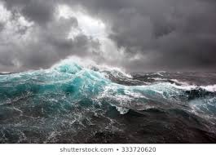
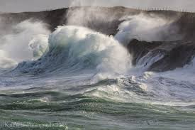
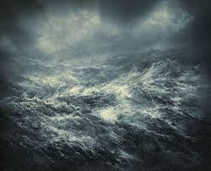
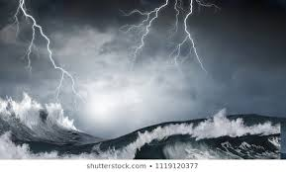
https://www.youtube.com/watch?v=AsD5u6k6dKI
Collect adjectives for the sea
Chotting box 3

Slide 17
Did you get any of these?
Vicious, spiteful, unrelenting, heartless, tumultuous
Gather human actions for the sea (tempting, then swallowing up King Aegeus)
Coaxed, lured, beckoned, summoned, tempted, swallowed, consumed, devoured

Slide 18
Now gather human actions for the sea (tempting, then swallowing up King Aegeus)
Coaxed, lured, beckoned, summoned, tempted, swallowed, consumed, devoured

Slide 19
Assign human attributes to the violent sea, tempting King Aegeus to his death
DEEPEN THE MOMENT: use figurative language alongside fronted adverbials to describe the sea

Slide 20
Teacher model
With nothing left to live for, the grieving father was lured and swallowed by the angry, tempestuous sea.
King Aegeus had tragically died in vain.

