Slide 1
Monday 16th November 2020
LI: can I plan my writing by drawing on reading (Y6 and research) where necessary?­­­­­

Slide 2
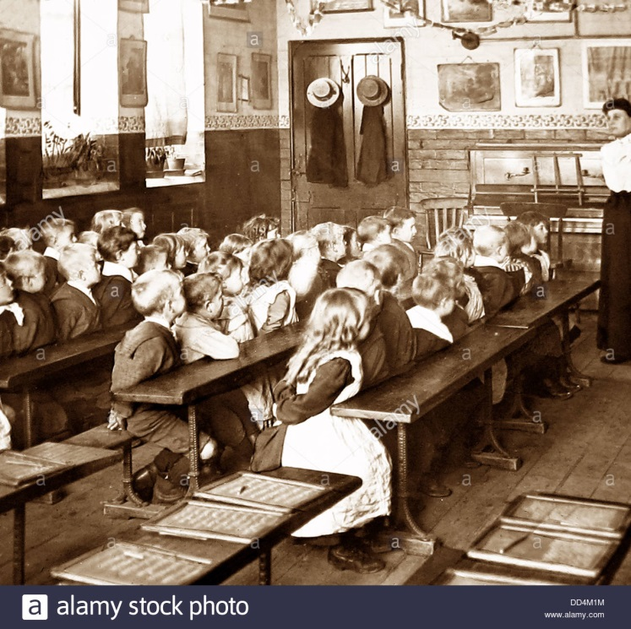
Watch the video, listening to the sounds of the schoolroom.
https://vimeo.com/252537630

Slide 3
Read Chapter 6
What is the same as school today?
What is different?

Slide 4
Lens 1:
Chotting
Chot down what Jim could hear.
Use adjectives.
Extend them into phrases.
The scraping of the chairs across the hard, wooden floor.

Slide 5
Share write a sentence to describe what Jim could hear.
Writing in heavy silence, the chalk scraped and scritched across the chalk boards like scratching fingernails, as the clock ticked the minutes away ominously.

Slide 6
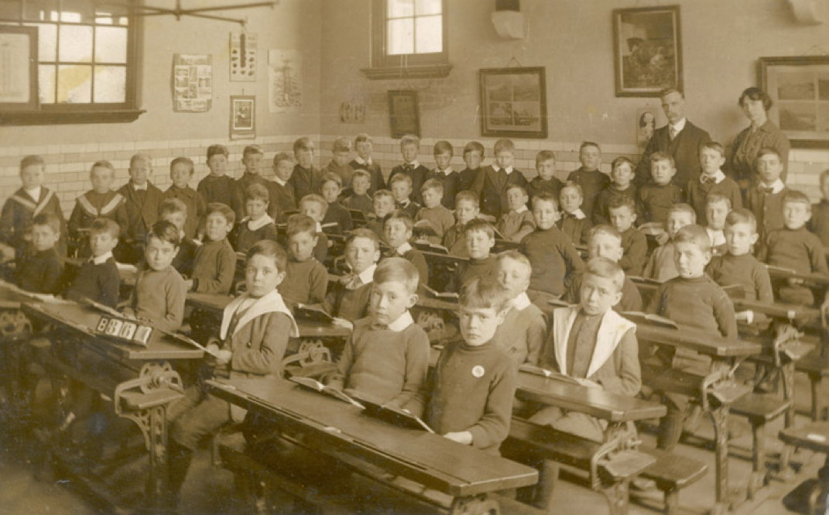
Your turn Challenge: Deepen the moment.
Write a sentence to describe what Jim could hear inside of the schoolroom
using
adjectives.

Slide 7
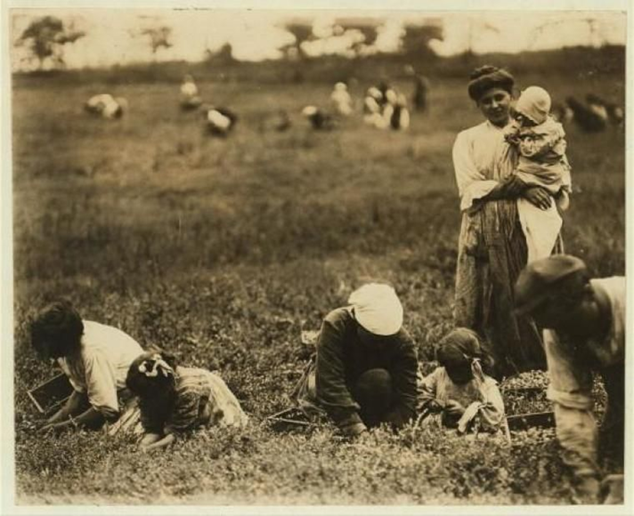
Lens 2: Past and Present tense.
Jim thinks back to his life with Ma, Pa and his sisters in the cottage in the country.

Slide 8
Chot down what Jim might be thinking about his life in the countryside.
He was happy when he played with his sisters.
They all worked hard on the farm.
He loved shoulder carries on his Pa’s, broad shoulders.
Chot down what he might think about his life now.
He feels lonely and isolated
He is miserable and unhappy.

Slide 9
Share write a sentence together to describe Jim thinking back to his life in the countryside and compare it to his life now.
Gazing out of the window, his thoughts drifted back to a happier time in his life, a time when he had laughed, played and run freely across the open fields. He had never felt as alone and afraid as he did now.

Slide 10
Your turn!
Write a sentence about Jim thinking back to happier times in his life.
Compare this to his life now.
Challenge- deepen the moment.

Slide 11
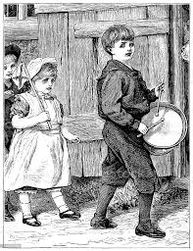
Lens 3: Repetition.
Jim and the workhouse boys are given a drum to ‘beat out their frustrations and anger’.
Chot what Jim might be thinking as he beats his drum.

Slide 12
Using repetition, share write a sentence together describing what Jim is thinking and feeling.
I want to go home. Bang bang bang. I hate it here. Bang bang bang. I want to run away. Bang bang bang. I don’t belong here. Bang bang bang.

Slide 13
Your turn!
Write a sentence using repetition for effect about What Jim is thinking as he beats his drum.
Challenge- deepen the moment.

