Slide 1
Monday 7th December
GPS
LI: I can understand the meaning of prefixes.
*back of English books*
In your books, under the date, please write:
LI: Year 5 and 6 prefixes (GPS)

Slide 2
What is a prefix? What are prefixes? - BBC Bitesize A prefix is a group of letters before the root word. We have looked at lots of different prefixes. On your whiteboards, list the ones that you can remember. Example: auto, super-

Slide 3
Your prefix spellings for the week:
Disable | Mistreat
Misbehave | Disown
Mistake | Disappear
Misplace | Unhappy
Can you think of any other words beginning with un-?

Slide 4
Task one:
Match the prefix to the root word.
Write them neatly in your book and underline the prefix.
Example: Mistake.
Year 6 – Put each one into a sentence.

Slide 5
Dis
Pre
Auto
Sub
Mis
Un
Fair
Order
Mobile
Way
Graph
Like
Spelt
Marine

Slide 6
Prefixes can be added to certain words to turn them into verbs. This works with the suffixes: dis- and mis-
Our rule:

Slide 7
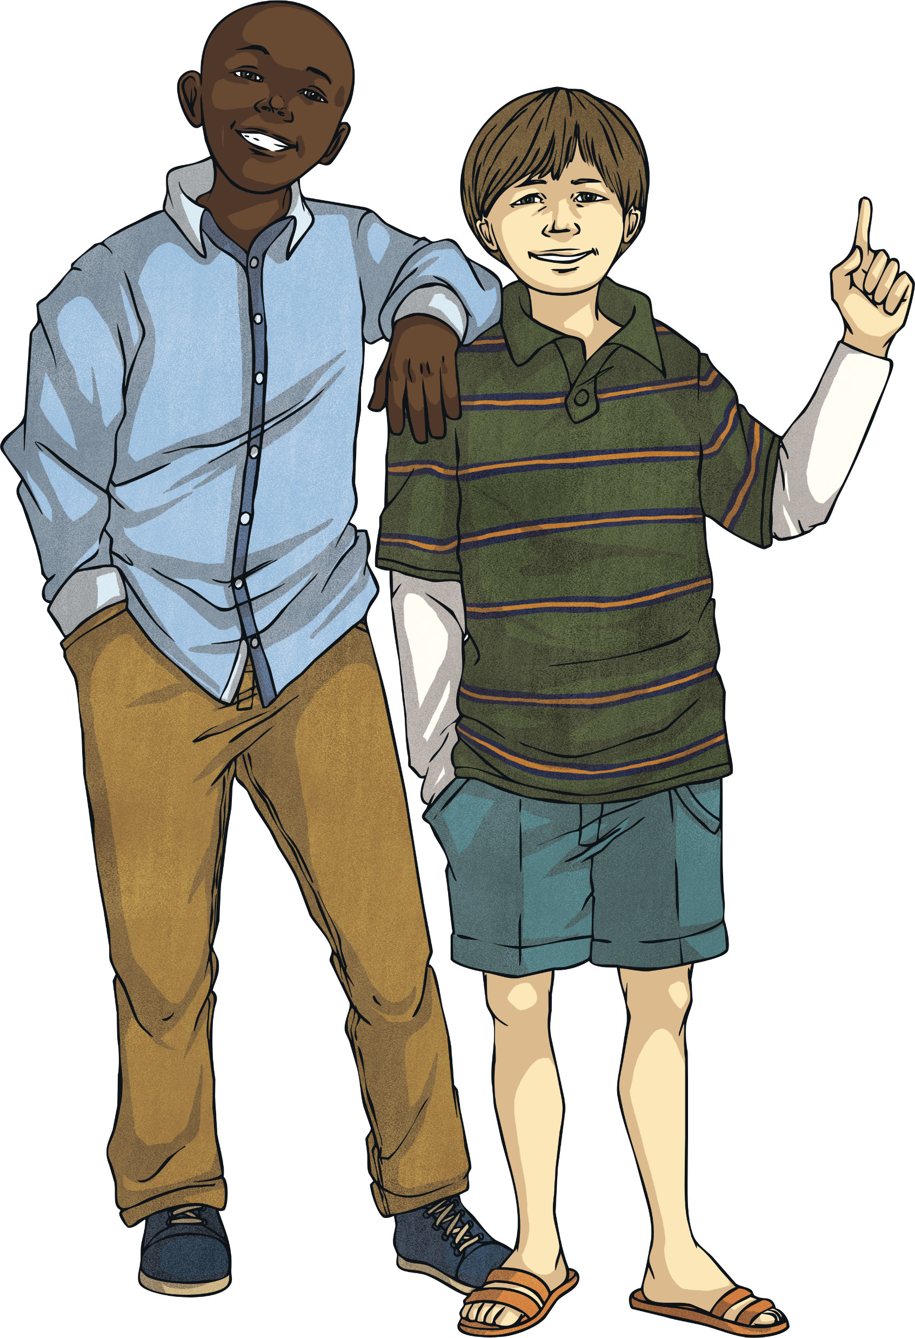
The Prefix dis-
Prefixes change the meaning of the root word.
How does this prefix change the meaning of these root words?
dis
connect
dis
appoint
The prefix dis- means ‘not’ or ‘the opposite of’
dis
courage
E.g: I tried to discourage my friend from playing a practical joke.

Slide 8
The Prefix mis-
Prefixes change the meaning of the root word.
How does this prefix change the meaning of these root words?
mis
treat
mis
read
The prefix mis- means ‘wrong’ or ‘false’
mis
place
E.g: My nan will often misplace her reading glasses that she needs when using the laptop.

Slide 9
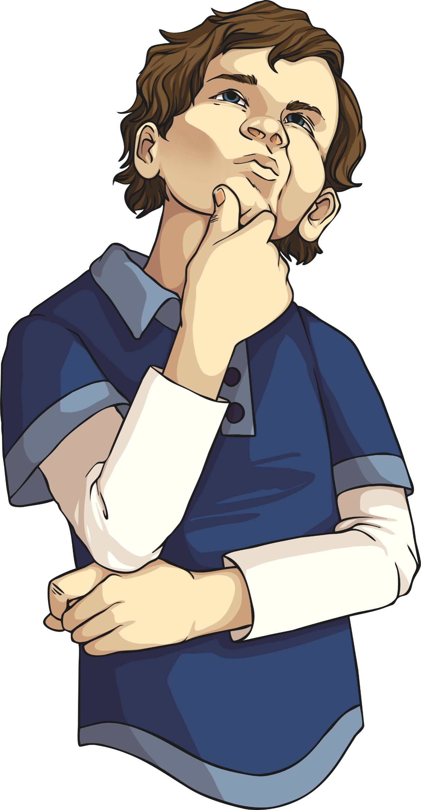
Task 1: in your books
Make the following root words into verbs by matching with one of the verb prefixes: dis–, de–, mis–, over– or re–.
dis-
de-
mis-
over-
re-
flate
play
form
manage
engage
estimate
embark
react
treat
inform
Click on the words to reveal answers

