Slide 1
Y5 LI:I can convert improper fractions to mixed numbers
Y6 (Recap)
Number: Fractions
Lesson 2
Spr2

Slide 2
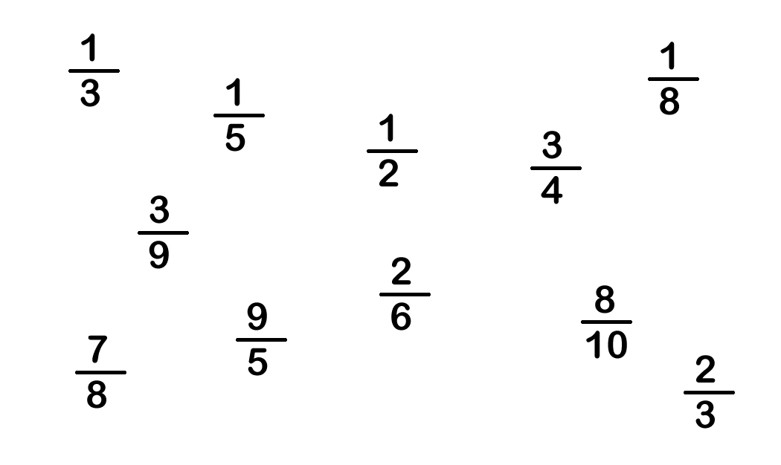
In focus task:
Success Criteria: I know that an improper fraction has a greater numerator than denominator I know that a mixed number is a whole number and a proper fraction I can convert improper fractions to mixed numbers
Which one is different?

Slide 3
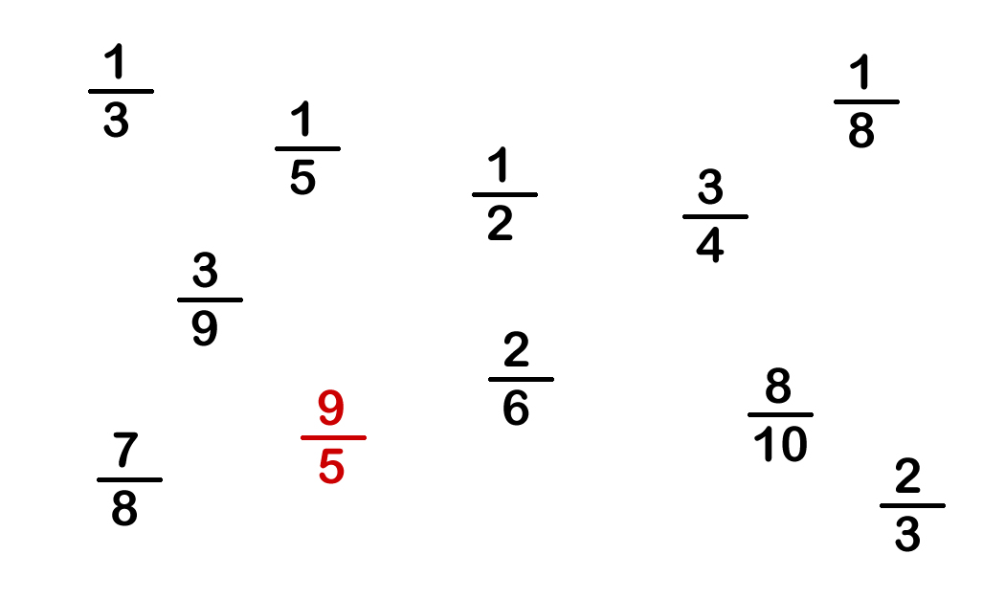
In focus task:
Success Criteria: I know that an improper fraction has a greater numerator than denominator I know that a mixed number is a whole number and a proper fraction I can convert improper fractions to mixed numbers
Which one is different?
How would you draw nine fifths?
Do you know the name for a fraction where the numerator is larger than the denominator?
There are several possible answers.
One is that nine fifths is different
because it is the only fraction where the numerator is larger than the denominator.

Slide 4
Talking time:
6 .
4_
How would you model the improper fraction using cubes?

Slide 5
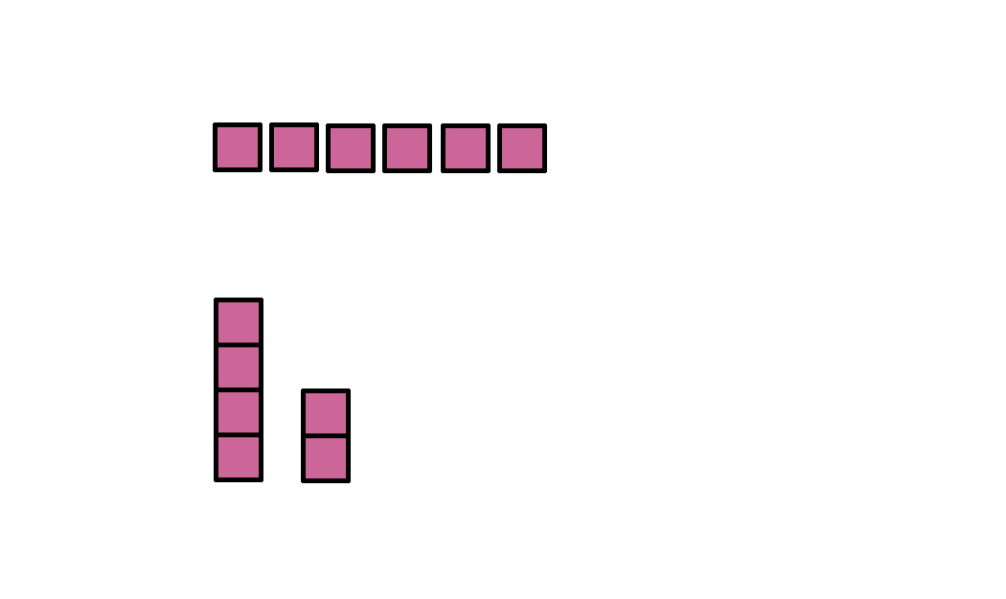
Talking time:
6 .
4_
How would you model the improper fraction using cubes?
Take 6 cubes.
These represent the six quarters of the fraction.
Use the six quarters to make one whole and two quarters. 1 2/4 is a mixed number.
6 .
4_
2 .
4_
= 1
What is meant by an ‘improper fraction’?
What is meant by a ‘mixed number’?

Slide 6
Talking time:
Complete the missing values.

Slide 7
Talking time:
Complete the missing values.
Why are the cubes being grouped into threes?

Slide 8
Talking time:
Complete the missing values.

Slide 9
Talking time:
Complete the missing values.
What is the same and what is different?

Slide 10
Activity 1:
Use cubes to convert these improper fractions into mixed numbers. Write your answers in your books fully.
a) 8 =
3
b) 21 =
5
c) 19 =
4
d) 17 =
3

Slide 11
Activity 1:
Use cubes to convert these improper fractions into mixed numbers. How did you do? Use your purple pen to mark.
a) 8 =
3
b) 21 =
5
c) 19 =
4
d) 17 =
3
2
2
3
4
1
5
4
3
4
5
2
3

Slide 12
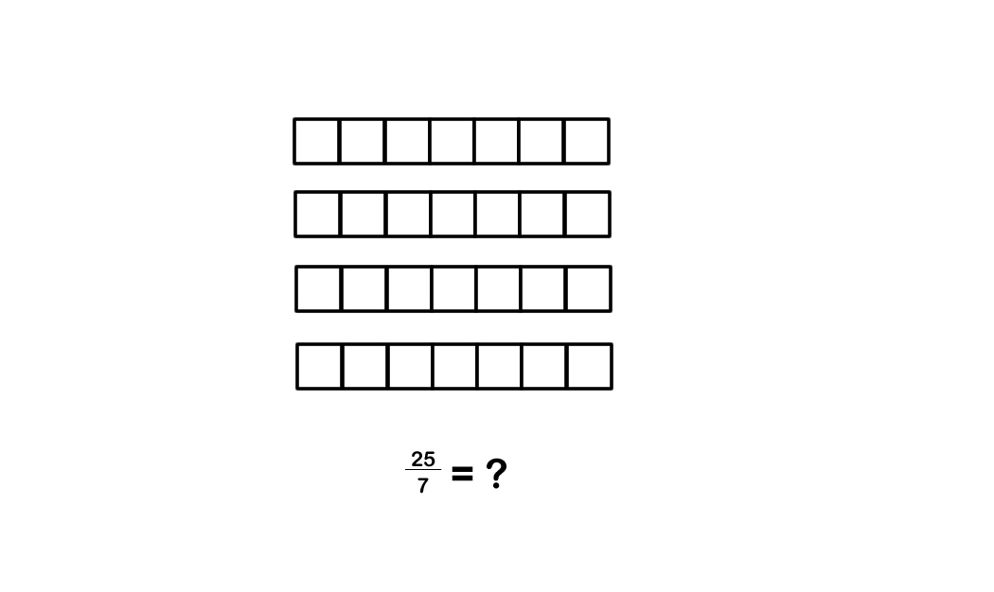
Talking time:
25
7
Use a bar model to convert into a mixed number.

Slide 13
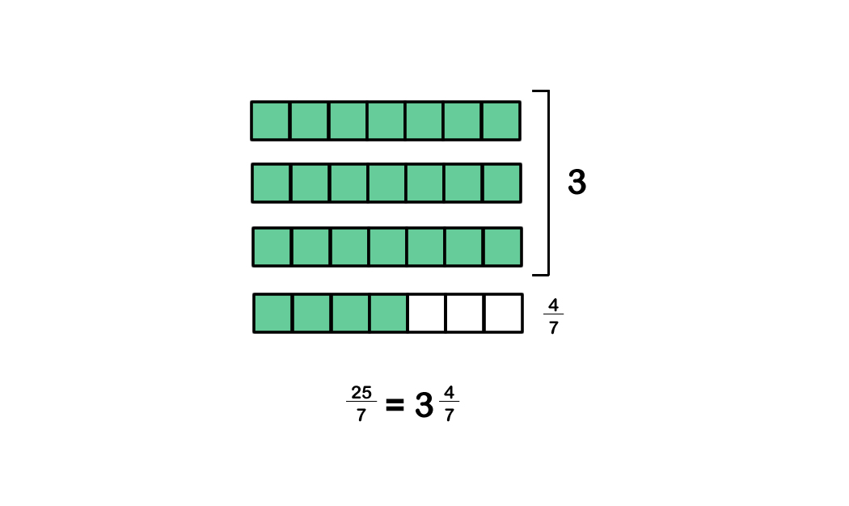
Talking time:
25
7
Use a bar model to convert into a mixed number.

Slide 14
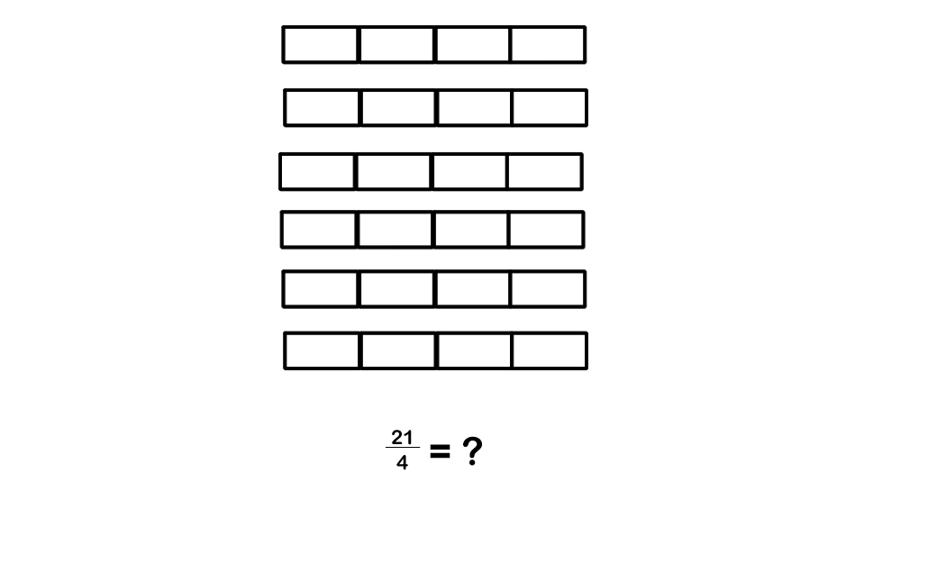
Talking time:
21
4
Use a bar model to convert into a mixed number.

Slide 15
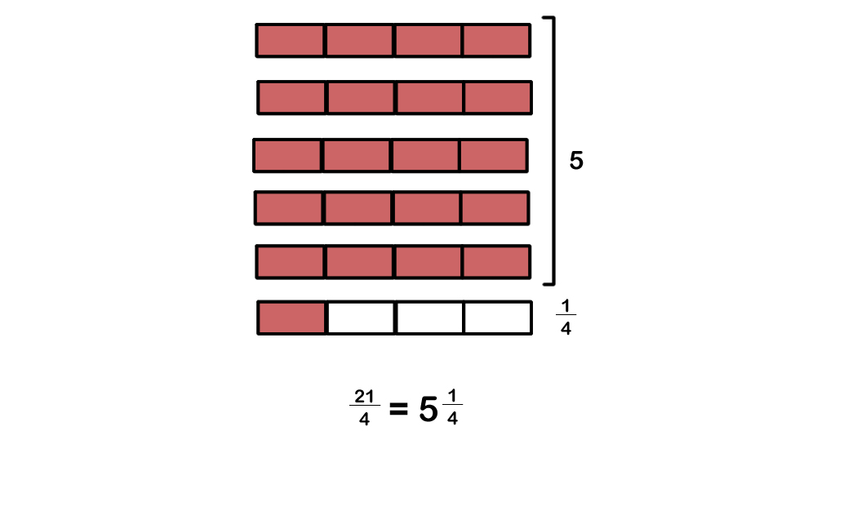
Talking time:
21
4
Use a bar model to convert into a mixed number.

Slide 16
Talking time:
21
4
Use a bar model to convert into a mixed number.

Slide 17
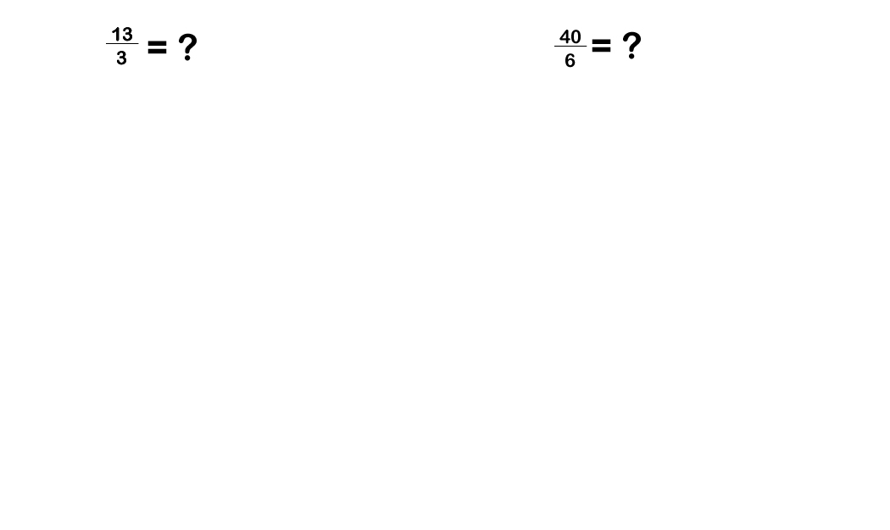
Activity 2:
Use bar models to convert these improper fractions into mixed numbers.

Slide 18
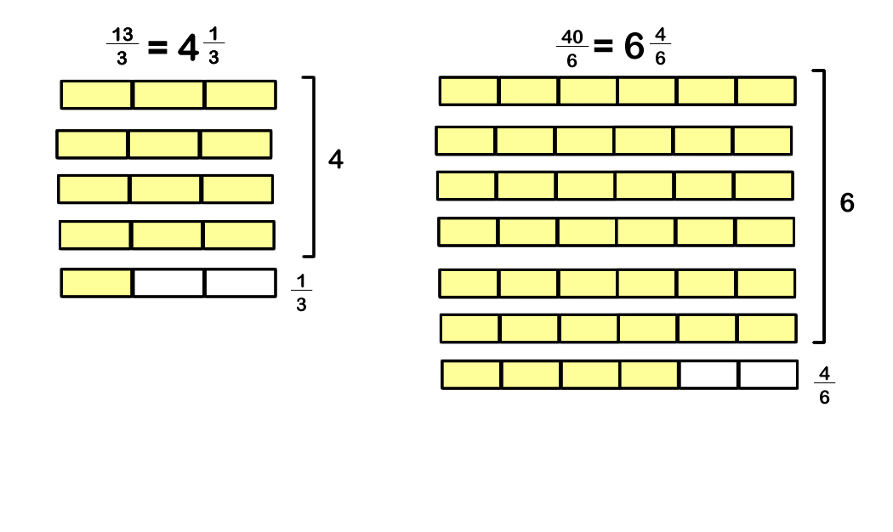
Activity 2:
Use bar models to convert these improper fractions into mixed numbers.

Slide 19
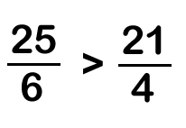
Activity 3:
Isla says,
25 is larger than 21, so
Do you think Isla is right? Explain your answer.

Slide 20
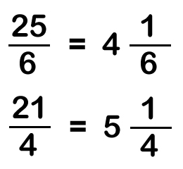
Activity 3:
Isla says,
25 is larger than 21, so
Do you think Isla is right? Explain your answer.
Isla is not right.
The two fractions can be converted into these mixed numbers:
So, we can see that the second fraction is actually larger.

Slide 21
Lightbulb challenge:
Success Criteria: I know that an improper fraction has a greater numerator than denominator I know that a mixed number is a whole number and a proper fraction I can convert improper fractions to mixed numbers
True or False?
If there are more than eight eighths, the fraction will
be an improper fraction.
b) is equal to five and three fifths.
Six thirds is the same as two wholes.
23
5
16
6
4
6
= 2
13
2
1
2
= 7

Slide 22
Lightbulb challenge:
Success Criteria: I know that an improper fraction has a greater numerator than denominator I know that a mixed number is a whole number and a proper fraction I can convert improper fractions to mixed numbers
True or False?
If there are more than eight eighths, the fraction will
be an improper fraction. TRUE
b) is equal to five and three fifths. FALSE
Six thirds is the same as two wholes. TRUE
23
5
16
6
4
6
= 2 TRUE
13
2
1
2
= 7 FALSE

