Slide 1
In focus
Complete the missing numbers:
1) 59,000 = 50,000 + ________
2) ______ = 30,000 + 2700 + 230
3) 75,480 = ______ + 400 + ______

Slide 2
Hafsa is thinking of a five-digit number.
She adds 100 to it.
She subtracts 1,000 from it.
She subtracts 10 from it.
Her answer is:
71, 647
What number did she start with?

Slide 3
Hafsa is thinking of a five-digit number.
She adds 100 to it.
She subtracts 1,000 from it.
She subtracts 10 from it.
Her answer is:
71, 647
What number did she start with?
Work backwards
Doing the opposite
Add 10: 71,647 + 10 = 71,657

Slide 4
Hafsa is thinking of a five-digit number.
She adds 100 to it.
She subtracts 1,000 from it.
She subtracts 10 from it.
Her answer is:
71, 647
What number did she start with?
Work backwards
Doing the opposite
Add 10: 71,647 + 10 = 71,657
Add 1,000 71,657 + 1000 = 72,657

Slide 5
Hafsa is thinking of a five-digit number.
She adds 100 to it.
She subtracts 1,000 from it.
She subtracts 10 from it.
Her answer is:
71, 647
What number did she start with?
Work backwards
Doing the opposite
Add 10: 71,647 + 10 = 71,657
Add 1,000 71,657 + 1000 = 72,657
Subtract 100 72,657 – 100 = 72,557

Slide 6
Acis is thinking of a five-digit number.
He subtracts 1000 from it.
He adds 100 to it.
He adds 10 from it.
His answer is:
85,482
What number did he start with?
Work backwards
Doing the opposite

Slide 7
Acis is thinking of a five-digit number.
He subtracts 1000 from it.
He adds 100 to it.
He adds 10 from it.
His answer is:
85,482
What number did he start with?

Slide 8
Acis is thinking of a five-digit number.
He subtracts 1000 from it.
He adds 100 to it.
He adds 10 from it.
His answer is:
85,482
What number did he start with?
Work backwards
Doing the opposite
Subtract 10: 85,482 – 10 = 85,472

Slide 9
Acis is thinking of a five-digit number.
He subtracts 1000 from it.
He adds 100 to it.
He adds 10 from it.
His answer is:
85,482
What number did he start with?
Work backwards
Doing the opposite
Subtract 10: 85,482 – 10 = 85,472
Subtract 100 85,472 – 100 = 85,372

Slide 10
Acis is thinking of a five-digit number.
He subtracts 1000 from it.
He adds 100 to it.
He adds 10 from it.
His answer is:
85,482
What number did he start with?
Work backwards
Doing the opposite
Subtract 10: 85,482 – 10 = 85,472
Subtract 100 85,472 – 100 = 85,372
Add 1000 85,372 + 1000 = 86,372

Slide 11
Rudolph thinks he can order the following numbers
by only looking at the first three digits.
12,516
12,832
12,794
12,679
12,538
Is he correct? Explain your answer.

Slide 12
Rudolph thinks he can order the following numbers
by only looking at the first three digits.
12,516
12,832
12,794
12,679
12,538
Is he correct? Explain your answer.
Rudolph is incorrect because two of the numbers start with twelve thousand five hundred
therefore you need to look at the tens to compare and order.

Slide 13
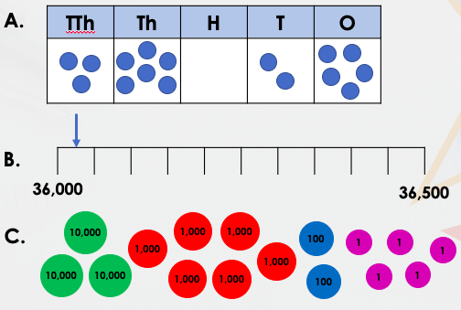
Find the odd one out in the representations below
Explain how you know.

Slide 14
Find the odd one out in the representations below
Explain how you know.
C is the odd one out because it represents 36,205. A and B represent 36,025

