Slide 1
Year 5 & 6 LI to round within 10, 100 & 1,000.
In Focus:
How many multiplication sums can you write on
your whiteboard to equal:
36
40

Slide 2
Learning Objective: To round to the nearest 10
Which ten is the following number nearest to?
36
30
40
30
40

Slide 3
Learning Objective: To round to the nearest 10
Which ten is the following number nearest to?
82
80
90
80
90

Slide 4
Learning Objective: To round to the nearest 10
Which ten is the following number nearest to?
125
120
130
120
130

Slide 5
Learning Objective: To round to the nearest 10
Which ten is the following number nearest to?
980
980
990
980
990

Slide 6
Learning Objective: To round to the nearest 10
Which ten is the following number nearest to?
1457
1450
1460
1450
1460

Slide 7
Learning Objective: To round to the nearest 100
Which hundred is the following number nearest to?
156
100
200
100
200

Slide 8
Learning Objective: To round to the nearest 100
Which hundred is the following number nearest to?
215
200
300
200
300

Slide 9
Learning Objective: To round to the nearest 100
Which hundred is the following number nearest to?
1670
1600
1700
1600
1700

Slide 10
Learning Objective: To round to the nearest 100
Which hundred is the following number nearest to?
1950
1900
2000
1900
2000

Slide 11
Learning Objective: To round to the nearest 100
Which hundred is the following number nearest to?
3370
3300
3400
3300
3400

Slide 12
On your whiteboard find the nearest ten and nearest 100?
54
76
97
172
On your whiteboard find the nearest ten and nearest 100?
611
244
152
806

Slide 13
Find the nearest ten and nearest 100?
54 → 50 100
76 → 80 100
97 → 100 100
172 → 170 200
Find the nearest ten and nearest 100?
611 → 610 600
244 → 240 200
152 → 150 200
806 → 810 800

Slide 14
Learning Objective: To round to the nearest 1000
Which thousand is the following number nearest to?
2352
2000
3000
2000
3000

Slide 15
Learning Objective: To round to the nearest 1000
Which thousand is the following number nearest to?
3892
3000
4000
3000
4000

Slide 16
Learning Objective: To round to the nearest 1000
Which thousand is the following number nearest to?
4090
4000
5000
4000
5000

Slide 17
Learning Objective: To round to the nearest 1000
Which thousand is the following number nearest to?
3593
3000
4000
3000
4000

Slide 18
Learning Objective: To round to the nearest 1000
Which thousand is the following number nearest to?
7457
7000
8000
7000
8000

Slide 19
Complete the table on your whiteboards:
Start number | Nearest 10 | Nearest 100 | Nearest 1,000
365
1,242
 | 4,770

Slide 20
Complete the table on your whiteboards:
Start number | Nearest 10 | Nearest 100 | Nearest 1,000
365 | 370 | 400 | 0
1,242 | 1,240 | 1,200 | 1,000
4,765 to 4,774 | 4,770 | 4,800 | 5,000

Slide 21
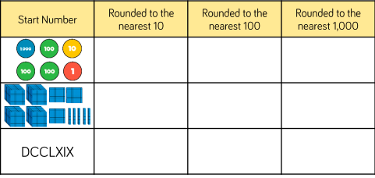
Stick this table in your books and complete:

Slide 22
Stick this table in your books and complete:
1,311
1,310
1,300
1,000
4,350
4,350
4,300
4,000
769
770
800
1,000

Slide 23
Now complete the rest of your sheets, cut out the tables and stick them in your books. Extension sheet: “How to round a number”

