Slide 1
Term 3 Week 1
Art
Fire Picture

Slide 2
L.I: To draw a fire picture using pencils, chalk, pens or paint.

Slide 3
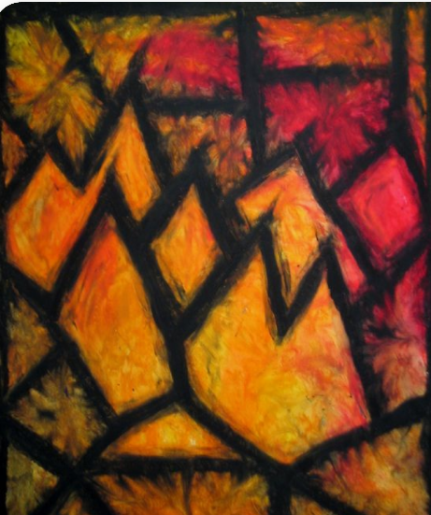
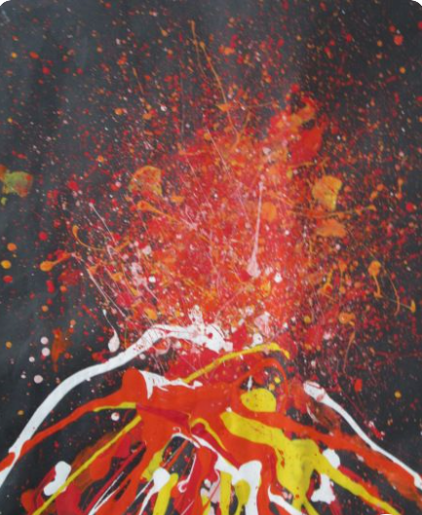
Examples

Slide 4
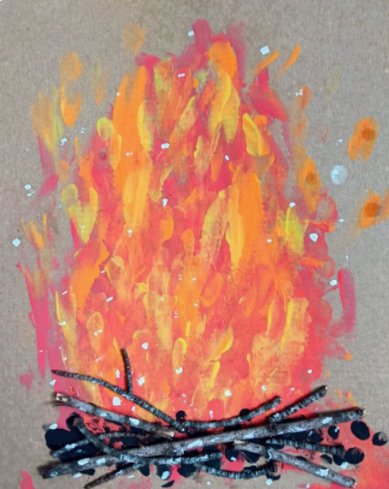
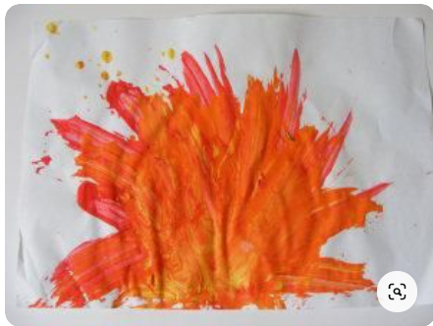
Examples

