Slide 1
Term 3 Week 1
History
The Great Fire of London

Slide 2
Learning Objectives
L.I: I can explain where the Great Fire took place.
L.I: I understand when it took place.
L.I: I can explain how London was different in the 17th century.
L.I: I understand where and when the Great Fire of London started?
Activity: Children sequence the events of the Great Fire of London on a timeline.

Slide 3
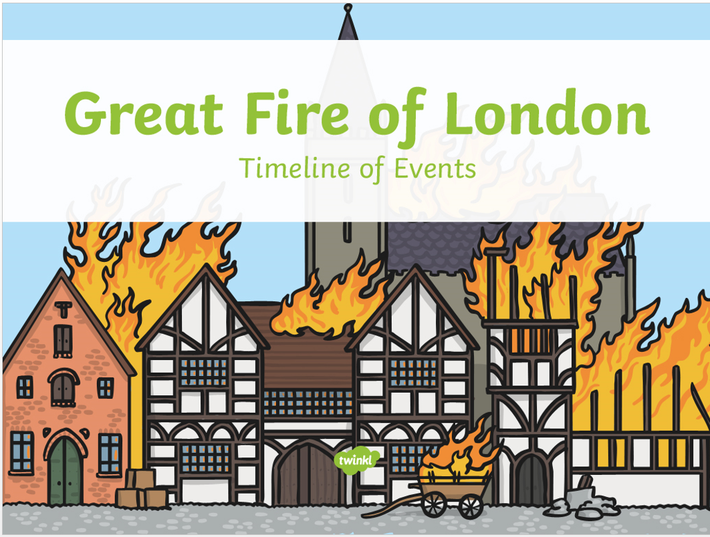

Slide 14
Task
To sequence the events of The Great Fire of London on a timeline.
You can cut and stick or write the events on to your timeline.

