Slide 2
Learning Intentions
To describe what plants need to grow and stay healthy.
To use my observations to say what food crops will need to grow and stay healthy.
Success Criteria
I can explain that plants need water, light and a suitable temperature to grow well.
I can explain that different plants have different needs.
I can give examples of food crops.
I can say how to care for food crops so they grow well.

Slide 3
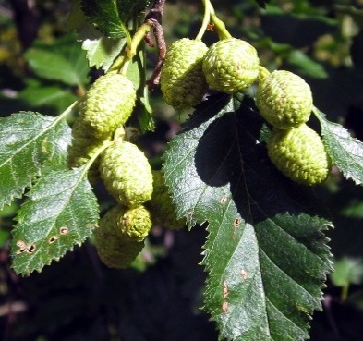
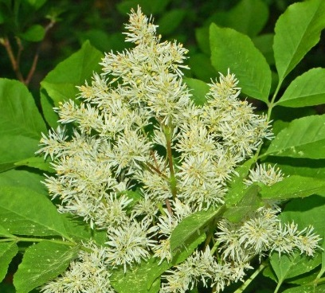
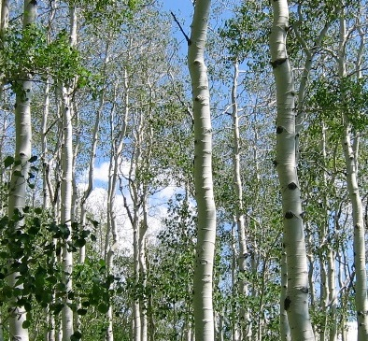
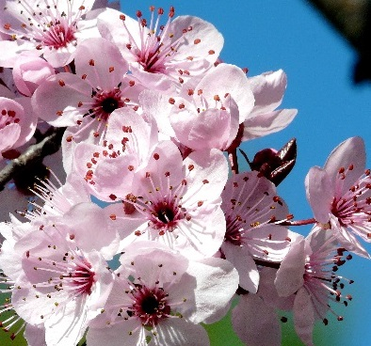
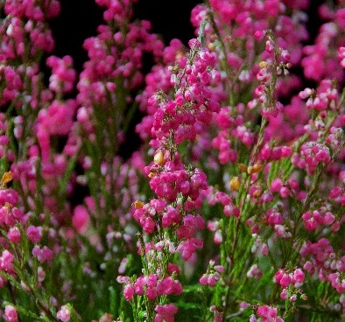
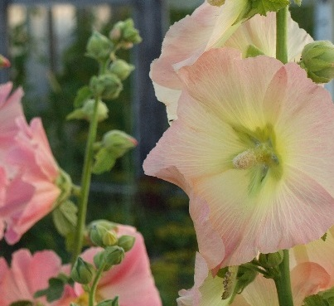
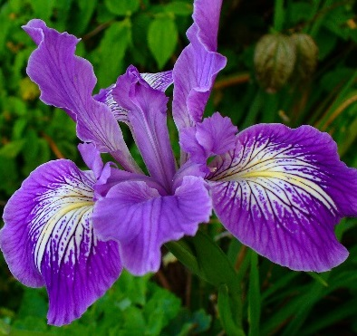
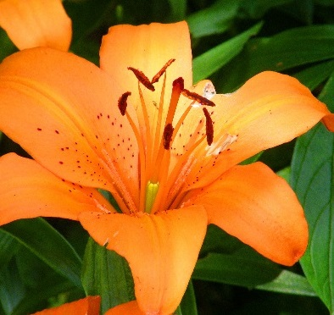
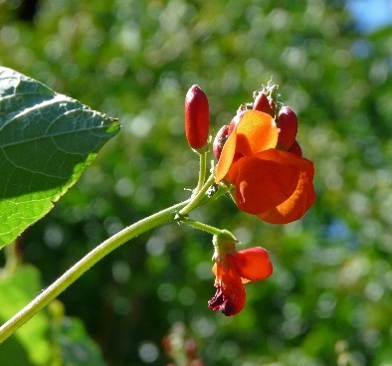
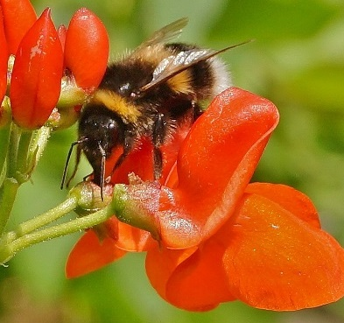
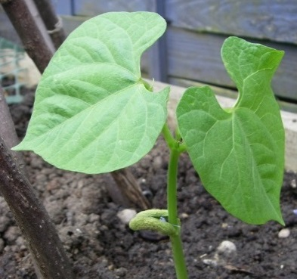
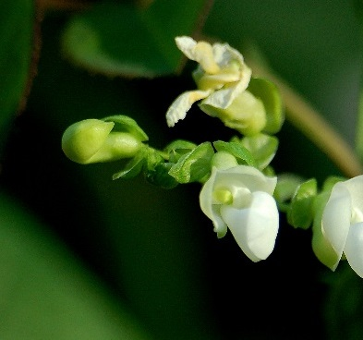
We have been learning about…
Plants.
Photos courtesy of Ruth and Dave, Ettore Balocchi, saaby, .Bambo., flora.cyclam, Dendroica cerulean, Darkroom Daze, Brenda Anderson, Howard Dickins, -adrienne-, free photos for you, rosipaw(@flickr.com) - granted under creative commons licence – attribution

Slide 4
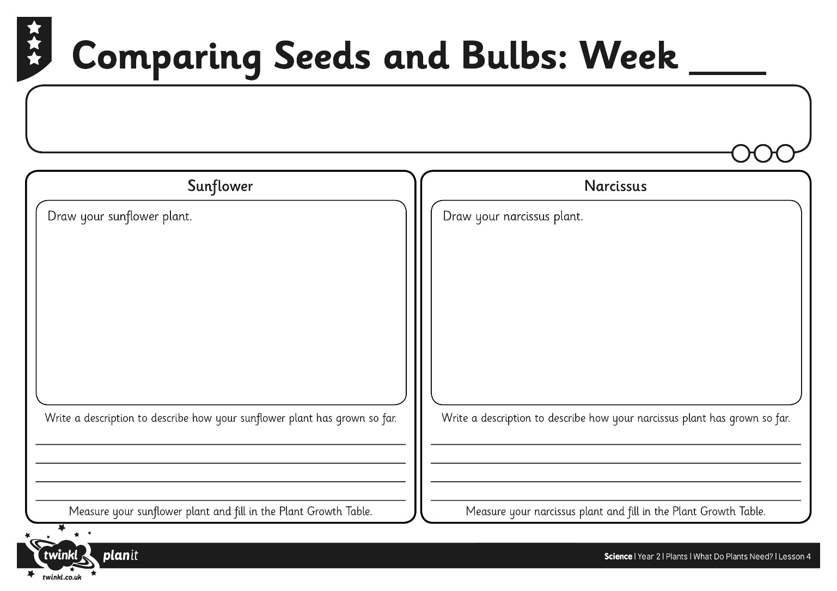
Task 1 Comparing Seeds and Bulbs

Slide 5
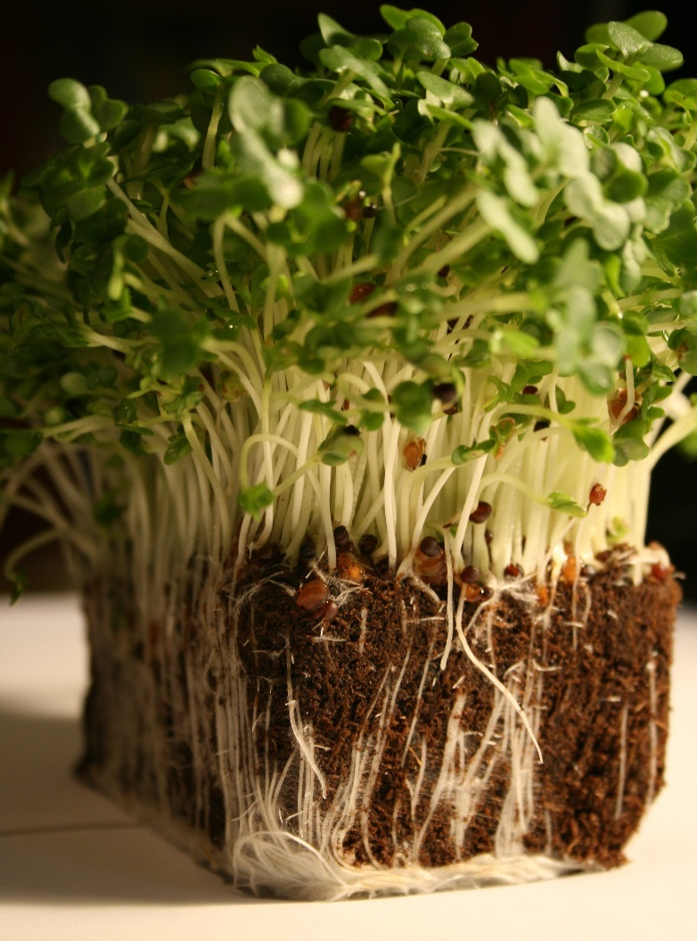
What Do Plants Need?
Do you remember we planted some cress?
Half of the cress has been growing outside where it is cool. The other half has been growing inside in a warm place.
Photos courtesy of thegshow (@flickr.com) - granted under creative commons licence – attribution

Slide 6
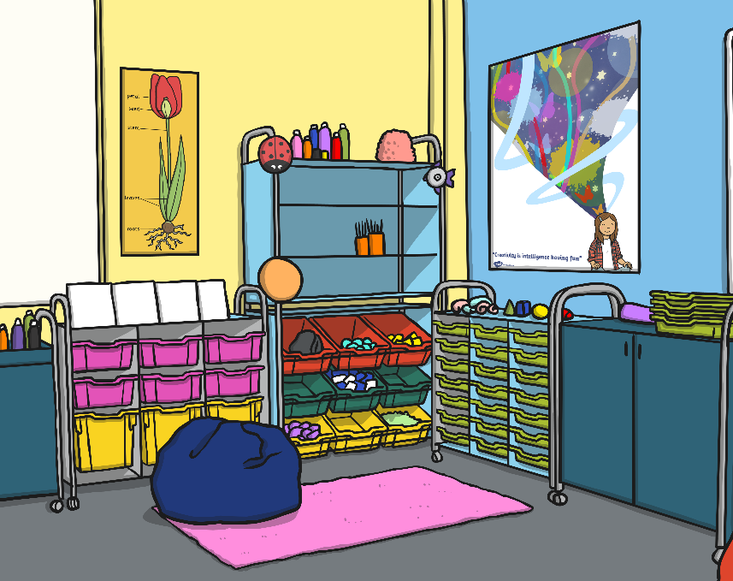
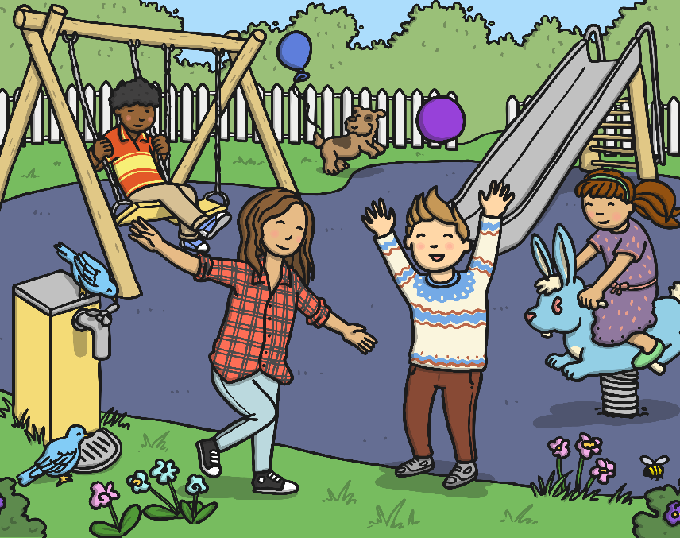
What Do Plants Need?
Which one do you think has grown the best? Why?
Inside (warm)
Outside (cool)

Slide 7
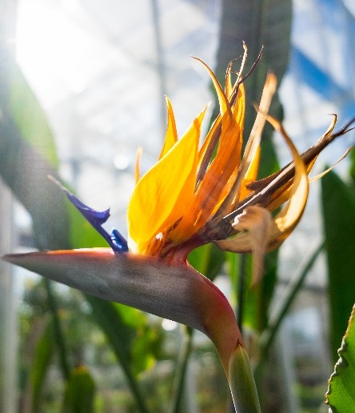
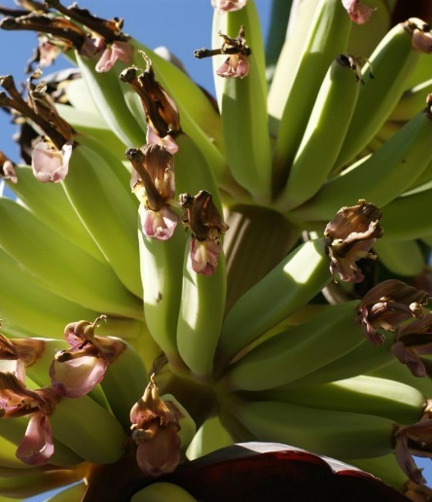
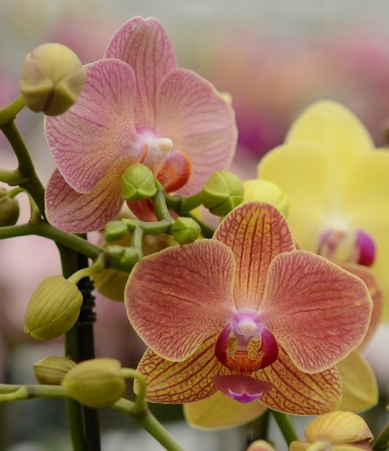
What Do Plants Need?
Cress grows best when it is warm.
All plants need the right temperature to grow well.
Here are some plants that like to grow where it is very hot.
These plants do not like to get too cold.
Palm Trees
Bird-of-Paradise
Bananas
Orchid
Photos courtesy of ealvaz, Janitors, RDPixelShop, Rene Mensen (@flickr.com) - granted under creative commons licence – attribution

Slide 8
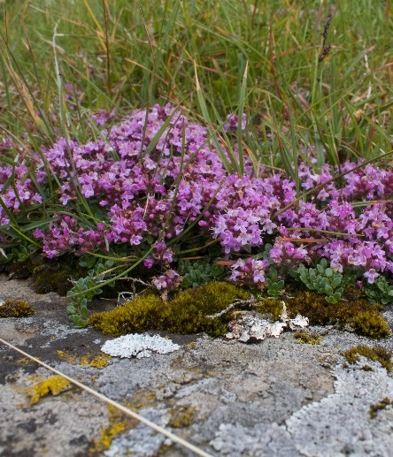
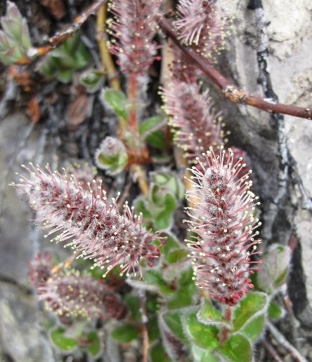
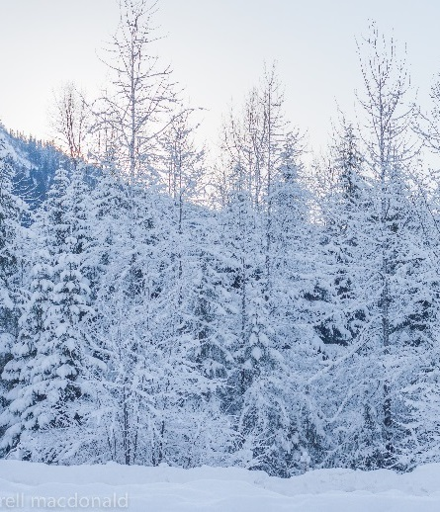
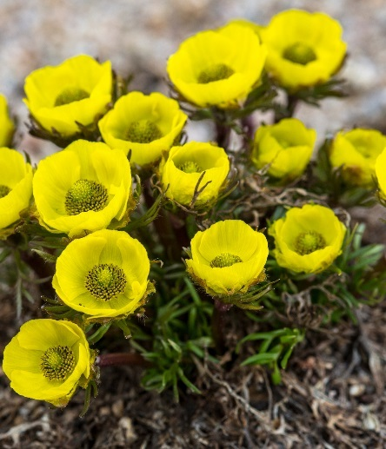
What Do Plants Need?
Here are some plants that like to grow where it is cold.
These plants do not grow well where it is warm.
Saxifrage
Arctic Willow
Fir Trees
Snow Buttercup
Photos courtesy of brian.gratwicke, euphro, john farrell macdonald, Rocky Mountain National Park (@flickr.com) - granted under creative commons licence – attribution

Slide 9
What Do Plants Need?
We know plants need the right temperature to grow well.
What other things do they need? How do we know?

Slide 10
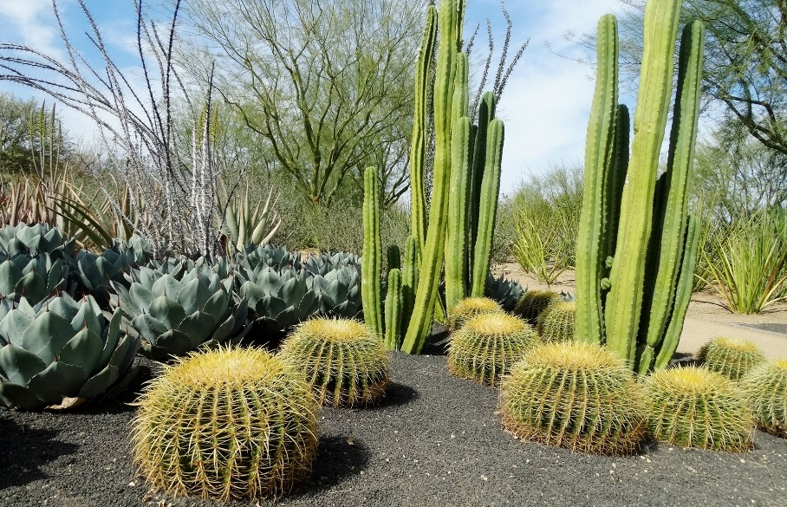
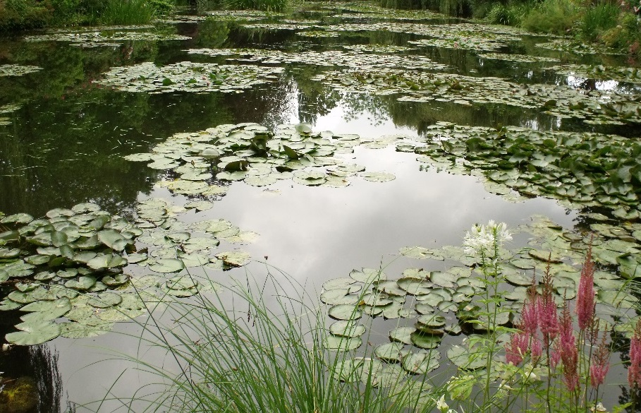
What Do Plants Need?
Just as some plants prefer the warm and some like to grow where it is cold, plants like different amounts of sunlight and water.
These plants grow where it is very sunny and dry.
These plants grow in the water.
Photos courtesy of inkknife_2000 (4 million views), ell brown (@flickr.com) - granted under creative commons licence – attribution

Slide 11
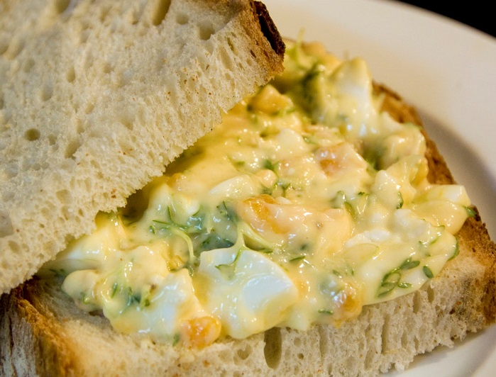
Plants We Eat
Cress is a plant that we eat.
Lots of the food that we eat is a part of a plant.
Can you think of any?
Photos courtesy of Tavallai (@flickr.com) - granted under creative commons licence – attribution

Slide 12
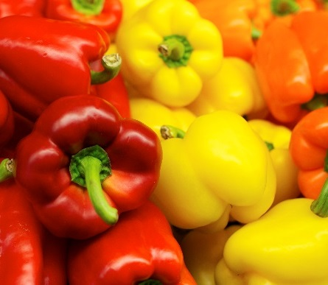
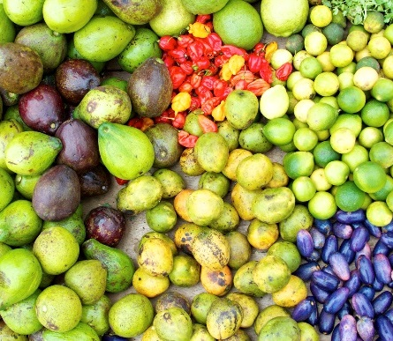
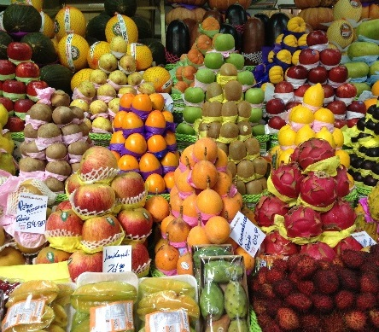
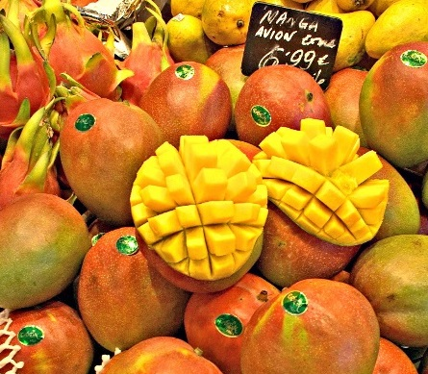
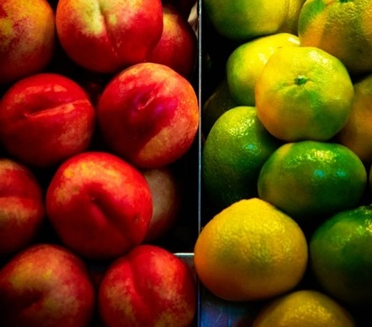
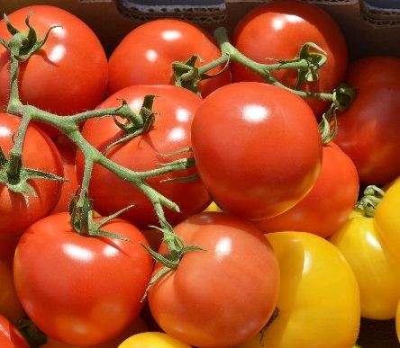
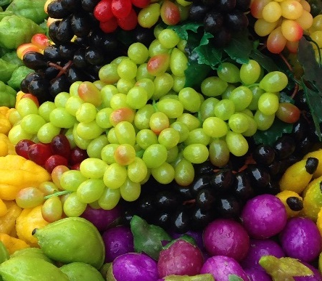
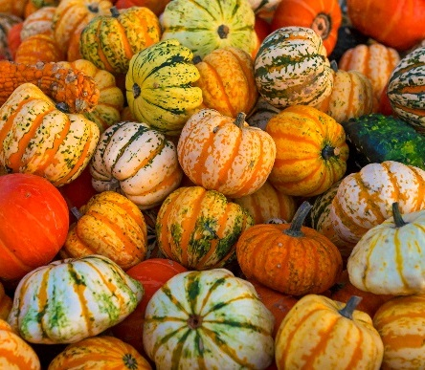
Plants We Eat: Fruit
Many plants have fruit to carry and spread their seeds.
Some of the food we think of as vegetables are actually fruits.
Photos courtesy of Andrew E. Larsen, Au Kirk, Embassy of Equatorial Guinea, Jason Rosenberg, Moyan_Brenn, ramnath bhat, swong95765, Tambako the Jaguar (@flickr.com) - granted under creative commons licence – attribution

Slide 13
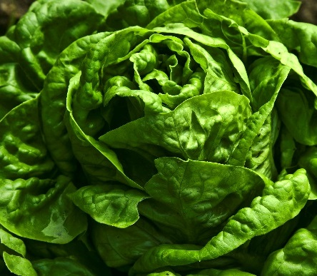
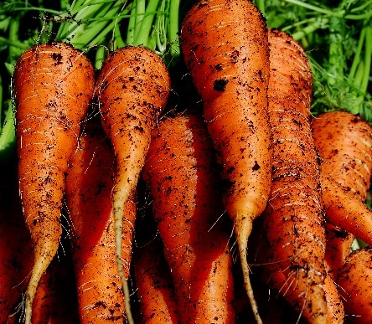
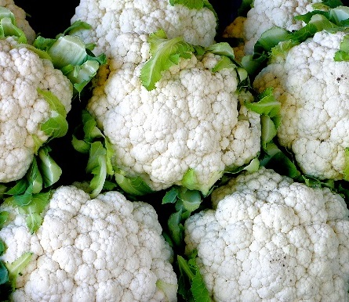
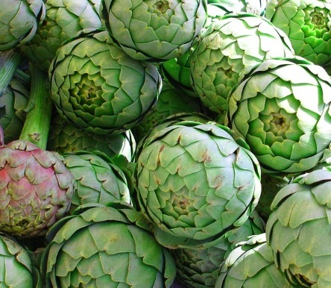
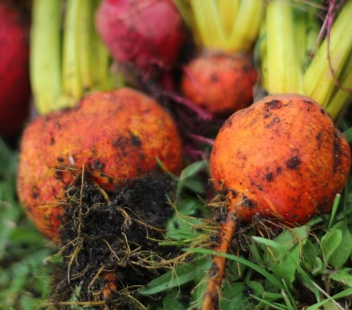
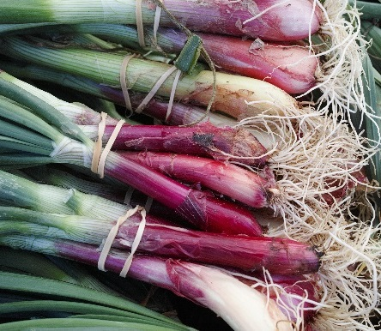
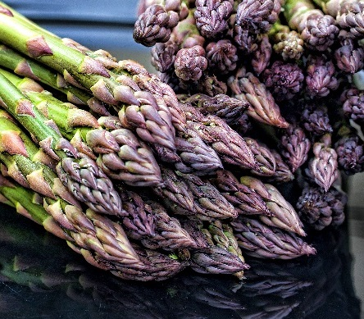
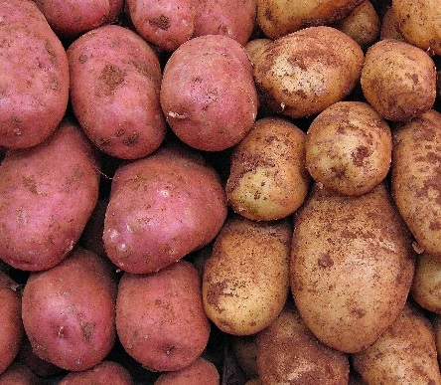
Plants We Eat: Vegetables
Vegetables come from all different parts of plants.
Photos courtesy of Muffet, looseends, NoiseCollusion, martindelisle31, Jun Seita, 16:9clue (@flickr.com) - granted under creative commons licence – attribution

Slide 14
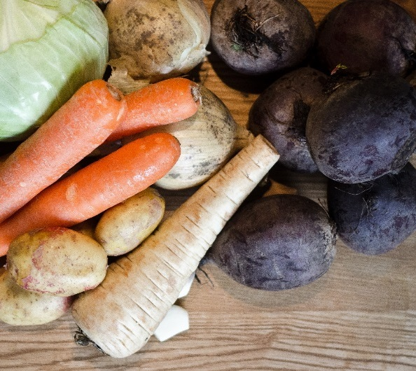
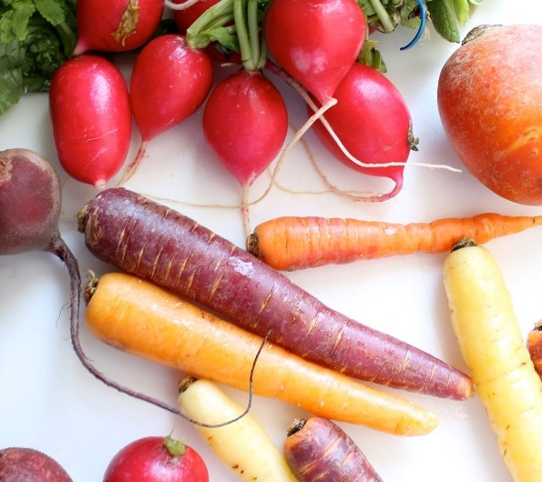
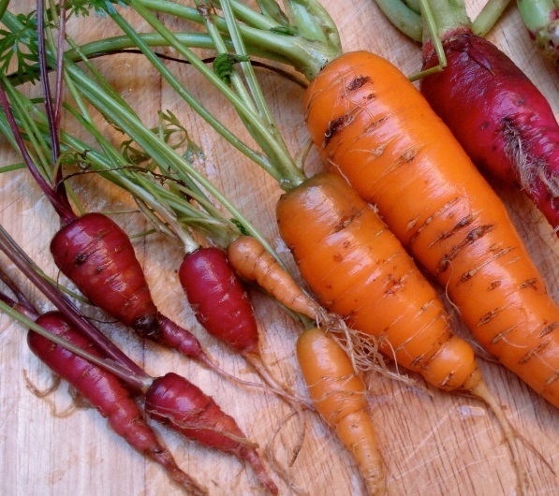
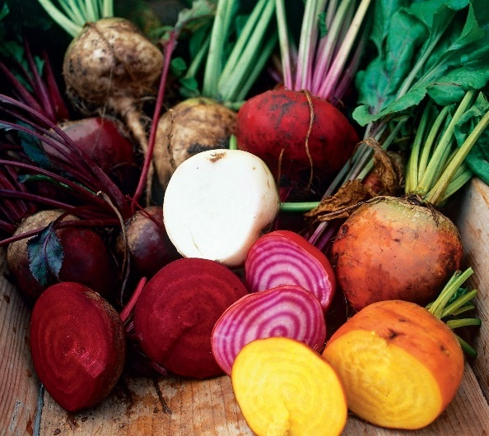
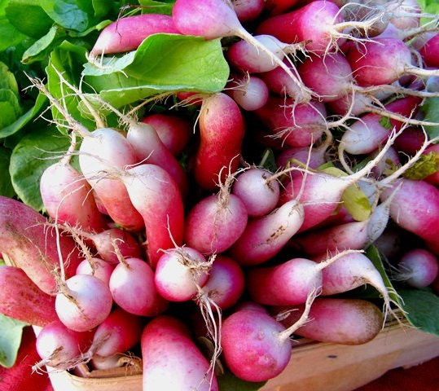
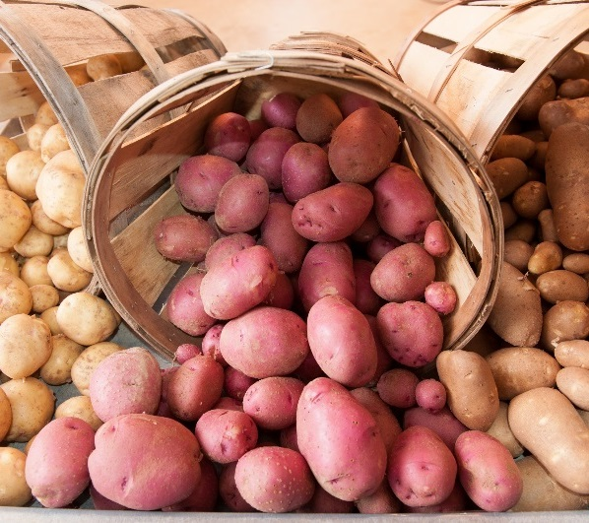
Plants We Eat: Root Vegetables
Photos courtesy of hepp, Le living and co., net_efekt, Skånska Matupplevelser, srqpix, UnitedSoybeanBoard (@flickr.com) - granted under creative commons licence – attribution

Slide 15
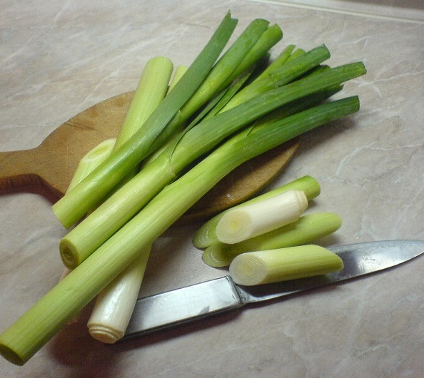
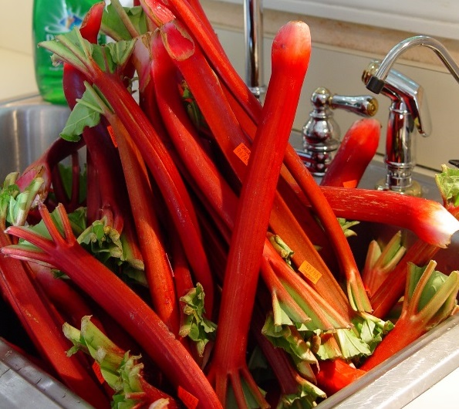
Plants We Eat: Stem Vegetables
Photos courtesy of Alesist, ksbuehler, Muffet, richard_north, wikioticsIan (@flickr.com) - granted under creative commons licence – attribution

Slide 16
Plants We Eat: Leaf Vegetables
Photos courtesy of asdfawev, krgjumper, Muffet, Nikki L., wikioticsIan, woodleywonderworks (@flickr.com) - granted under creative commons licence – attribution

Slide 17
Plants We Eat: Flower Vegetables
Photos courtesy of beautifulcataya, French Tart, Grempz, Mishimoto, Muffet, sk8geek (@flickr.com) - granted under creative commons licence – attribution

Slide 18
Plants We Eat: Grains and Cereals
These foods are the seeds of grassy plants.
Grains are very important foods around the world.
Photos courtesy of CIAT International Center for Tropical Agriculture, David Spender, echiner1, stevendepolo, Lauren Tucker Photography, Stacy Spensley (@flickr.com) - granted under creative commons licence – attribution

Slide 19
Plants We Eat: Nuts, Seeds and Legumes
Photos courtesy of balise42, DeSegura89, geishaboy500, Matt Biddulph, The Travelling Bum, WhyKenFotos (@flickr.com) - granted under creative commons licence – attribution

Slide 20
Plants We Eat
You have 1 minute to remember 5 different foods that we eat that are parts of plants.
Write or draw them on your whiteboard.
On your marks…
Get set…
GO!
01:00
00:59
00:58
00:57
00:56
00:55
00:54
00:53
00:52
00:51
00:50
00:49
00:48
00:47
00:46
00:45
00:44
00:43
00:42
00:41
00:40
00:39
00:38
00:37
00:36
00:35
00:34
00:33
00:32
00:31
00:30
00:29
00:28
00:27
00:26
00:25
00:24
00:23
00:22
00:21
00:20
00:19
00:18
00:17
00:16
00:15
00:14
00:13
00:12
00:11
00:10
00:09
00:08
00:07
00:06
00:05
00:04
00:03
00:02
00:01
00:00
00:00

Slide 21
From Farm to Fork
Most of the plants that we eat are grown by farmers.
Farmers grow plants for food. They call the plants crops.
Photos courtesy of edibleoffice, whl.travel, USDAgov, Rod Waddington, keeva999, Christian.Pratt (@flickr.com) - granted under creative commons licence – attribution

Slide 22
From Farm to Fork
The farmers sell the food to supermarkets and other shops.
Photos courtesy of ell brown, bunnyhero, Dean Hochman (@flickr.com) - granted under creative commons licence – attribution

Slide 23
From Farm to Fork
We buy the food,
take it home and eat it!
Photos courtesy of cletch, Kylethebookpolice, macspite, Martin Cathrae, NatalieMaynor, veganheathen (@flickr.com) - granted under creative commons licence – attribution

Slide 24
From Farm to Fork
Farmers have to look after their plants very carefully so they can grow lots of food for us to eat.
Watch this video to find out more:
Notes:
Please check that the content in this link, including any comments, is suitable for your educational environment before showing. Please do not let the next video automatically play at the end of the clip. Twinkl accepts no responsibility for the content of third party websites.
24

Slide 25
Task 2 On the Farm

Slide 26
Food, Glorious Food
Shall we try some of the food we have been talking about?
What parts of plants do these foods come from?
How do you think farmers help them to grow?

