Slide 1
Term 4 Week 5
GPS
Year 2
L.I: I can use commas when I am writing a list.
L.I: I can form adjectives using suffixes –ful, - less.

Slide 2
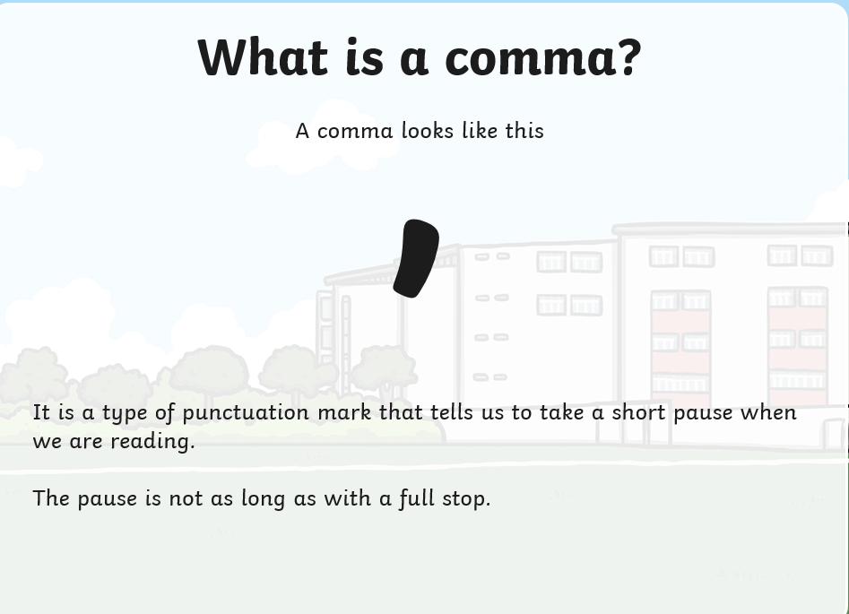
Task 1 L.I: To use commas to separate items in a list(in a sentence).

Slide 3
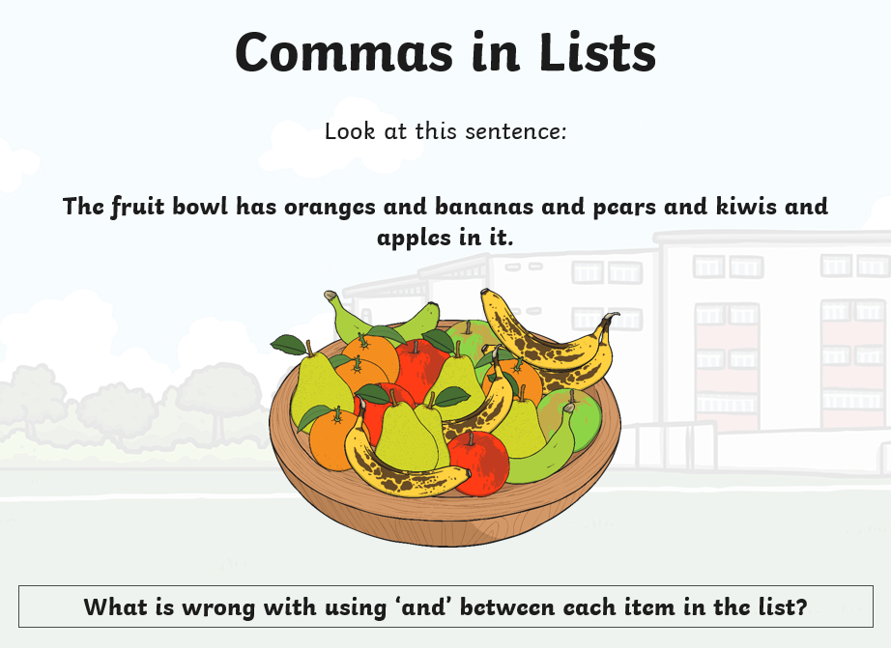

Slide 4
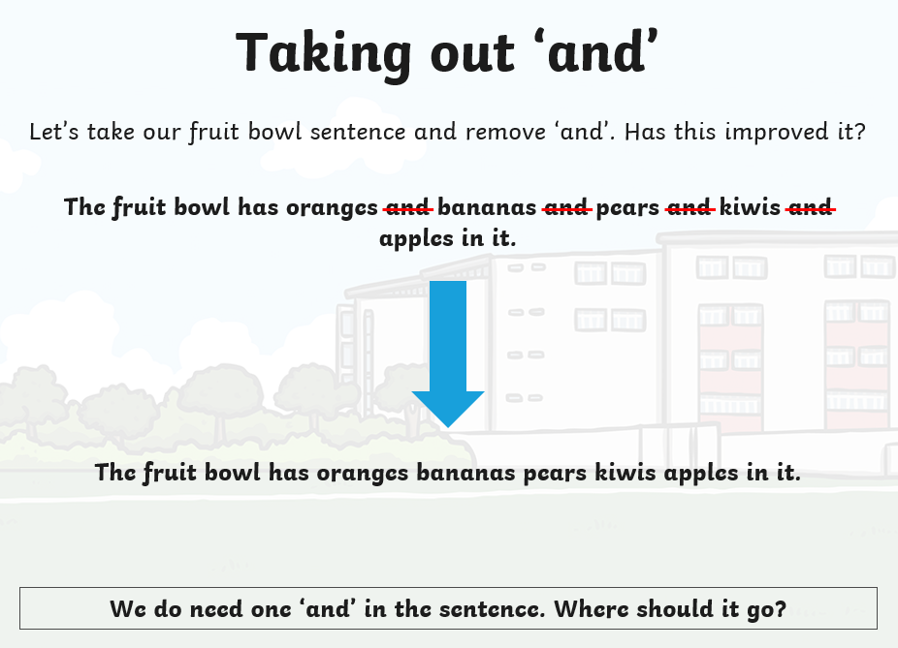

Slide 5
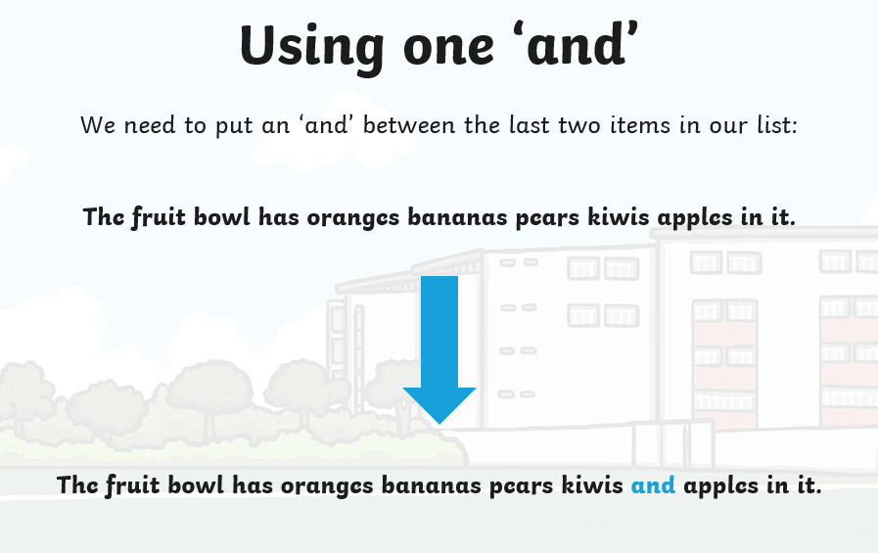

Slide 6
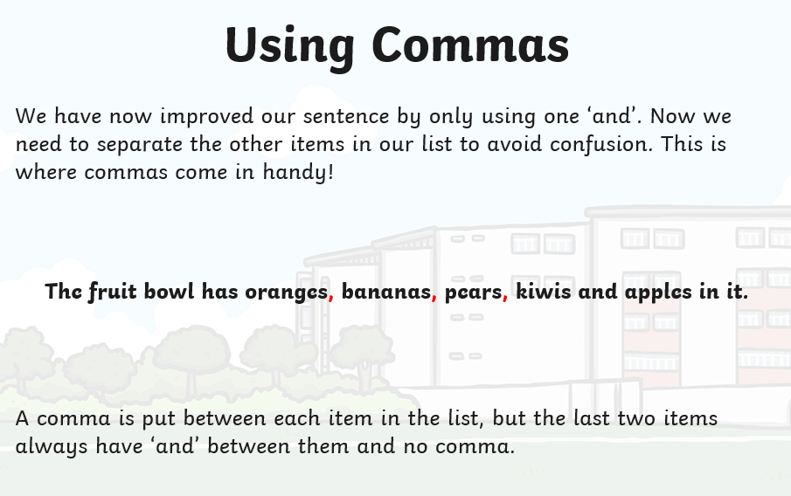

Slide 7
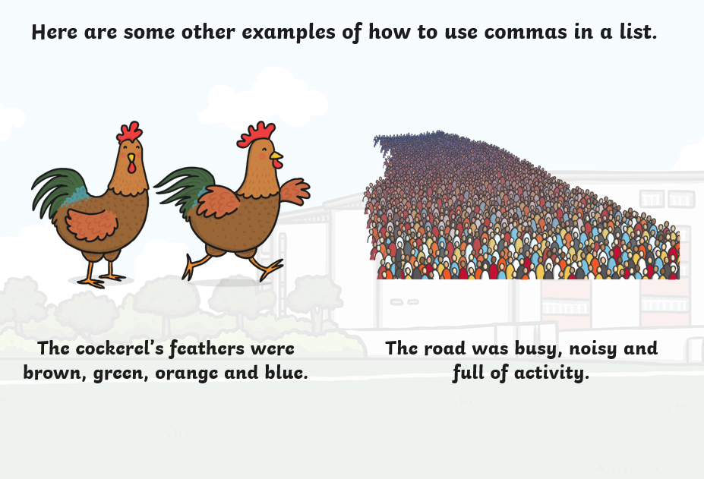

Slide 8
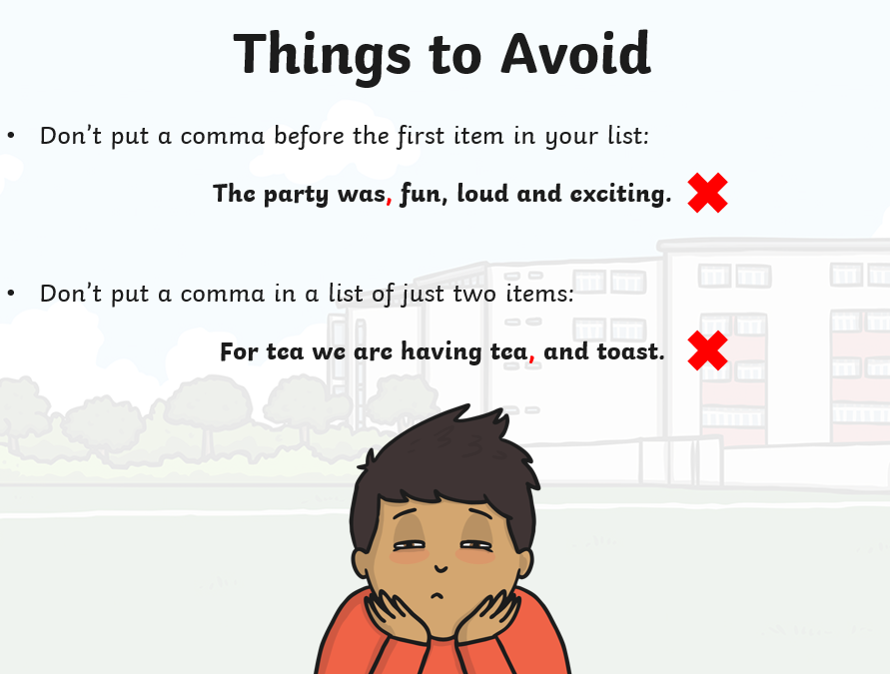

Slide 9
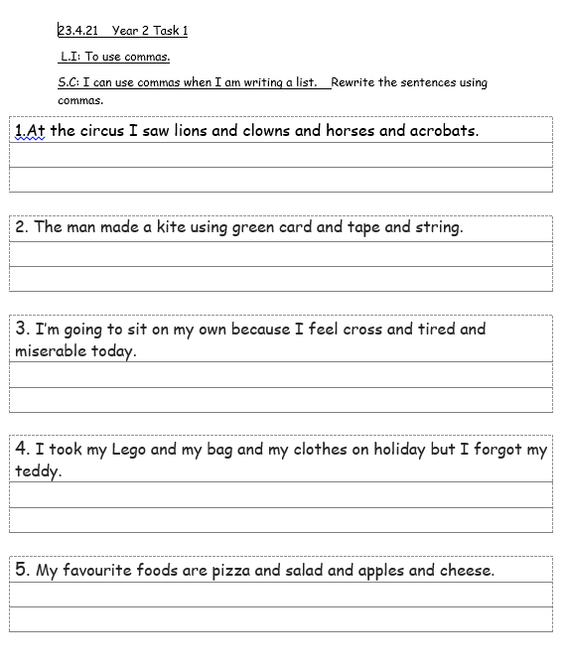
Task 1
Rewrite the sentences using commas.

Slide 10
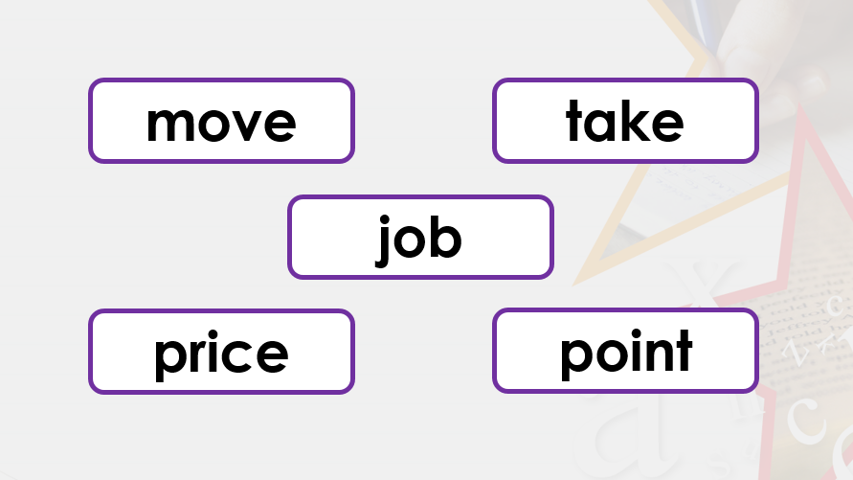
Task 2
L.I: I can form adjectives using suffixes –ful, - less.
Which of these words make a new word when you add –less?

Slide 11
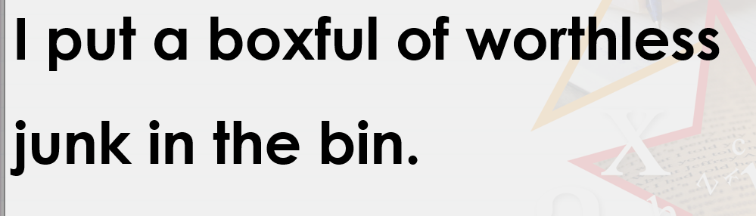
Spot the words with a suffix in the sentence below.

Slide 12
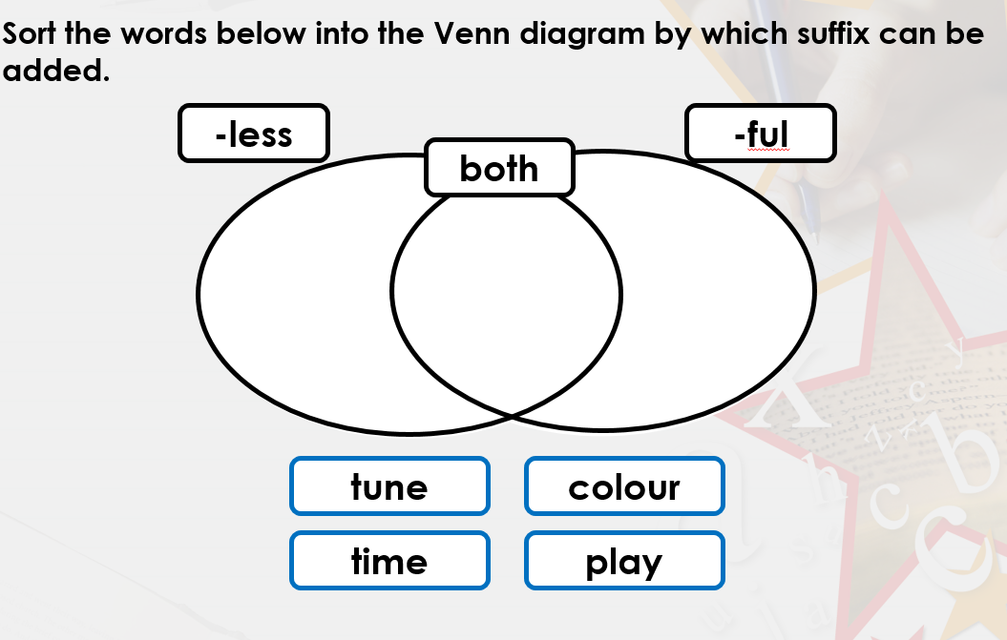

Slide 13
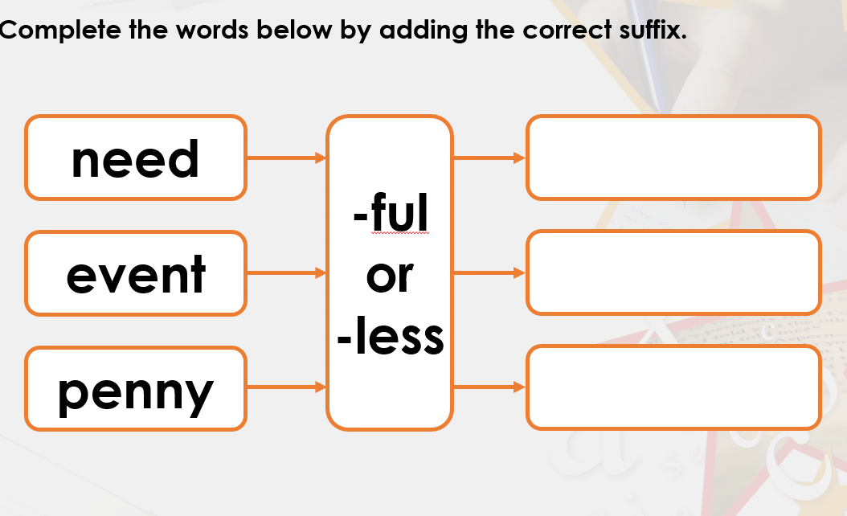

Slide 14
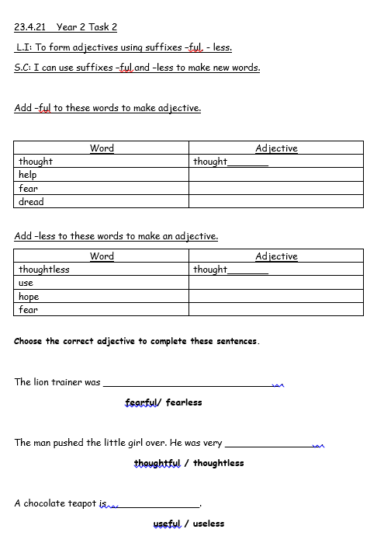
Task 2
To use -ful and -less to make new words.

