Slide 1
LI: to be able to describe how living things are classified into different groups
Steps to Success:
I can identify how living things are similar and different
I can classify living things based on their features
I can compare and sort living things into different groups

Slide 2
How many different species of living things do you think there are on Earth? Choose your answer and then your teacher will click which one you choose.
3 million
16 million
Incorrect
Incorrect
10 million
Correct!
7 million
Incorrect
Scientists believe that there could be as many as 10 million different species on Earth! It would be very hard to study the lives and behaviours of all these living things without grouping them together somehow.​
Scientists sort and group living things according to their similarities and differences. This is called classification. Scientists who classify living things are called taxonomists.​

Slide 3
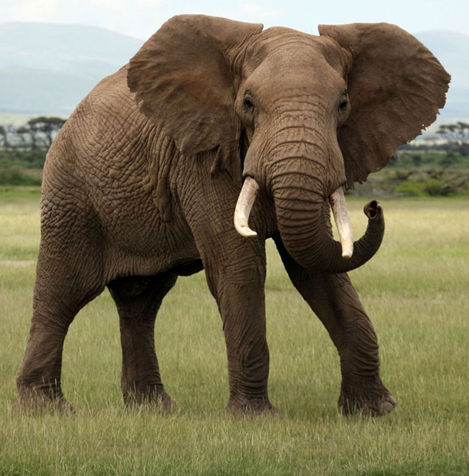
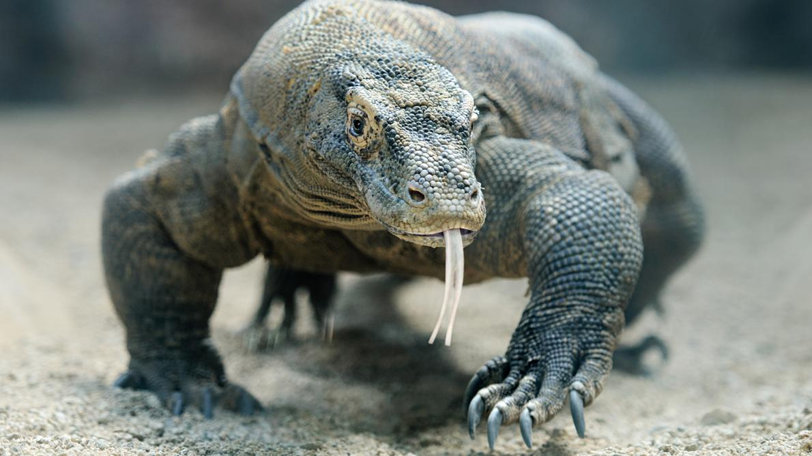
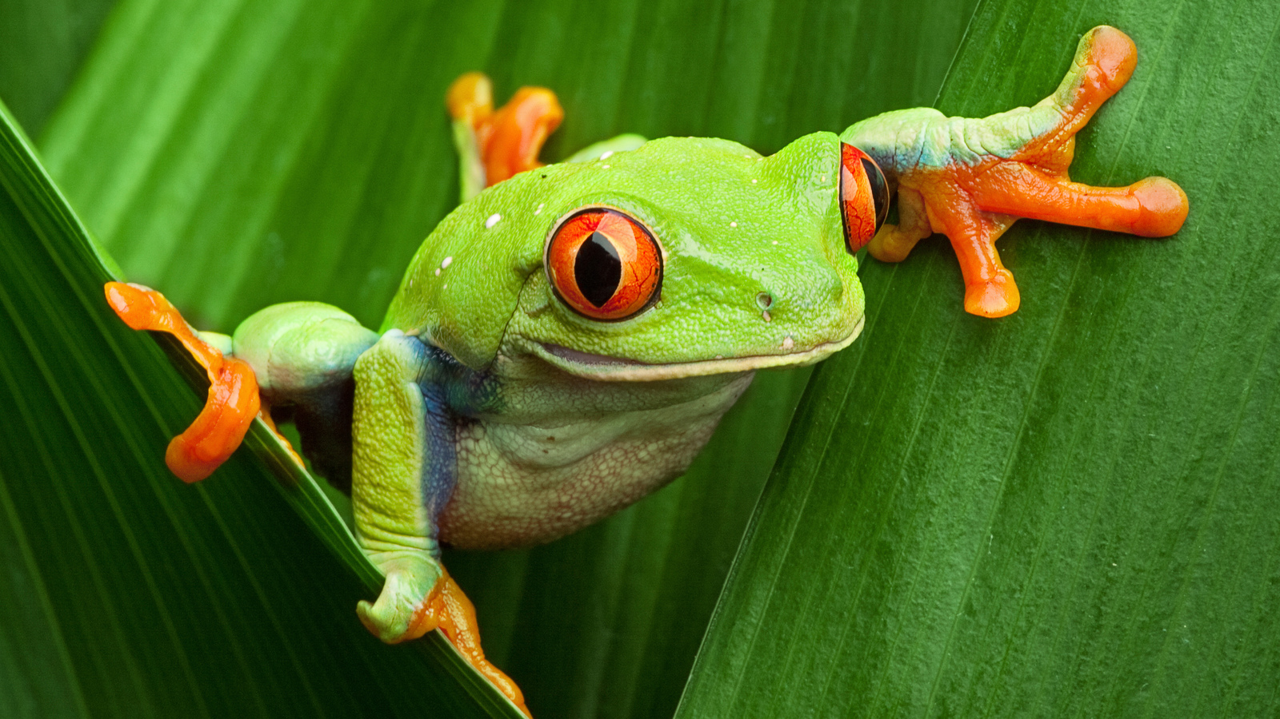
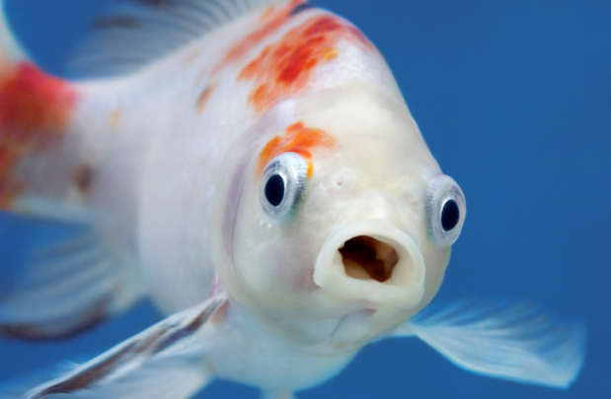
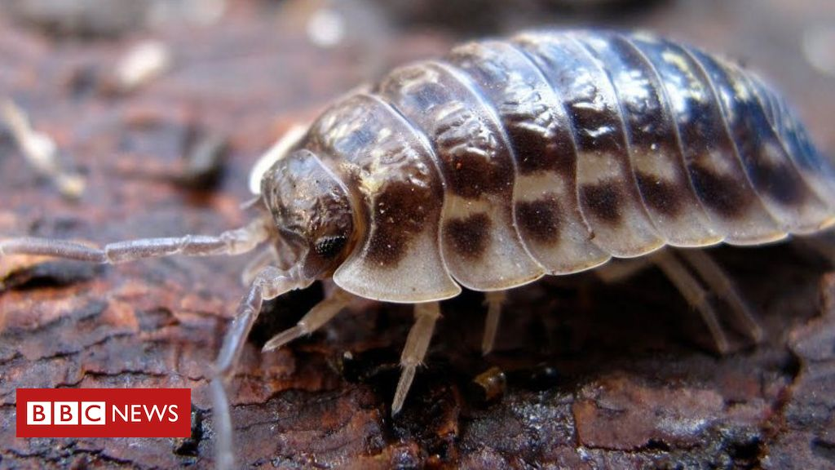
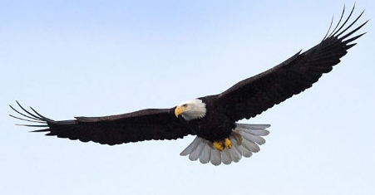
Animals can be sorted into different groups, using common features they all share. Each of these animals represent a category they are grouped together in. Can you guess what each of the categories are? Write them down on your whiteboard and then give your answer to your teacher to see if you are correct.
Mammals | Reptiles | Amphibians | Fish | Birds | Insects

Slide 4
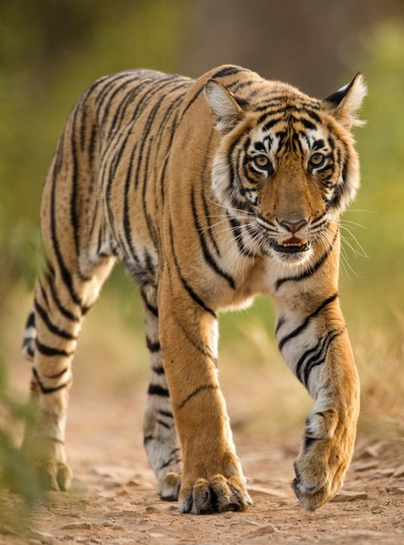
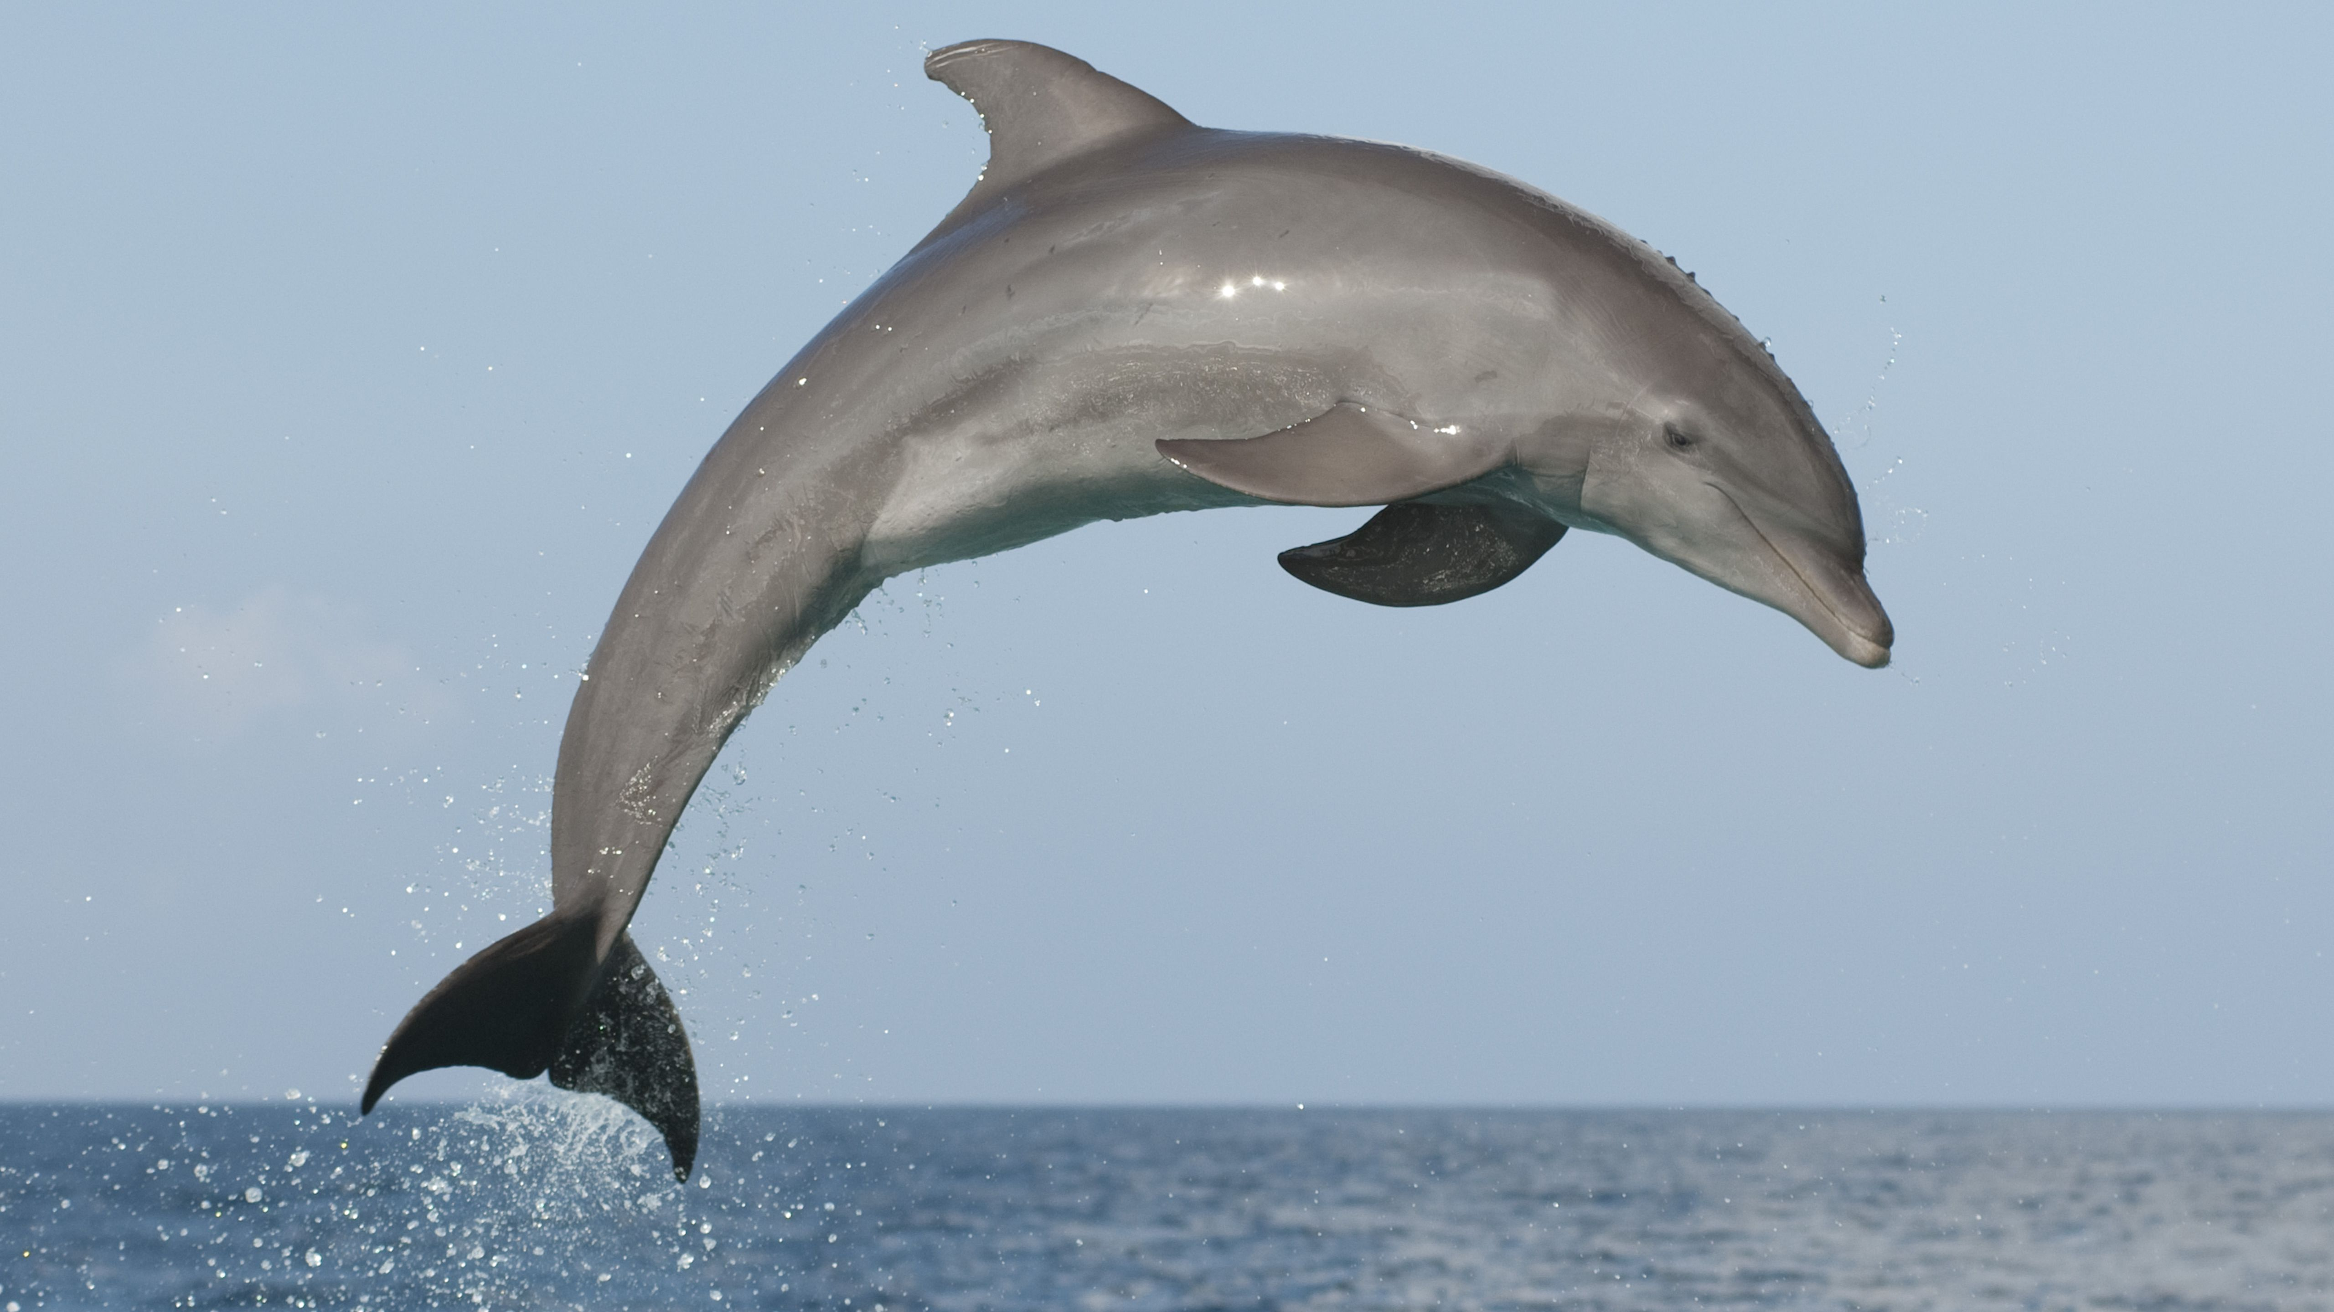
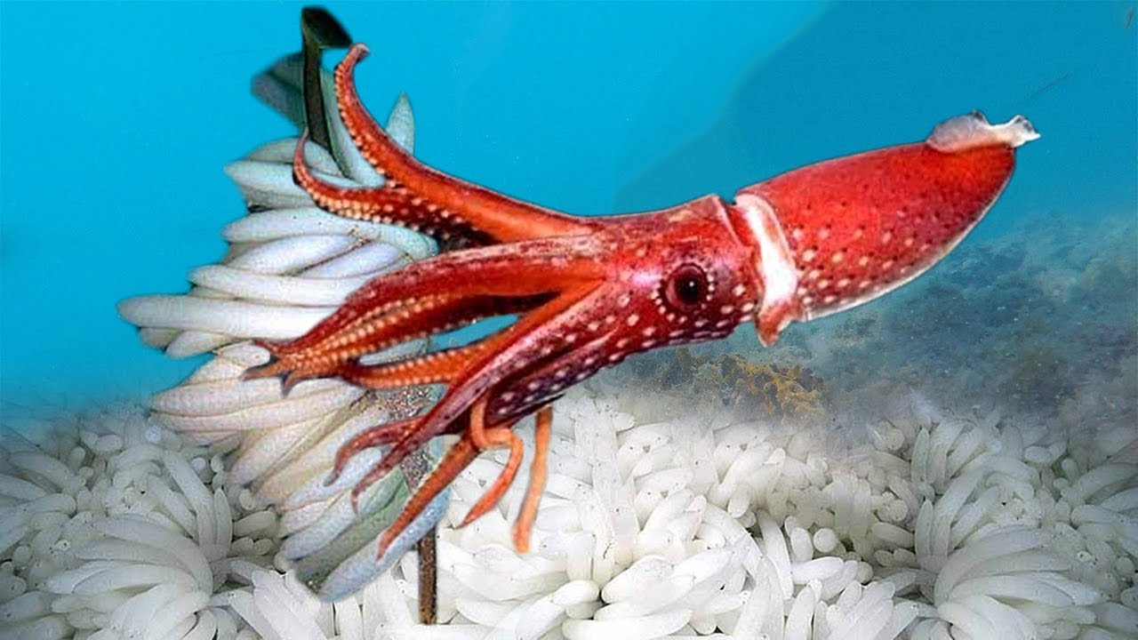
All living things have similar and different features. Taxonomists use these similarities and differences to sort them into groups. Write the following sentence in your book and then make a list underneath stating what questions you can ask yourself about these animals: To compare animals, we can ask the following questions: How many legs does it have? Does it have fur? Once you have had a go at this, we will share our questions with the class.

Slide 5
Now you have asked some questions about these animals, based on their features, we are now going to have a go at grouping them together.
4 legs
Not 4 legs
Mammals
Not Mammals
More than 4 legs
Less than 4 legs
Land
Sea
Birds
Not birds

Slide 6
Your Task Drusillas Park is re-designing their zoo and need your help with where to place the animals. They want the animals that share similar features near each other in the zoo. Your job is to use a list of animal provided and create your own classification chart to help them do this. You will receive a list of the animals and you will need to draw the classification chart in your book as neatly as you can. For Challenge Activity, see your teacher!

Slide 7
You will need to decide where the animal goes and write it in the correct box. For the first box, cut the picture of the animal out and stick it in. Every time you go down the chart, you will need to write the animals name again, depending on what category you have put it in.
4 legs
Not 4 legs
Mammals
Not Mammals
More than 4 legs
Less than 4 legs
Elephant
Dolphin
Land
Sea
Birds
Not birds
Dolphin

