Slide 1
2 3. 1 1 . 2 1
3&4: Can I find fractions?
5: Can I equivalent fractions?
6: Can I simplify fractions?
I know what a fraction is.
I can identify fractions.
I know how to identify equivalent fractions.
In focus task

Slide 2
In focus
Circle the non-unit fractions
$\frac{\text{2}}{\text{5}}$ $\frac{\text{1}}{\text{7}}$ $\frac{\text{4}}{\text{5}}$ $\frac{\text{5}}{\text{6}}$ $\frac{\text{1}}{\text{9}}$
2) What fraction of the bar is shaded in?
3) What fraction of the bar is shaded in?

Slide 3
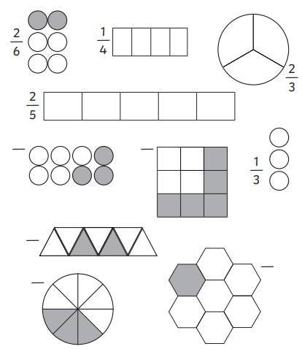
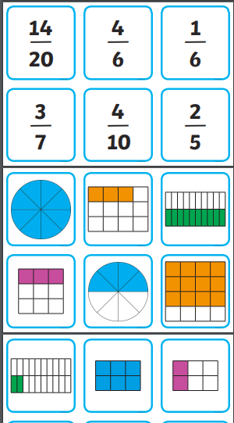
Lola, Ella, Frankie, Bobby, Tiyler & Terry
You are going to be finding fractions today.
Then, you will be playing this fraction matching game:

Slide 4
This is the Year 5 input, but Year 6s please pay attention as this will help you to remember what we did yesterday.
Equivalent fractions
Equivalent means the same value or amount.
is equivalent to

Slide 5
New learning
$\frac{\text{1}}{\text{2}}$
$\frac{\text{1}}{\text{2}}$
$\frac{\text{1}}{\text{2}}$
$\frac{\text{1}}{\text{4}}$ | $\frac{\text{1}}{\text{4}}$
$\frac{\text{1}}{\text{4}}$ | $\frac{\text{1}}{\text{4}}$
$\frac{\text{1}}{\text{4}}$ | $\frac{\text{1}}{\text{4}}$
$\frac{\text{1}}{\text{2}}$ is equivalent to $\frac{\text{2}}{\text{4}}$

Slide 6
Develop Learning
Can you imagine what these fractions look like?
$$\frac{\text{1}}{\text{2}}$$
$$\frac{\text{1}}{\text{4}}$$
$$\frac{\text{3}}{\text{5}}$$
$$\frac{\text{17}}{\text{25}}$$
$$\frac{\text{12}}{\text{48}}$$

Slide 7
Develop Learning
$$\frac{\text{1}}{\text{2}}$$
$$\frac{\text{2}}{\text{4}}$$
$×$ 2
$÷$ 2
$÷$ 2
$×$ 2
$\frac{\text{1}}{\text{2}}$
$\frac{\text{1}}{\text{2}}$
$\frac{\text{1}}{\text{2}}$
$\frac{\text{1}}{\text{4}}$ | $\frac{\text{1}}{\text{4}}$
$\frac{\text{1}}{\text{4}}$ | $\frac{\text{1}}{\text{4}}$
$\frac{\text{1}}{\text{4}}$ | $\frac{\text{1}}{\text{4}}$

Slide 8
Develop Learning
$×$ 4
$$\frac{\text{3}}{\text{4}}$$
$$\frac{\text{12}}{\text{16}}$$
$$=$$
$×$ 4

Slide 9
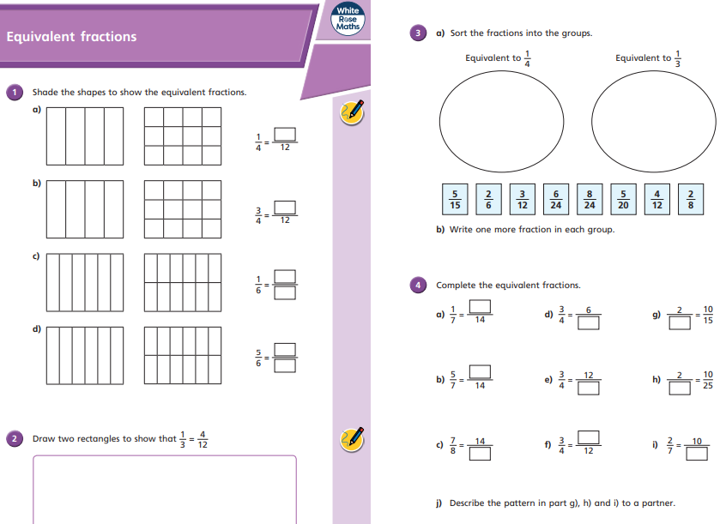
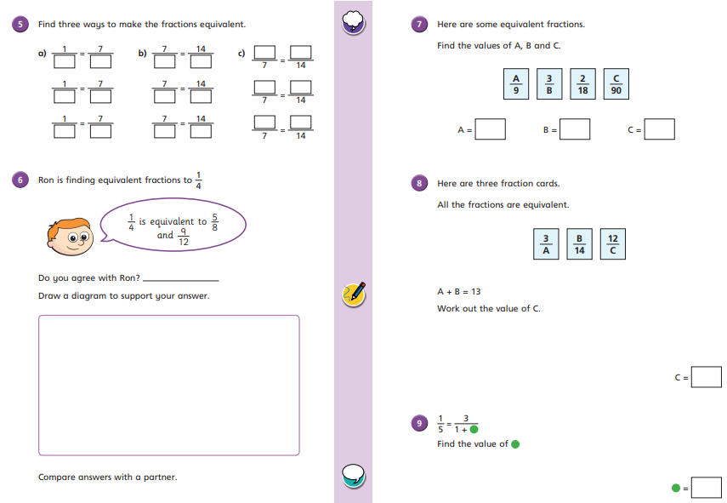
Independent
Year 5s, you now need to complete your independent work.
Year 6s, we are learning about simplifying fractions today. We’re going to use our knowledge of equivalent fractions to simplify them.

Slide 10
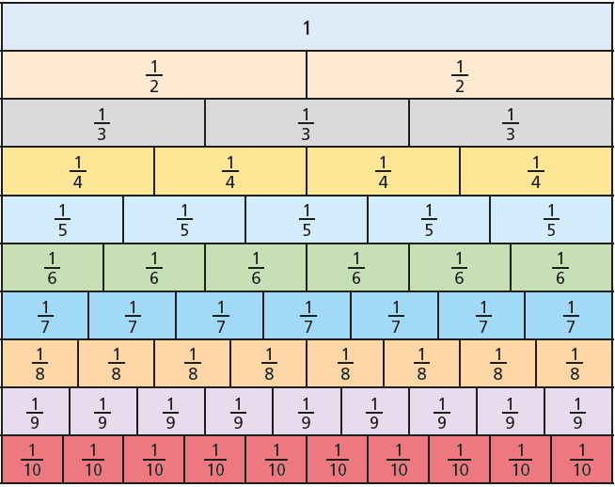
New Learning

Slide 11
New Learning
$$=\frac{\text{1}}{\text{2}}$$
$$=\frac{\text{3}}{\text{5}}$$

Slide 12
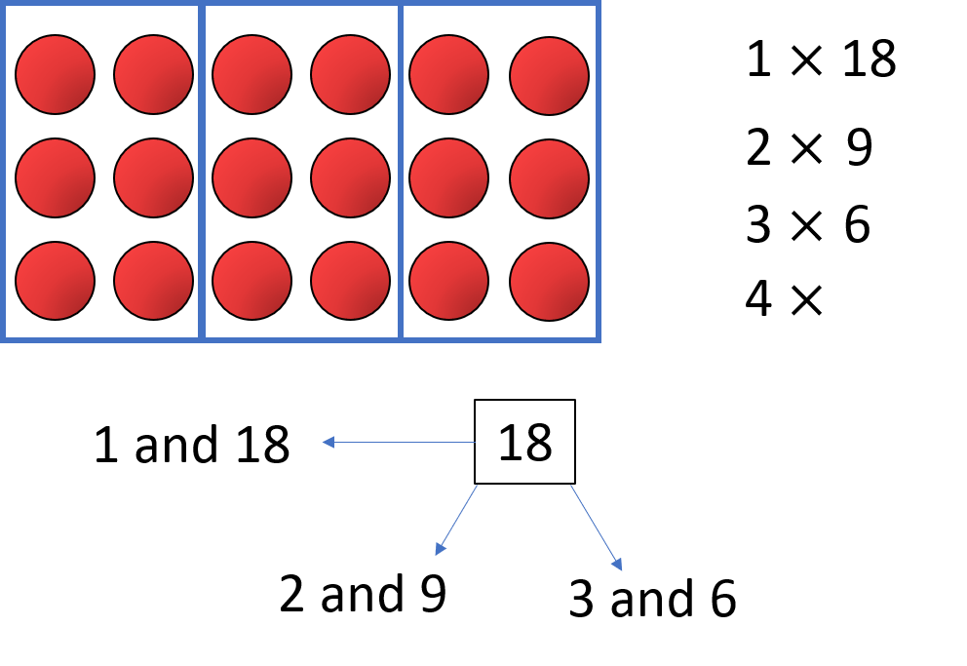
New Learning
$÷$ 1
$$\frac{\text{5}}{\text{7}}$$
$$\frac{\text{5}}{\text{7}}$$
$$=$$
$÷$ 1
Factors of 5
Factors of 7
1
5

Slide 13
New Learning
$\frac{\text{5}}{\text{7}}$ cannot be simplified any further
$\frac{\text{5}}{\text{7}}$ is in its simplest form

Slide 14
Develop Learning
$÷$ 3
$$\frac{\text{6}}{\text{9}}$$
$$\frac{\text{2}}{\text{3}}$$
$$=$$
$÷$ 3
Factors of 6: 1, 2, 3, 6
Factors of 9: 1, 3, 9

Slide 15
Develop Learning
$\frac{\text{12}}{\text{16}}$ $=\frac{\text{6}}{\text{8}}$
$\frac{\text{12}}{\text{16}}$ $=\frac{}{}$

Slide 16
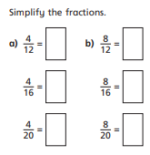
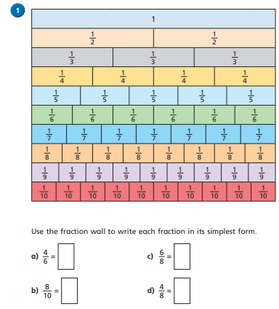
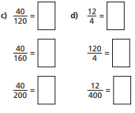
Independent Task
Year 6
e) Use the fraction wall to explain why 7/10 does not simplify.

Slide 17
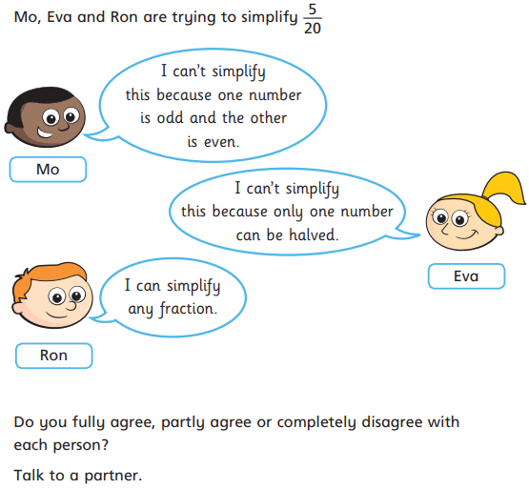
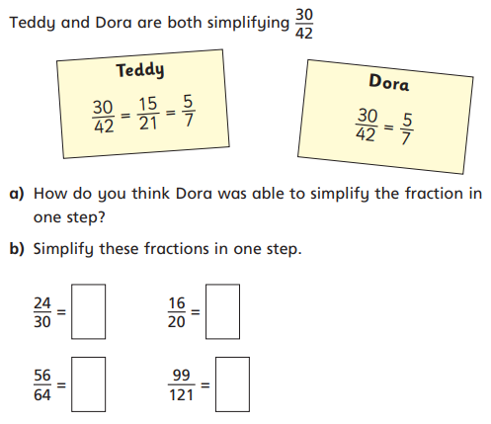
Reasoning
Year 6

Slide 18
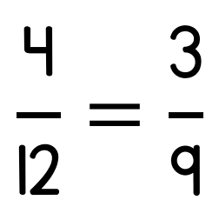
Plenary
Light Bulb Challenge
*Remember to answer in full sentences*
It is true because… or It is false because…
Y5
Y6
alternative

