Slide 1
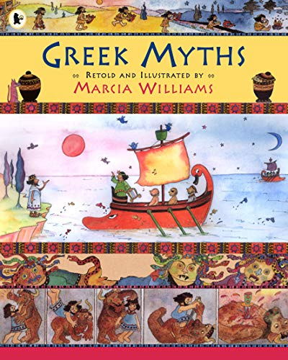
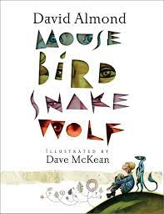
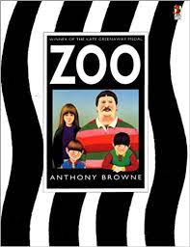
Maths – Year 3
Length
Add and subtract lengths
Fractions
Unit and non-unit fractions
Equivalent fractions
Count in fractions
Making a whole
Fractions on a number line
Add and subtract fractions
Compare and order fractions
Fractions of a set of objects
Tenths as fractions and decimals
Year 3&4 - Term 4
Ancient Greeks
Maths – Year 4
Fractions
Unit and non-unit fractions
Equivalent fractions
Count in fractions
Fractions greater than 1
Add and subtract fractions
Subtract fractions from whole amounts
Calculate fractions of a quantity
Tenths as fractions and decimals
English
Core texts The Tunnel and Zoo by Anthony Brown (Book Week author).
Theseus and the Minotaur in “Greek Myths” by Marcia Williams.
Meet the Ancient Greeks by James Davies.
Mouse, Bird, Snake, Wolf by David Almond.
Reading
- Read a range of age-appropriate books fluently without overtly sounding out words.
- Identify and explain the sequence of events within a text.
- Skim and scan to find words with a similar meaning as a given word.
- Draw inferences and justifying inferences with evidence.
- Summarise the text.
- Make links between texts and recognise similar features in the works by the same author.
Writing - Write a letter to an author.
- Write a recount of a Greek myth.
- Write an information text about the Ancient Greeks.
Grammar, punctuation and spelling
Correct use of all punctuation taught: capital letters, full stops, commas in lists, question marks, exclamation marks and apostrophes for contraction and possession.
Year 3: prepositions, speech, noun phrases.
Year 4: prepositional phrases, punctuation for speech, noun phrases.

Slide 2
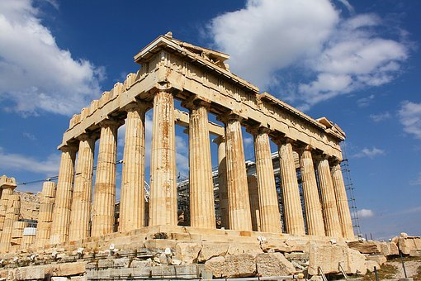
Year 3&4 - Term 4
Ancient Greeks
PSHE – Healthy me
Recognise how different social and friendship groups are formed.
Effects of smoking and alcohol.
Dealing with peer pressure.
RSHE – My relationships
Year 3:
- I know what a relationship is and the different types of relationships that people enjoy.
- Exploring gender stereotypes.
Year 4:
- I am able to judge what kind of physical behaviours and contact are acceptable and unacceptable, and ways to respond.
- Recognising differences and similarities between people.
History
Ancient Greeks
- Who were the Greeks?
- Daily life in Ancient Greece
- Athens, Sparta and democracy
- The Olympics
- Greek Gods and Goddesses
Computing
Data logging
How and why do we collect data.
Capture data over time and analyse this.
French
Playtime
Simon says
I play
In the playground
What do you like to play?
Science
Light
- Recognise that they need light in order to see things and that dark is the absence of light.
- Notice that light is reflected from surfaces.
- Recognise that light from the sun can be dangerous and that there are ways to protect their eyes.
- Recognise that shadows are formed when the light from a light source is blocked by an opaque object.
- Find patterns in the way that the size of shadows change.
Science week
Theme: Growth
- Study the work of various biologists and plant life
RE
The Garden of Gethsemane
The events leading up to Easter
Music
Lean on me
- Soul / gospel
Art
Pottery
Patterns
Study decorative Greek story telling on pottery
Create a vase using paper mâché and modroc
PE
Dance Swimming

