Slide 1
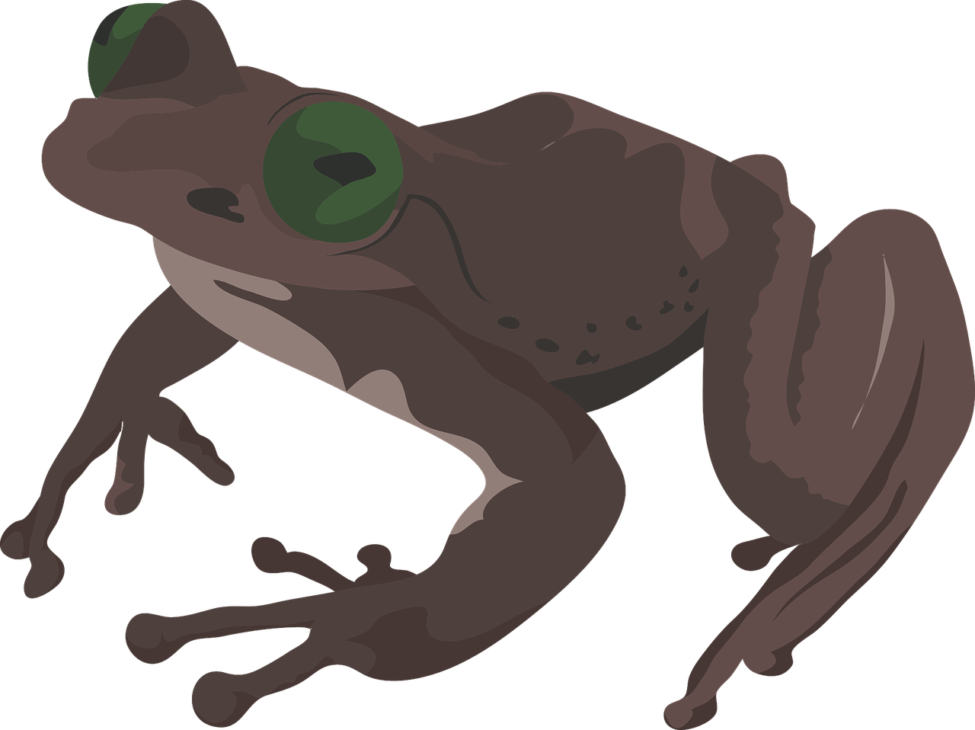
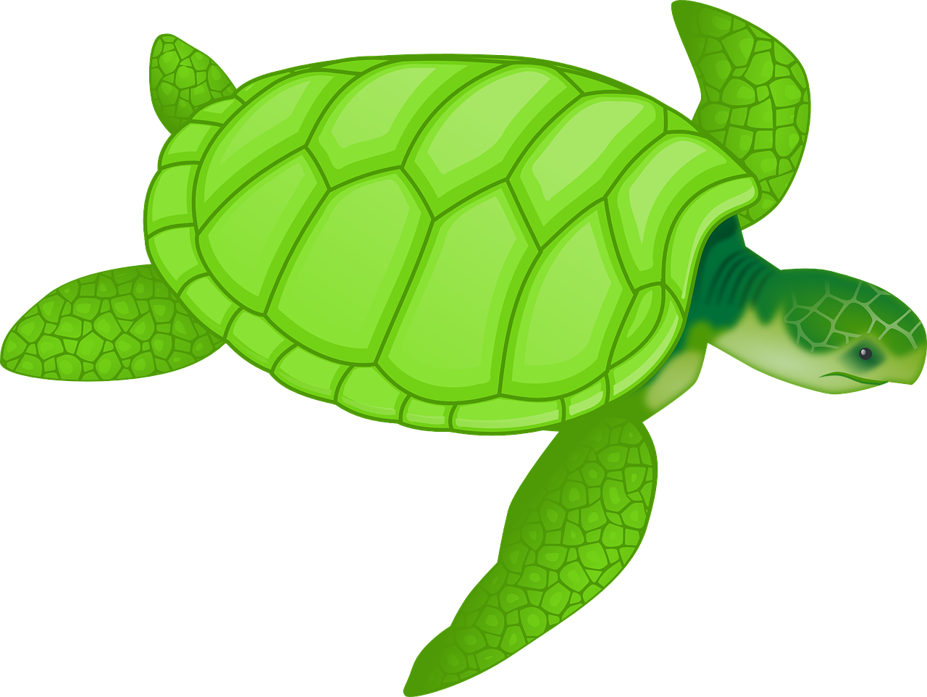
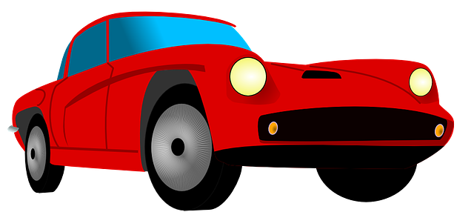
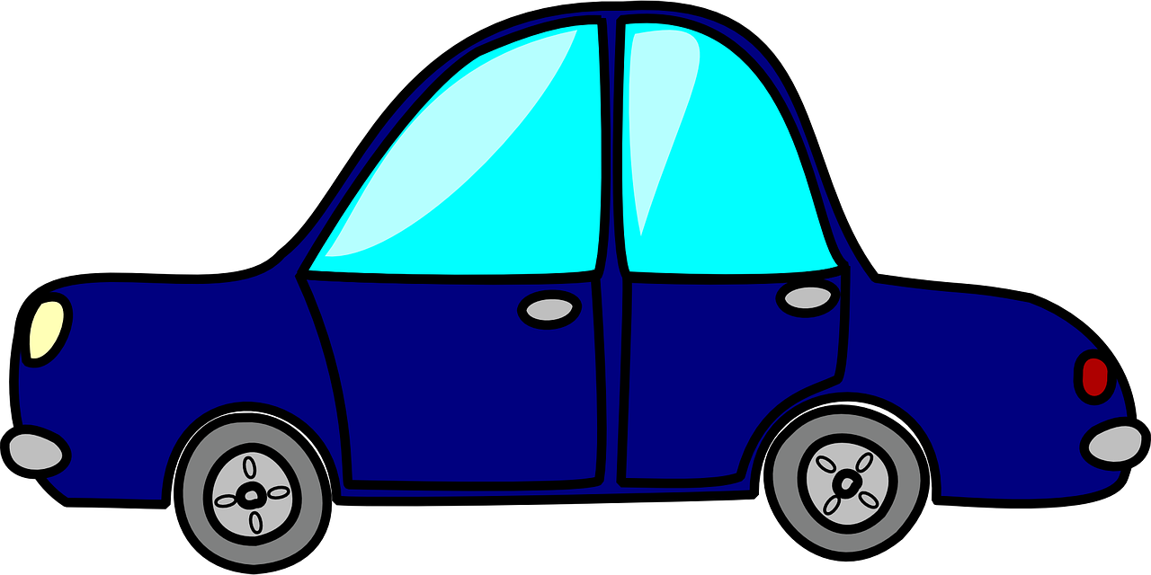
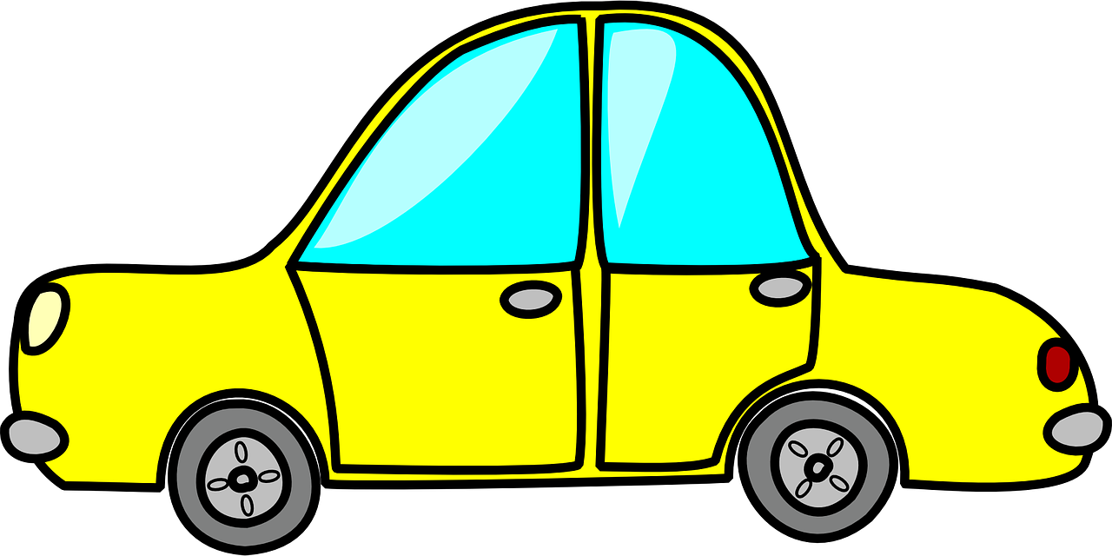
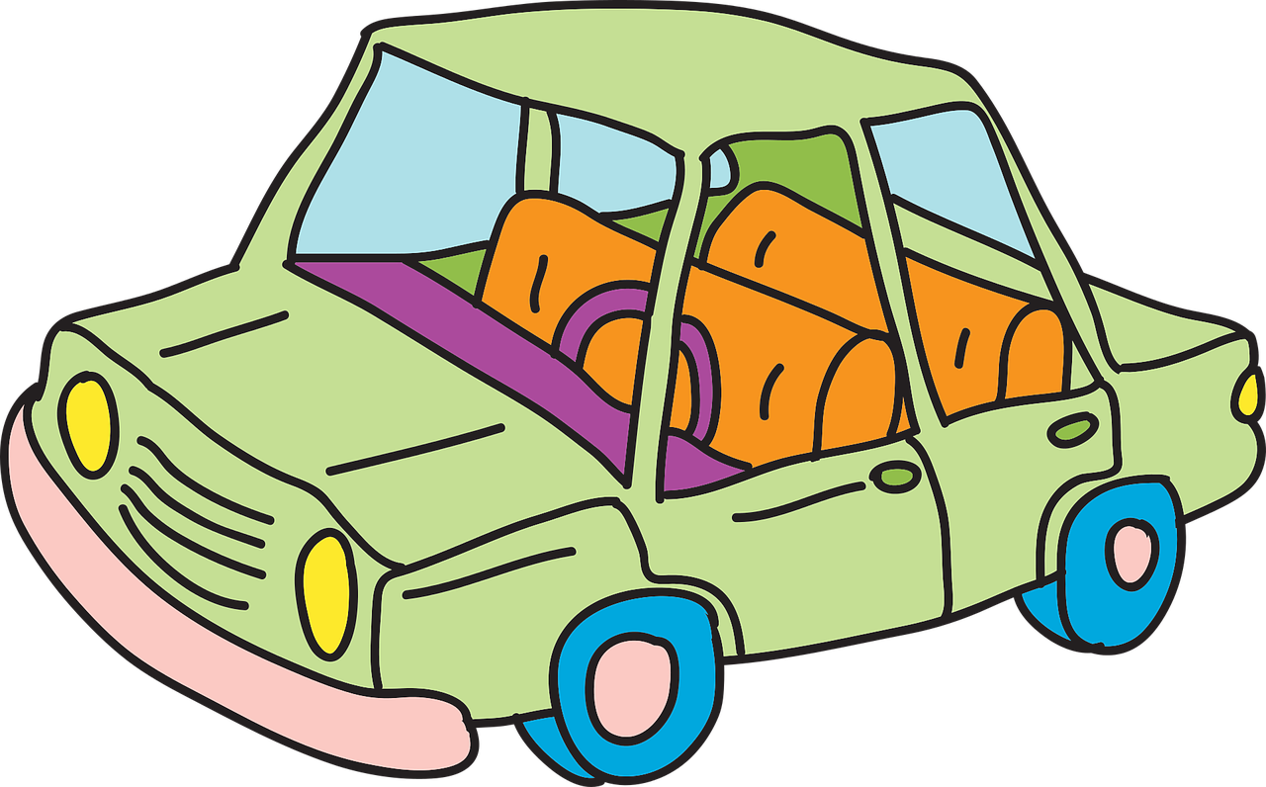
Year 1 – Grouping data Lesson 1 – Label and match | Activity sheet Save a copy
Labelling groups
Draw arrows to match the group labels to the correct groups.
Books
Frogs
Animals
Trees
Cars
Bikes
This resource is available online at ncce.io/dat1-1-a3-w. Resources are updated regularly — please check that you are using the latest version.
This resource is licensed under the Open Government Licence, version 3. For more information on this licence, see ncce.io/ogl.
Notes:
Last updated: 21-07-20
Image sources:
Green car: https://pixabay.com/vectors/automobile-car-cartoon-green-1293048/
Yellow car: https://pixabay.com/vectors/car-taxi-cab-cab-yellow-vehicle-303614/
Blue car: https://pixabay.com/vectors/car-blue-side-vehicle-drawing-307709/
Red car: https://pixabay.com/vectors/truck-cars-vehicle-pickup-sedan-29490/
Black book: https://pixabay.com/vectors/book-closed-black-blank-library-306468/
Red book: https://pixabay.com/vectors/book-pink-read-study-learn-2026675/
Green and red books: https://pixabay.com/vectors/books-library-education-literature-42701/
Green frog: https://pixabay.com/vectors/frog-amphibian-animal-green-157934/
Turtle: https://pixabay.com/vectors/tortoise-green-reptiles-turtles-47047/
Brown frog: https://pixabay.com/illustrations/frog-brown-amphibian-animal-nature-2457344/
Light green tree: https://pixabay.com/vectors/cartoon-green-happy-tree-1296497/
Dark green tree: https://pixabay.com/vectors/tree-art-artwork-trunk-cartoon-576819/
Brown tree: https://pixabay.com/vectors/tree-art-artwork-trunk-cartoon-576859/

