Slide 1
Towers, Tunnels and Turrets
Key Stage 1 – English
Non-Fiction
Term 4 Week 1 – Thursday Features of an Information Text

Slide 2
LI: To write a non-fiction text
I can recognise the main heading, introduction, subheading and topic of an information text (non-chronological report)
I make up short sentences to express my thoughts loud. [Level 1]
I write a short phrase using the sounds I already know. [Level 1]
I discuss my favourite words and phrases. [Level 2 & 3]
I talk about the meaning of words I know and the meaning of new words. [Level 2 & 3]
I join my sentences together to write a non-chronological report. [Level 2]
I write for different purposes using ideas and language from things I’ve read. [Level 3]
Use the basics!! Make sure you use capital letters, full stops and question marks correctly.

Slide 3
LI: To write a non-fiction text
Can you remember the shape parts to write a non-fiction text?
Sub-Heading
Sub-Heading
Sub-Heading
Main Heading
Topic
Topic
Topic
Introduction
Thinking Question

Slide 4
Sub-Heading
Main-Heading
Topic
Introduction
Sub-Heading
Sub-Heading
Topic
Topic
Sub-Heading
Sub-Heading
Topic
Topic

Slide 5
Sub - Heading and Topic
Sub-Heading
Topic
All the sentences begin with the same sentence starter. Use your own words to label and describe the castles features of the castle. You could use the information sheets to help you.

Slide 6
Sub-Heading
Main-Heading
Topic
Introduction
Sub-Heading
Sub-Heading
Topic
Topic
Sub-Heading
Sub-Heading
Topic
Topic

Slide 7
Sub - Heading and Topic
Sub-Heading
Topic
Use your own words to describe some of the jobs that people had in the castle. You could use the information sheets from yesterday to help you.

Slide 8
Sub-Heading
Main-Heading
Topic
Introduction
Sub-Heading
Sub-Heading
Topic
Topic
Sub-Heading
Sub-Heading
Topic
Topic

Slide 9
Thinking Question
Write your own thinking question. You could one use of these sentence starters: Did you know... ? What would you ...?

Slide 10
Time to check your writing.
Capital letters, full stops and question marks.
Spelling.
Do your sentences make sense?

Slide 11
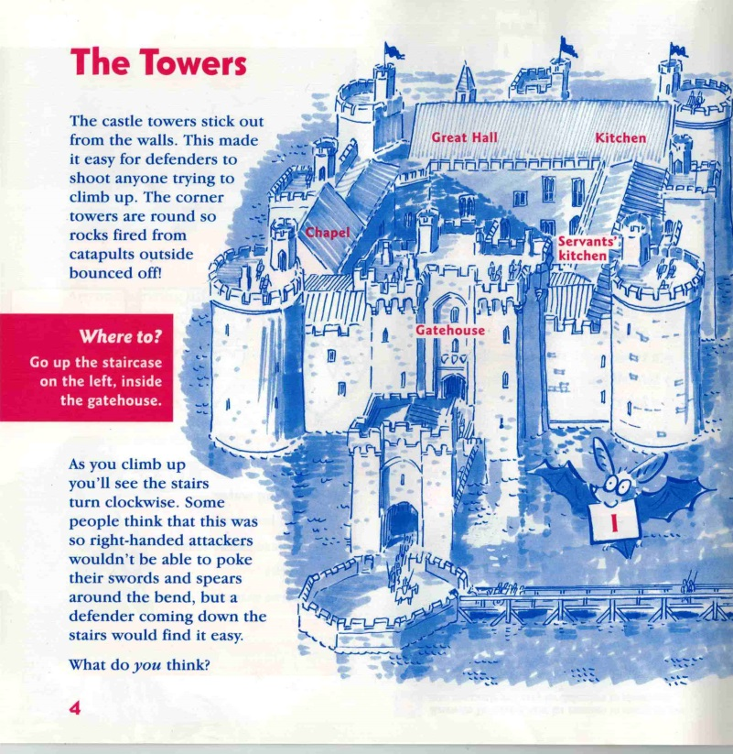
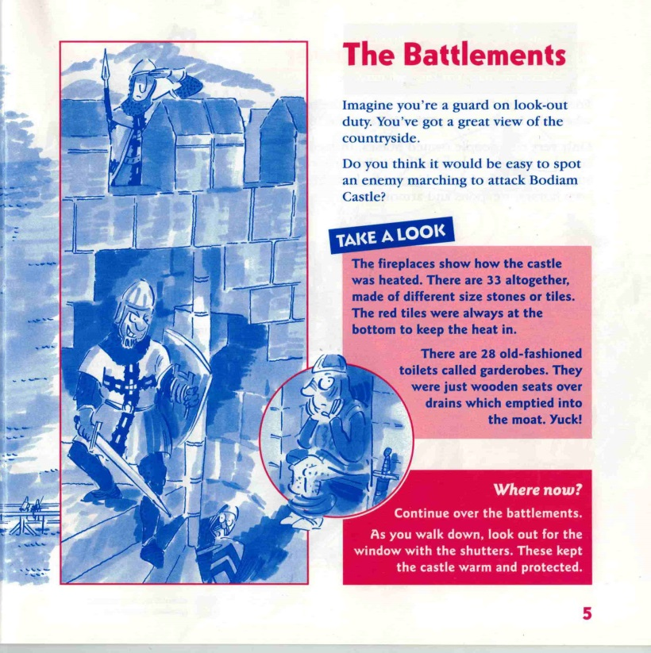
What is an information text?

Slide 12
What is an information text?
https://www.dkfindout.com/uk/history/castles/

Slide 13
What is an information text?
Sub-Heading
Sub-Heading
Sub-Heading
Main Heading
Topic
Topic
Topic
Introduction
Thinking Question

