Slide 1
Towers, Tunnels and Turrets
Key Stage 1 – English
Non-Fiction
Term 4 Week 1 – Wednesday Features of an Information Text

Slide 2
LI: To write a non-fiction text
I can recognise the main heading, introduction, subheading and topic of an information text (non-chronological report)
I make up short sentences to express my thoughts loud. [Level 1]
I write a short phrase using the sounds I already know. [Level 1]
I discuss my favourite words and phrases. [Level 2 & 3]
I talk about the meaning of words I know and the meaning of new words. [Level 2 & 3]
I join my sentences together to write a non-chronological report. [Level 2]
I write for different purposes using ideas and language from things I’ve read. [Level 3]
Use the basics!! Make sure you use capital letters, full stops and question marks correctly.

Slide 3
LI: To write a non-fiction text
Can you remember the shape parts to write a non-fiction text?
Sub-Heading
Sub-Heading
Sub-Heading
Main Heading
Topic
Topic
Topic
Introduction
Thinking Question

Slide 4
Sub-Heading
Main-Heading
Topic
Introduction
Sub-Heading
Sub-Heading
Topic
Topic
Sub-Heading
Sub-Heading
Topic
Topic

Slide 5
Main Heading and Introduction
Main Heading
Introduction
What could you use for your main heading?

Slide 6
Main Heading and Introduction
Main Heading
Introduction
Can you explain what your information page is about?

Slide 7
Sub-Heading
Main-Heading
Topic
Introduction
Sub-Heading
Sub-Heading
Topic
Topic
Sub-Heading
Sub-Heading
Topic
Topic

Slide 8
Sub - Heading and Topic
Sub-Heading
Topic
Use your own words to explain why castles were built. You could use the information sheets from yesterday to help you.

Slide 9
Sub-Heading
Main-Heading
Topic
Introduction
Sub-Heading
Sub-Heading
Topic
Topic
Sub-Heading
Sub-Heading
Topic
Topic

Slide 10
Sub - Heading and Topic
Sub-Heading
Topic
Use your own words to explain what castles were built from. Extend your sentence by using conjunctions and an explanation (because, so)

Slide 11
Sub-Heading
Main-Heading
Topic
Introduction
Sub-Heading
Sub-Heading
Topic
Topic
Sub-Heading
Sub-Heading
Topic
Topic

Slide 12
Sub - Heading and Topic
Sub-Heading
Topic
Use your own words to explain where castles were built. Extend your sentence by using conjunctions and an explanation (because, so)

Slide 13
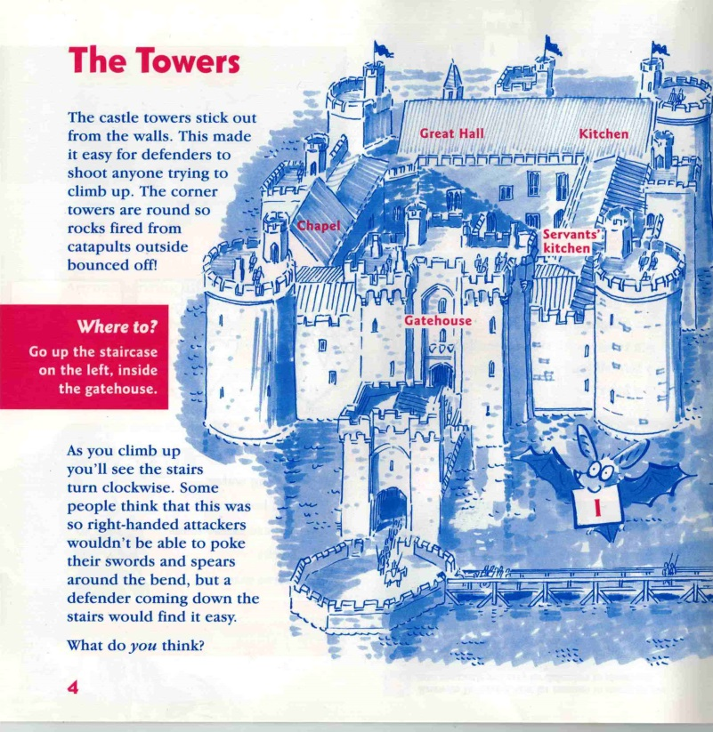
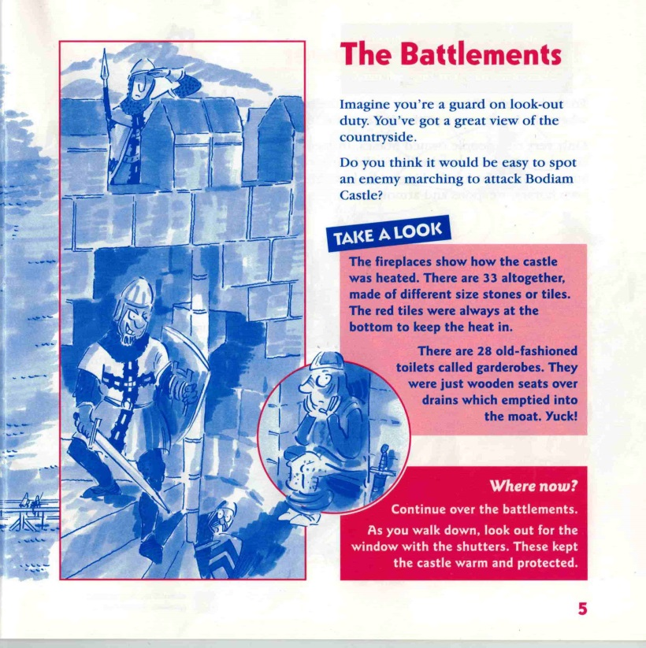
What is an information text?

Slide 14
What is an information text?
https://www.dkfindout.com/uk/history/castles/

Slide 15
What is an information text?
Sub-Heading
Sub-Heading
Sub-Heading
Main Heading
Topic
Topic
Topic
Introduction
Thinking Question

