Slide 2
What is a Lapbook?
A lapbook is an interactive collection of completed learning tasks related to a specific subject.
Lapbooks make lovely records of learning projects and can be put together in many different ways – the following slides will show just one way to make them.

Slide 3
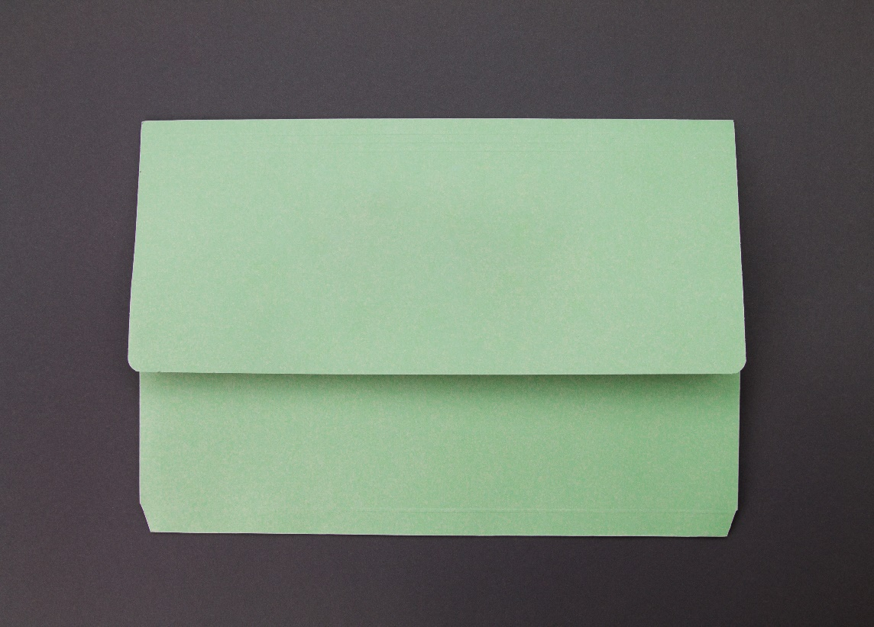
You can make your lapbook from an A4 document wallet. You might want to pick a colour that matches the theme of your project.

Slide 4
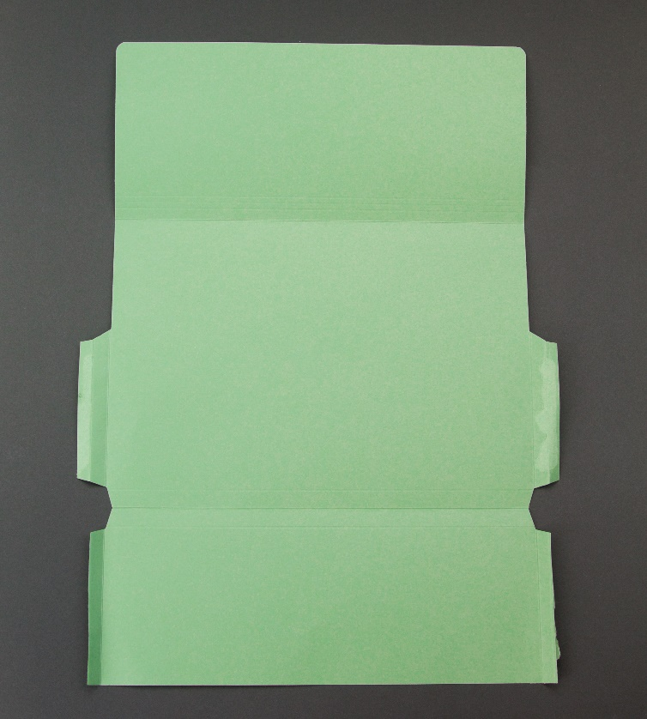
Start by completely opening the wallet out and separating all the tabs carefully.

Slide 5
Then snip the tabs off to leave you with nice, straight edges.

Slide 6
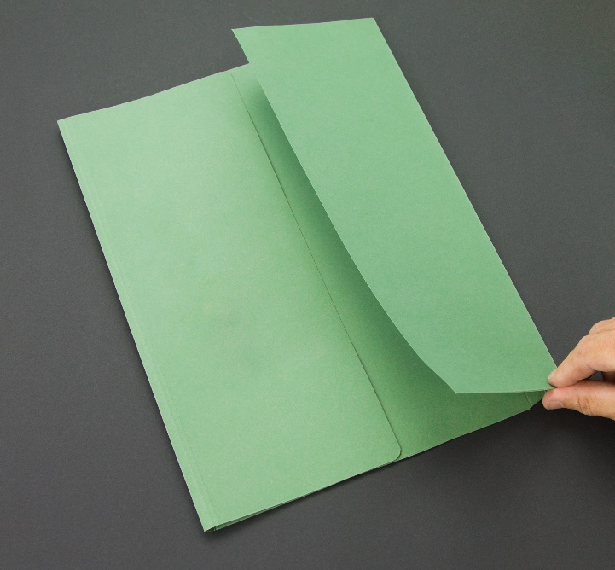
Next, reposition the folds so that you have 2 tabs that can fold inwards to meet in the middle. Some of the pre-scored lines on the document wallet will help you to do this.

Slide 7
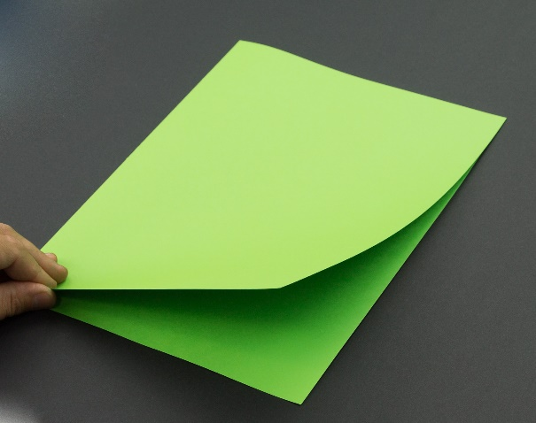
You can achieve almost exactly the same result with a square cut A4 folder.

Slide 8
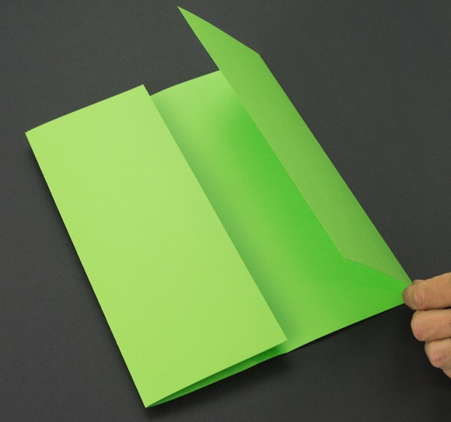
Open the folder out and fold the front and back covers in on themselves until they meet in the middle.

Slide 9
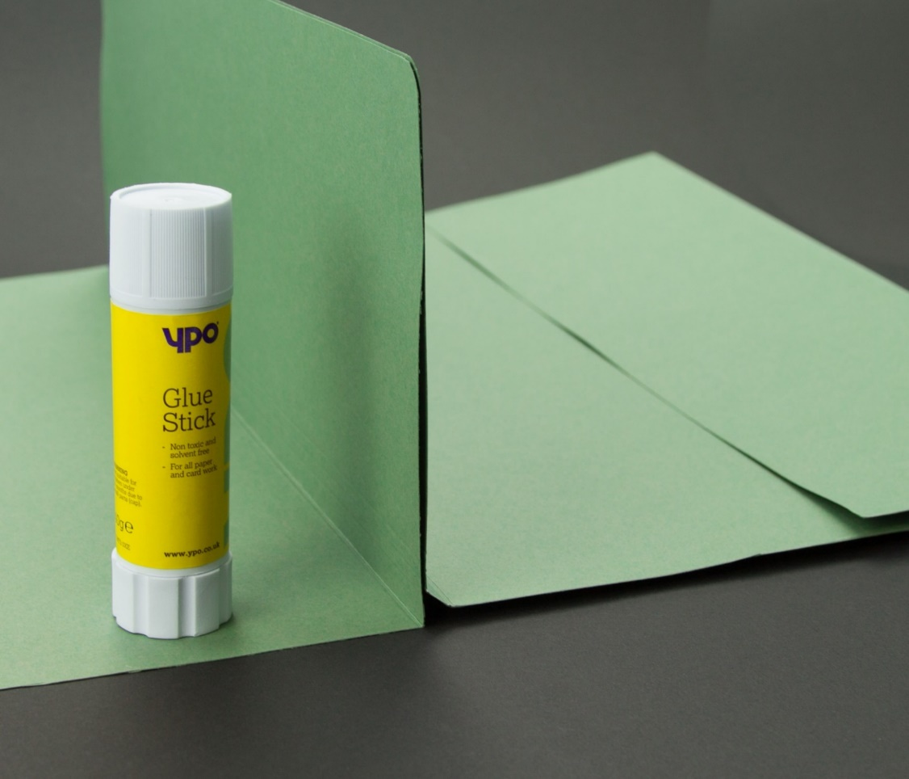
When you are working on a bigger project or including a lot of your own research, you may find that you need a bigger lapbook.
You can make a double, triple or even a quadruple lapbook by sticking the front flaps of separate folders together as shown.

Slide 10
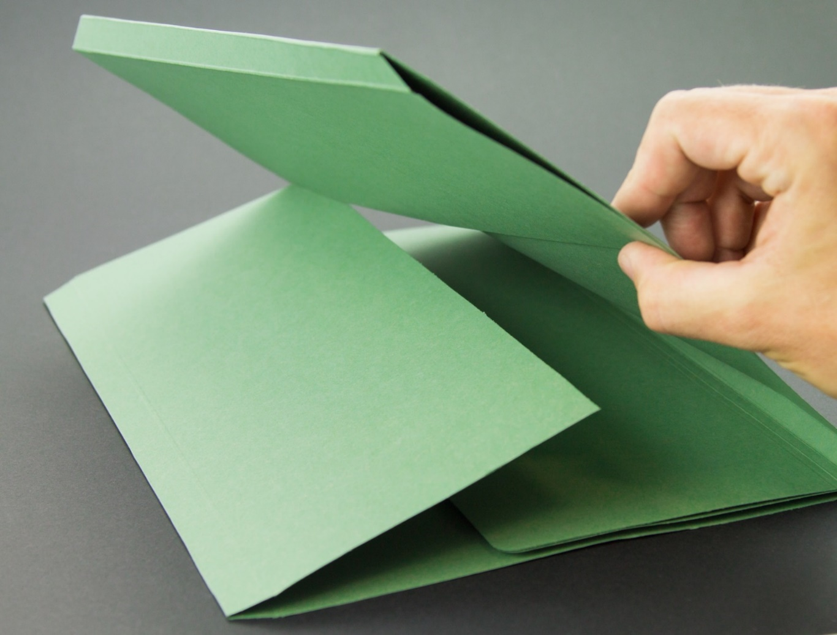
However far you extend your lapbook, you should find that it folds together neatly for storage.

Slide 11
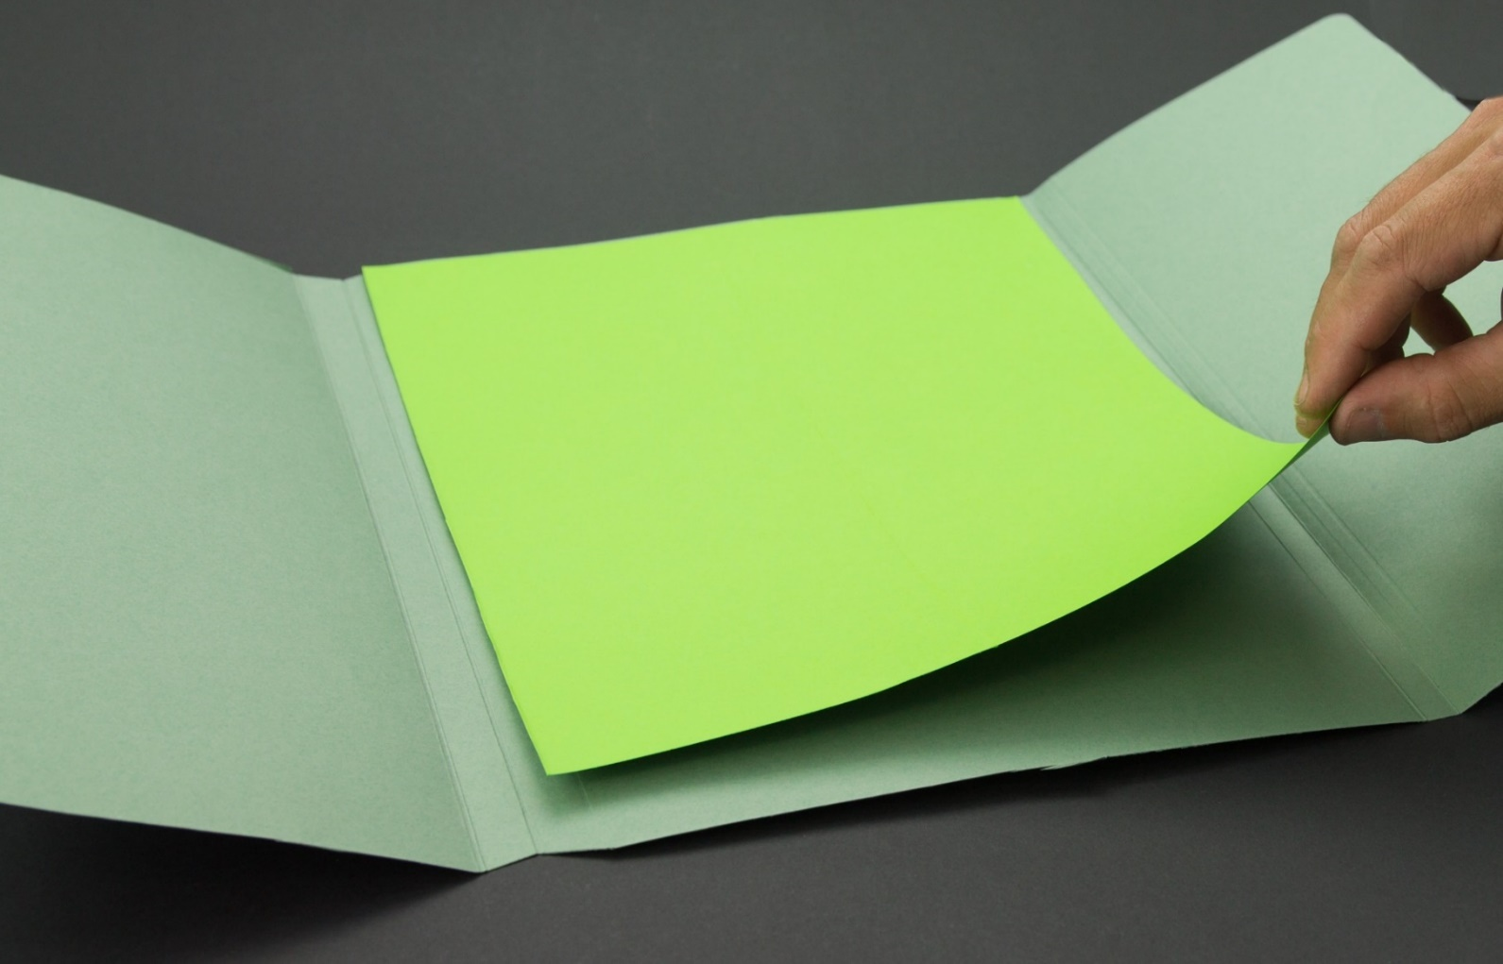
Another way to create more space or extra dimensions for your project is to attach separate pieces of A4 paper or card to the centre panel of the lapbook folder.

Slide 12
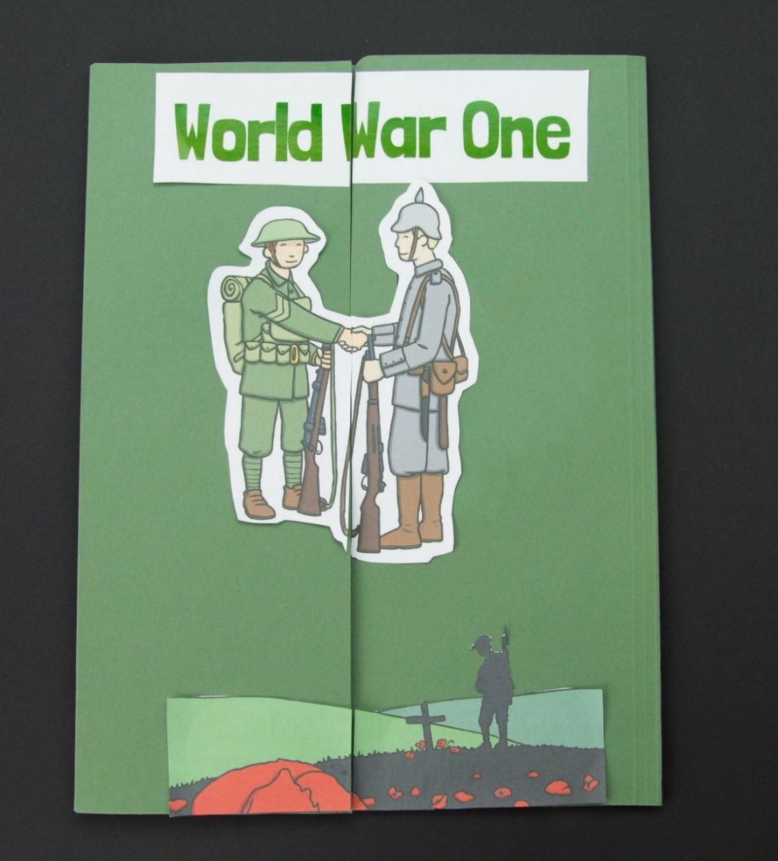
Once you have your folder in place, it’s time to start adding your work.
The cover of your lapbook will need a title and some kind of decoration.
Many of the lapbook packs include colouring sheets, these are perfect for the front cover. However, your own drawing or printed picture can work just as well.

Slide 13
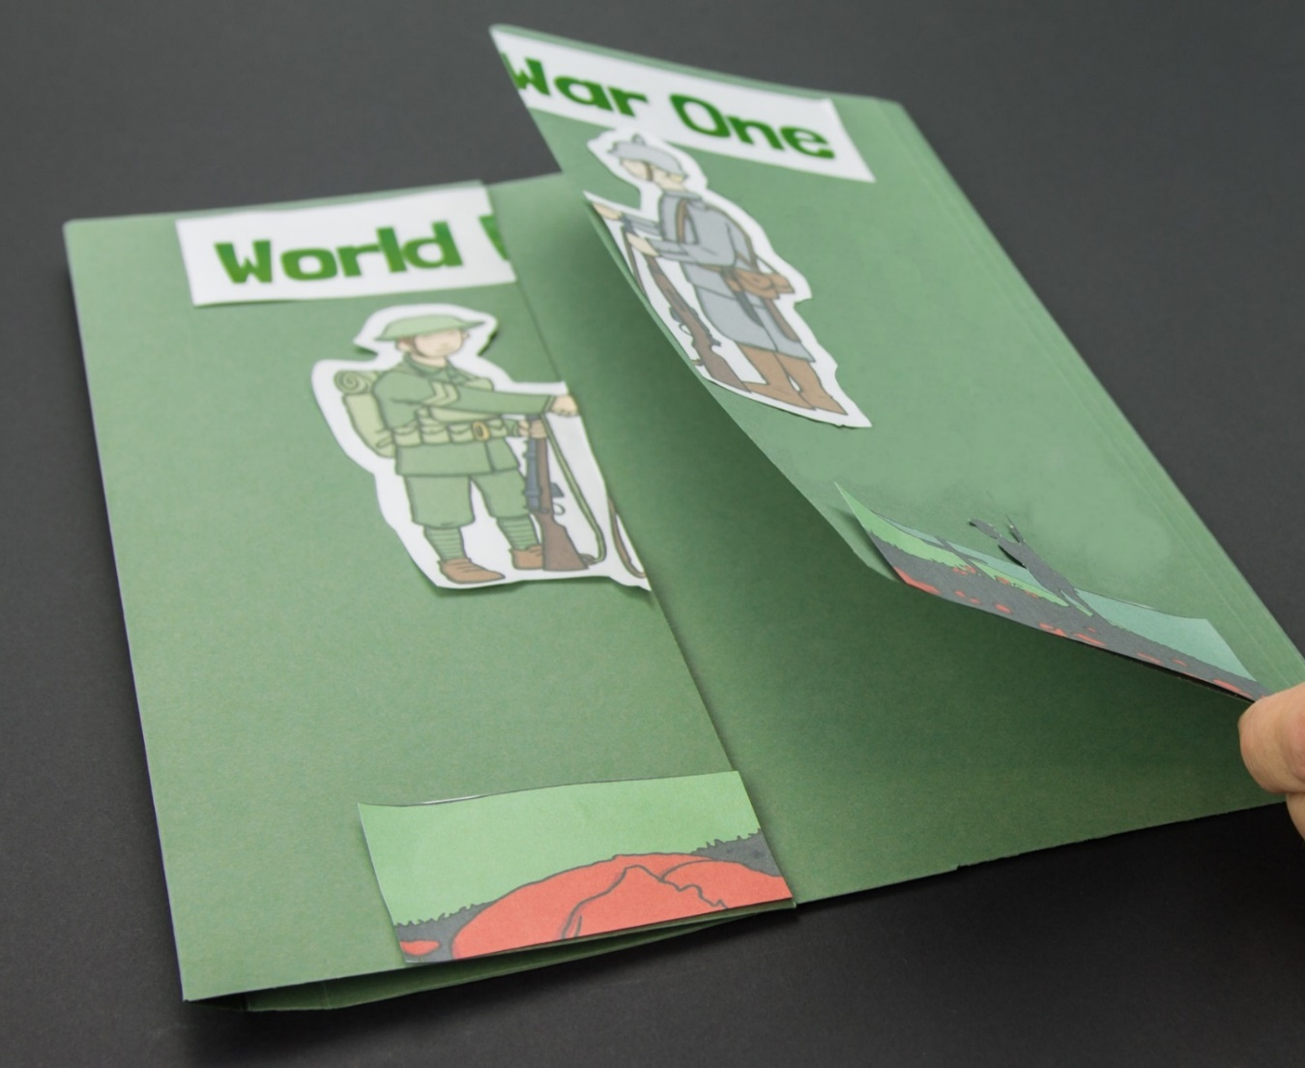
Either before or after you stick them down, you will have to cut the things you have chosen for your front cover in half so that your lapbook can still be opened.

Slide 14
At some point, you will have to get busy printing out all the lapbook resources. You will be cutting, folding and learning all about your chosen subject.
You can complete and use as many or as few of the Twinkl lapbook resources as you like.
You can always add into the mix anything else that you find or make on your own.

Slide 15
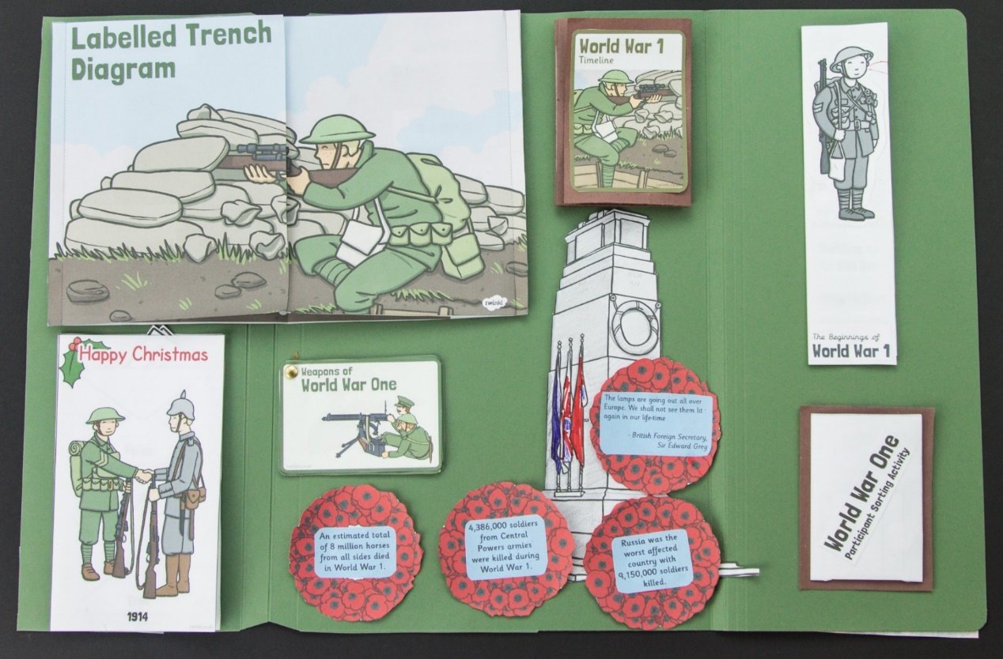
A good tip is to wait until you have completed all you work before you start sticking things into your lapbook.
Finished resources are different shapes and sizes. Many of them are interactive, meaning they need more space to be fully appreciated.

Slide 16
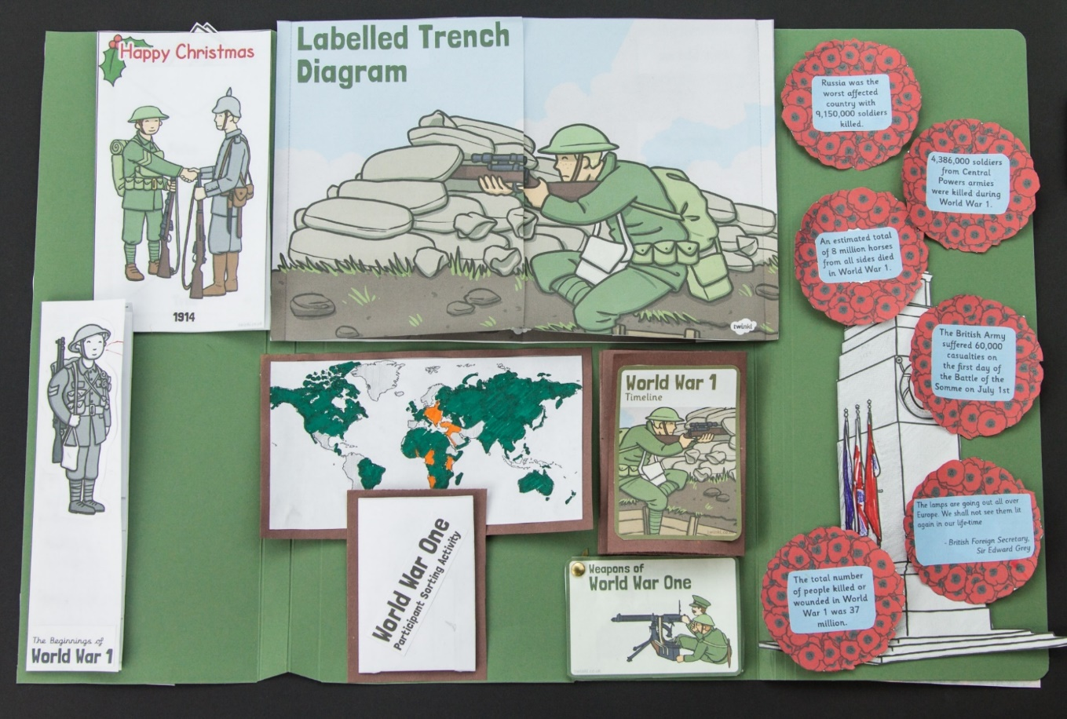
Experiment by moving your work around the lapbook until you find the best way of using the space. When you are happy with your choice, stick your work down to create your finished lapbook.

Slide 17
Once you have stuck everything down securely, it’s time to show off! Share all the hard work you have put into your project and all the knowledge you have gained. Demonstrate and enjoy the interactive folds, flaps and facts.

Slide 18
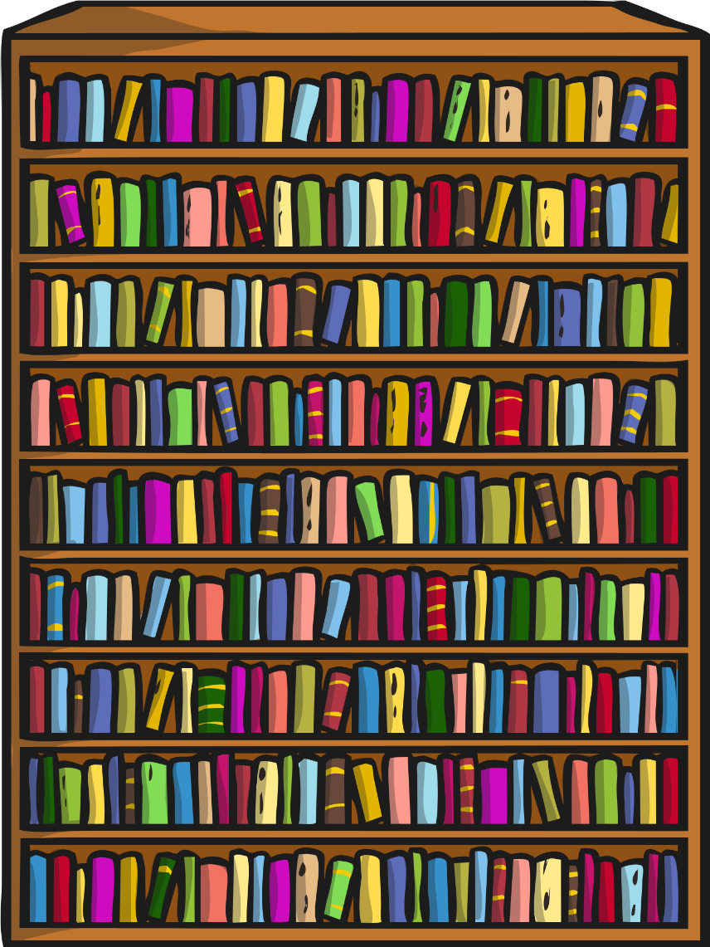
Keep your lapbook somewhere safe and build up a collection. A lapbook is a great record of all the learning you have done and great to pull out every now and then as a reminder.
Now you have to decide which one you are going to work on next.

